Slide 1
Commercialisation Support to Pilots and Competence Centres
Dissemination level: Public

Slide 2
Commercialisation Support to Pilots and Competence Centres
Why? To drive a business mindset
What? Tailor-made business orientation
How? Webinars, coaching, market insights and network with entrepreneurship key stakeholders (serial entrepreneurs, marketers, investors, corporates, …)
Notes:
to build-up successful market take-up and commercial boost strategy

Slide 3
Commercialisation Support to Pilots and Competence Centres
Services provided through specific webinars
Business Model Canvas
Marketing & Communication
Business Internationalisation
Pitching
Transfer Technology Models
Public Funding
Others may be made available depending on Pilots & CCs needs/expectations

Slide 5
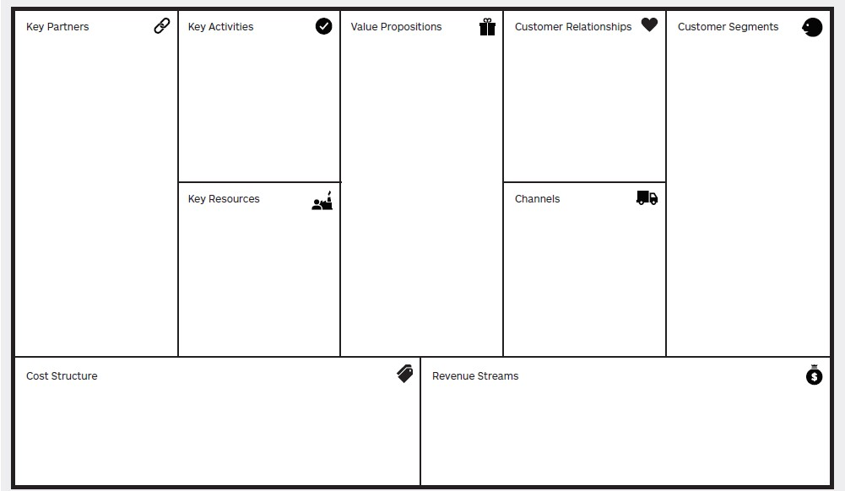
Commercialisation Support to Pilots and Competence Centres
Notes:
Invented by Alexander Osterwalder
Strategic management tool
More simple to build, visualize and validate your business model
Webinar will serve to explain what it is, how to set up your product model, understand its different fields and the innovation behind the business model, with real examples

Slide 6
Notes:
Presented by Marketing expert with professional experience in the area
What strategies to use when disseminating their product/portfolio
Marketing rules & guidelines
Which tools to which situation and target audience

Slide 7
Commercialisation Support to Pilots and Competence Centres

Slide 8
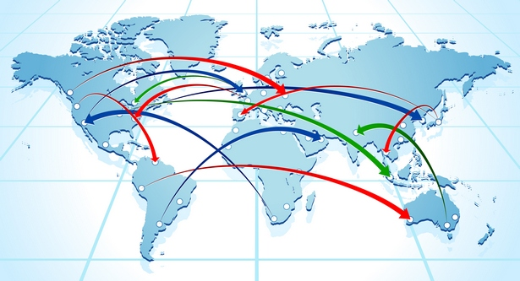
Business Internationalization
Technology transfer models

Slide 9
Commercialisation Support to Pilots and Competence Centres
Public Funding
Insight into EU Funding opportunities
Where and how to apply
Eligible and ineligible expenses, funding rates, rights and obligations of beneficiaries
Horizon2020 as an useful tool to take a project/ product/ service to the next level, with financial support from the European Commission

