Slide 1
Designing Thematic Services
Roadmap and Challenges

Slide 2
DODAS: quick reminder
Dynamic On Demand Analysis Service: DODAS
Platform as a Service tool which aim is to guarantee deployment of complex and intricate setup on “any cloud provider” with almost zero effort.
Key objectives:
Opportunistic computing
Batch system as a Service
Big Data processing & reduction on demand
Machine/Deep Learning as a Services

Slide 3
Status
Status of the Thematic Service: In production since March
No Technical or social obstacles met so far
But we are investing a relevant fraction of effort to support users at all levels to keep things easy ad to allow smooth transition

Slide 4
Status
Relevant progresses on the exploitation program:
In addition to CMS Experiment, we started to support New communities, New use cases and New countries:
The Alpha Magnetic Spectrometer (AMS-02) operating on the International Space Station
CMS-OpenData @ CERN
UK: Imperial College London
Any major technology gap?
Not at the current stage... although:
we still need to integrate advanced accounting features
We start now getting more advanced requests on MLaaS and BigData use cases

Slide 5
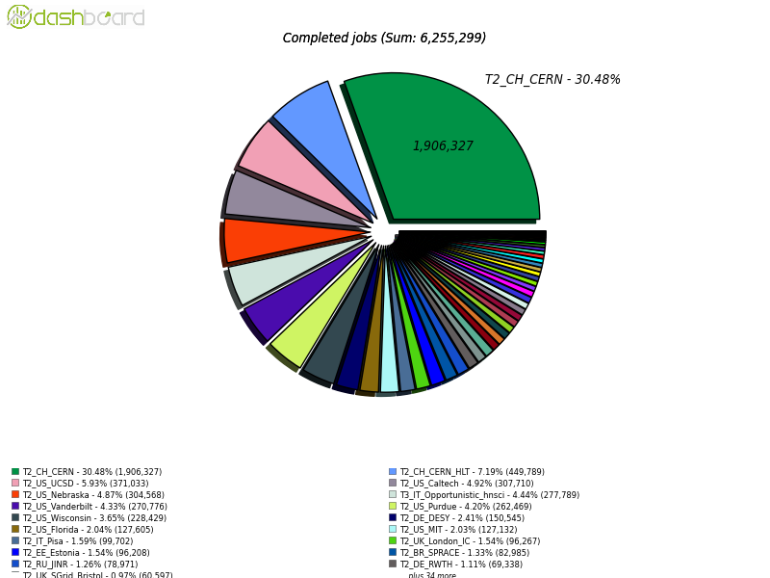
Resources
Resource availability in EOSC-Hub
DODAS in production @CMS since 1 year
Under adoption/evaluation by several projects
AMS02 produced 30+TB of re-processed data using DODAS resources
~500Kjobs since Aug.
A DODAS generated CMS-Site

Slide 6
Resources:
Resource availability in EOSC-Hub
During the development stage (testbed level) DODAS enabling facility plays a key-role!
Allows service integration, experiment software porting, training activity as well as prototyping new uses cases
Virtual Access mechanism:
First reporting period has been done
Waiting for feedback from EC to know if all is ok.
No major technical issues, however new use cases/communities might require us effort to improve log collection
CMS uses case is all ok

