Slide 1
Paolo Manghi
Institute of Information Science and Technologies - CNR
The HOW: the OpenAIRE graph
OpenAIRE content in support of Open Science monitoring

Slide 2
Open Science: carrying out and publishing
Carrying out
Publishing
Facilities (eInfrastructures)
Scientific workflows (experiments and provenance)
Practices and standards (methodology and interoperability)
Communities and collaboration (RIs, VREs)
Community training and support (RIs, EC)
Reuse, repeat, reproduce experiments
Transparency (provenance and attribution)
FAIR-ness for all products
Assessment and Scientific reward (open review, citations, usage stats, and alt-metrics)
Community training and support (RIs, EC)

Slide 3
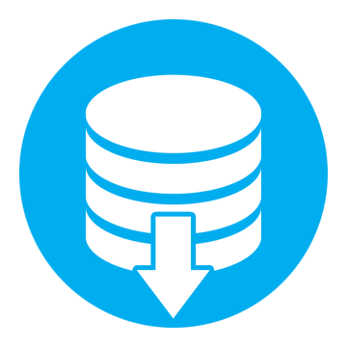
(Open) Science Stakeholders: carryng out and publishing
Research admins
Researchers
Citizen Scientist
Content providers
Research communities
Funders
SMEs
Research Organization
Notes:
Content providers in scholarly communication: publications, datasets, processes, projects, organizations, researchers

Slide 4
OpenAIRE infrastructure: on supporting Open Science scholarly communication
Foster and encourage the shift of scholarly communication towards Open Science
Monitor Open Science scholarly communication
Support Open Science publishing
Citizen Scientist
Research admins
Researchers
Content providers
Research communities
Funders
SMEs
Research Organization
Notes:
Content providers in scholarly communication: publications, datasets, processes, projects, organizations, researchers

Slide 5
OpenAIRE: Service infrastructure for Open Science
Foster and encourage the shift of scholarly communication towards Open Science
Monitor Open Science scholarly communication
Support Open Science publishing
Citizen Scientist
Research admins
Researchers
Content providers
Research communities
Funders
SMEs
Research Organization
Notes:
Content providers in scholarly communication: publications, datasets, processes, projects, organizations, researchers

Slide 6
OpenAIRE Open Science Monitoring
Research impact: # number of products by type
Research admins
Funders
Open Access trends
Research Organization
Research communities

Slide 7
An academic graph aggregating all information required to deliver monitoring tools
OpenAIRE research graph
On demand delivery of (customizable) monitoring tools for stakeholders
OpenAIRE Dashboards

Slide 8
The OpenAIRE Graph

Slide 9
The OpenAIRE scholarly communication graph
Building and maintaining an open metadata scholarly communication graph of interlinked scientific products, in turn linked to Open Access information, funding information and community views
Complete
De-duplicated
Participatory
Graph

Slide 10
Complete
Collecting metadata about all products of science
Literature, datasets, software, other products
Collecting metadata about other entities of science
Funders, projects, authors, organizations, data sources
Collecting and inferring product-product links and product-entities link
Scholexplorer for dataset-article links and text mining for article-project, article-software, article-dataset, article-article links
Collecting usage statistics from institutional repositories

Slide 11
De-duplicated
Publications
Products with “equivalent” PIDs, title, authors, dates are grouped
Dataset
Products with “equivalent” PIDs are grouped
Software
Products with “equivalent” original URLs are grouped
Other products
Products with “equivalent” PIDs, title, authors, dates are grouped

Slide 12
Participatory
Rely on quality scholarly communication sources of different kinds and giving them visibility by provenance
Institutional repositories, aggregators, data archives, software repositories, research infrastructure sources, funder grant repositories, entity registries, publishers
Include solutions and content from any interested and quality-driven content provider in scholarly communication

Slide 13
Metadata collection and Dashboards
OpenAIRE Dashboards
TERMS
OF USE
Info Space Services
Research
communities
Researchers (All)
Content providers
Innovators
Research managers
Funders
Brokering
Funding
Funder
Cleaning
De-duplication
Organization
Project
communiity
Validation
Inference
Result
Source
Harvesting
Uploading
Publication
Data
Software
ORP
GUIDE
LINES
Content Providers
EOSC-Hub
Research
Infras
Publications repositories
Data repositories
Registries
Software
repositories
OA
Journals
CRIS
systems

Slide 14
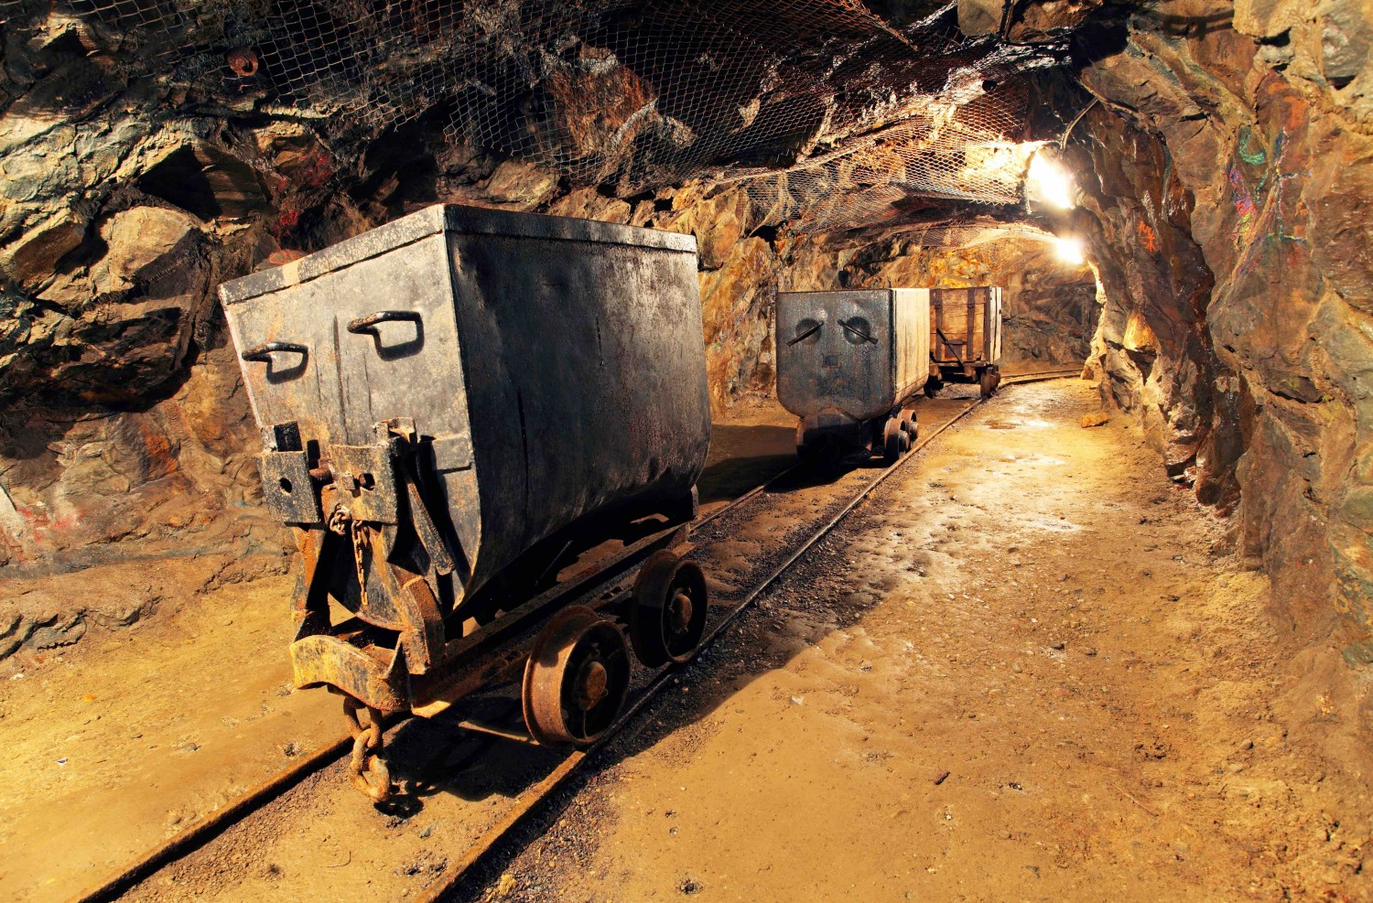
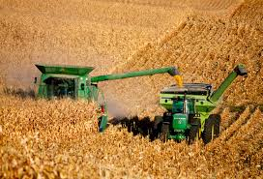
OpenAIRE Data Model and Flows
Funding
Funder
Organization
deposition
mining
Project
community
Source
Result
Publication
Research Data
Software
Other res. products
harvesting

Slide 15
Open Science publishing
Bridging RIs and Scholarly Communication Transparency and reproducibility
e-Infrastructures and Research Infrastructures
Scholarly Communication infrastructure
Experiment product
Dataset
Experiment
Publishing
the experiment
Publications
Dataset
Thematic Service
Input
Method
Data repo
Method
Thematic Service
Input
Dataset
Research data,
Software,
Workflows,
Publications
Output
Dataset
Method repo
Parameters
Experiment repo

Slide 16
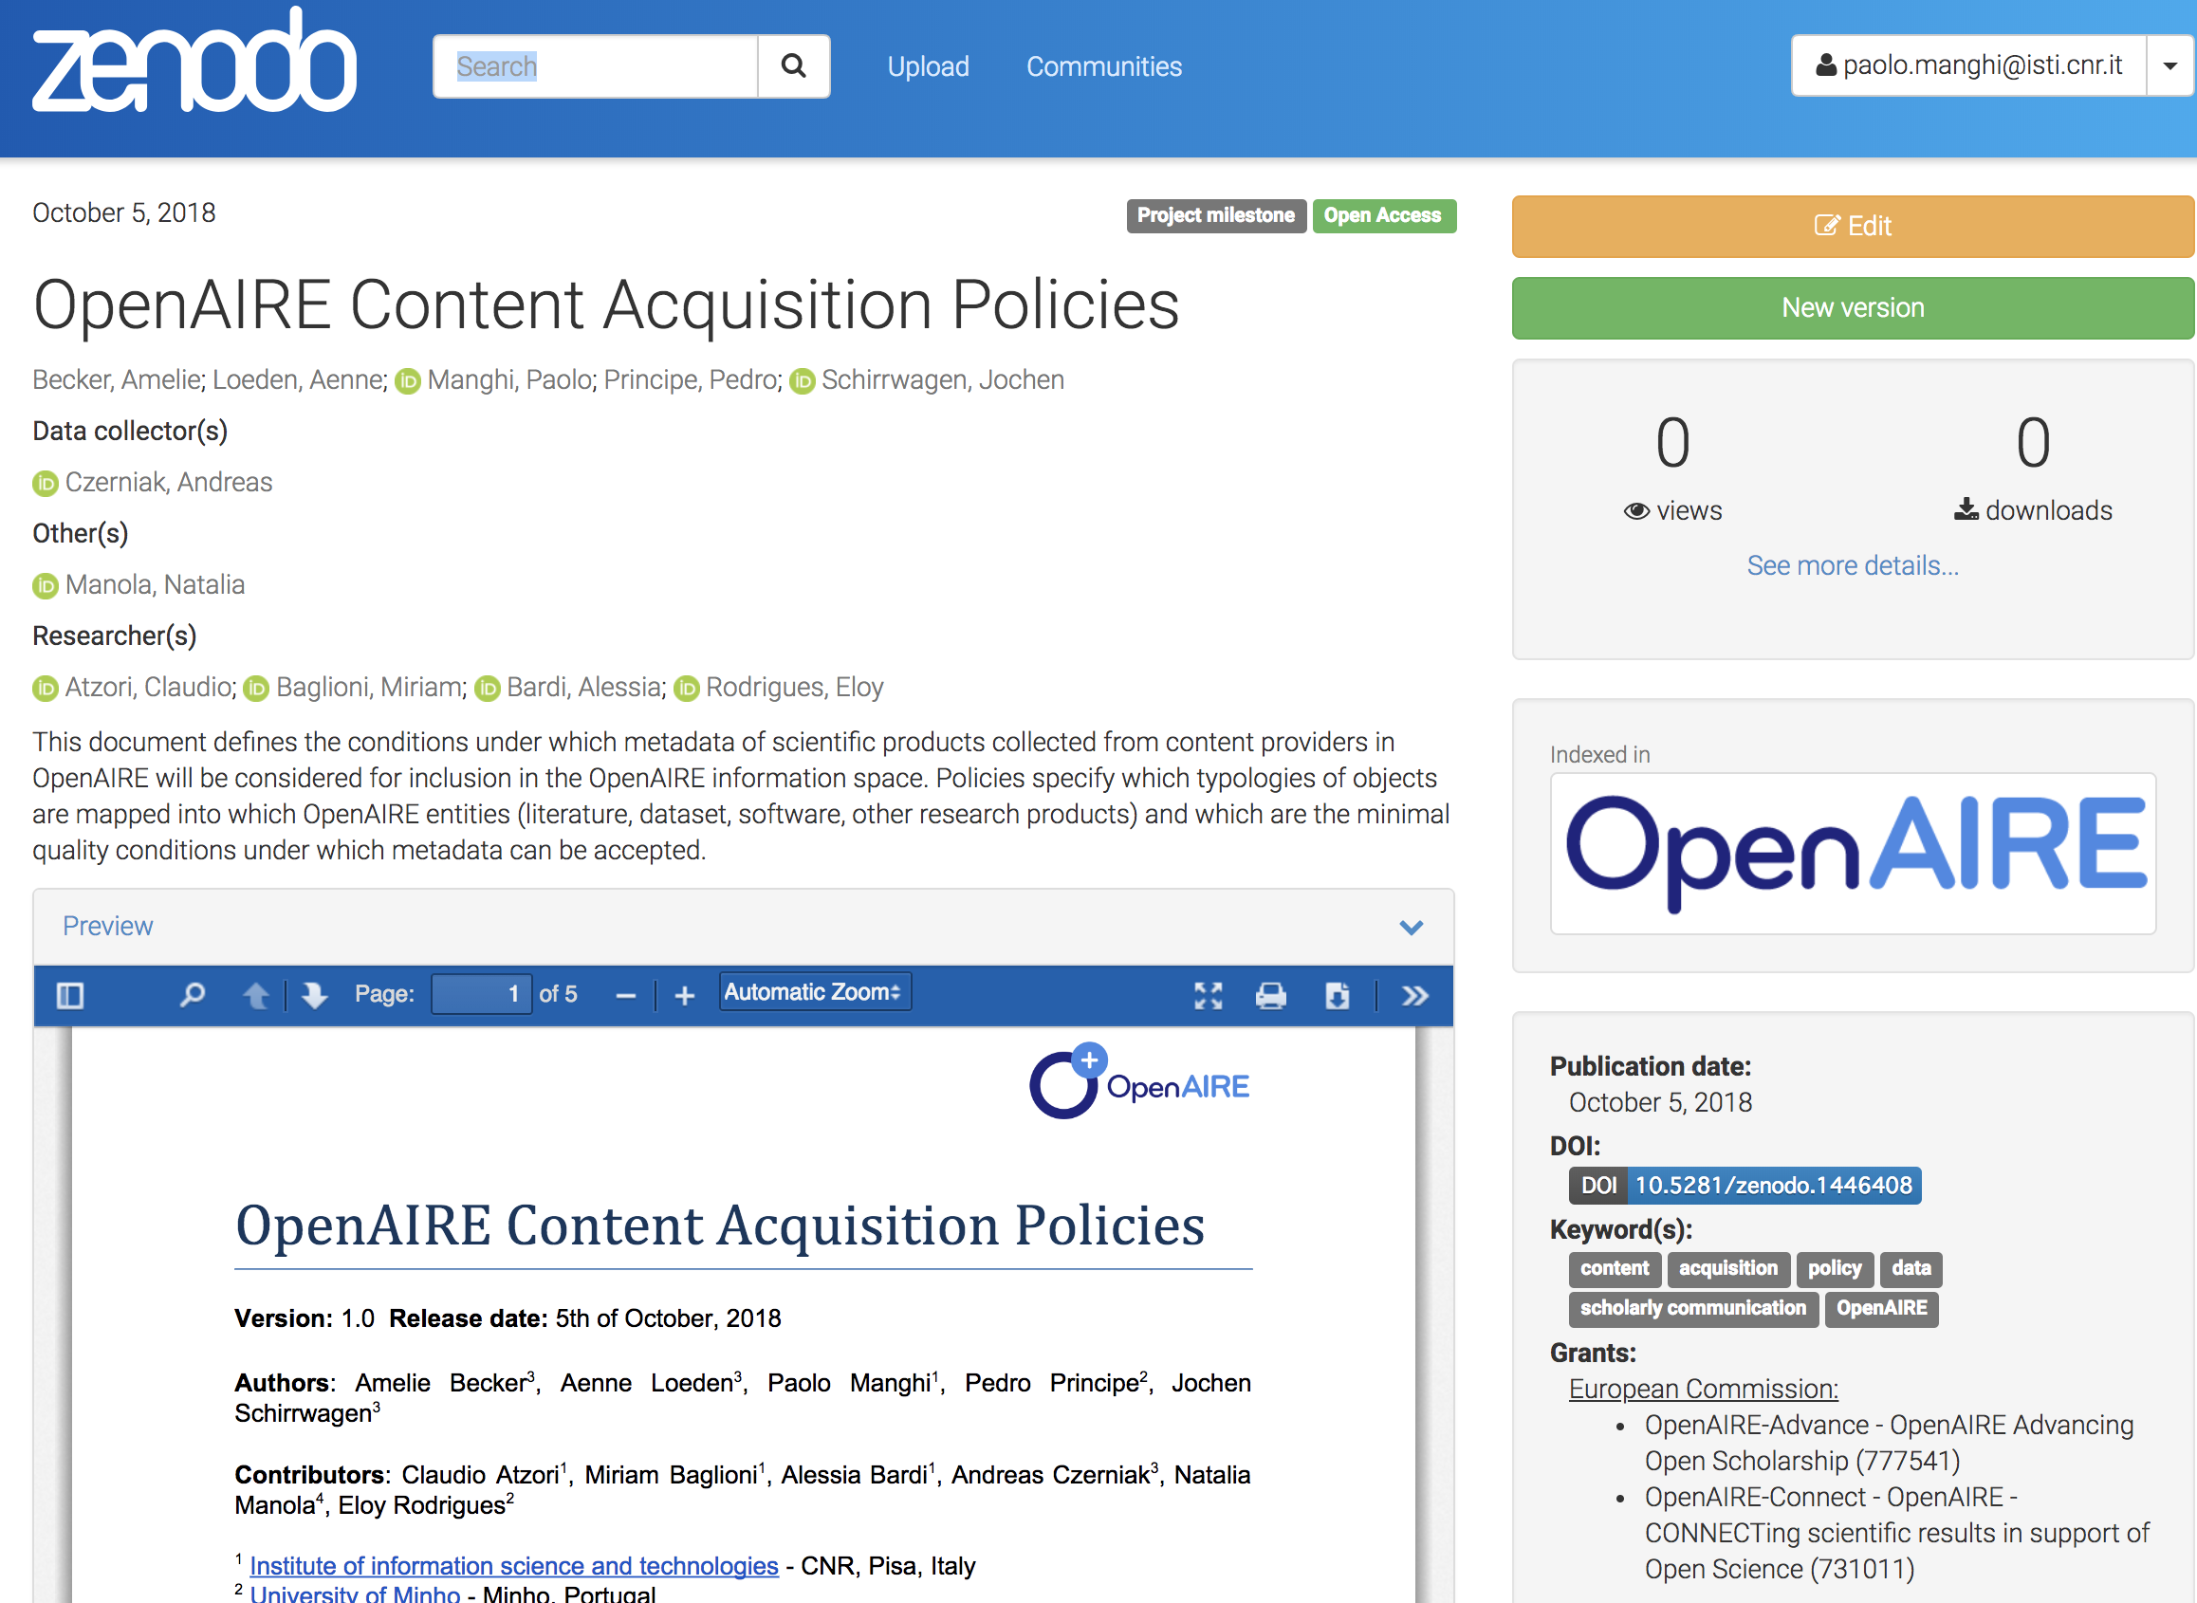
Content Acquisition Policy
ALL Literature, Research data, Software, Other research products
Respecting the OpenAIRE guidelines (DataCite metadata)
Using PIDs with resolvers

Slide 17
Publications
Article
Report
Datasets
Dataset
Collection
Software
Other Research Products
…
Preprint
Clinical Trials
…
Service
Workflow
Interactive Resource
…
Research Software
…
Harvesting: Revised Classification of Research Products
Institutional/
publication repositories
Data repositories
Software repositories
Other Products repositories
Journals/
publishers

Slide 18
Content acquisition policy transition: from Oct 2018 to November 2018

Slide 19
Content: October 2018 (OA bias from previous CAP)
Publications (20,997,018)
OA, non-OA with links to projects
Research data (606,183)
OA with links to publications
Software (45,507)
OA, non-OA with links to projects
Other products (2,910,663)
OA, non-OA with links to projects
Under “cleaning”

Slide 20
Content: November 2018 (numbers from testing)
Publications (100,000,000)
CrossRef, Unpaywall, DOAJ, publication repositories, national/thematic aggregators
Research data (10,000,000)
DataCite, RI repositories, publication repositories
Software (70,000)
Research Software Repositories, publication repositories
Other products (2,000,000)
Data repositories, publication repositories, otjher product repositories

Slide 21
Research Community Dashboard

Slide 22
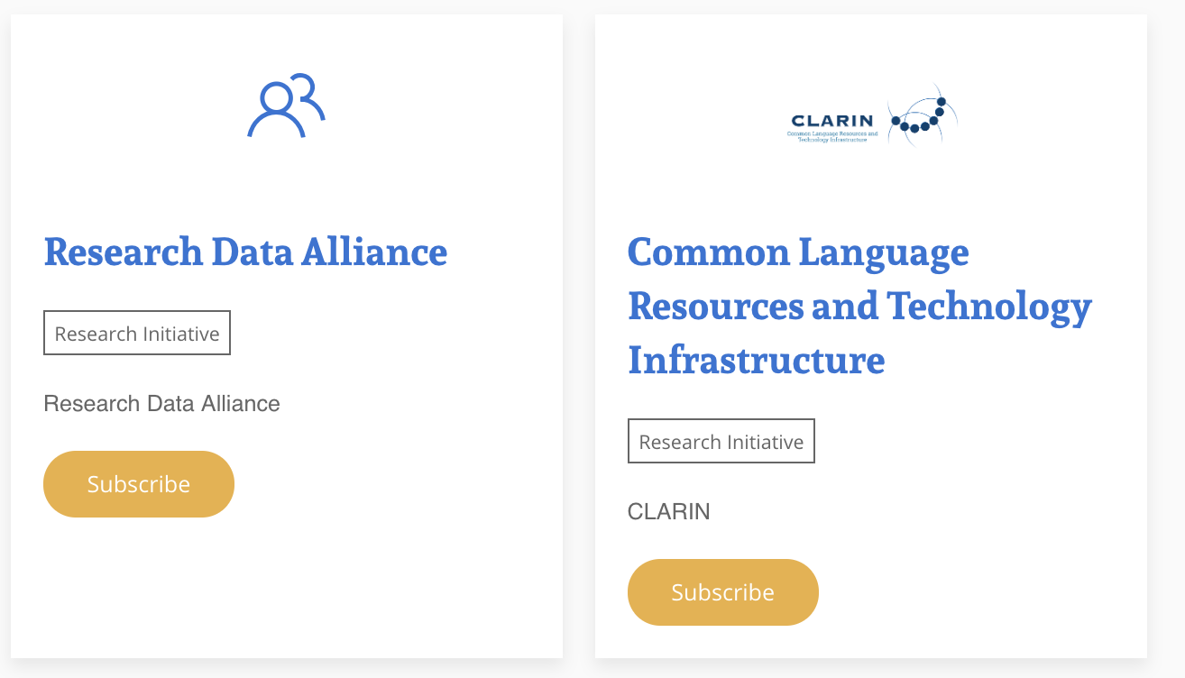
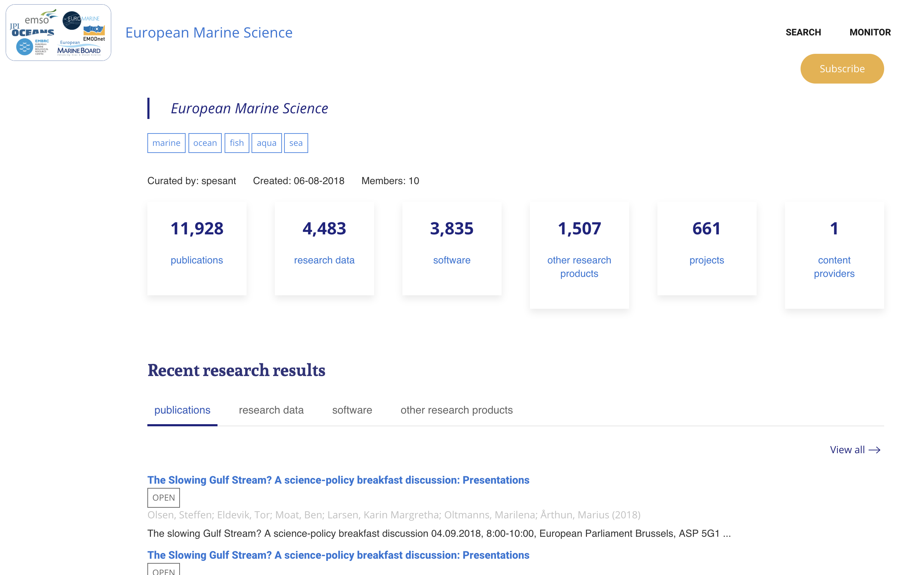
Research initiatives

Slide 23
Aims for Research Infrastructures
Funding
Impact
Open Access/Science
Impact
Publications, research data, software published thanks to the existence of the RI
Monitoring of Open Science impact: data/software FAIRness, reproducibility trends

Slide 24
Added-value functionalities
Funders
Trends in research fields: new (multidisciplinary) disciplines
Institutions
OA/OS behavior, ability to attract cross-funder grants
Projects
Success, interconnections, possible liaisons

Slide 25
Funder Dashboard

Slide 26
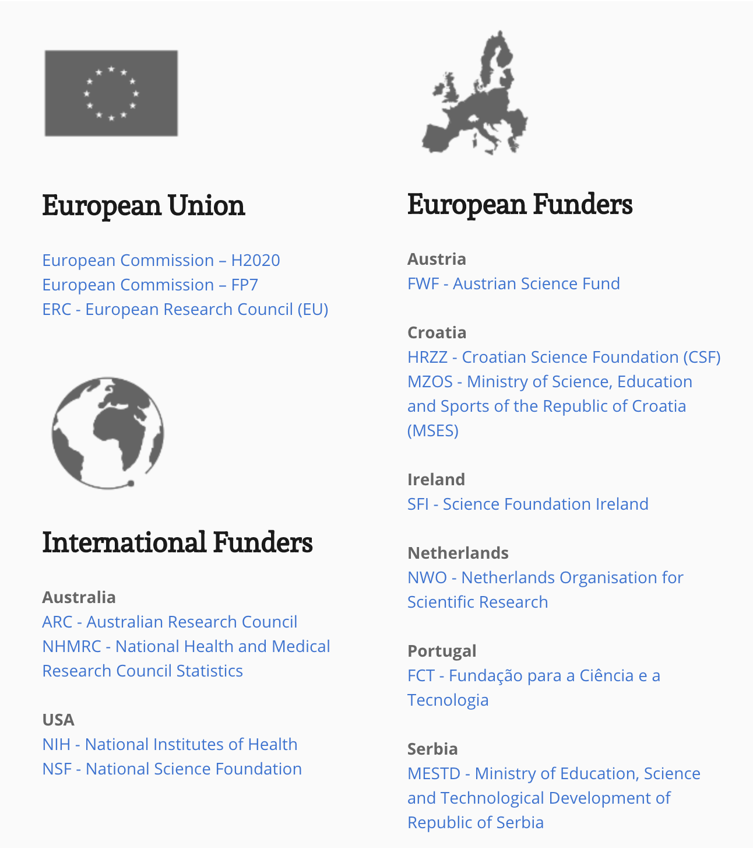

Slide 27
Aims
Funding
Impact
Open Access/Science
Impact
Publications, research data, software published thanks to grants awarded by the funder
Monitoring of Open Science impact: data/software FAIRness, reproducibility trends

Slide 28
Added-value functionalities
Funders
Trends in research fields: new (multidisciplinary) disciplines
Institutions
OA/OS behavior, ability to attract cross-funder grants
Projects
Success, interconnections, possible liaisons

Slide 29
Institutional Dashboard
(under development)

Slide 30
Aims
Research
Impact
Service capacity impact
Funding
impact
Ability of researchers affiliated with the institution to produce innovative and quality scientific products
Ability of services maintained and operated by the institution to support researchers at producing or storing scientific products
Ability of institution to reach funding from different funders and disciplines

Slide 31
Added-value functionalities
Funders
Recent and past EC and other funders’ activities (representing various funding levels)
Checking compliance to funder mandates
Institutions
Collaboration network (by institution) via projects and products
Projects
Check if projects are eligible for Post-Grant APC funding
Compare project portfolio against that of other similar institutions (anonymized)

Slide 32
Paolo Manghi
paolo.manghi@isti.cnr.it

