Slide 1
Open Badges: What Are They and How Are They Used ?
Giuseppe La Rocca, EGI Foundation
Technical Outreach Expert

Slide 2
Advanced Computing for Research

Slide 3
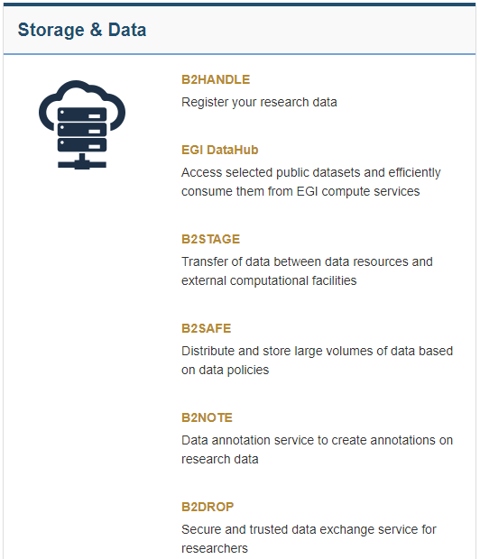
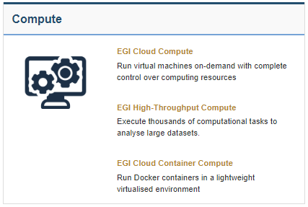
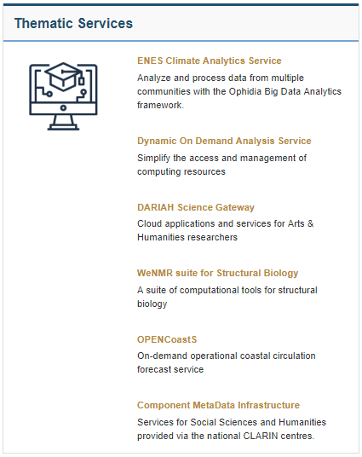
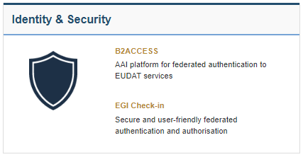
EOSC-hub Service Catalogue https://eosc-hub.eu/catalogue

Slide 4
Motivations
Training is part of any service we deliver:
Common and federated, FiTSM, domain-specific
Cross-cutting domain trainings
FiTSM/ISO 27K have some certification schemes
APMG and ICO-Cert Cert Certification Authorities
Exploring some lightweight scheme to assert competence of other EGI (and EOSC-hub) trainings

Slide 5
What is a (digital) badge ?
Digital badges are awarded to an individual when they have met the required criteria or provided the required evidence
An individual may collect digital badges from different issuers and choose where to store and display these badges
Digital badges are used to:
Recognize an achievement, and
Proof of the accomplishment of that particular skill

Slide 6
Why do we use badges?
Improvement of the training effectiveness
Increase motivation of Students
Make visible additional skills earned outside their regular study programme
Badges can be displayed across a range of different systems, including Learning Management Systems, résumé applications, and social networks (e.g.: LinkedIn)
Companies may be interested in additional competences not included in traditional master courses

Slide 7
Why do we use badges?
Micro-credentials
They allow to split learning into smaller units which can be certified separately
Increase the visibility of the Universities/Educational Institutes
Use badges to shortened pathway (of students)

Slide 8
The Open Badge Standard
The Open Badges standard is a group of specifications and standards aiming at regulating the management of digital badges
The Open Badges standard was founded in 2011 by the Mozilla Foundation
Open Badges 1.0 developed by Mozilla in 2012
By 2013 over 1,450 organizations were issuing badges
In 2015 IMS Global Learning Consortium announced their commitment to Open Badges as an interoperable standard for credentials
IMS Global Learning Consortium is responsible for this standard from 2017

Slide 9
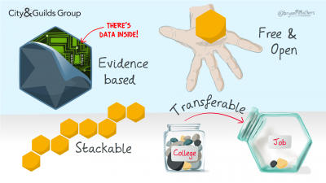
Open Badges’ features
Open Badges allows you to verify your skills, interests and achievements through credible organizations and attaches that information to the badge image file

Slide 10
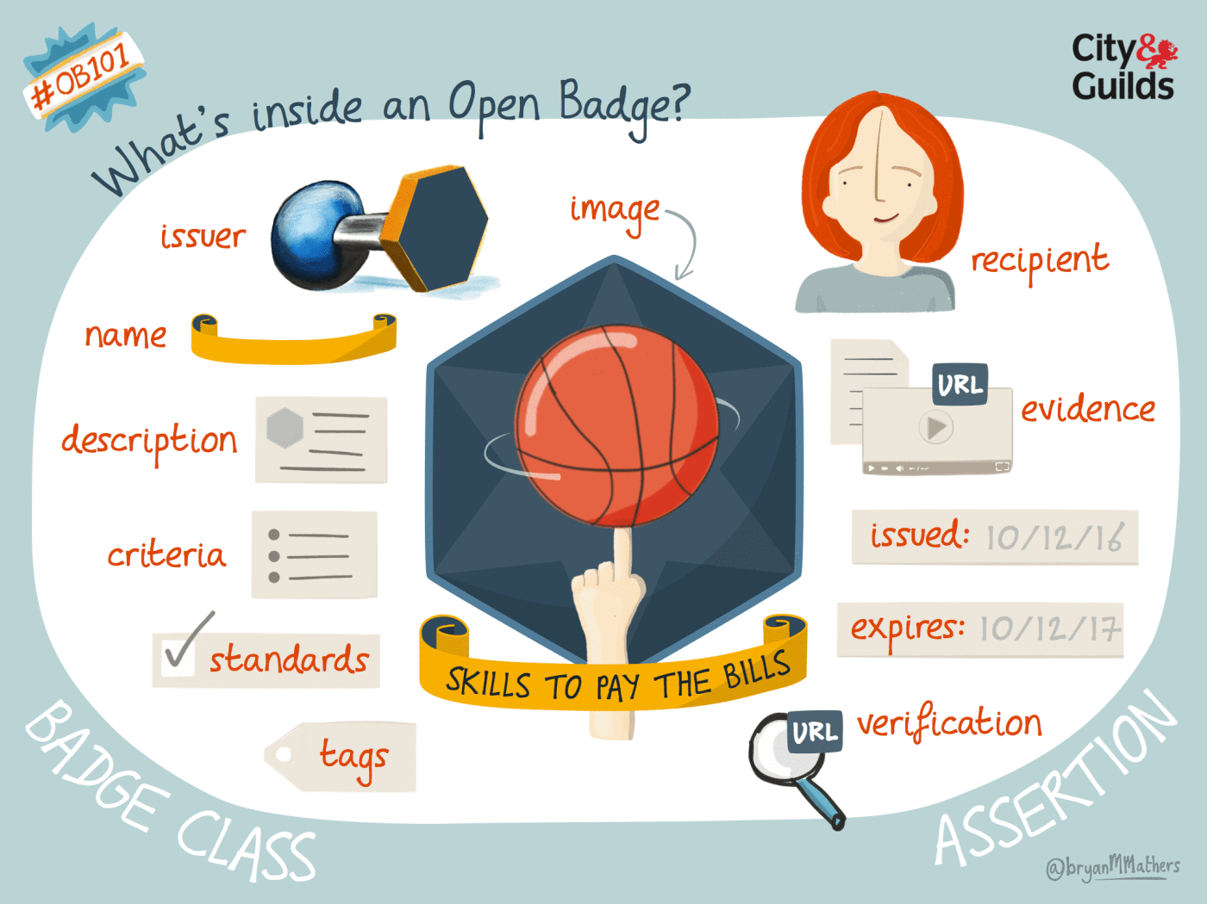
What’s inside an OpenBadge ?

Slide 11
Who is issuing OpenBadges ?
Hundreds of educational institutions, programs and organizations have started to issue Open Badges.
More info at: https://openbadges.org/about/participating-issuers/
CINECA
More info at: https://bestr.it/organization/show/19
University of Turin
Open-source Learning Management Systems (LMS)
More info in the next slides …

Slide 12
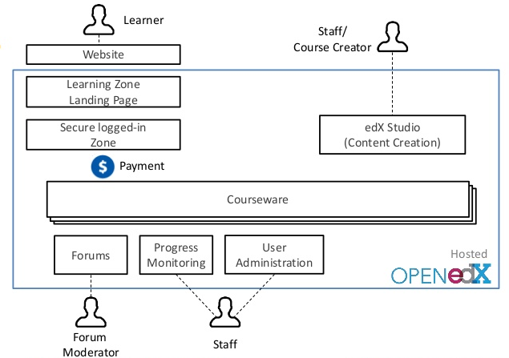
Learning Management System
Open edX platform is a free and open-source Learning Management System (LMS) used to host Massive Open Online Courses (MOOCs) as well as smaller classes and training modules
Sites powered by Open edX
What is included in Open edX ?
- edX Studio
- The edX LMS (Learning Management System)
Discussion forum
…
- Badges

Slide 13
Badges in Open edX
Courses on Open edX by default have digital badges enabled
When digital certificates are generated for a course, badges are automatically generated at the same time
Badges contain meta information about the learner and the course for which the badge was awarded
Learners receive a badge at the same time as they receive a course certificate
Learners can share the badge(s) in badging site such as Mozilla Backpack
The Open edX platform supports Open Badges, an open standard originally developed by the Mozilla Foundation

Slide 14
Traditional vs. Learning Management System
Traditional courses
Learning Management Systems
Difficult to assess trainee’s competences after the event
No formal certification
Impossible to verify progress
LMS leads to greatly increasing training efficiency
Open edX course creation process is really easy
Provides tools to assess participant’s skills and competences and prepare courses

Slide 15
Provide your comments on
https://www.menti.com/7c49d1d9

Slide 16
Thank you for your attention!
Contact:
giuseppe.larocca@egi.eu

