Slide 1
Paolo Manghi
Institute of Information Science and Technologies - CNR
Research data discovery in OpenAIRE

Slide 2
Populating the OpenAIRE scholarly communication graph
Searching over the OpenAIRE graph

Slide 3
The OpenAIRE Graph

Slide 4
Building the graph and Dashboards
OpenAIRE Dashboards
TERMS
OF USE
Info Space Services
Research
communities
Researchers (All)
Content providers
Innovators
Research managers
Funders
Brokering
Funding
Funder
Cleaning
De-duplication
Organization
Project
communiity
Validation
Inference
Result
Source
Harvesting
Uploading
Publication
Data
Software
ORP
GUIDE
LINES
Content Providers
Research
Infras
Publications repositories
Data repositories
Registries
Software
repositories
OA
Journals
CRIS
systems

Slide 5
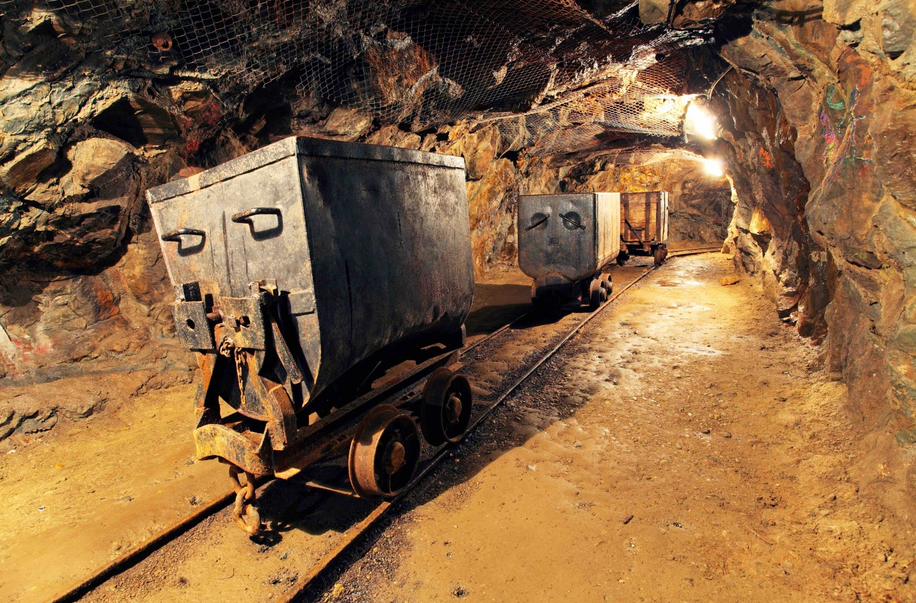
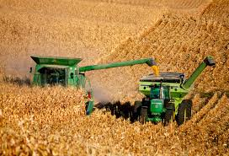
OpenAIRE Data Model and Flows
Funding
Funder
Organization
deposition
mining
Project
community
Source
Result
Publication
Research Data
Software
Other res. products
harvesting

Slide 6
The OpenAIRE scholarly communication graph
Building and maintaining an open metadata scholarly communication graph of interlinked scientific products, in turn linked to Open Access information, funding information and community views
Complete
De-duplicated
Participatory
Graph

Slide 7
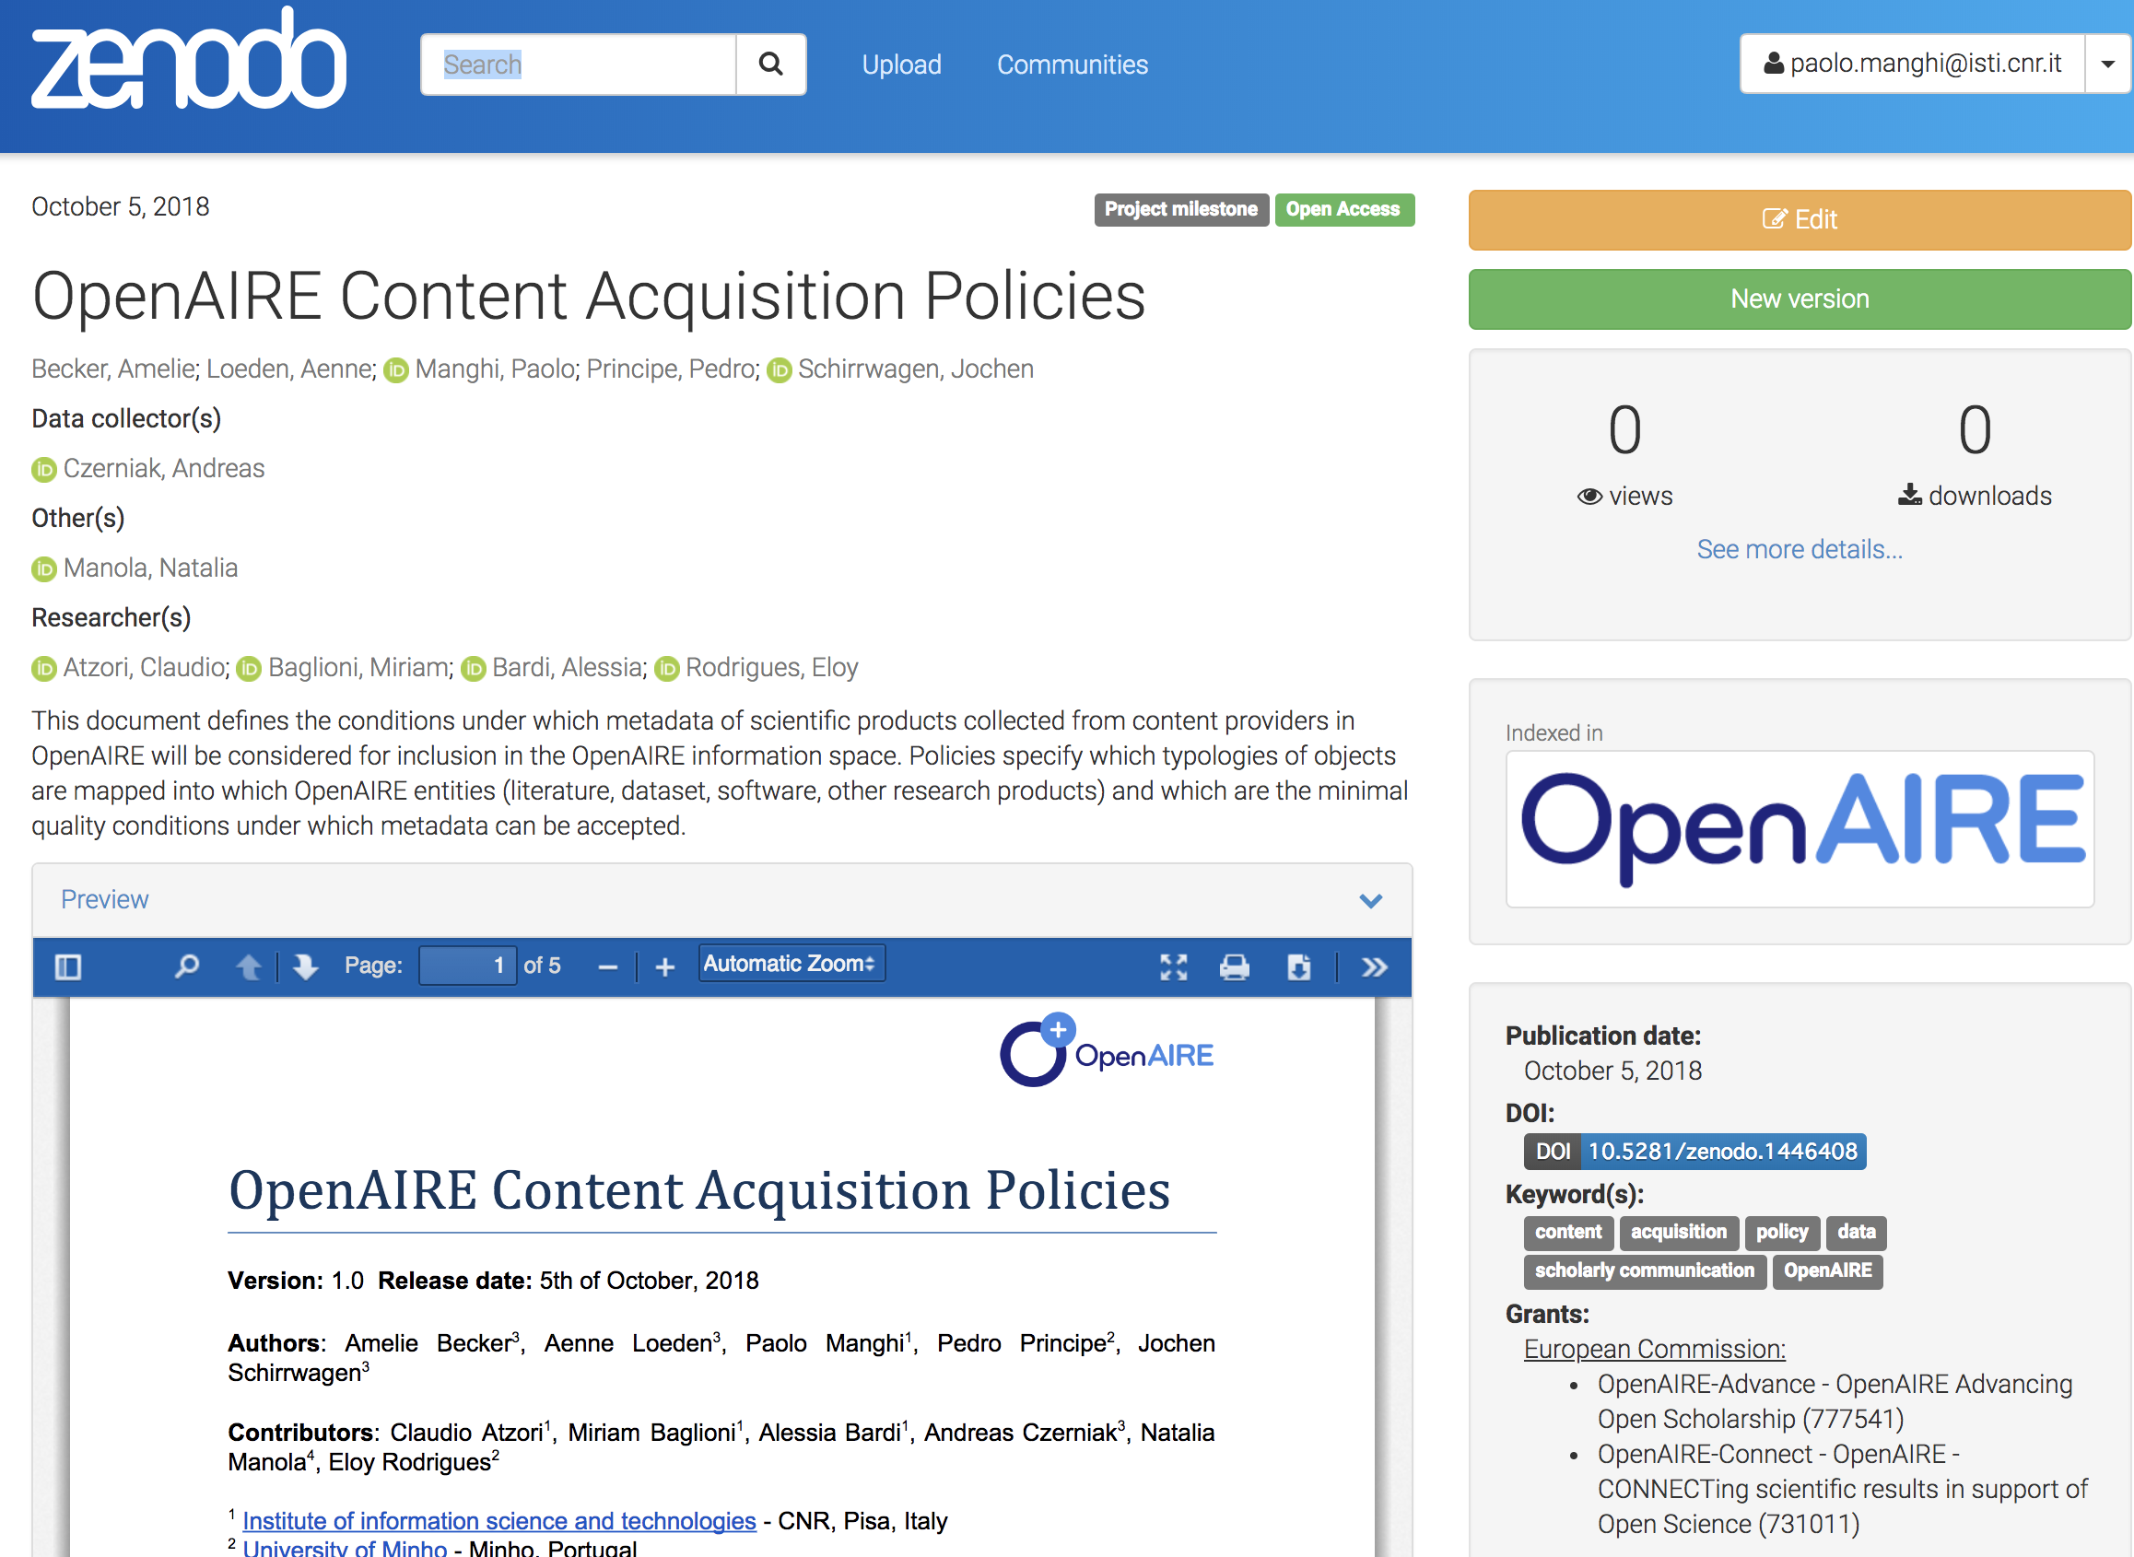
Content Acquisition Policy
ALL Literature, Research data, Software, Other research products
Respecting the OpenAIRE guidelines (DataCite metadata)
Using PIDs with resolvers

Slide 8
Publications
Article
Report
Datasets
Dataset
Collection
Software
Other Research Products
…
Preprint
Clinical Trials
…
Service
Workflow
Interactive Resource
…
Research Software
…
Harvesting: Revised Classification of Research Products
Institutional/
publication repositories
Data repositories
Software repositories
Other Products repositories
Journals/
publishers

Slide 9
Content acquisition policy transition: from Oct 2018 to November 2018
100+Mi
10+Mi
40Mi links
80+K

Slide 10
Exploring the graph

Slide 11
Disovery of data in OpenAIRE
Search, browse, claim, and interlink products
Navigation between interlinked objects

Slide 12
Search plans in OpenAIRE
Data maturity-driven search
Search datasets used in at least K papers
Community-driven search
Search for data in a community or used-cross-community
Search beyond dataset metadata
From dataset files or from related entities (publications, project)

Slide 13
General challenges raised by experience
Low quality metadata
Scientists should take seriously metadata curation and interlinking with other scientific products
Metadata citation Vs metadata for reuse within or across disciplines
Varying granularity among communities
Communities should leverage a granularity level adequate to the intended discovery
Datasets have different descriptions, driven by the intended usage, which drive the possible searches
Systems should be prepared to include new metadata/link information to existing depositions, to reflec the ecolution of the domain

Slide 14
Paolo Manghi
paolo.manghi@isti.cnr.it

