Slide 1
FIM4R v2
Federated Identity Management for Research Collaborations
Chris Atherton, GÉANT

Slide 2
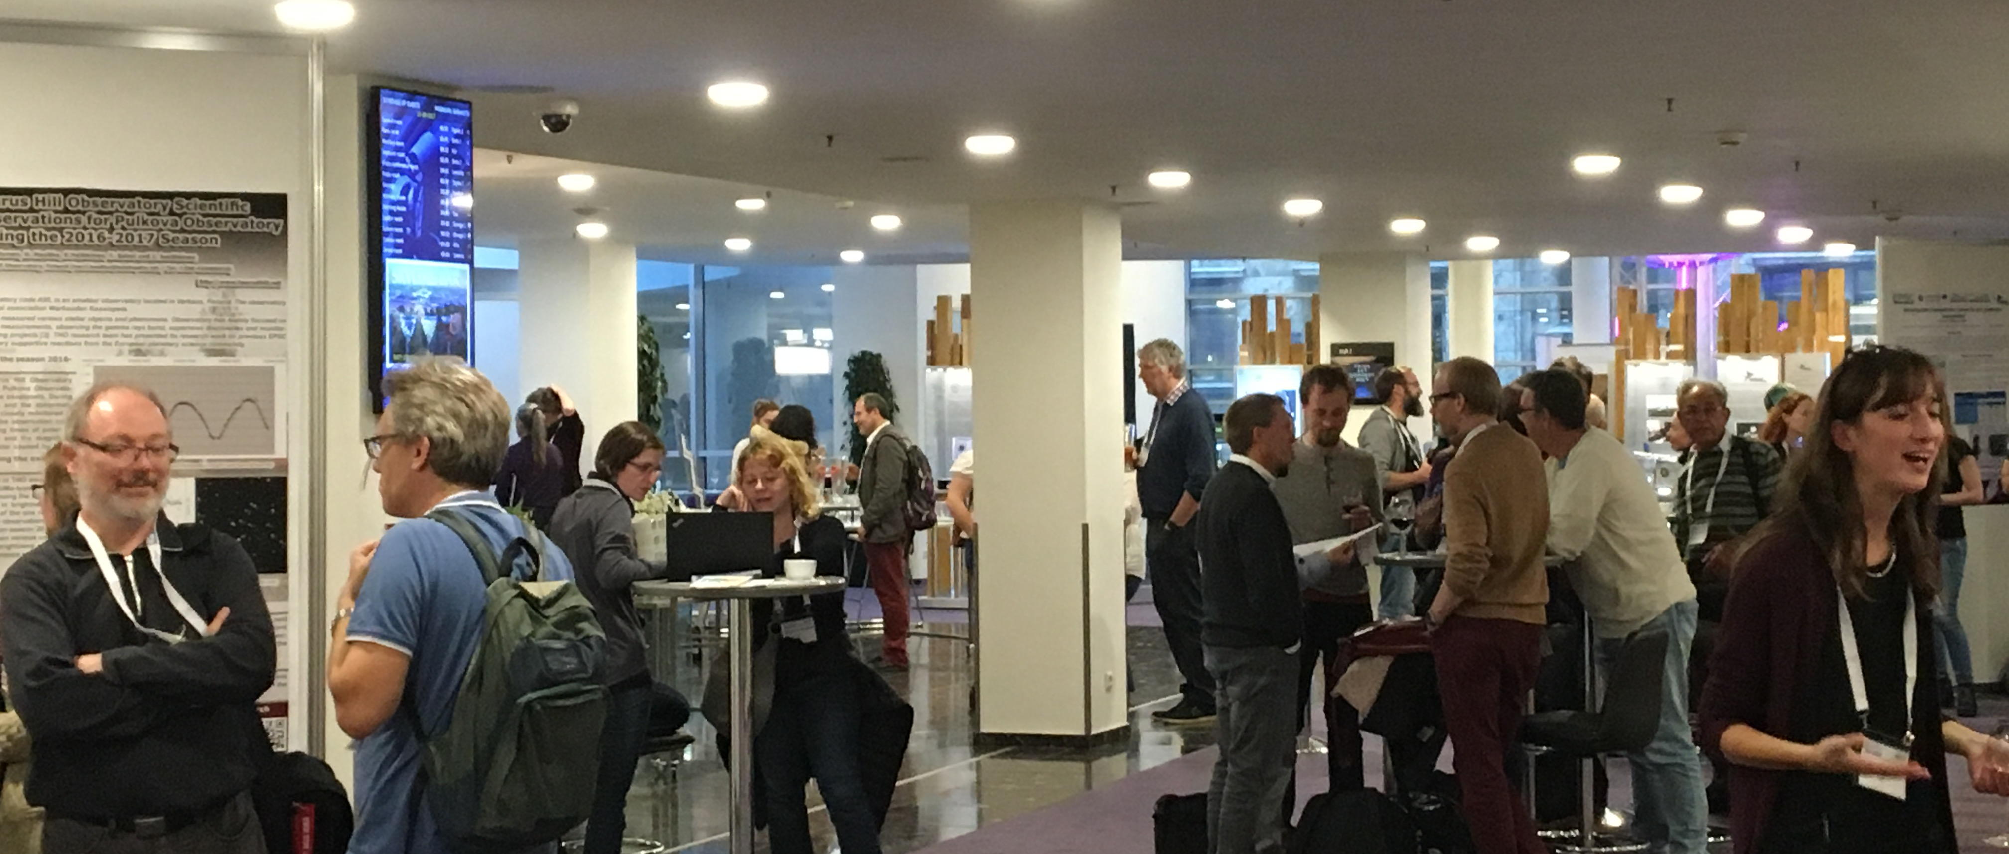
FIM4R The Challenge
Notes:
Trust and identity services have evolved greatly over the last 5 years in the academic world.
eduGAIN works great for teams working together from large institutions but there still remain challenges working with the long tail of science or with commercial organisations.
The white paper captured this well with the following quote:
“Every researcher is entitled to focus on their work and not be impeded by needless obstacles nor required to understand anything about the FIM infrastructure enabling their access to research services.” FIM4R version 2

Slide 3
FIM4R The Evolution
Notes:
FIM4R V1 Aim: “Authenticate locally, authorize globally” • deliver good user experience • extend the reach of campus credentials • reduce the number of credentials needed by users • leverage campus credential management practices – focus more energy on their own services • make federation a global infrastructure – academic collaboration, itself global, benefits In a very substantial sense, this has been achieved (for Authentication) • FIM now spans the national R&E federations from many countries into an aggregated whole known as eduGAIN

Slide 4
FIM4R Successes since 2012
Notes:
since 2012 the FIM4R V1 paper was taken seriously
AAI is now more mature with many successes
• European Commission funding (H2020) for the AARC/AARC2 projects
• Federations and interfederation have found their role as an Authentication infrastructure; Authorisation managed by Communities
• eduGAIN’s operational support capability is now in place and maturing
• e-Infrastructures are deploying shared AAI services (EGI, EUDAT, GÉANT, EOSC-hub, …) • Specific successes include the Sirtfi and Snctfi trust frameworks

Slide 5
FIM4R Shocking Challenges Remain
Notes:
Shockingly, there are still problems:
• Usability & User Experience – Considerable time spent in bilateral debugging – Discovery services unintuitive
• Data Privacy and EU GDPR – Better data access and privacy expectations need to be balanced, E.g. ELIXIR Human Data resources are potentially liable for breaches – Attribute release by risk averse IdPs is already problematic, this may be aggravated
• Level of Assurance – Frameworks defined but not well adopted or propagated • Interfederation and many federations do not offer an adequate level of operational support and security for Research use cases – eduGAIN has become recognised as a brand and those wishing to “join” experience a steep learning curve and inconsistent federation practices
• Although several generic AAI infrastructures are evolving, their respective advantages and availability are unclear

Slide 6
FIM4R The Background
Notes:
FIRST MET IN MONTREAL and decided to write the new paper

Slide 7
FIM4R The Background
Notes:
Met in Vienna to get the requirements and recommendations agreed

Slide 8
FIM4R TNC 18
Notes:
FIM4R V2 published this year at TNC 18 in Trondheim

Slide 9
About FIM4R
FIM4R V2 White Paper
Notes:
Lots of people and organisations contributed

Slide 10
FIM4R The Requirements
The Requirements
Notes:
42 in 11 categories

Slide 11
FIM4R Identity Lifecycle & Linking
Notes:
Covers the requirements which relate to the portability and persistence of an identity over time, as well as the ability to link credentials from multiple IdPs. An example of this kind of challenge is when a researcher moves institute or research field throughout the lifetime of their career. ORCID is the recognised means of achieving the persistent identity for a researcher.

Slide 12
FIM4R Discoverability & Usability
Notes:
relates to the ease of a user to be able to find the authentication and authorisation infrastructure services that they are searching for or required to interact with. This includes the discovery of the user’s IdP by the most efficient means as well as discovery of the services offered by SPs that are available to them

Slide 13
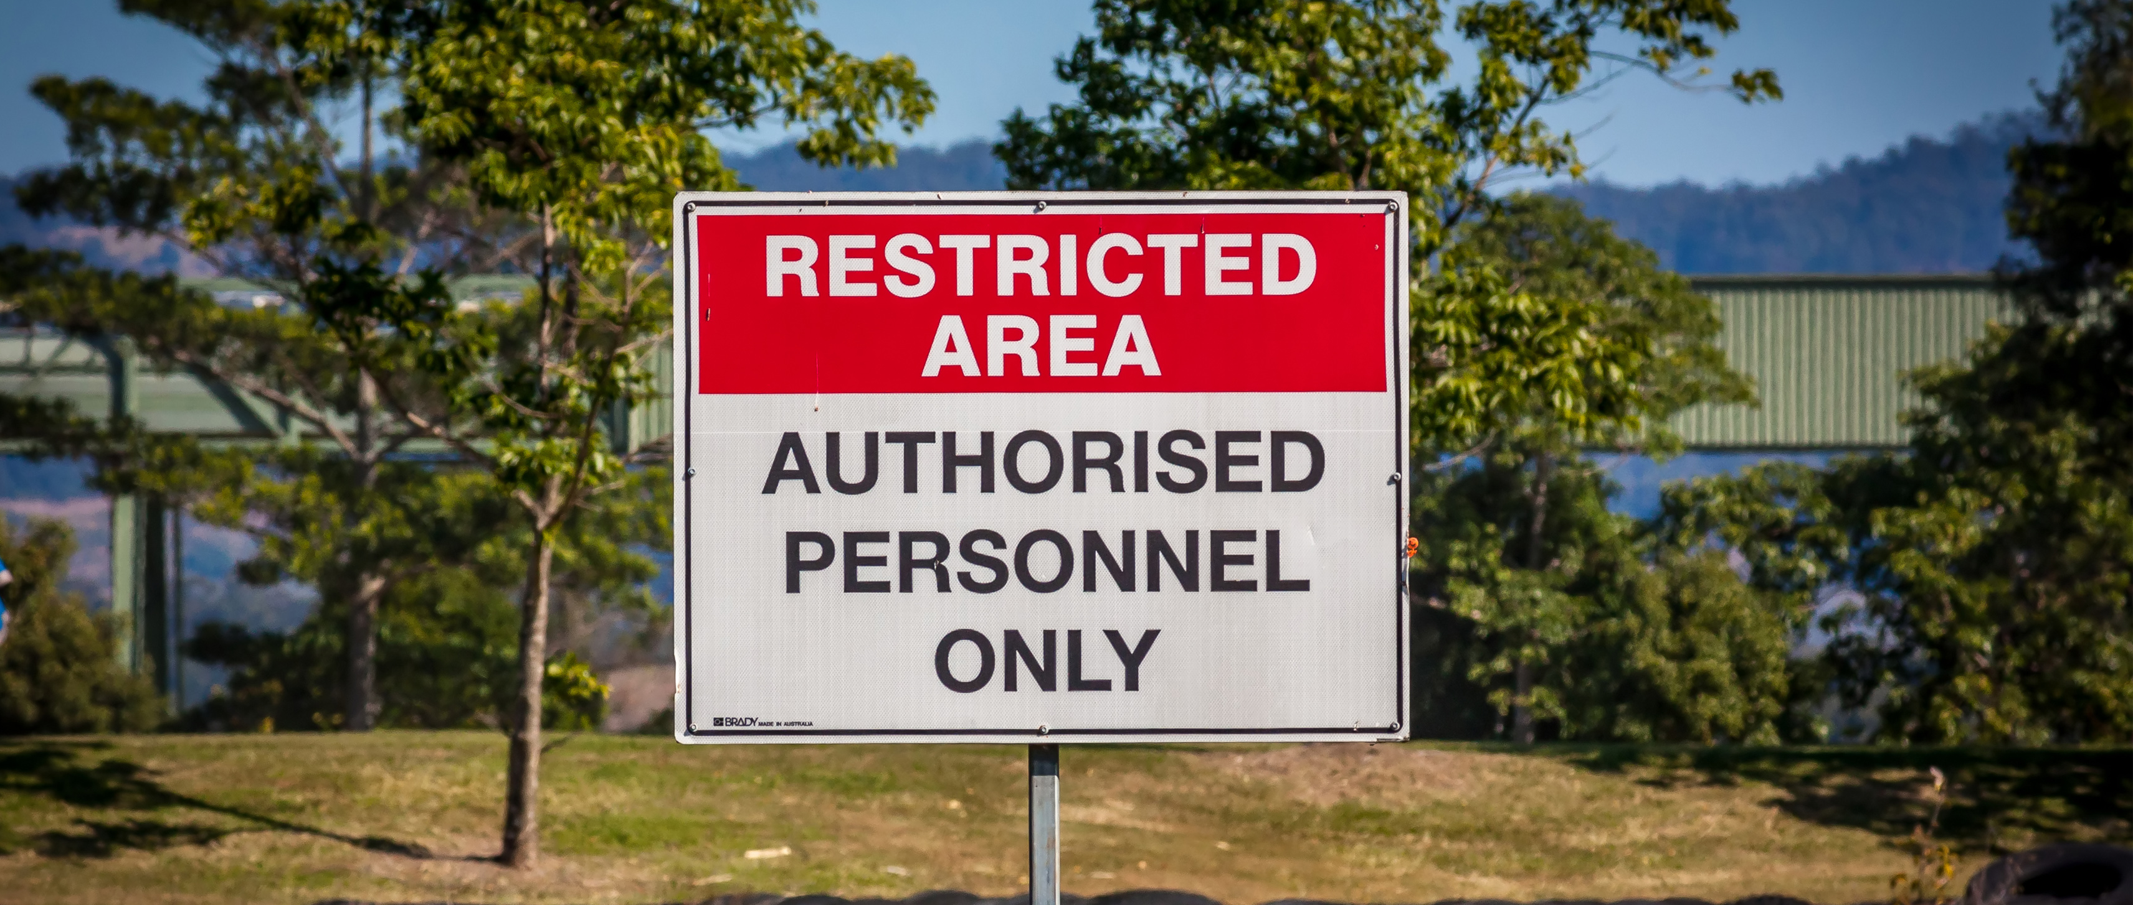
FIM4R Authorisation and (De-)/Provisioning
Notes:
is the granting and revoking of permissions and the access-enabling artifacts necessary to do so. However, the requirements raised by the community go into a much granular level, covering the various nuances of authorisation not yet fully covered by the services and systems which the community relies upon. These requirements focused around the policies and technologies required for authorisation at a global scale such as the ability for an SP to de-authorise a user at an individual research institute or infrastructure, real time updating of the authorisation rights, the ability to manage group formation and levels of access to systems and resources with appropriate accounting.

Slide 14
FIM4R Attribute Release
Notes:
is a long running requirement of the community. Attributes are the pieces of information relating to a user which are made available by IdPs. As mentioned above attribute release remains problematic. The requirements serve to outline a number of elements which need to be addressed in order to reduce the issues caused by lack of attribute release.

Slide 15
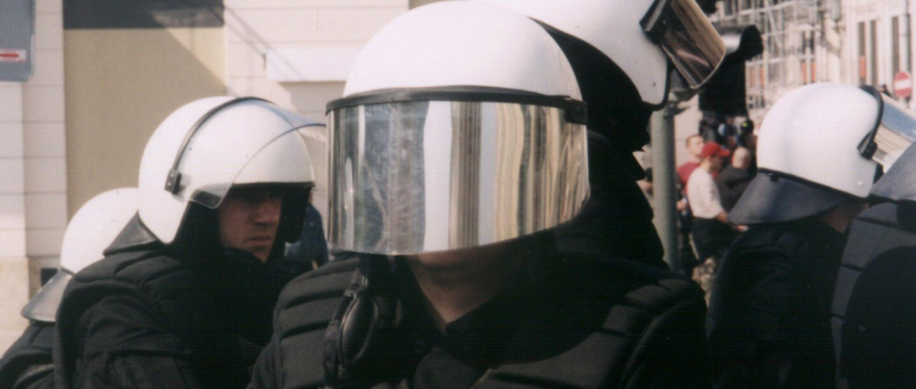
FIM4R Security Incident Response
Notes:
is an important concern for the research community. The Security Incident Response Trust Framework for Federated Identity, Sirtfi for short, is the framework which most easily addresses the security incident response requirements of the research community. This framework allows for a means of enabling coordinated security incident response across federated organisations. There are, however, a number of improvements which the research community believes could be made to the existing eco-system to improve the situation for all communities, which are outlined in that section.

Slide 16
FIM4R Research Community Proxies
Notes:
are entities used to contribute additional attributes or services not provided by identity federations or service providers. Only these entities are specifically established and operated on behalf of a specific research community. They serve as a collective representation of all of the internal services or service providers and identity proxies which are offered within a research community. The FIM4R research communities have contributed a number of requirements that they would like to see from a number of groups, which would enhance the effectiveness and scalability of research proxies for the benefit of the wider research community.

Slide 17
FIM4R Assurance & Multi Factor Authentication
Notes:
relates to the need for a service provider to be assured that the identity being verified is of a high standard to ensure the necessary trust between the entities. This can be further enhanced through the use of multiple authentication factors to increase assurance and trust that the identity being authenticated is verified. In this section proposals around ways to increase assurance and adoption of multi factor authentication are proposed.

Slide 18
FIM4R Interoperability
Notes:
refers to standards of operation needed to ensure that users have a consistent experience across the FIM ecosystem.

Slide 19
FIM4R Non Web
Notes:
relates to the requirement for AAI services to support command line or web service based federated authentication, rather than authentication via web portals. Within the research community many interactions between clients and servers are via the user’s command-line or through interacting applications using API access to AAI. This section explores ways in which non web authentication can be achieved or improved.

Slide 20
FIM4R On-Boarding & Support
Notes:
from the perspective of the research community describes ways in which federations, eduGAIN and research community proxies can make it easier for research communities to interfederate and to test their AAI infrastructures before making them live.

Slide 21
FIM4R Sustaining Critical Infrastructure
Notes:
some common challenges and concerns faced by the research communities to do with the long term sustainability of key services which are utilised in FIM.

Slide 22
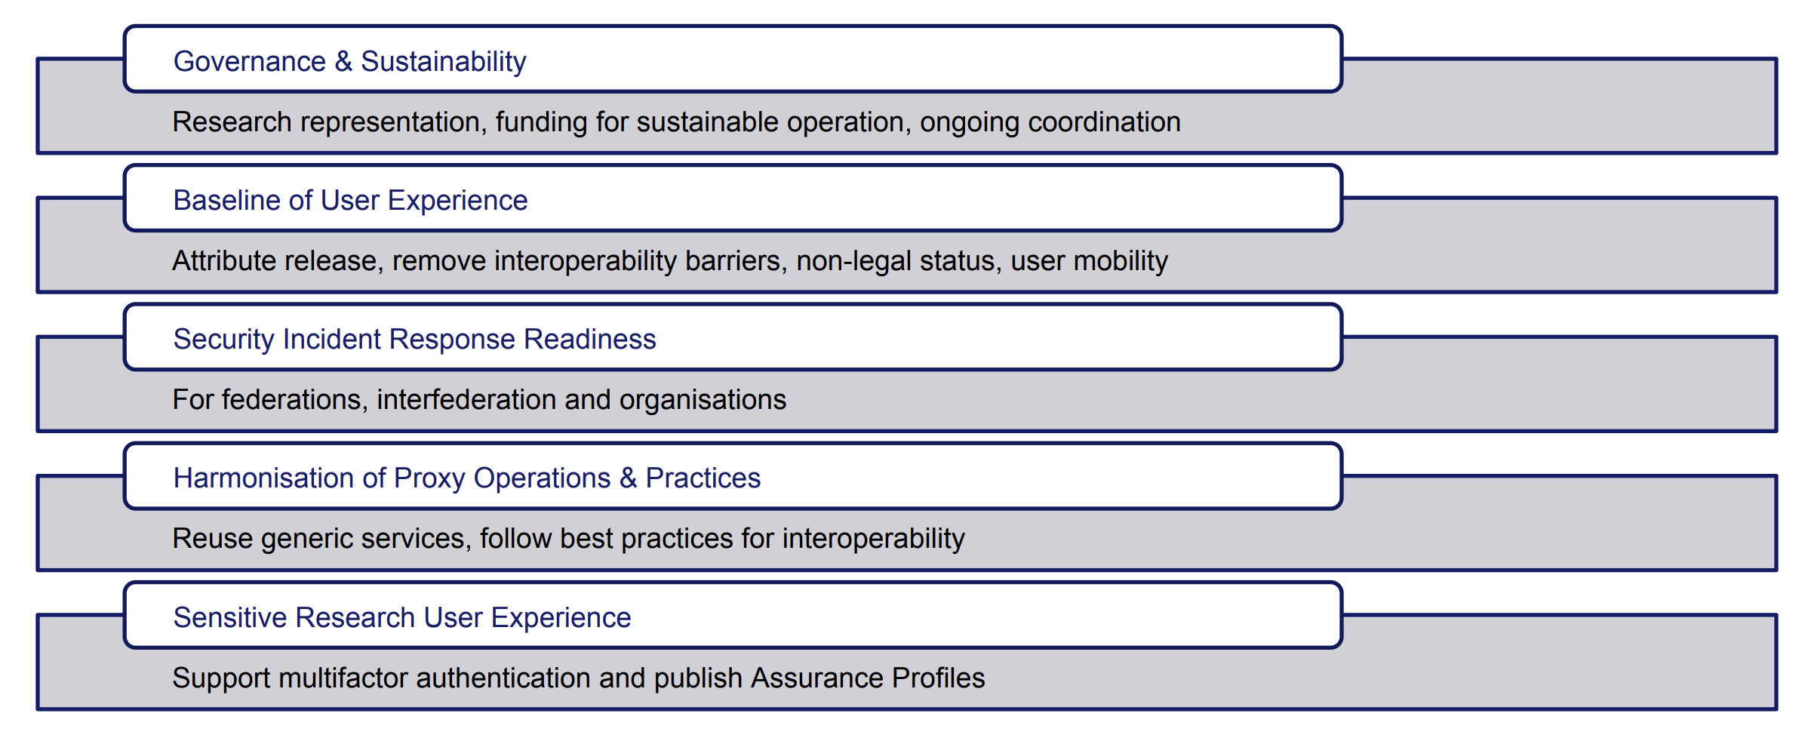
FIM4R Recommendations
Notes:
5 sets of recommendations!

Slide 23
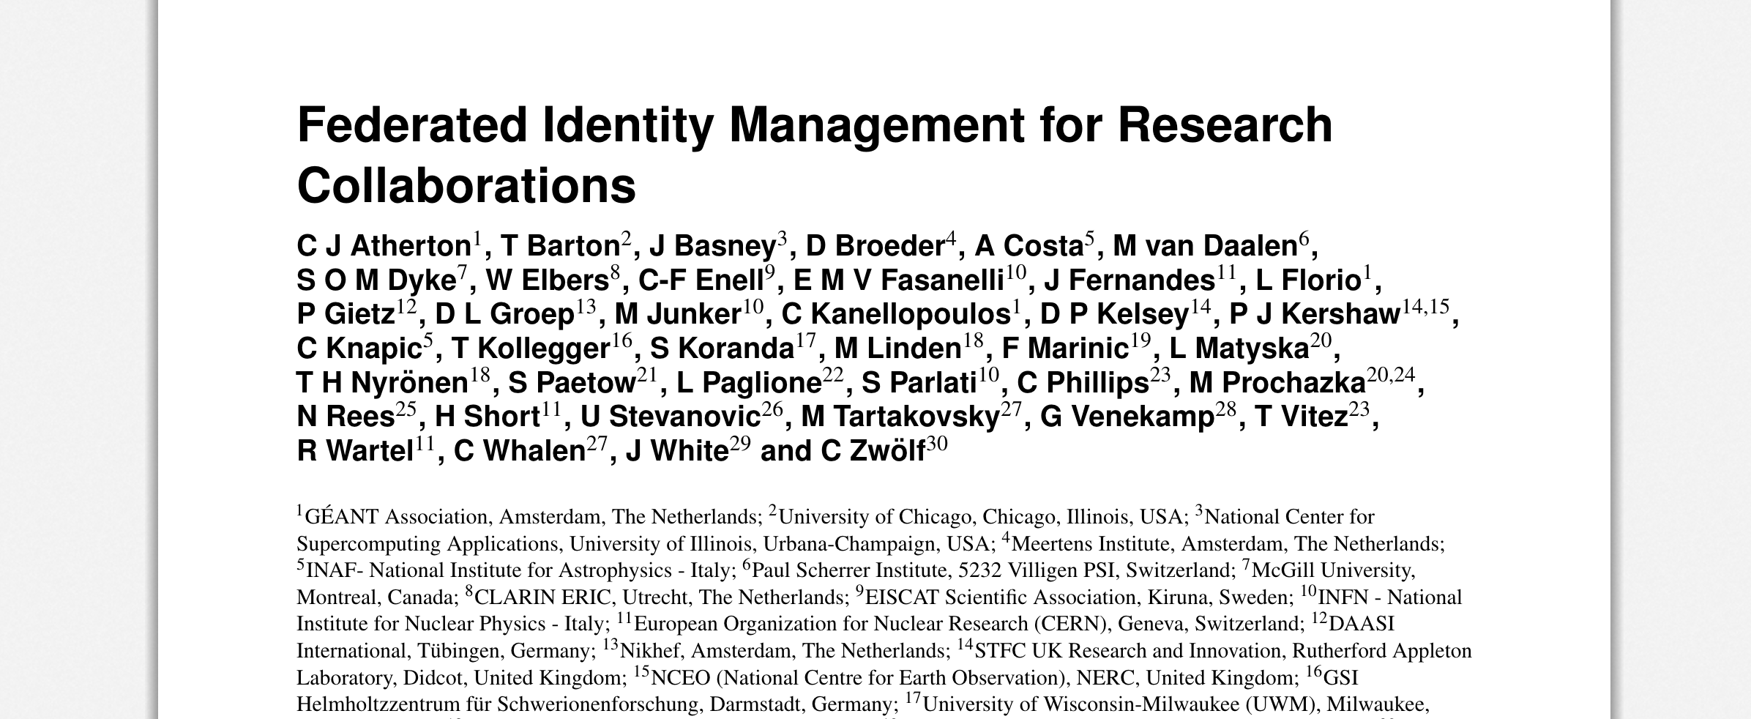
FIM4R TNC 18
https://doi.org/10.5281/zenodo.1307551
Notes:
Published on Zenodo! Go read here:
https://doi.org/10.5281/zenodo.1307551

Slide 24
Conclusion
Notes:
The community knows where they want to go: – an interoperable infrastructure that:
• solves current issues
• is as invisible to the researcher as much possible
• All depends upon the substantial participation and cooperation of several groups
• In the recommendations FIM4R V2 specifically addresses each of these groups

Slide 25
Thank you

