Slide 1
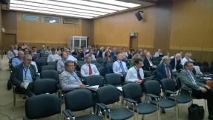
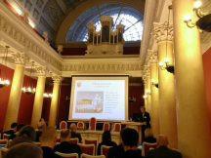
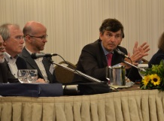
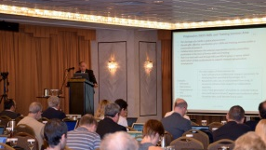
Towards a common approach on KPIs from e-Infrastructures
Fotis Karayannis, Jan Wiebelitz,
On behalf of e-IRGSP5 consortium
http://e-irgsp5.e-irg.eu
Lisbon, Thursday 11 October, 2018

Slide 2
Introduction – how this work came about?
From EC call text – Policy support to e-Infrastructure programme
“…The activities should include the collection and aggregation of relevant policy information with impact on the development of EC-funded e-infrastructures, including KPIs and cost-related information, in coordination with the funded e-infrastructure initiatives and made available in open formats for reuse.
The collected information will enable the e-IRG with the support of independent expert panels to provide strategic advice on the evolution of the European e-infrastructures landscape and associated cost".
This work also related with a set of projects/studies ended ~5 years ago: e-FISCAL, eNventory, ERINAplus, RI Impact
H2020 2016-17 e-Infra calls required KPIs: “..the proposals should define, collect and make available key performance indicators (KPIs) in support of operational, technical and socio-economic impact assessment" https://ec.europa.eu/futurium/en/content/how-set-kpis-work

Slide 3
Definitions-Background
Metrics / Key Performance Indicators (KPIs) are intended to measure the effectiveness of investments in infrastructures / compared to a set of objectives
and provide convincing arguments for sustainable support from funders
For e-Infrastructures: evaluate services, policies, costs and overall impact
e-IRGSP5 is focusing on policy and financial information/indicators/KPIs
eInfraCentral is focusing on operational/service-related KPIs

Slide 4
Background: e-IRG framework paper on KPIs
Issued at March 9th, 2017
Discussed topics:
High-Level Goals of the funding/governing body and users
Classification of high-level goals into categories
Categories (and corresponding expectations)
political
e-Infrastructure providers
scientific users
general public
Web page: http://e-irg.eu/kpi
Notes:
1. Offer access to state-of-the-art infrastructure and high-quality services 2. Meet the users’ needs and enable them to conduct excellent research6 3. Provide access to results of research (stressing the re-use of data/content, based on the recently adopted FAIR-principles)7 4. Increase the efficiency, effectiveness and excellence of public research system8 5. Provide high-speed, secure and trustworthy infrastructures and content services 6. Reinforce trust and security in digital services and in the handling of personal or sensitive data. 7. Open national systems to each other and to the world, in order to be more inter- connected and more inter-operable 8. Offer participation in the developed e-Infrastructure to other stakeholders (“citizen science”; corporations according to accepted EOSC governance models) 9. Governance to guarantee long-term sustainability and enable stakeholders’ trust

Slide 5
KPIs gaining further traction..
In Sep‘17, the EC Staff Working Document (SWD) "Sustainable European Research Infrastructures, a Call for Action" expressed the need to "assess the quality and impact of the RI and its services, by developing a set of Key Performance Indicators“
In May’18, the Competitiveness Council adopted conclusions on Accelerating Knowledge Circulation in the EU which “invites MS and the EC within the framework of ESFRI to develop a common approach for monitoring of their (RIs) performance and invites the Pan-European Research Infrastructures, on a voluntary basis, to include it in their governance and explore options to support this through the use of Key Performance Indicators”
In Sep’18, ESFRI has decided to create a WG on monitoring RIs performance including the definition of KPIs
HorizonEurope SWD includes new plans for KPIs and impact assessment
https://ec.europa.eu/info/publications/horizon-europe-impact-assessment-swd-2018-307_en
https://ec.europa.eu/info/sites/info/files/swd_2018_307_f1_impact_assesment_en_v7_p1_977548.pdf
(next slide)

Slide 6
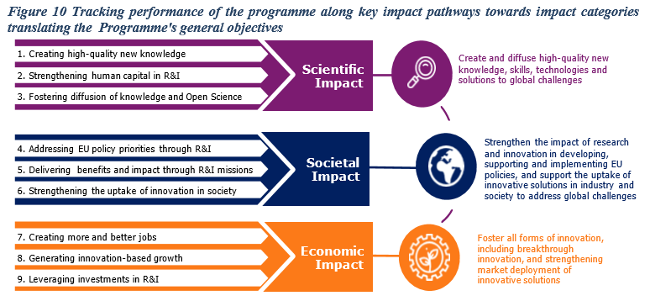
HorizonEurope monitoring/evaluation framework (plans)
3 main building blocks
Annual monitoring of the programme performance:
tracking of performance indicators in the short, medium and longer-term according to key impact pathways towards Programme objectives
Continuous collection of programme management and implementation data
Two fully-fledged (meta)-evaluations of the programme at mid-term and ex-post (upon completion)

Slide 7
KPIs on policy and financial aspects?!?
In the policy and financial areas indicators are:
not straightforward!
hard to define!
The e-IRGSP5 work deals broadly with policy and financial “information”, which may include indicators/KPIs
But what is the end goal?
Policy: Several EU policies need to be evaluated including impact; may shape the e-Infras landscape evolution
Financial: e-Infrastructures need to be competitive (compared to the market services)
Current work outcome is available at:
http://e-irg.eu/documents/10920/340155/eIRGSP5+-+WP4+-+KPI+First+report+ver.2.6.pdf
Disclaimer: Work in progress - deliverable not reviewed yet

Slide 8
Methodology
Other tools/services
GEANT
EOSC-hub (EGI, EUDAT, IndigoData Cloud)
Data
Select/contact representative e-Infra projects and collect existing policy and cost info/KPIs
Computing
OpenAIRE
PRACE
Omnigator
http://kpi.e-irg.eu
Networking
Other
Other
Harmonise, generalise, aggregate -
Recommendations for policy, cost info & KPIs
1. Collect information from projects - Agile approach
Select representative, responsive projects which have KPIs
Other tools/services
From SoA review
Geant Compendium
EGI
Compendium
Data
Existing
Computing
e-FISCAL
Data projects
State of the art review in policy and cost information/KPIs
Networking
Market research
3. Analyse and present
(compare 1 and 2) – Community consultation
4. Make proposal – Recommendations
(with possible examples/values)
RDA/CODATA Groups
2. Review state-of-the-art – Agile approach
e-Infrastructures and market

Slide 9
Track 1- KPI collection from projects
20 e-Infra projects contacted
Contact persons determined
Collected a number of inputs (not from all!)
Set of new projects also contacted
EOSCPilot, EOSC-Hub
http://e-irg.eu/kpi-collection
 | Project name |  | Project name
1 | AARC | 11 | READ
2 | BlueBRIDGE | 12 | SESAMENet
3 | EarthServer2 | 13 | IndigoDataCloud
4 | EDISON | 14 | LEARN
5 | EGI ENGAGE | 15 | MuG
6 | EUDAT2020 | 16 | OpenAIRE
7 | EVER-EST | 17 | OpenDreamKit
8 | GEANT | 18 | OpenMinTed
9 | PRACE | 19 | Phenomenal
10 | RDA EU3 | 20 | VI-SEEM

Slide 10
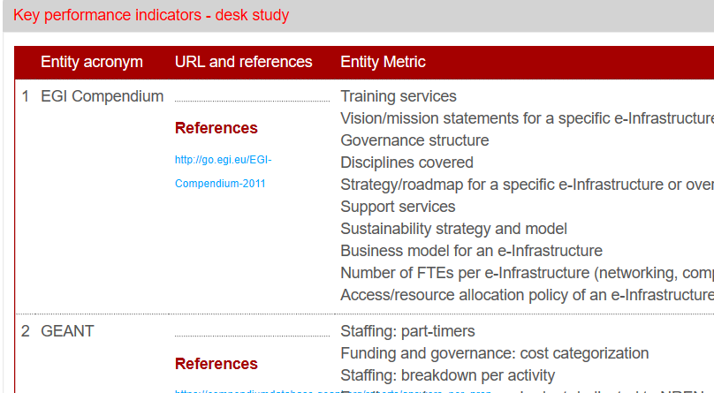
Track 2- Desk research - State of the art
Desk research in:
Policy aspects
Financial aspects
And:
Relevant Information/Metrics/KPIs
http://e-irg.eu/kpi-sota
Geant Compendium
EGI
Compendium
e-FISCAL
Data projects
RDA/CODATA Groups
Market research

Slide 11
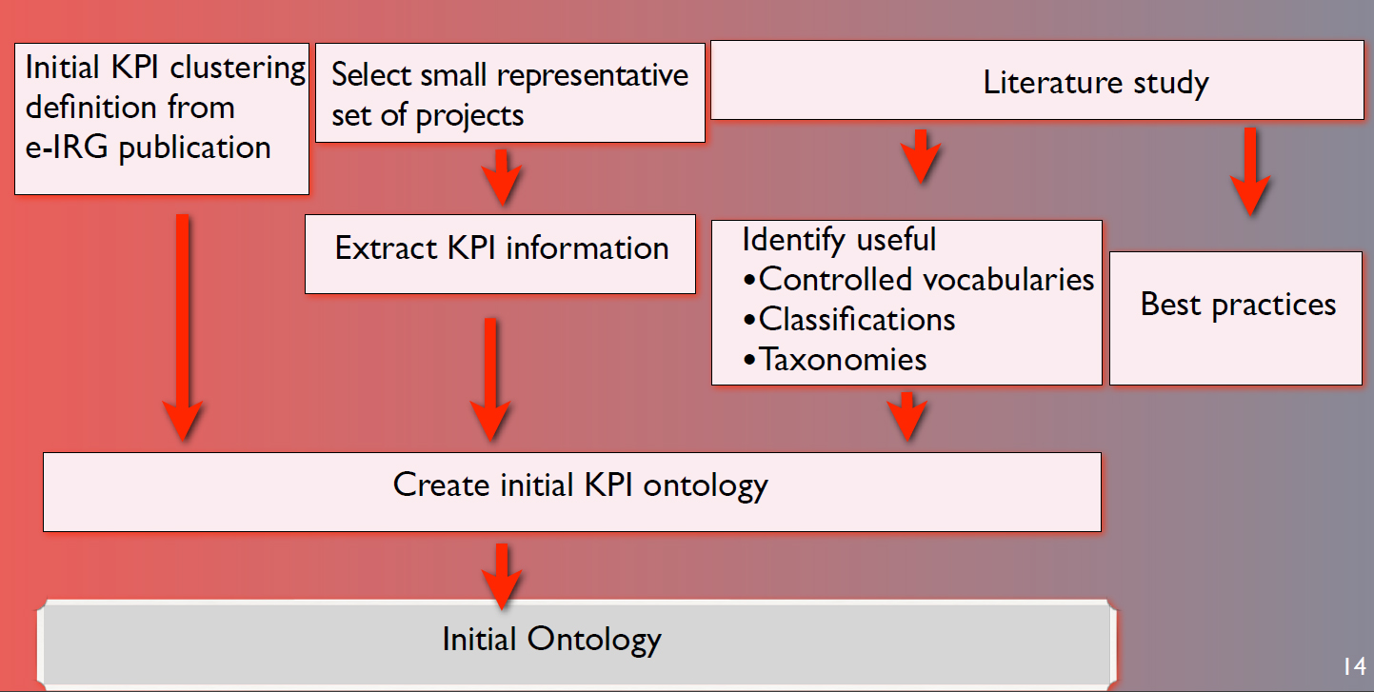
Ontology definition scheme
Ontology encompasses a representation, formal naming, and definition of the categories, properties, and relations between the concepts, data, and entities that substantiate one, many, or all domains*
*Wikipedia

Slide 12
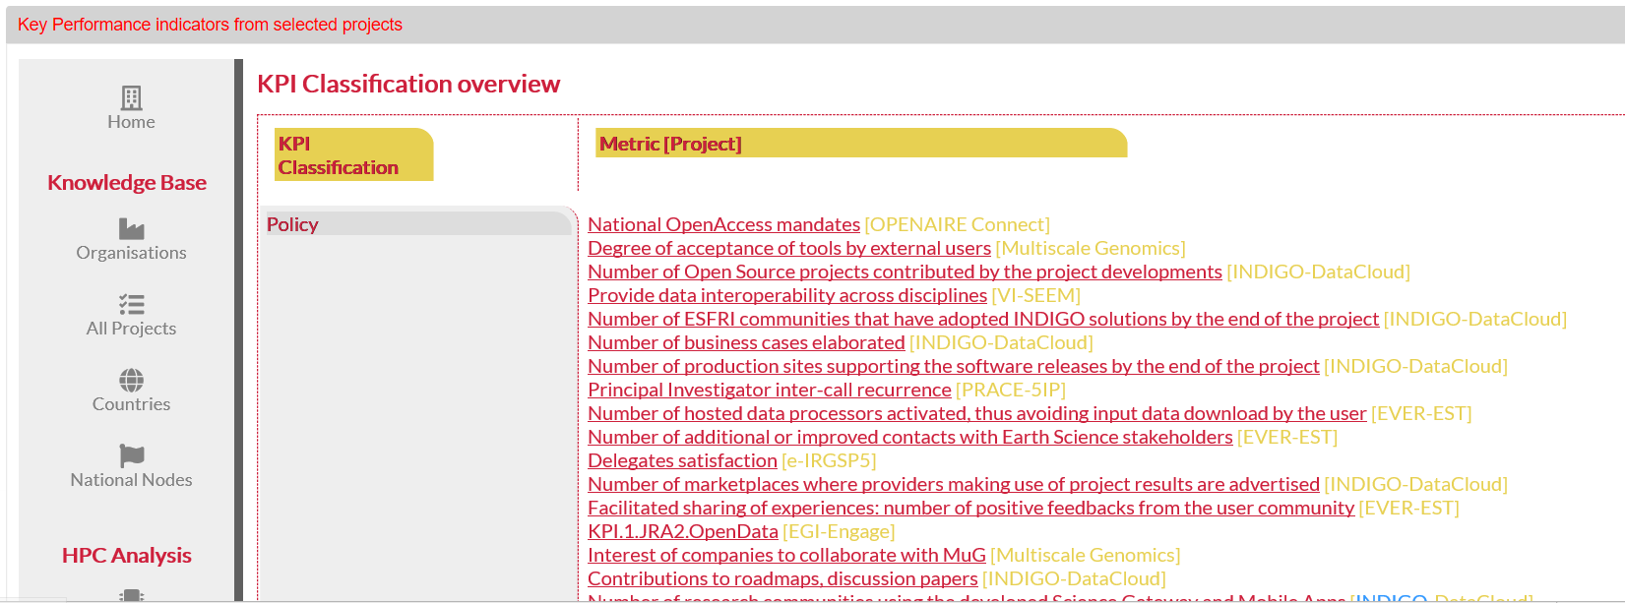
Orchestration - Omnigator
Portal for KPI collection/presentation
Automatic/Manual integration
Collected from projects/Desk Research
Classification(s)
Browsing
..

Slide 13
Metric standard metadata
Example from Track 1 – Collected from project
Similar for Track 2 (tbd)
The two tracks to be harmonised!

Slide 14
Demos of current outputs (work in progress)
Short demo video: https://vimeo.com/294312078
Long demo (20-minutes) video, webinar style: https://vimeo.com/294330433

Slide 15
Initial recommendations
e-Infrastructure projects offering services should be keeping some basic information on both policies and costs; not only on the project itself, but also the whole e-Infrastructure (including national nodes)
e-Infrastructure projects should be keeping their information/metrics/KPIs in a systematic way and be prepared to share it/them with a central entity
A central entity should also keep track of current practices and developments on information / metrics /KPIs in related e-Infrastructure projects and in funders’ policies
e-Infrastructure initiatives should keep track of metrics/KPIs on stakeholder’s satisfaction
The EC, via appropriate support, should put into effect a common process/structure for KPI collection/performance tracking in RI/e-Infrastructure initiatives/projects providing services

Slide 16
Plans for upcoming period
Finalisation of recommended metrics/classification/recommnedations → final deliverable
Review by selected external experts
Updated recommendations
Harmonisation in the omnigator tool
Open consultation of proposed final deliverable
please provide comments already to the first draft!
Try to clarify how this work be taken up

Slide 17
Acknowledgement
This project has received funding from the European Union's Horizon 2020 research and innovation programme under grant agreement No 730954
Thank you
http://e-irgsp5.e-irg.eu

