Slide 1





ELIXIR-GA4GH Compatible Cloud for EOSC
Ania Niewielska, Erik van den Bergh, Gianni Dalla Torre, Jinny Chien, Pau Ruiz Safont, Susheel Varma, Steven Newhouse
Risto Laurikainen, Olli Tourunen, Jaakko Leinonen, Juha Törnroos, Ilkka Lappalainen, Shubham Kapoor, Tommi Nyrönen
Alexander Kanitz, Foivos Gypas, Jaroslaw Surkont, Kevin Sayers, Mihaela Zavolan, Torsten Schwede
Giacinto Donvito, Marco Tangaro, Federico Zambelli
Burkhard Linke, Marius Dieckmann, Alexander Goesmann
DI4R, Lisbon Portugal
10 October 2018

Slide 2

ELIXIR’s mission is to operate a sustainable European infrastructure for biological information, supporting life-science research and its translation to society, the bio-industries, environment and medicine
medicine
agriculture
bioindustries
environment
ELIXIR’s strategy is to connect national bioinformatics centres and EMBL-EBI into a distributed infrastructure build from coordinated national and international data resources, tools and services
Notes:
ELIXIR is a unique undertaking that consolidates Europe’s core bioinformatics resources, services, and national centres into a single, coherent platform.
ELIXIR support international collaboration, decision making and secures long-term sustainability.

Slide 3
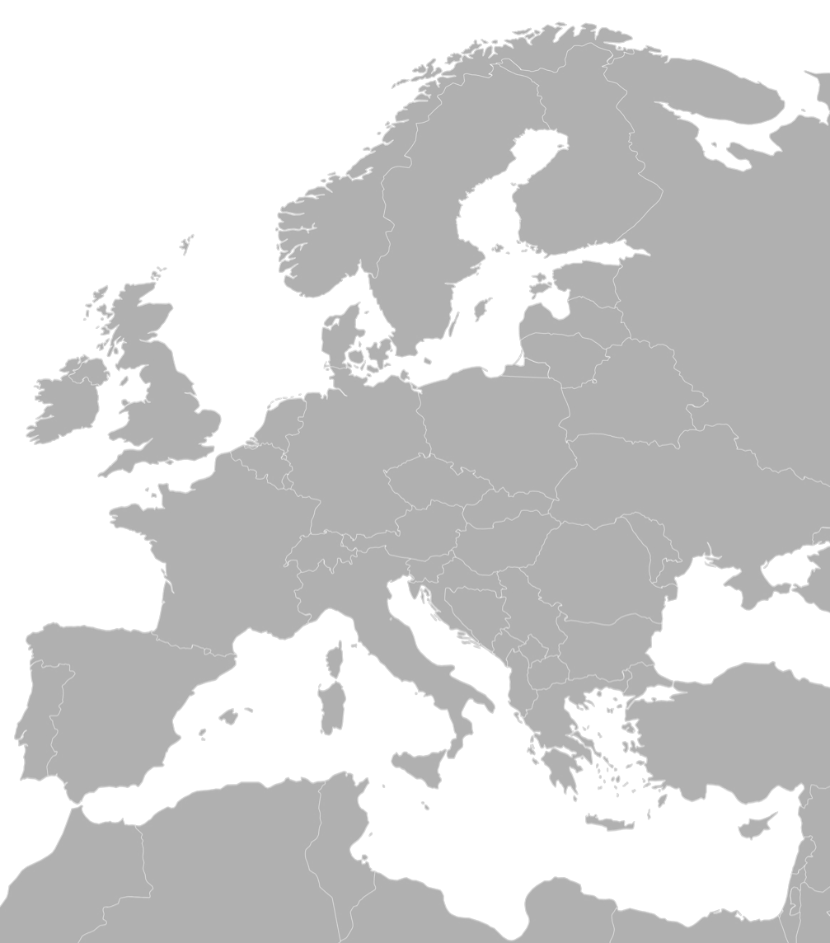












In 2023: Continent-scale, standards-based infrastructure for accessing and analysing life-science data
Compute
Data
Training and Skills
…delivered in partnership with research communities
Tools
Standards
Notes:
First part of build:
ELIXIR is distributed and key part of our remit is to connect and strengthen national infrastructures. The key mechanism for this is our platforms – connect and develop services
We also begin to run stable services for the whole community – foundation infrastructure services – AAI key example but many more are possible.
Harmonisation; this is where the platforms begin to recommend the architecture for data management, cloud deployments etc – Deopistion data bases are the prototype, work ongoing in multiple platforms
Connecting – drive alignment between platforms: strategic investments in key areas + community led implementation studies that focus on the need of an individual communiey
Second part of the build:
ELIXIR Communities : Experts in our nodes + users in the wider community => drive the standards and services needed for a specific life-science field; establish DM practice for this field; look after strateig infrastructure investments for the field (human data is the forerunner here, others are definitely thinkable)

Slide 4
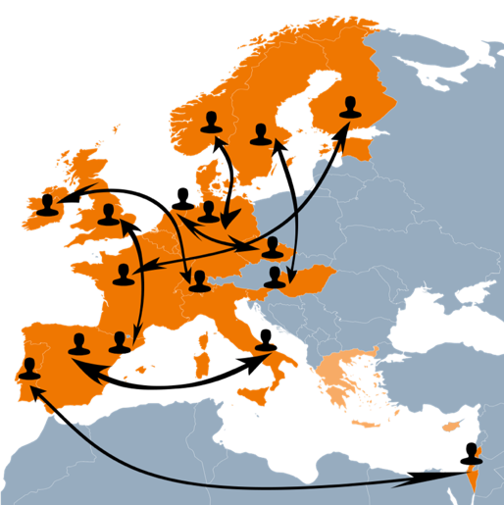

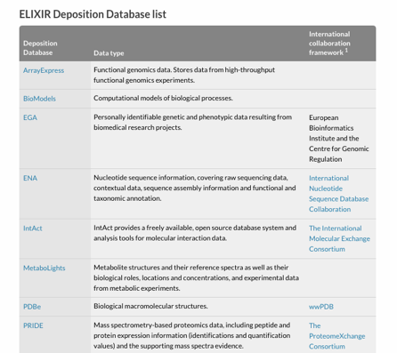
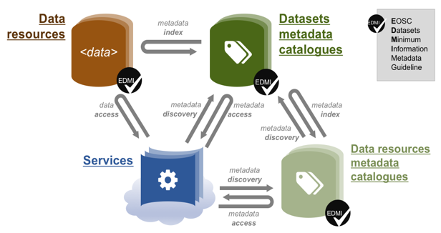


ELIXIR mission and strategy aligns with EOSC – implement life-science foundation in EOSC-Life
FAIR data management in the life sciences 10.7490/f1000research.1114985.1
Gateway for User access and mechanism for exposing life-science services (via ELIXIR Registries)
Compatible Cloud / Workflows / Reference Data Set Distribution Service

Slide 5



Overlap in mission - data sharing
GA4GH
Developing standards for international data sharing
ELIXIR
Adopting and implementing standards focused on European countries
Working towards GA4GH standards, APIs and toolkits to be used throughout ELIXIR Nodes for human data discovery and access
Notes:
Important to do this as a community, including the users
Simplify the way people search for and request access to potentially identifiable data in international and national genomic data resources

Slide 6
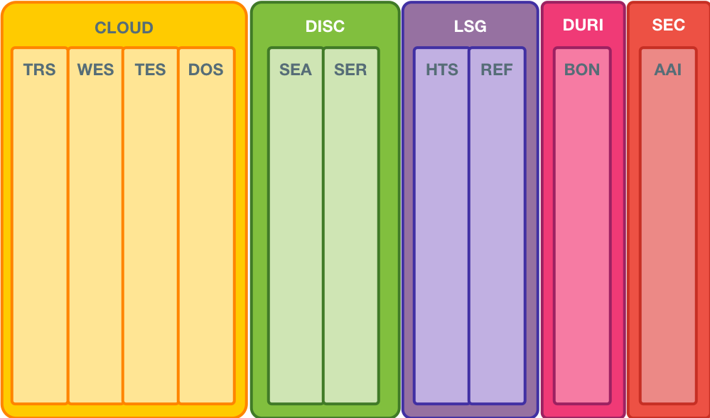
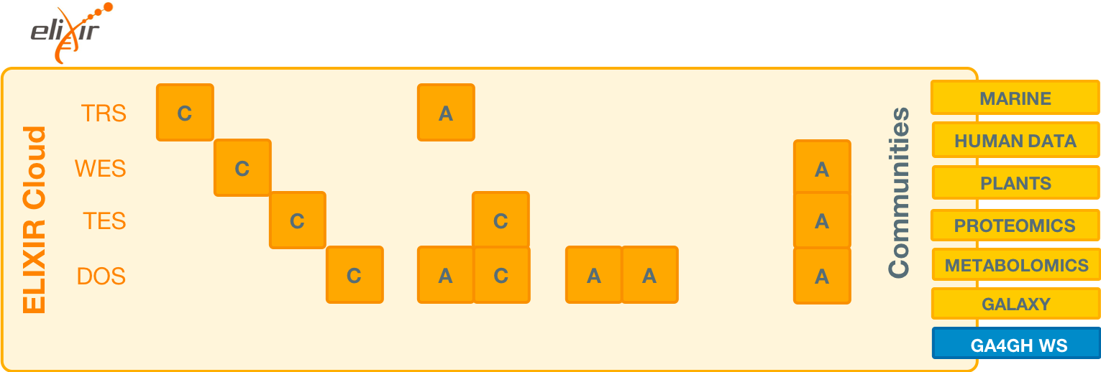
AAI
A
A
A
C
C
C – Contributing (active) A – Adopting (passive)

Slide 7
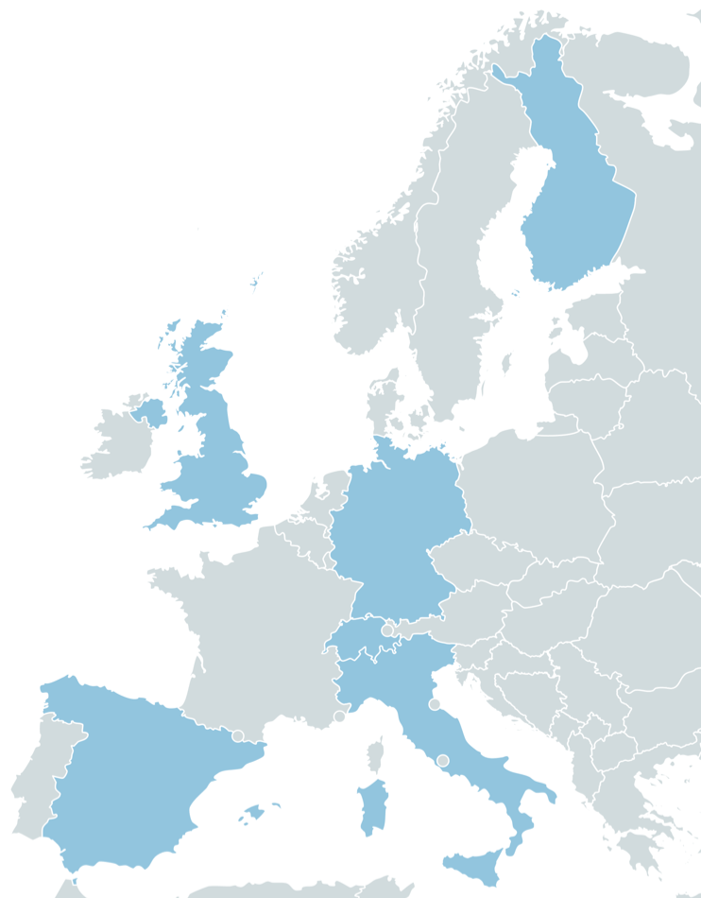
GA4GH Compatible Cloud – ELIXIR Implementation Study
2018-IS-COMPUTE-GA4GH-Compatible-Cloud
Federated execution of GA4GH workflow ecosystem
Operationalise GA4GH Cloud WS Standards
WES – Workflow Execution Service
  Choreographs Execution of Workflow specifications
TES – Task Execution Service
  Orchestrates staging in/out of data and execution of tasks
TRS – Tool Registry Service
  Verified and validated tool registry
  Using Biocontainers.pro 2.0

Slide 8




ELIXIR - GA4GH Compatible Cloud Ecosystem
Tool Registry Service
Workflow Execution Service
Task Execution Service
Data Object Service
TRS
WES
TES
DOS
Biocontainers
WES-ELIXIR
TESK
RDSDS
AAI
ELIXIR TOOLS
ELIXIR COMPUTE

Slide 9
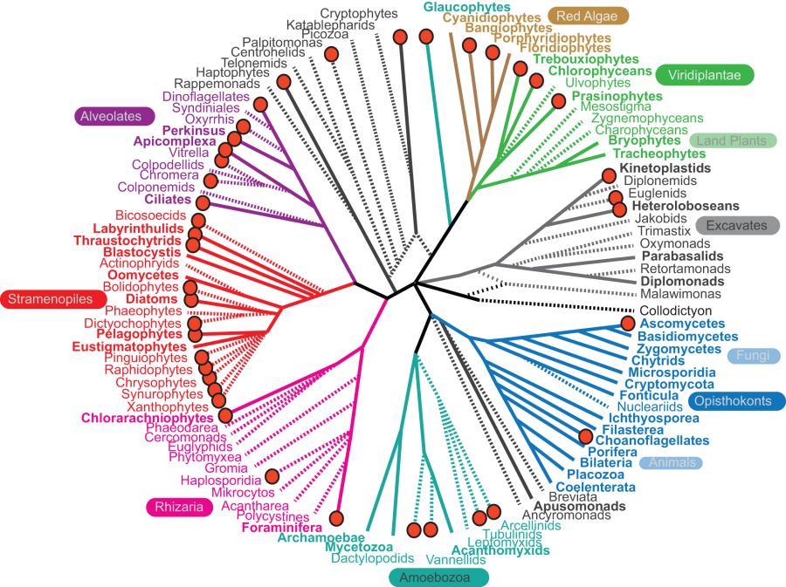
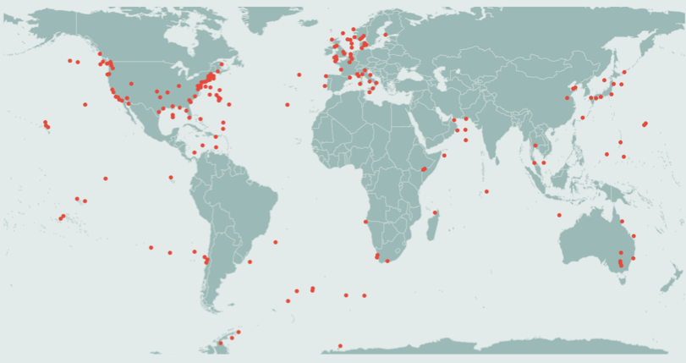
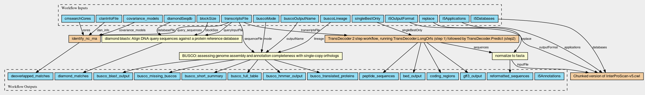
Marine Microbial Eukaryote Transcriptome Sequencing Project (MMETSP)
2018-IS-Interop-CWL
Pipeline for the assembly and annotation of marine eukaryotic transcriptome
Datasets: Tara Ocean and MMETSP
Goal is to develop and deploy CWL workflows to multiple environments
  ELIXIR GA4GH Compatible Platform (WES - TES)
  ELIXIR Galaxy Community (usegalaxy.eu)
Current focus on:
  Containerisation of the assembly and annotation pipelines
  Galaxy – CWL Interoperability
Ready for multi-site CWL execution

Slide 10
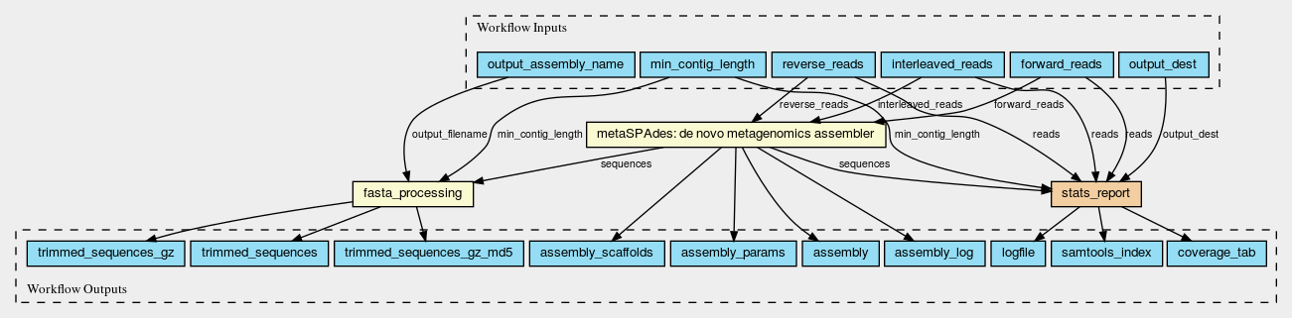
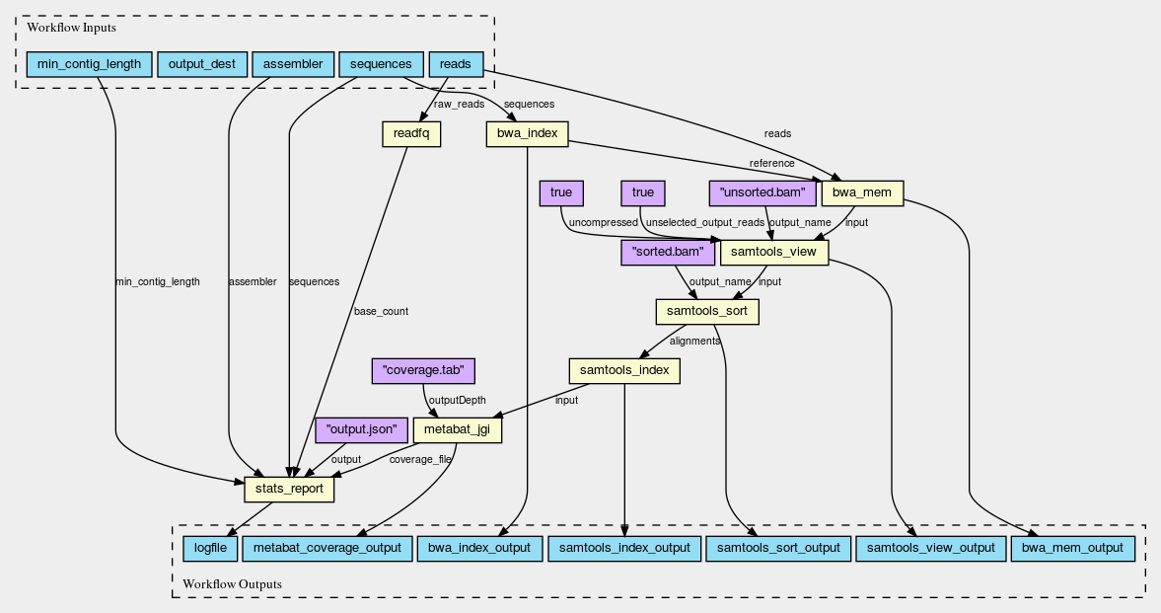
Marine Metagenomics (MMG) Workflow

Slide 11
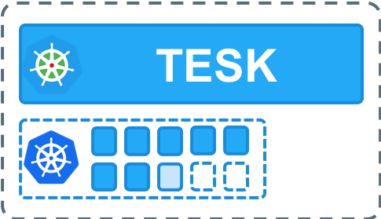
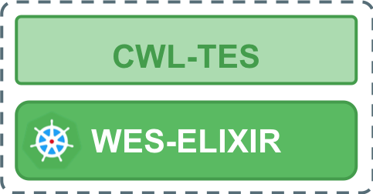
ELIXIR Cloud Analysis Platform – Current Status
ELIXIR-FI (Rahti)
AuthZ
TESK
ELIXIR-IT
AuthN
CWL-TES
ELIXIR-DE
WES-ELIXIR
TESK
ELIXIR-CH & CSC (cPouta)
FTP
ELIXIR-CH
Biocontainers 2.0
EMBL-EBI (Embassy)
Embassy
cloud

Slide 12
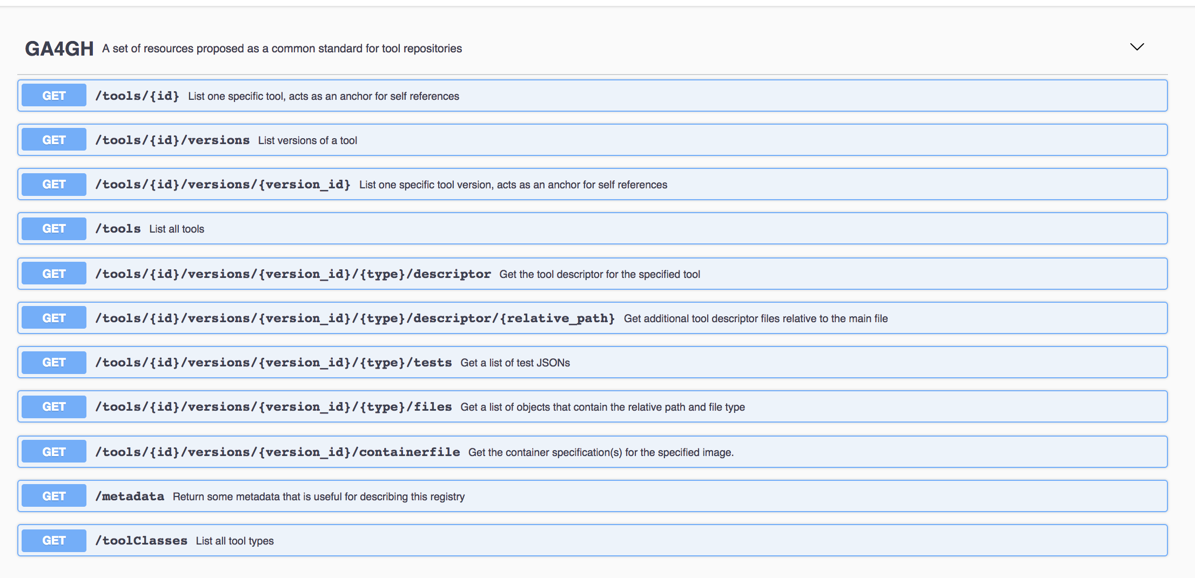
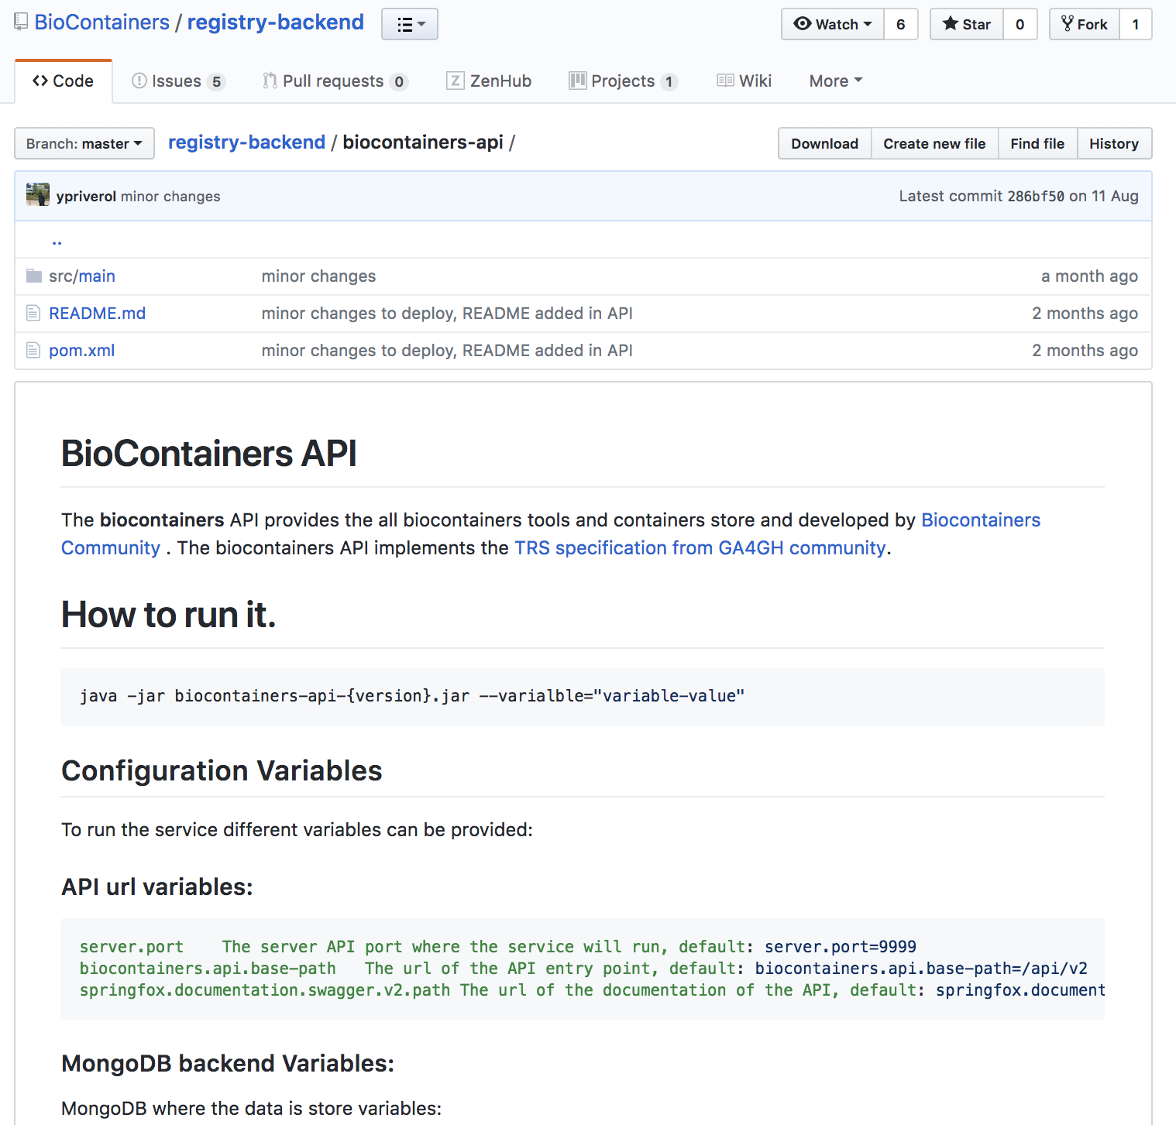
GA4GH-ELIXIR TRS Services (2018-IS-Tools-Biocontainers 2.0)

Slide 13
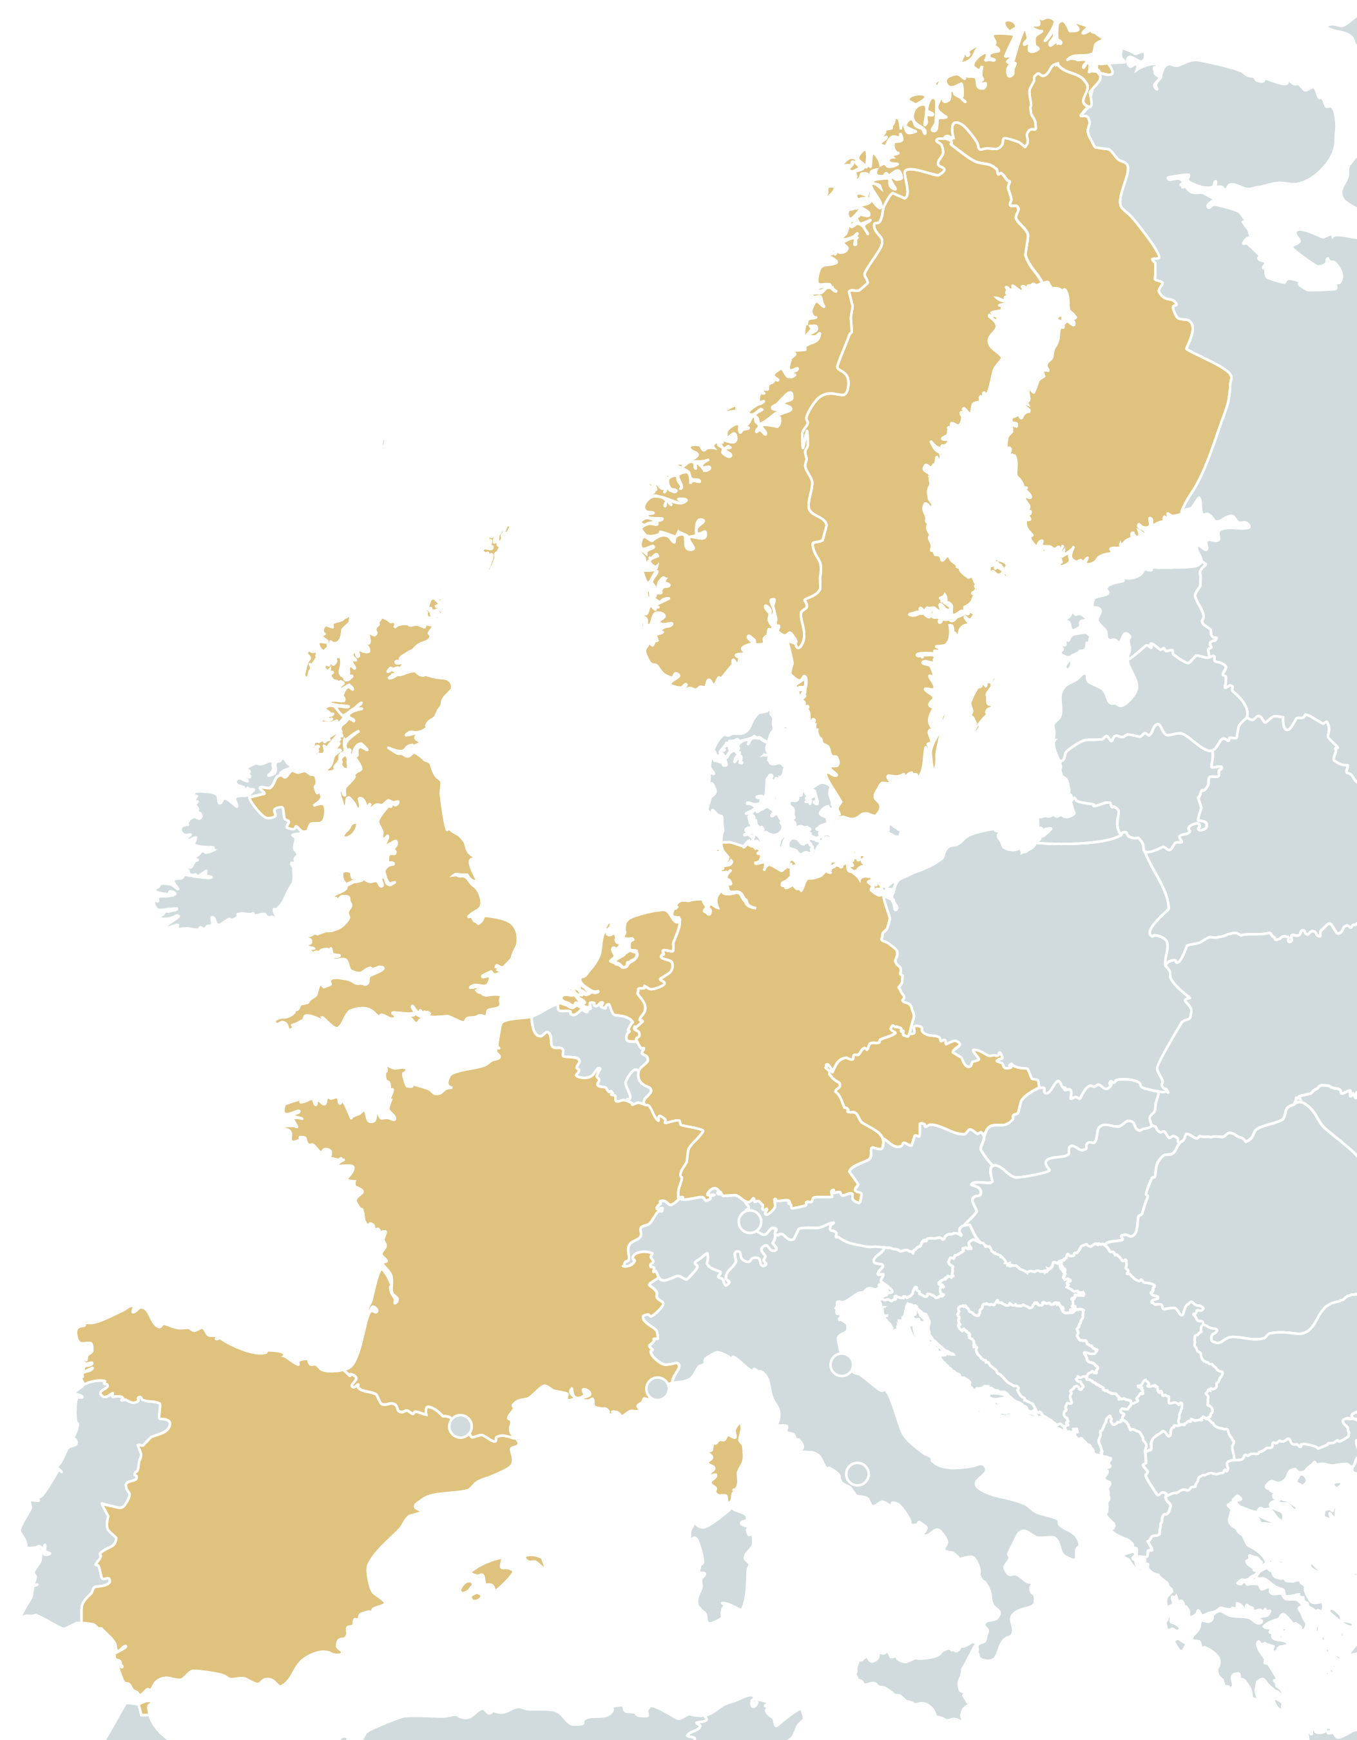

Reference Data Set Distribution Service (RDSDS)
Developed as part of EOSC-Hub
RDSDS – Data Distribution Network
Provides a centralised Dataset registry, management and distribution
Integrated with ELIXIR AAI for AuthN-Z
Supports HTTP, FTP, GSIFTP, S3, FTS3 and Globus Connect*
Plans to decentralise and upgrade to content-based dataset identifiers
Virtual Dataset sidecar container for local data cache (Q4 2018)

Slide 14
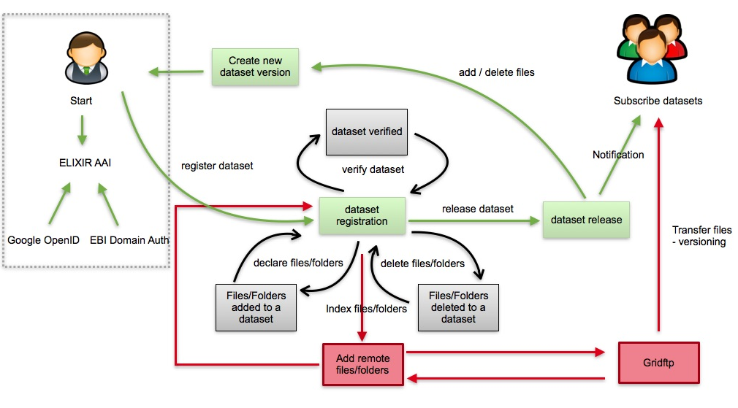
RDSDS Dataset Management Lifecycle

Slide 15
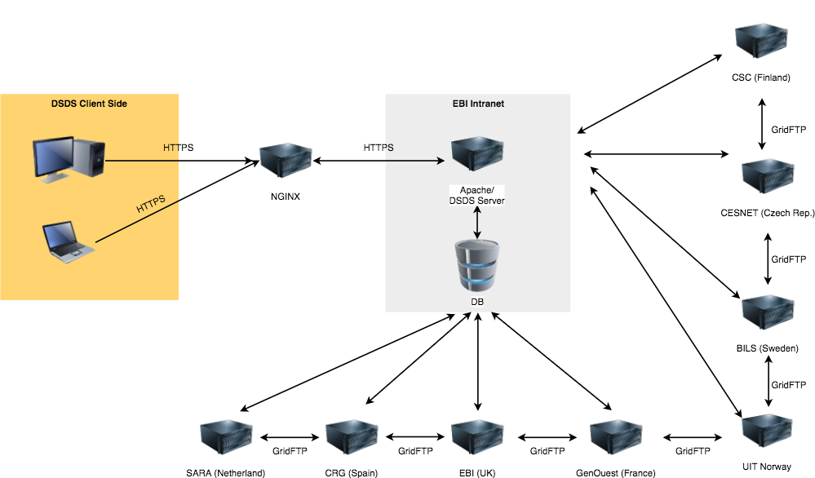
RDSDS Architecture

Slide 16
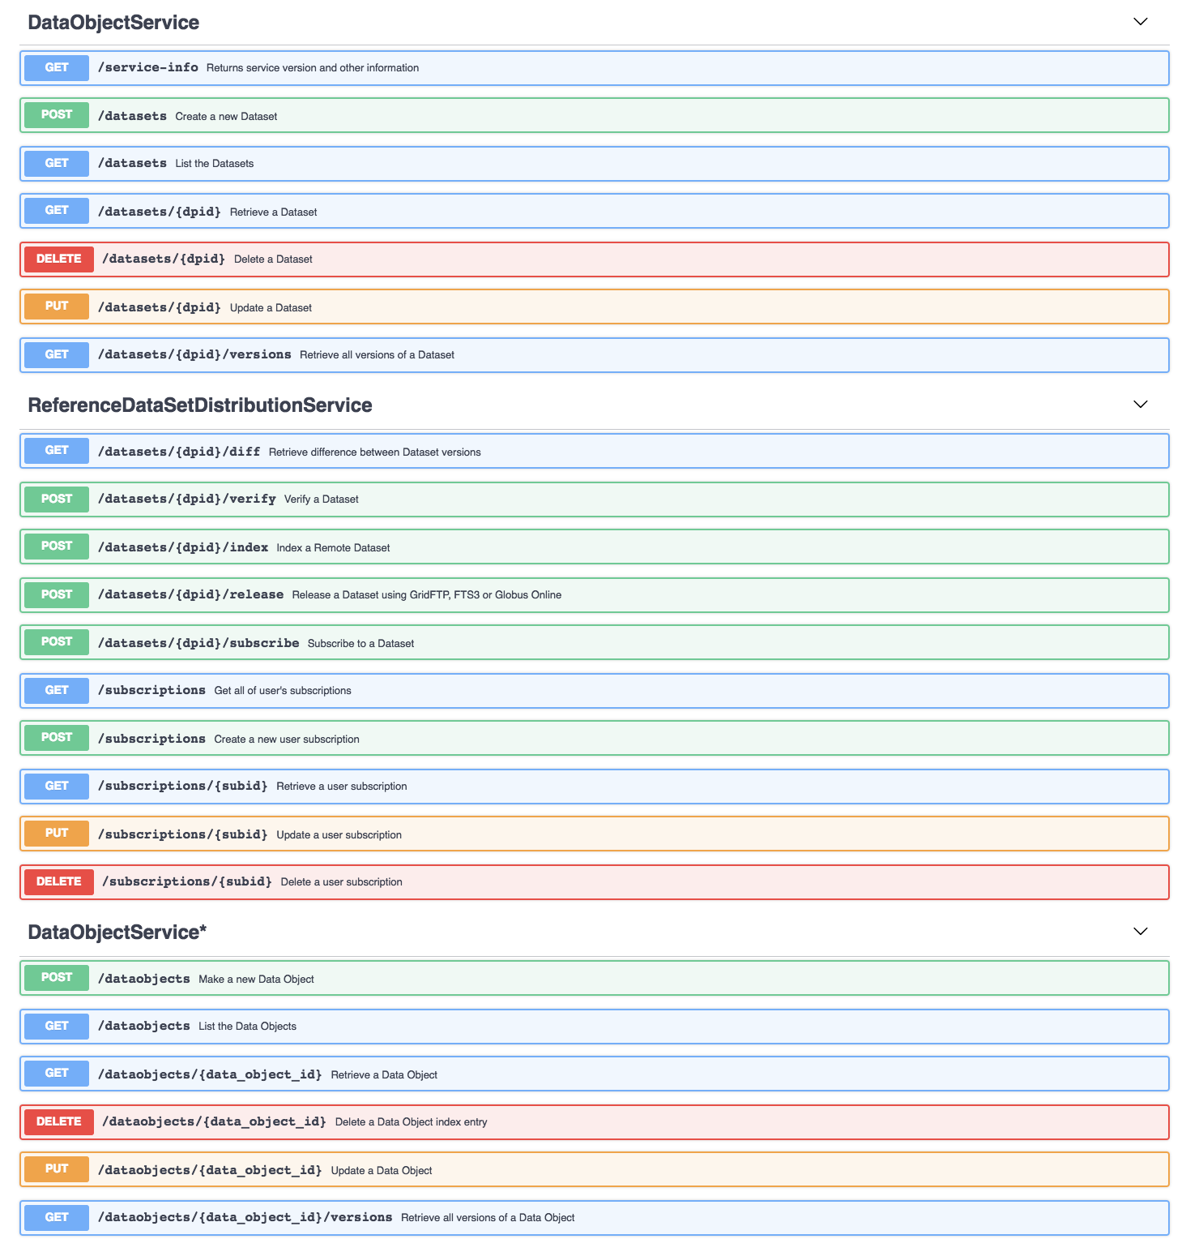
Upgrading RDSDS --> GA4GH DOS 0.3.1 Compatibility
Ref Dataset Distribution Service
WIP –DOS Compatibility API
Support for:
  Databundles → Datasets
WIP for:
  Dataobjects → Files
Std Development:
  Data Transfers
  Data Lifecyle Mgmt.
  Subscriptions
2017-Data-Movement
  EUDAT 2020
  EOSC-Hub

Slide 17
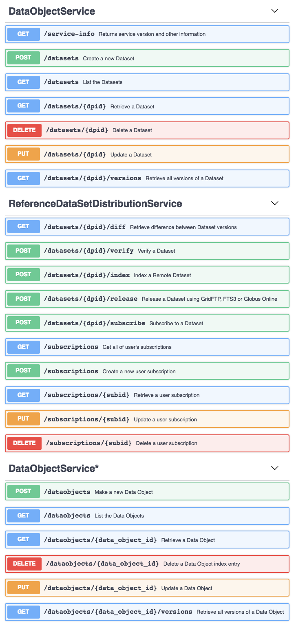
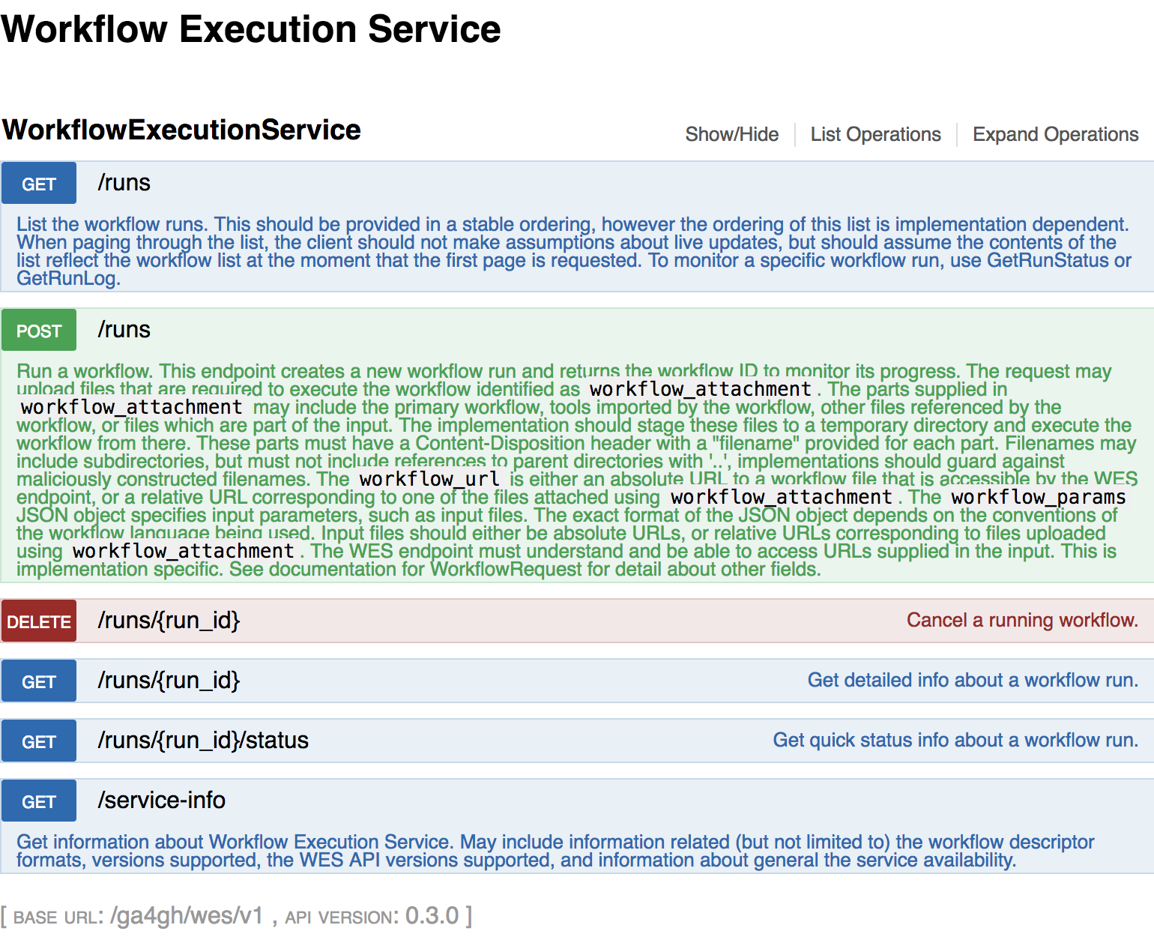
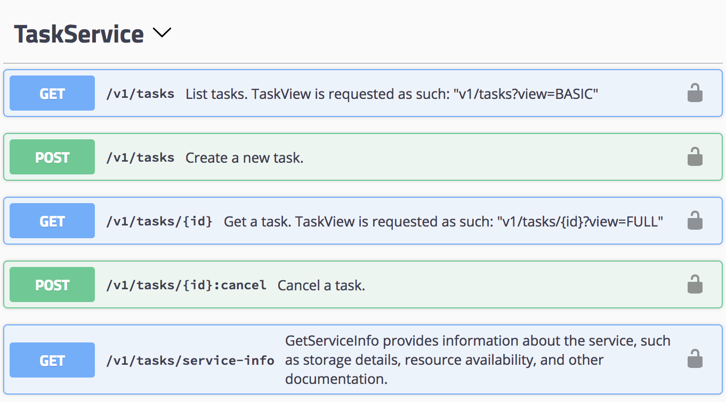
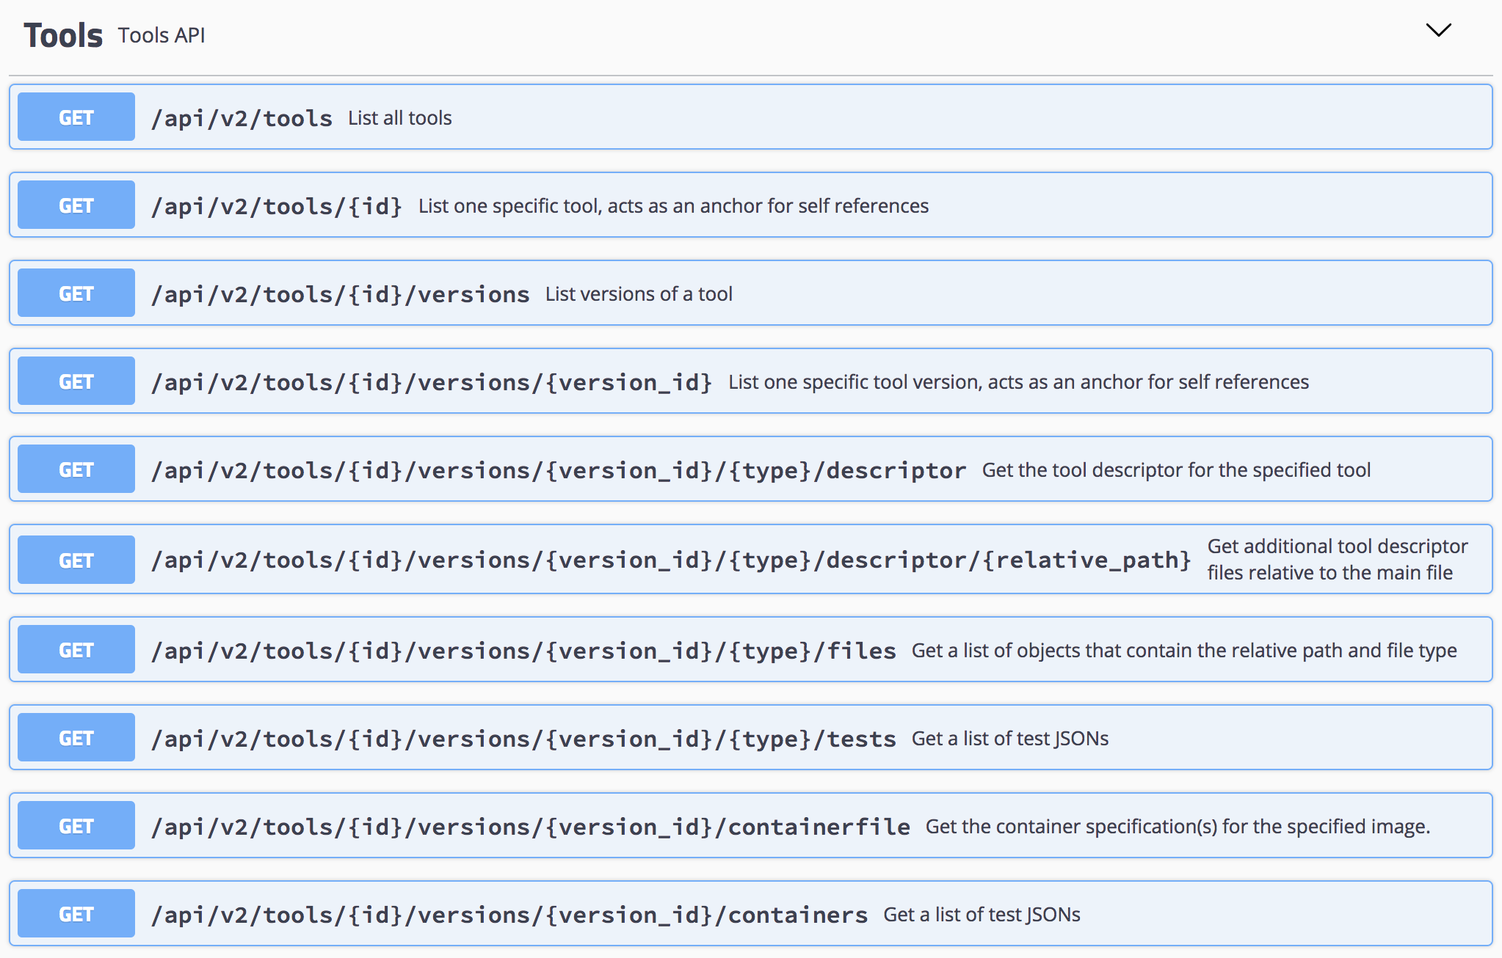
ELIXIR-GA4GH Compatible Cloud Ecosystem
DOS
TES
TRS
WES
Biocontainers 2.0
6000+ tools
MMG & MMETSP wfs
Std development
http://api.biocontainers.pro/swagger-ui.html#/Tools
WES-ELIXIR
Refactored Kirini [Prototype]
Support for TES Backend
ELIXIR AAI Integration
CWL-TES integration
[WIP] Cromwell & Nextflow*
http://193.167.189.73:7777/ga4gh/wes/v1/ui/
TESK
Wrapper around K8s
ELIXIR AAI
[WIP] ResUtil dev
EOSC Deploy. & AAI
https://tesk.c01.k8s-popup.csc.fi
https://tes.tsi.ebi.ac.uk
http://cloud-90-147-75-83.cloud.ba.infn.it:8080/
RDSDS
[WIP] DOS Compatibility Wrapper API
https://dsds-service.ebi.ac.uk

Slide 18
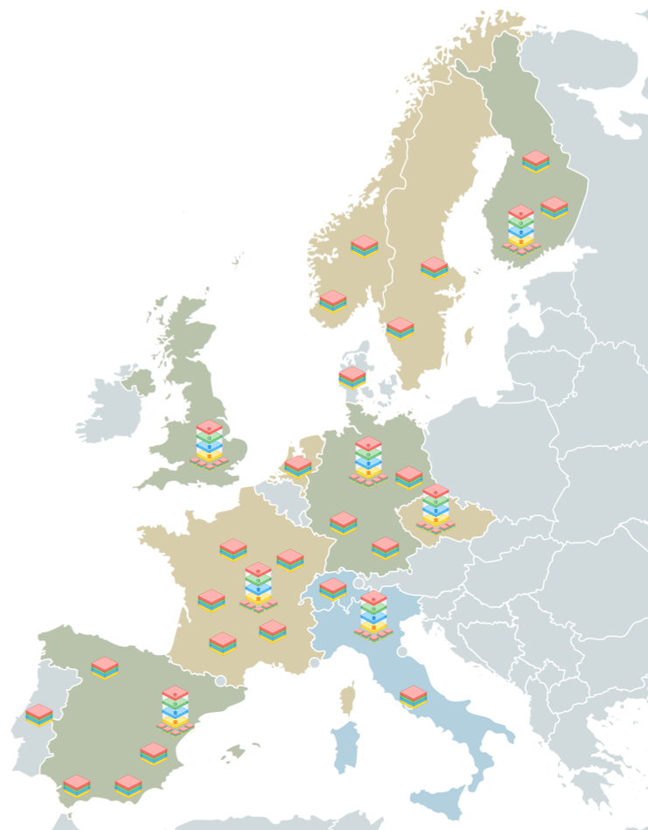
ELIXIR Compute Platform for EOSC-Hub & EOSC-Life
Integrate user federation into local compute and data deployments - ELIXIR AAI
Rationalise a ELIXIR-wide Data Distribution Network – starting with Reference datasets ~ RDSDS
Drive ELIXIR Compute Platform support to Nodes to develop hybrid cloud/HPC deployments
Develop Task Distribution Network using Task orchestration engines – e.g. Kubernetes ~ TES
Support national or regional Workflow Choreography Engines – e.g. CWL-TES, Cromwell, Nextflow, Galaxy, etc. ~ WES

Slide 19




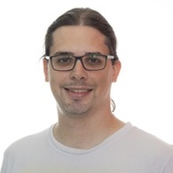

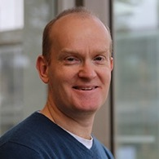


2018-GA4GH-CC Imp. Study Team
ELIXIR-FI
EMBL-EBI
ELIXIR-DE
ELIXIR-CH
ELIXIR-IT

Slide 20


Thank you
Contributions welcome!!
Find us on Github:
EMBL-EBI-TSI/TESK
ELIXIR-EUROPE/WES-ELIXIR
Join us at the
BioHackathon
Nov 12-16 @ Paris
https://bh2018paris.info/

Slide 21
DEMO Slides

Slide 22


A GA4GH workflow
Workflow Execution Service
Task Execution Service
WES
TES
Workflows
Data
Metadata
TRS
DOS
Tool Repository Service
Data Object Service
Client

Slide 23



Current state of integration
Workflow Execution Service
Task Execution Service
ELIXIR AAI token protected
WES-
ELIXIR
cwl-
tes
TESK
CWL
Data
Metadata
GitHub
FTP
Tool Repository Service
Data Object Service
Swagger

Slide 24





WES-ELIXIR
Choreography of workflow runs
Compliant with current WES specs (v0.3) →
Lean service designed to work with TES
Support for CWL via cwl-tes, cwltool and py-tes packages
Python Flask microservice with
  “Modelless” API rendering by Zalando Connexion and Swagger/OpenAPI
  MongoDB database
  Background execution of cwl-tes via Celery/RabbitMQ
  Containerized deployment via Docker

Slide 25
TESK
Orchestration of task executions
Simple stateless wrapper around Kubernetes
TESK API creates k8s job per task
TaskMaster - orchestrates task execution
Filer - stages input/output files to PVC
TESK polls k8s API for execution status
Implemented using
  Spring Boot
  Python
  Kubernetes

Slide 26

Status / Outlook
WES-ELIXIR instance at
  CSC, Helsinki http://193.167.189.73:7777/ga4gh/wes/v1/ui/
  Re-factoring to prepare for support of WDL, Nextflow, ...
  Production-ready version planned for end of 2018
TESK instances at
  EBI, Hinxton: https://tes.tsi.ebi.ac.uk/
  CSC, Helsinki: https://tesk.c01.k8s-popup.csc.fi/
  Indigo-DataCloud: http://cloud-90-147-75-83.cloud.ba.infn.it:8080/swagger-ui.html
  Biozentrum Basel: under development!
Integration with GA4GH TRS & DOS
  TRS: BioContainers
  DOS: RDSDS
Prototype!

