Slide 1
OpenAIRE Open Science Publishing for Research Infrastructures: the EPOS use-case
Paolo Manghi, Michele Manunta, Miriam Baglioni, Alessia Bardi, Francesco Casu, Claudio De Luca,

Slide 2
Open Science publishing: principles and waivers
Research Infrastructures
Scholarly Communication Infrastructure
Publishing packages of products to enable reproducibility
Publishing an up-to-date record of research products metadata and links
Publishing of all kinds of research products and semantic links in between
Research literature:
Articles, docs, white papers
Enabling reproducibility
Research
data
01101010
01100001
11010010
e-infra Tools &
Services
Research
data
Enabling transparent
evaluation
01101010
01100001
11010010
Open Science
Publishing
Enabling omni-comprehensive scientific reward
Research
Software
Scientific process
Notes:
Highlight difference between citation and other kinds of relationships

Slide 3
Barriers
Research communities lack culture on Open Science publishing
Focus (funding) is not on scholarly communication practices
Lack of tools for Open Science publishing in Research Infrastructures

Slide 4
OpenAIRE Research Community Dashboard
Share
Link
all your research results: publications, data, software, methods, etc.
all your research effectively
Gather
Monitor and report
all your research results in one place
your community’s progress and impact
A virtual environment to implement Open Science publishing practices

Slide 5
OpenAIRE Research Community Dashboard
Research
Community/Infrastructure
Manager
Request
Dashboard
for Community
Research Community Service
fund
01101010
01100001
11010010
01101010
01100001
11010010
01101010
01100001
11010010
fund
01101010
01100001
11010010
01101010
01100001
11010010
De-duplicate
Inference
Harvest
Harmonize
Repositories of publications, datasets, projects, software, packages …

Slide 6
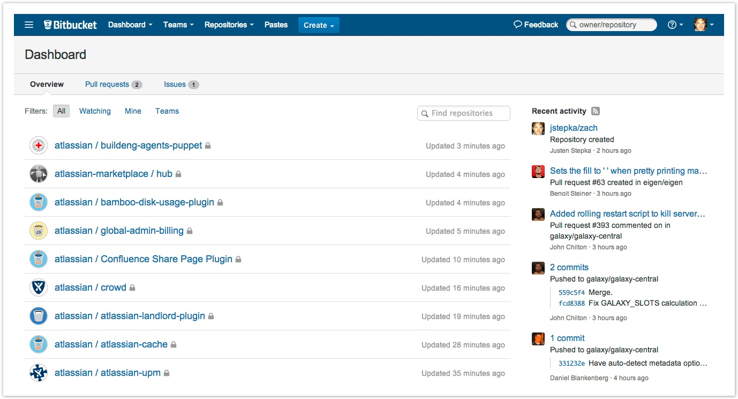
OpenAIRE Research Community Dashboard
Research
Community/Infrastructure
Manager
Authorized Services
Researchers
Manage users
Configure statistics
Configure inference criteria
Deposit (DOI)
Link
Research Community Service
fund
01101010
01100001
11010010
01101010
01100001
11010010
01101010
01100001
11010010
fund
01101010
01100001
11010010
01101010
01100001
11010010
Deduplicate
Inference
Harvest
Harmonize
Repositories of publications, datasets, projects, software, packages …

Slide 7
The EPOS use case

Slide 8
A pan-European distributed Research Infrastructure for solid Earth Science
Integration of National Research Infrastructures, their data, software and services
CNR-IREA: EPOS service provider
Satellite Earth Observation services

Slide 9
EPOSAR and GEP
EPOSAR provided by CNR-IREA
On-demand execution of P-SBAS algorithm (Parallel Small Baseline Subset) for the generation of surface deformation time series and velocity maps, useful to model, for example, the source mechanism of an earthquake
GEP provided by ESA
Geohazards Exploitation Platform that offers scalable and parallel processing/analysis tools over pre-loaded satellite big datasets
EPOSAR is one of the applications integrated in GEP and served as-a-service

Slide 10
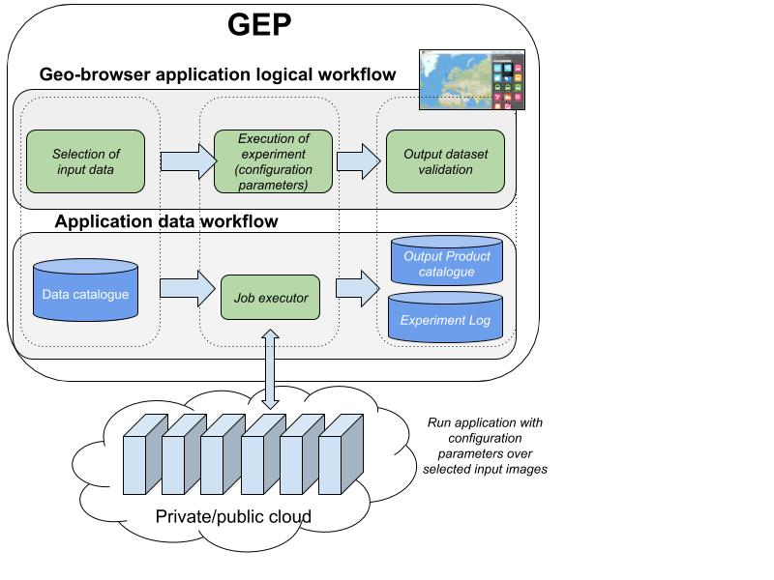
Scientific workflows in GEP
No best practices on deposition
No best practices on citation
Low degree of FAIR-ness and reproducibility
Provenance of datasets not shared
Experiments not shared
Satellite image selection via a geo-spatial browser e.g. images of old ESA missions and from the Copernicus Programme repository
Data typically embedded in the article as image or table
Outputs generated by algorithm (maps and time series)
History of executions kept by GEP (provenance and reproducibility)

Slide 11
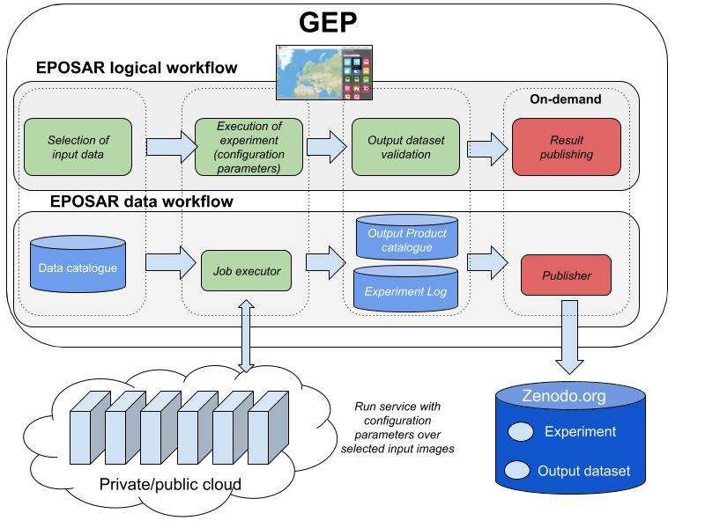
The EPOSAR workflow integrated with OpenAIRE RCD
User activates the on-demand publishing workflow
Fetch experiment and dataset information, repackage them for Zenodo deposition.
Publisher component performs the deposition on behalf of the user
Notes:
Add Open Science publishing capabilities
On demand publishing workflow

Slide 12
Conclusion
On demand Open Science publishing
Delegate RI services to publish on behalf of the user
The user decides when the experiment is mature
The RI service collects the information (data and metadata) needed for publishing and ask the scientist for what is missing
E.g. GEP has not the complete list of scientists working on the experiment, licenses and access rights
Implementation planned to be completed in 2019
All other GEP applications may use the on demand OS publishing workflow

