Slide 1
West-life – services and tools for structural biology
Tomáš Kulhánek, Chris Morris, Martyn Winn
STFC Daresbury Laboratory
DI4R, Lisbon, Portugal, 9-11 Oct 2018

Slide 2
Structural biology
Integrative structural biology
Computational structural biology

Slide 3
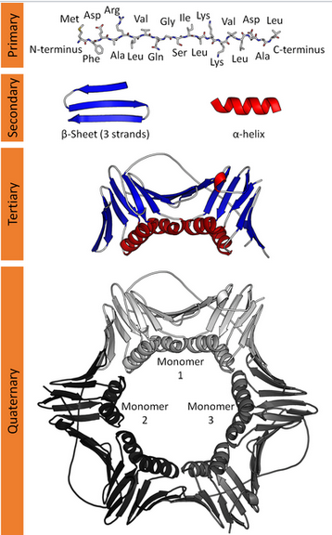
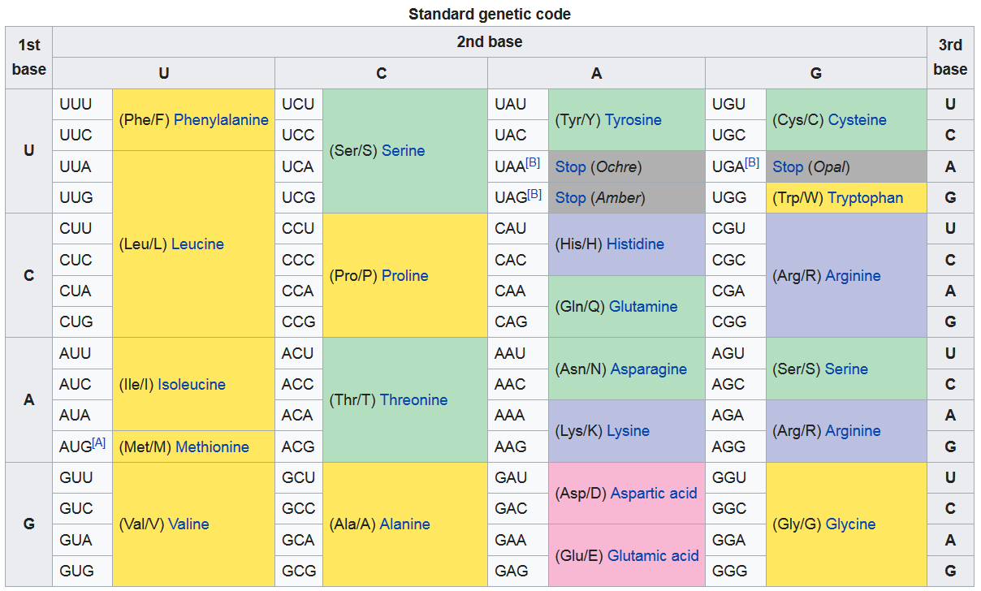
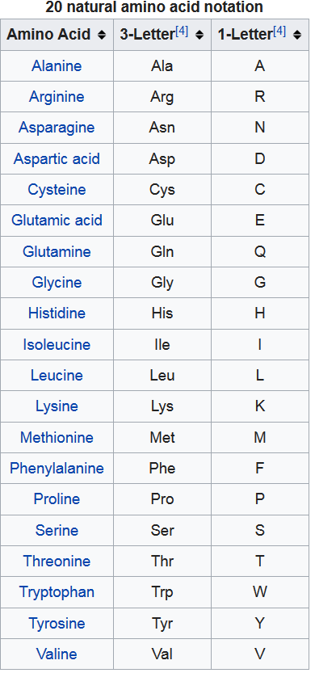
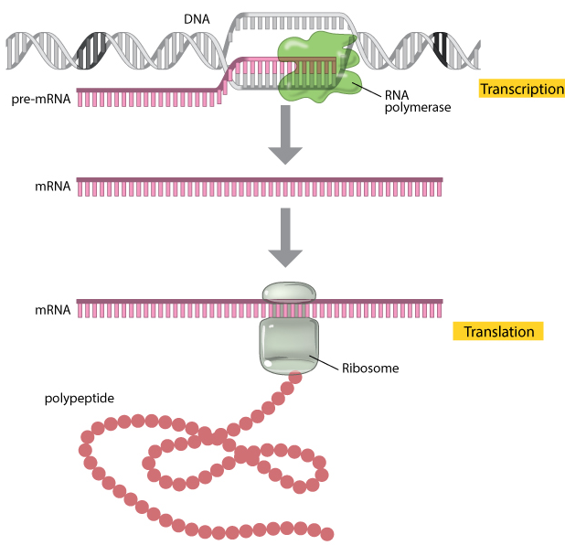
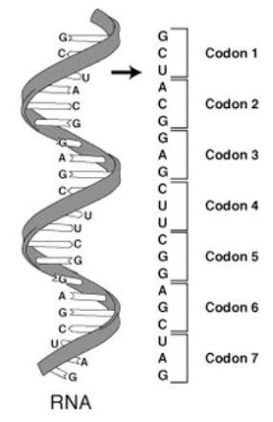
Structural biology
Study the structure of macromolecules

Slide 4
Why to now structure
Science
Structural knowledge:
Design of drugs
the structures of the small molecule inhibitor STI-751 (Gleevec®/Imatinib) bound to Abl kinase to treat chronic myelogenous leukemia
Design of vaccines
The knowledge of the structural properties of the antigen from many variants of Meningococcus B allowed the design of a chimera antigen
Structural Vaccinology

Slide 5
Reveal the structure at 0.1 nm=1Å
Direct observation:
Optical microscope – 200 nm
X-Ray microscope – 10 nm
Gamma Ray microscope ?
Electron microscope 10 – 0.5 nm - …
Indirect observation:
X-ray crystallography
NMR
Mass Spectrometry, Small angle scattering, …

Slide 6
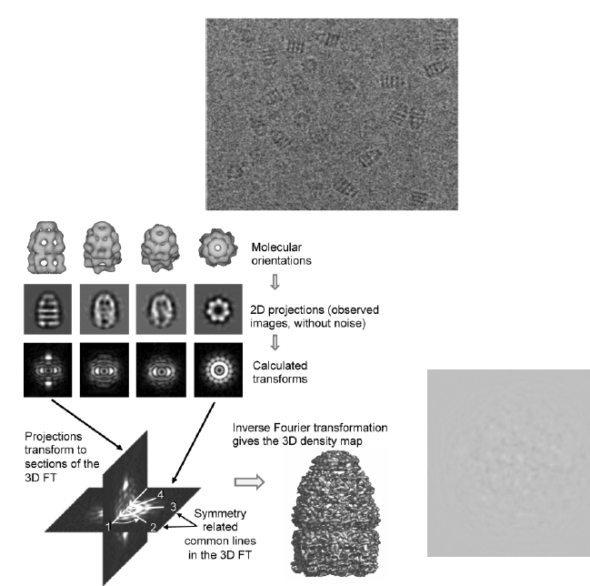
Cryo electron microscopy
Transmission electron microscopy
Sample is vitrified in liquid ethane
Images noisy 2D projections
Class averages are constructed for each orientation
Ultimately results in 3D density maps

Slide 8
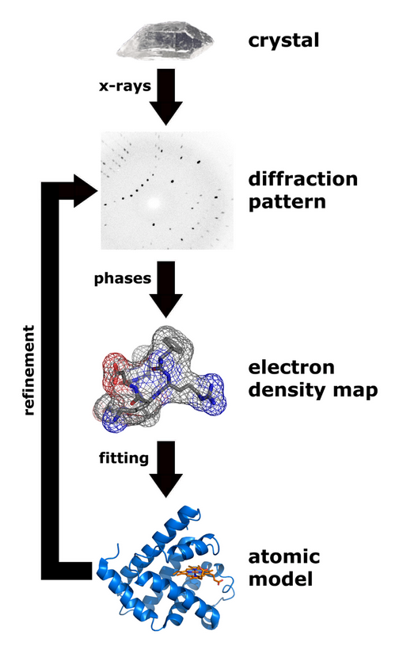
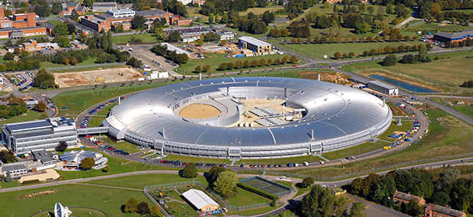
Crystallography
X-ray crystallography
X-beam produced in synchrotron

Slide 9
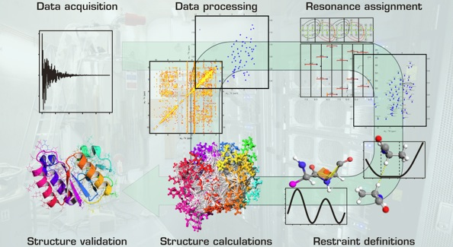
Nuclear Magnetic Resonance

Slide 10
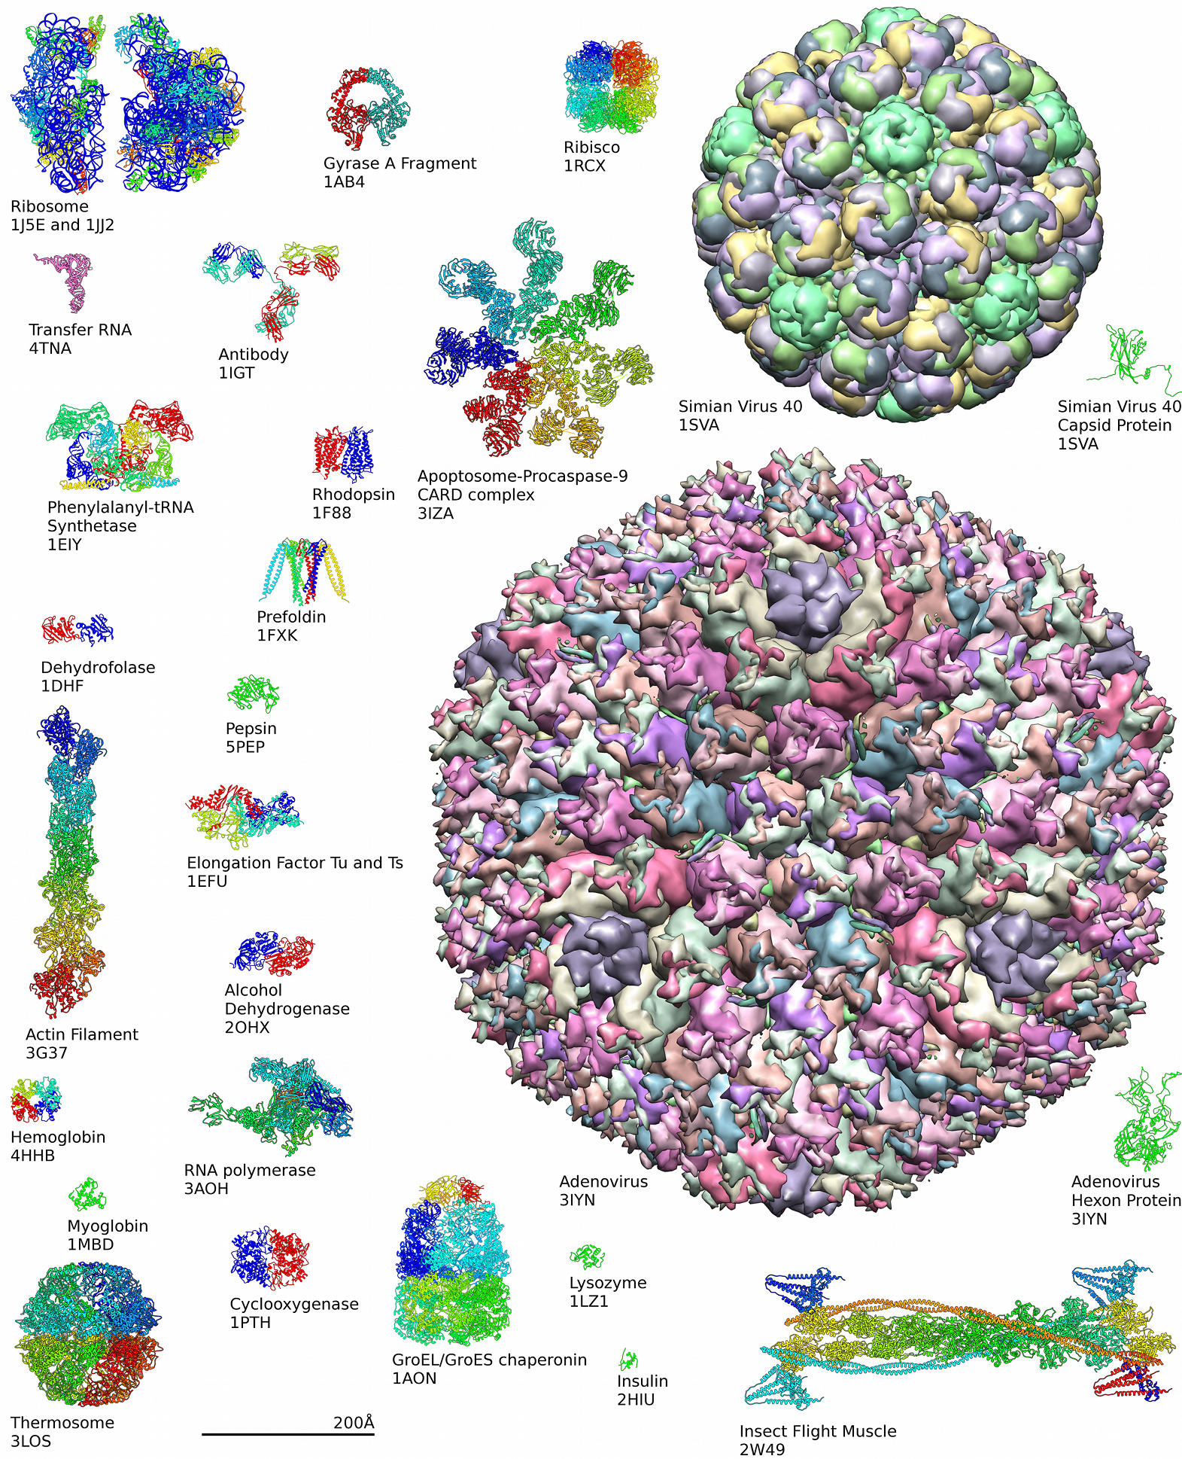
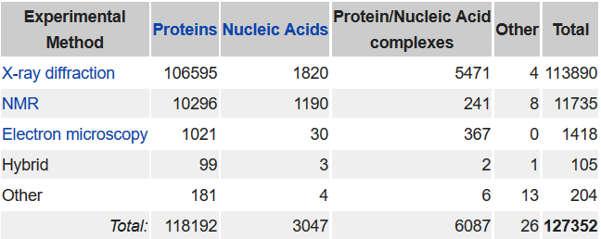
Databases
Protein Database – PDB (www.pdbe.org)
Uniprot (uniprot.org) - resource of protein sequence and functional information
EMDataBank – cryoEM raw data database, …
Zenodo – general db for scientific datasets

Slide 11
West-Life
Hybrid techniques – new challenge to software developers
Instruct - ESFRI Research Infrastructure for integrated structural biology in Europe -
H2020 Virtual Research Environment project (2015-2018)
To cope the complexity of integrative approach
To provide the application level services specific to uses cases in structural biology, covering all experimental techniques (e.g. Xray, cryo-EM, NMR, SAXS),
enabling structural biologists to get the benefit of the generic services developed by EUDAT and the EGI.
10 partners: STFC (UK), Instruct (UK), NKI (NL), LUNA (FR), Utrecht University (NL), CIRMMP (IT), INFN (IT), EMBL, Masaryk University in Brno(CZ), CSIC (ES)

Slide 12
West-Life
Simplify integration of existing software tools and methods - X-Ray crystallography (CCP4), NMR (CCPN, WeNMR), Cryo-EM (CCPEM, Scipion), SAXS, SANS, Mass Spectrometry, …
Shared data management - Virtual Folder – access to scattered data storage providers and public databases (PDB,Uniprot)
Follow&collaborate other generic research infrastructures
Single Sign On solutions – West-Life SSO

Slide 13
Data management Virtual Folder – access to scattered data

Slide 14
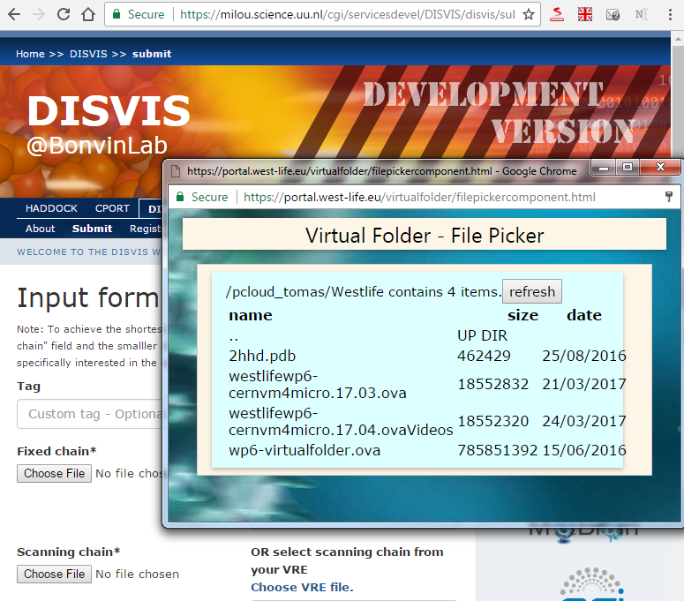
Integration with web based tools

Slide 15
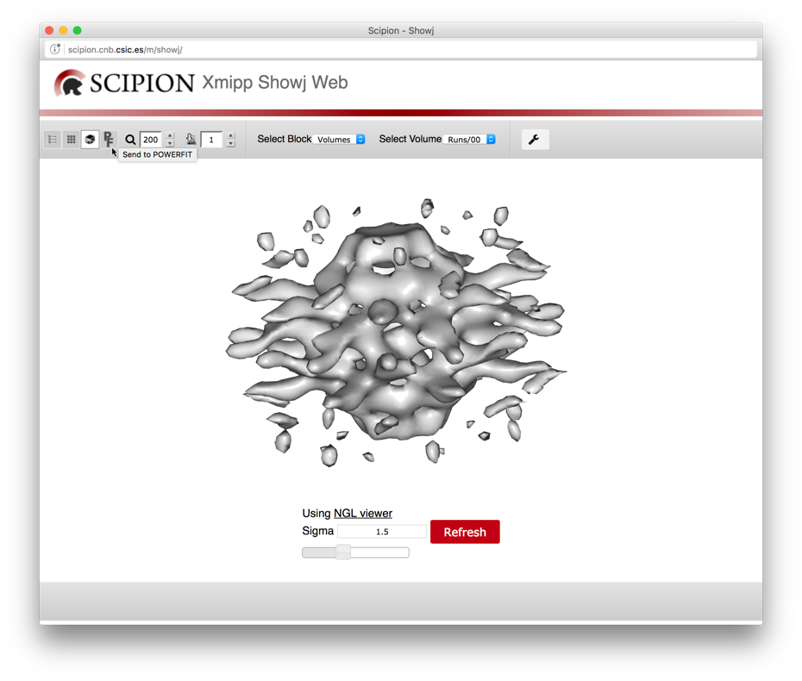
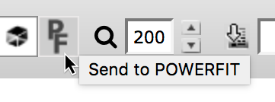
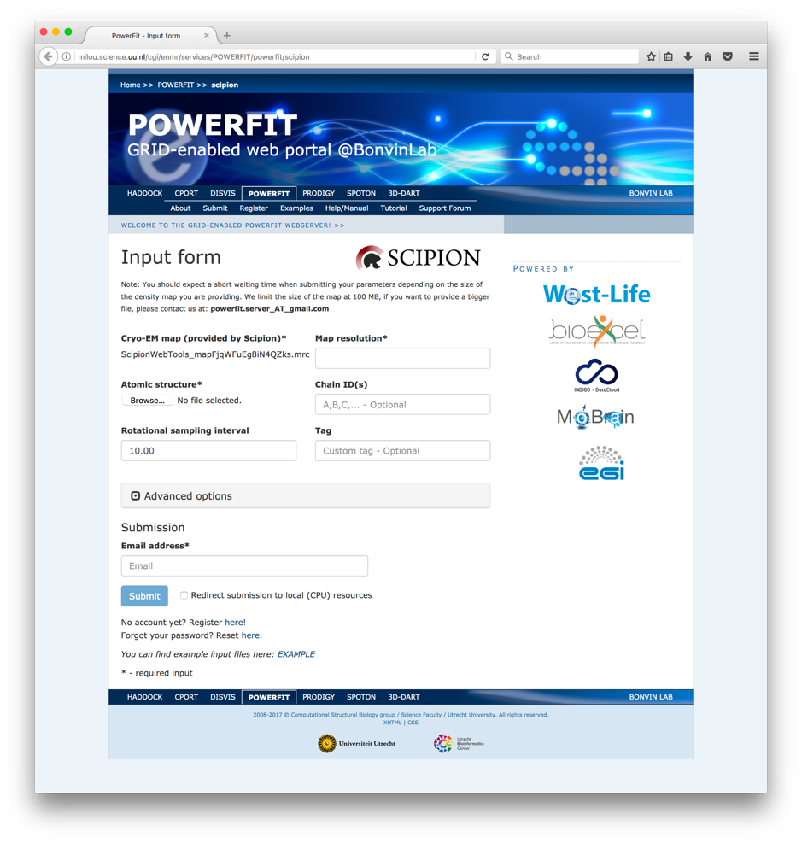
Scipion – PowerFit workflow

Slide 16
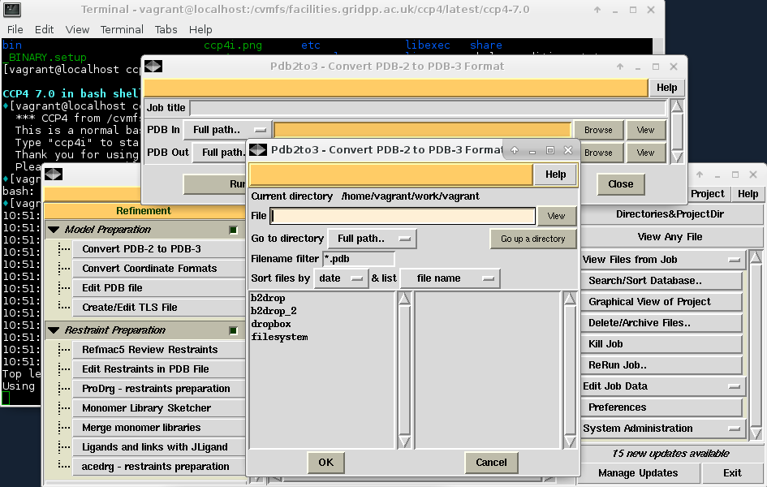
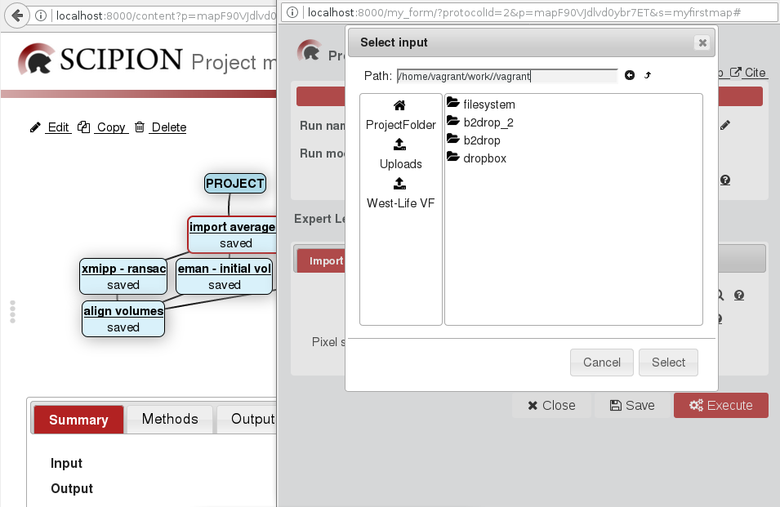
Virtual Machine Templates
Based on CervnVM 4 (boots to Scientific Linux 7 – RHEL 7 derivative)
Software for structural biology – distributed via CernVM FS
Virtual Folder mounted as directory in file system

Slide 17
Repository
Exemplar repository – compatible with VF for small facilities
Supports WEBDAV
Integrated workflow with Instruct instrument/facility booking system – ARIA

Slide 18
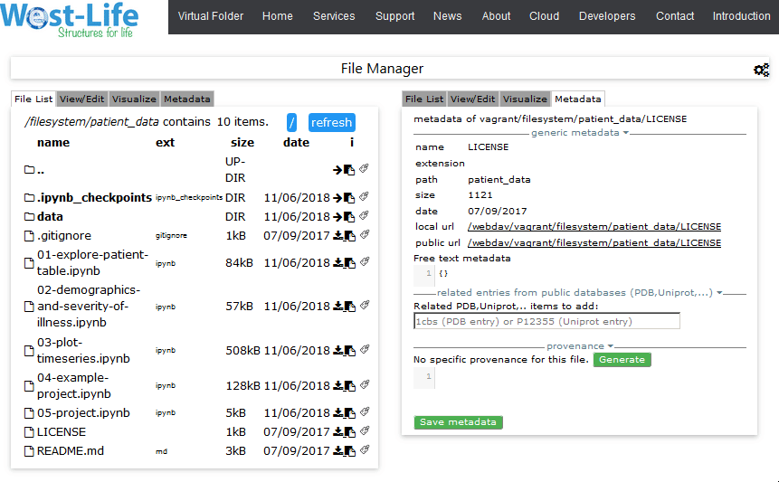
Data annotation
Metadata – provided by device, software tools (parameters of computation)
Provenance

Slide 19
Data Annotation
Related ontologies and databases:
PROVSTORE – public db for provenance data – follows W3C PROV-O standard https://openprovenance.org/
Common Research Information Format (CERIF) – OpenAIRE
Well-Known URI host-meta specified by RFC 6415 (https://tools.ietf.org/html/rfc6415)
Integrated Resource for Reproducibility in Macromolecular Crystallography (IRRMC) https://proteindiffraction.org/

Slide 20
Summary
West-Life project:
support integrative structural biology approach
simplified access to software tools
enabled data access and data management,
adopted existing workflows,
put tools together,
proof of concept for metadata and provenance
Integrated SSO (West-Life SSO, ARIA, social accounts),
data storages (EUDAT B2DROP, Dropbox, …),
common web services, domain specific software and services (PDB database, PDB components, PDB-REDO service and database)
https://github.com/h2020-westlife-eu/
https://appdb.egi.eu/store/vappliance/west.life.vm
https://appdb.egi.eu/store/vappliance/d6.1.virtualfoldervm

Slide 21
Thank you for your attention
tomas.kulhanek@stfc.ac.uk

Slide 23
Instruct

Slide 24
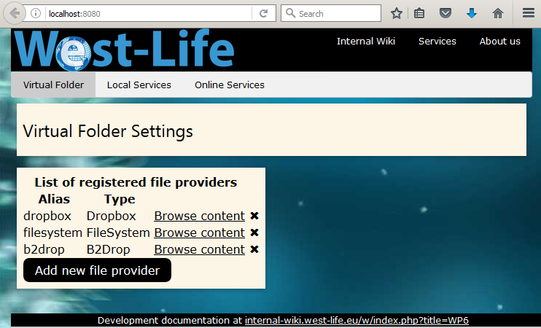
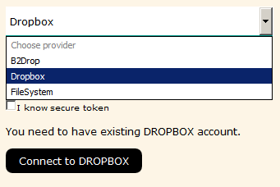
Virtual Folder
configure connection to data provider,
B2DROP (provided by EUDAT – default 20 GB space - single, uses WEBDAV)
Dropbox (multiple, proprietary API, 2GB default, up to 1TB commercial),
Filesystem (multiple, local scratch disk space, mounted facility storage, USB)
WEBDAV (standard interface, any storage provider, e.g. B2DROP, Pcloud, …)
Provides links to scattered data
allows access to legacy apps
Common interface to data – WEBDAV API

Slide 25
Virtual Machine Templates
Virtual machine https://appdb.egi.eu/store/vappliance/d6.1.virtualfoldervm
Customized VM with software and tools installed and connected to virtual folder to support integrative structural biologist.
Base system: CernVM 4.0 - image size 18 MB!, bootloader to SL 7.x, optimal for cluster/cloud deployment with heavy caching
Base system: Scientific Linux 7 or any derivative RHEL 7.x
Software and tools distributed by CernVM-FS, read-only file system
/cvmfs/west-life.egi.eu – SCIPION, West-life related tools
/cvmfs/facilities.gridpp.ac.uk – CCP4 Suite
/cvmfs/wenmr.egi.eu

