Slide 1
Scientific domain specific services
Services provided by the communities for the communities
Dissemination level: Public

Slide 2
Outline
Which community services?
What are they offering to the users?
How are they integrating themselves within EOSC-hub?
What they can offer to EOSC?

Slide 3
Thematic Services
Services in production already used by their community.
But each one in its own «pot»
ECAS
CLARIN
DARIAH
LifeWatch
WeNMR
DODAS
GEOSS
OPENCoastS
EO Pillar
Designed by Freepik (https://it.freepik.com/vettori-gratuito/collezione-fioriere-divertenti_802472.htm)

Slide 4
Discipline-specific data analytics 1/3
Who | Service
WeNMR. A worldwide e-Infrastructure for NMR spectroscopy and Structural biology | Amber is a suite of programs that allow users to perform molecular dynamics simulations on biological systems HADDOCK is an information-driven flexible docking approach for the modelling of biomolecular complexes. The CS-ROSETTA web server generates 3D models of proteins. DISVIS allows visualising and quantifying the information content of distance restraints between macromolecular complexes. FANTEN is a user-friendly web tool for the determination of the anisotropy tensors and residual dipolar couplings. The GROMACS web server is an entry point for molecular dynamics on the grid. POWERFIT performs a full-exhaustive 6-dimensional cross-correlation search between the atomic structure and the density. The UNIO web server is an entry point for molecular dynamics on the grid. Besides the application software, the services also provide automated pre- and post-processing, the compute, storage and job scheduling and monitoring for running the application.
ENES. Services for Climate Modeling in Europe | The ENES Climate Analytics Service (ECAS) will enable scientific end-users to perform data analysis experiments on large volumes of climate data, by exploiting a PID-enabled, server-side, and parallel approach
Compact Muon Solenoid (CMS) | Dynamic On Demand Analysis Service (DODAS) provides dynamic generation of scalable, monitored HTCondor-based batch system clusters and Spark/Hadoop-based Big Data clusters instantiated on-demand over IaaS clouds
analytics
analytics
Data
management
analytics
Data
management

Slide 5
Discipline-specific data analytics 2/3
Who | Service
CLARIN (European Research Infrastructure for Language Resources and Technology) | The Component MetaData Infrastructure provides a framework to describe and reuse existing metadata blueprints
INCD (Portuguese National Infrastructure for Distributed Computation that provides scientific computing services for science) | On-demand Operational Coastal Circulation Forecast Service (OPENCoastS) builds on-demand circulation forecast systems for selected sections of the Portuguese coast
Earth Observation Data and Adding Value Services (EO Pillar) | MEA is a geospatial data analysis tool empowered with OGC standard interfaces. EPOSAR allows for a systematic generation of ground displacement maps and time series. Sentinel Playground - provide access to complete archive of Sentinel-2 data and ESA Archive of Landsat 5,7 and 8. Datacube Data Analytics Service proposes a multi-sensor, -scale and -purpose datacube approach. Geohazards Exploitation Platform is focused on the integration of Ground Segment capabilities and ICT technologies to maximise the exploitation of EO data. OSS-X Sentinel Service is a web based system designed to provide EO data users with Search - Cataloguing - Order and Dissemination capabilities for the Sentinel products. EO Cloud is a cloud processing platform based on open source OpenStack technology. EODC SDIP provides cloud, high performance computing and data storage facilities.
analytics
Data discovery
analytics
Data
management
analytics

Slide 6
Discipline-specific data analytics 3/3
Data discovery
Who | Service
DARIAH (pan-European infrastructure for arts and humanities) | DARIAH Science Gateway offers cloud-based services and applications to the humanities research communities
GEOSS (Global Earth Observation System of Systems) | The GEOSS services support the implementation of the Sustainable Development Goals (SDGs) defined by the United Nations. Services scope is to help SDG monitoring and assessing by providing the necessary Indicators and Essential Variables (EVs) defined by the Community. The core of the service, GEO DAB (Discovery and Access Broker), will be able to access via open APIs the virtual IaaS and PaaS provided by EOSC-hub.
LifeWatch (a European e-Science distributed Infrastructure focused on how to measure the impact of Global Climate Change issues on Earth Biodiversity and Ecosystem Research) | Citizen Science Services include a platform for biodiversity observations, a platform for automatic image analysis and services for crowdsourcing any task and generating 3D models from pictures. Digital Knowledge Preservation Framework is a tool for Open Data supporting the full research data life cycle, providing Open Access to research publications, enabling direct access, without any kind of restriction, registration or subscription and Enhanced Research Data Management, covering the full data cycle, data cycle, from planning, acquisition and curation to publication, integration in analysis and preservation. GBIF data access under biogeographic context provides access with advanced facets to GBIF biodiversity data under a biogeographic context. PAIRQURS (public data access component of the bigger project LIFE+RESPIRA) consists of a network of 50 portable air pollution sensor suites that are carried by a team of volunteer cyclists during their daily commute throughout the city of Pamplona, Spain. By doing this they collect data records of atmospheric pollutants, other auxiliary data and GPS coordinates Remote Monitoring and Smart Sensing is a webserver designed to cover the entire process of working with Sentinel data products.
analytics
Data
management
Data discovery
analytics
Data discovery
analytics
Data
management

Slide 7
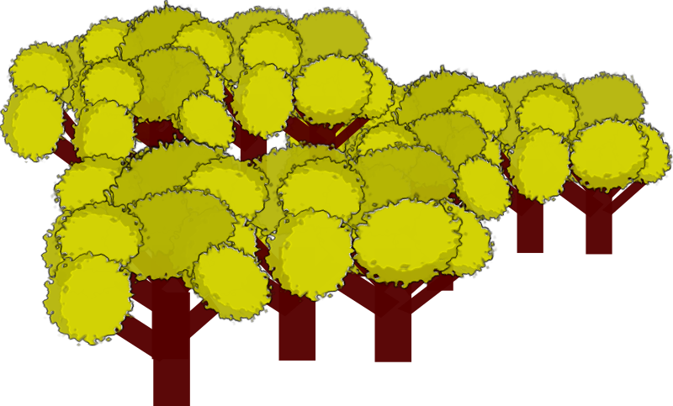
EOSC-hub integration
EOSC allows them to grow
Vertically
Integration with EOSC-hub core services: security, data management, resource brokering, job scheduling, etc.
Horizzontally
Scale out: storage, computing, virtual nodes

Slide 8
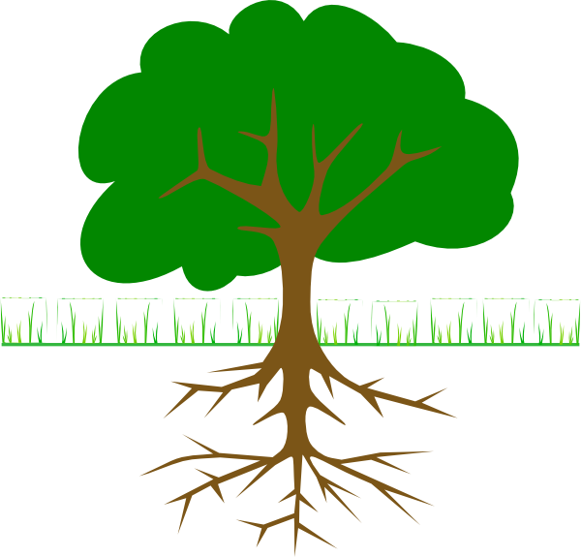
Cultivating the service
Marketplace
Service catalog
Metadata discovery service (B2FIND)
Persistent Identifiers Management
(B2HANDLE)
Scientific Workflow Management and Orchestration
(DIRAC4EGI, TOSCA)
Data Management
(B2SAFE, B2SHARE, B2DROP, DataHub)
Federated authentication
(Check-in, B2ACCESS, IAM)
Federated Computing
IaaS and PaaS
Federated High
Throughput Computing (HTC)

Slide 9
What they offer to EOSC 1/2
Most of them is dedicated to a specific research community
ECAS: climatology
CLARIN: linguistics
GEOSS and EO Pillar: Earth science
WeNMR: biology
OPENCoastS: marine science
DARIAH: art and humanities
LifeWatch: environmental science

Slide 10
What they offer to EOSC 2/2
Some of them can offer features which are scientific disciplin agnostic like DODAS:
It provides dynamic generation of scalable, monitored HTCondor-based batch system clusters and Spark/Hadoop-based Big Data clusters instantiated on-demand over IaaS clouds.

Slide 11
Service provider perspective
Workflows integrated with EOSC services in a seamless way, for example:
Single identity of the user across community and EOSC services through federated identity, allowing access to computing resources with per-user accounting reports.
Additional features like data archiving and data publishing, implemented as separated services offered by EOSC, but transparently available to the community.
Predefined workflow

Slide 12
Researcher perspective
Additional options offered by the «usual» services of the community and possibility to combine multiple services on-demand, for example:
Storing the results of an analysis on a personal space, copying them directly from the computing node and share them with the team.
Or, viceversa, copying the data from the data archive to a personal computing space where it is possible to analyze them.
Dynamic workflow

Slide 13
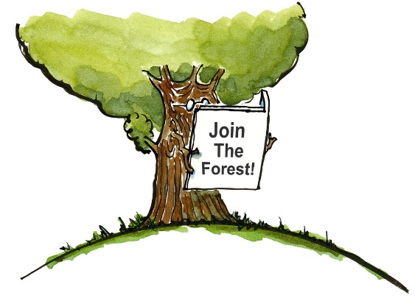
Designed by https://www.flickr.com/photos/hikingartist

