Slide 1
EOSC Service Architecture
AAI integration activities in the context of EOSC-Hub
Dissemination level: Public

Slide 2
In a nutshell
The EOSC-hub AAI:
Contributes to the EOSC infrastructure implementation roadmap by enabling seamless access to a system of research data and services provided across nations and disciplines
Builds on existing interoperable AAI solutions from EGI Federation, EUDAT CDI, GÉANT, and INDIGO-DataCloud that have successfully delivered a portfolio of operational services in this field over the last years
Leverages eduGAIN identity providers and other institutional or social media credentials to expand the access to researchers, high-education, and business organisations

Slide 3
Example use case
Characteristics:
Access & orchestration from a community portal/framework
Underpinned by EGI services (e.g. Cloud; DIRAC; OneData, …)
Underpinned by EUDAT services (B2STAGE, B2SAFE, B2DROP, …)
Requirements:
SSO through the portal/framework with institutional ID (e.g. eduGAIN)
Seamless translation of identities among underlying services
ICOS Carbon portal
*Credit to Maggie Hellström

Slide 4
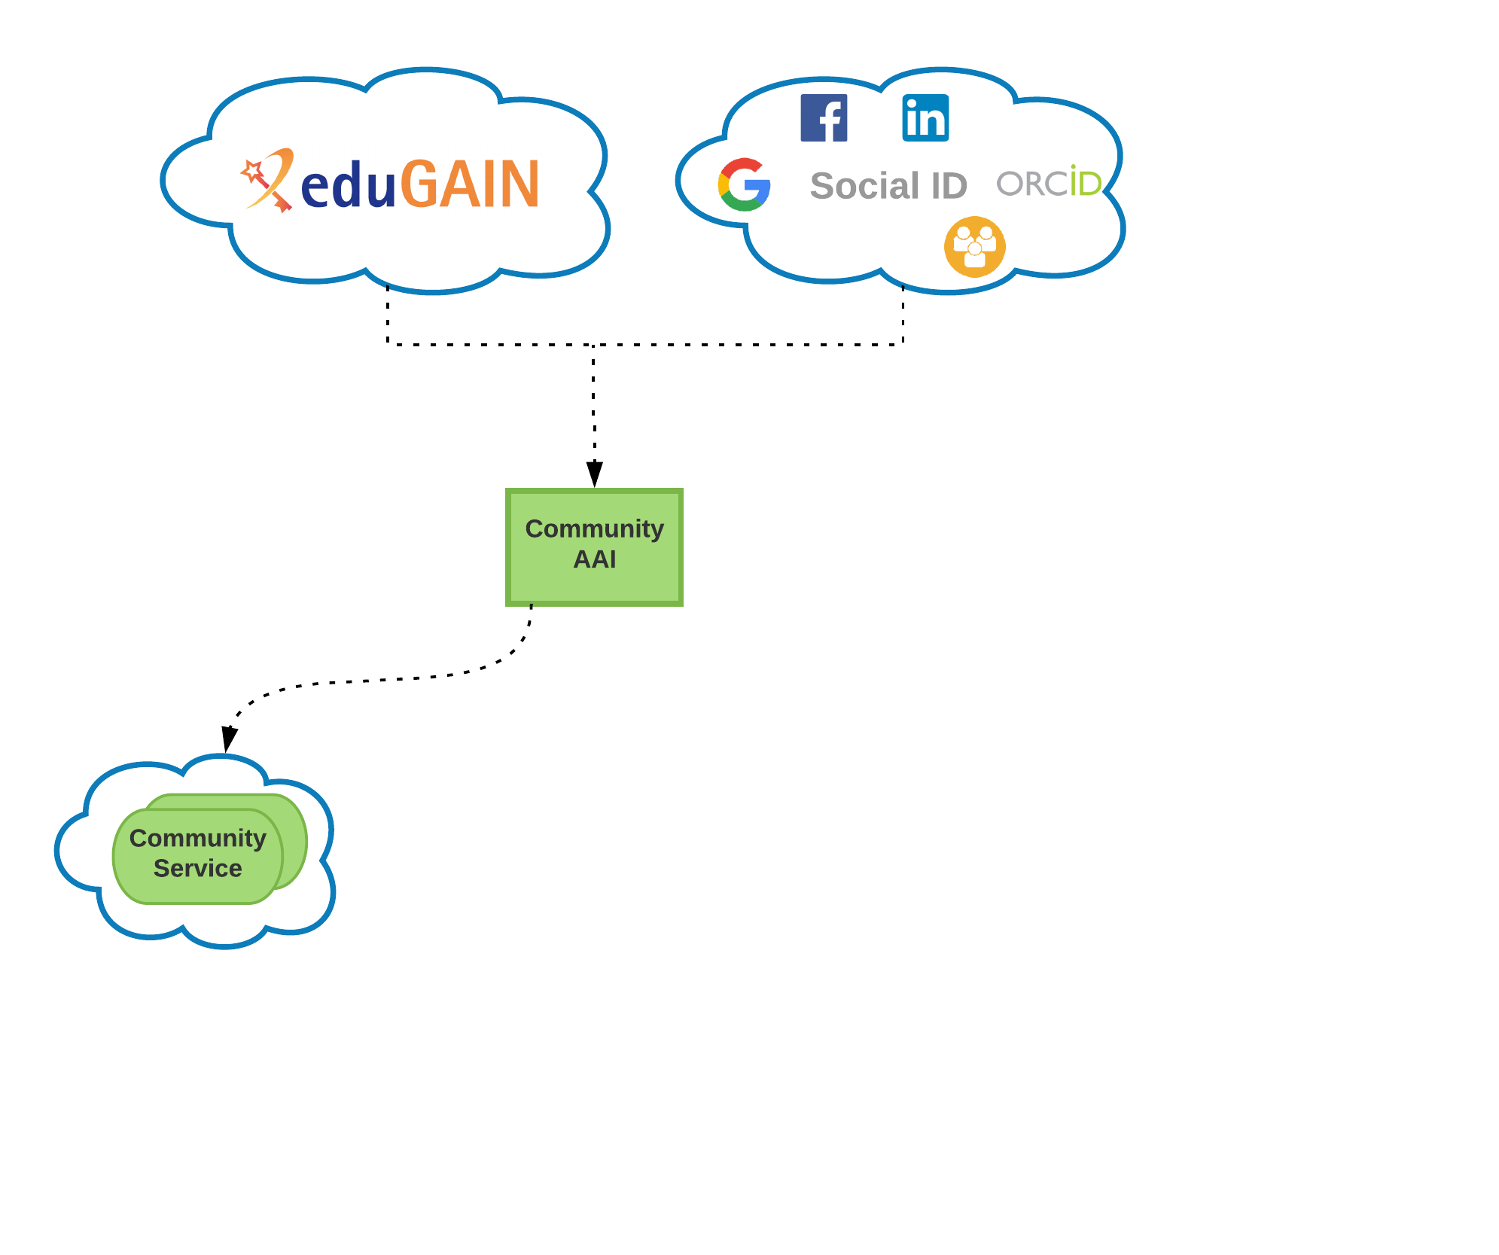
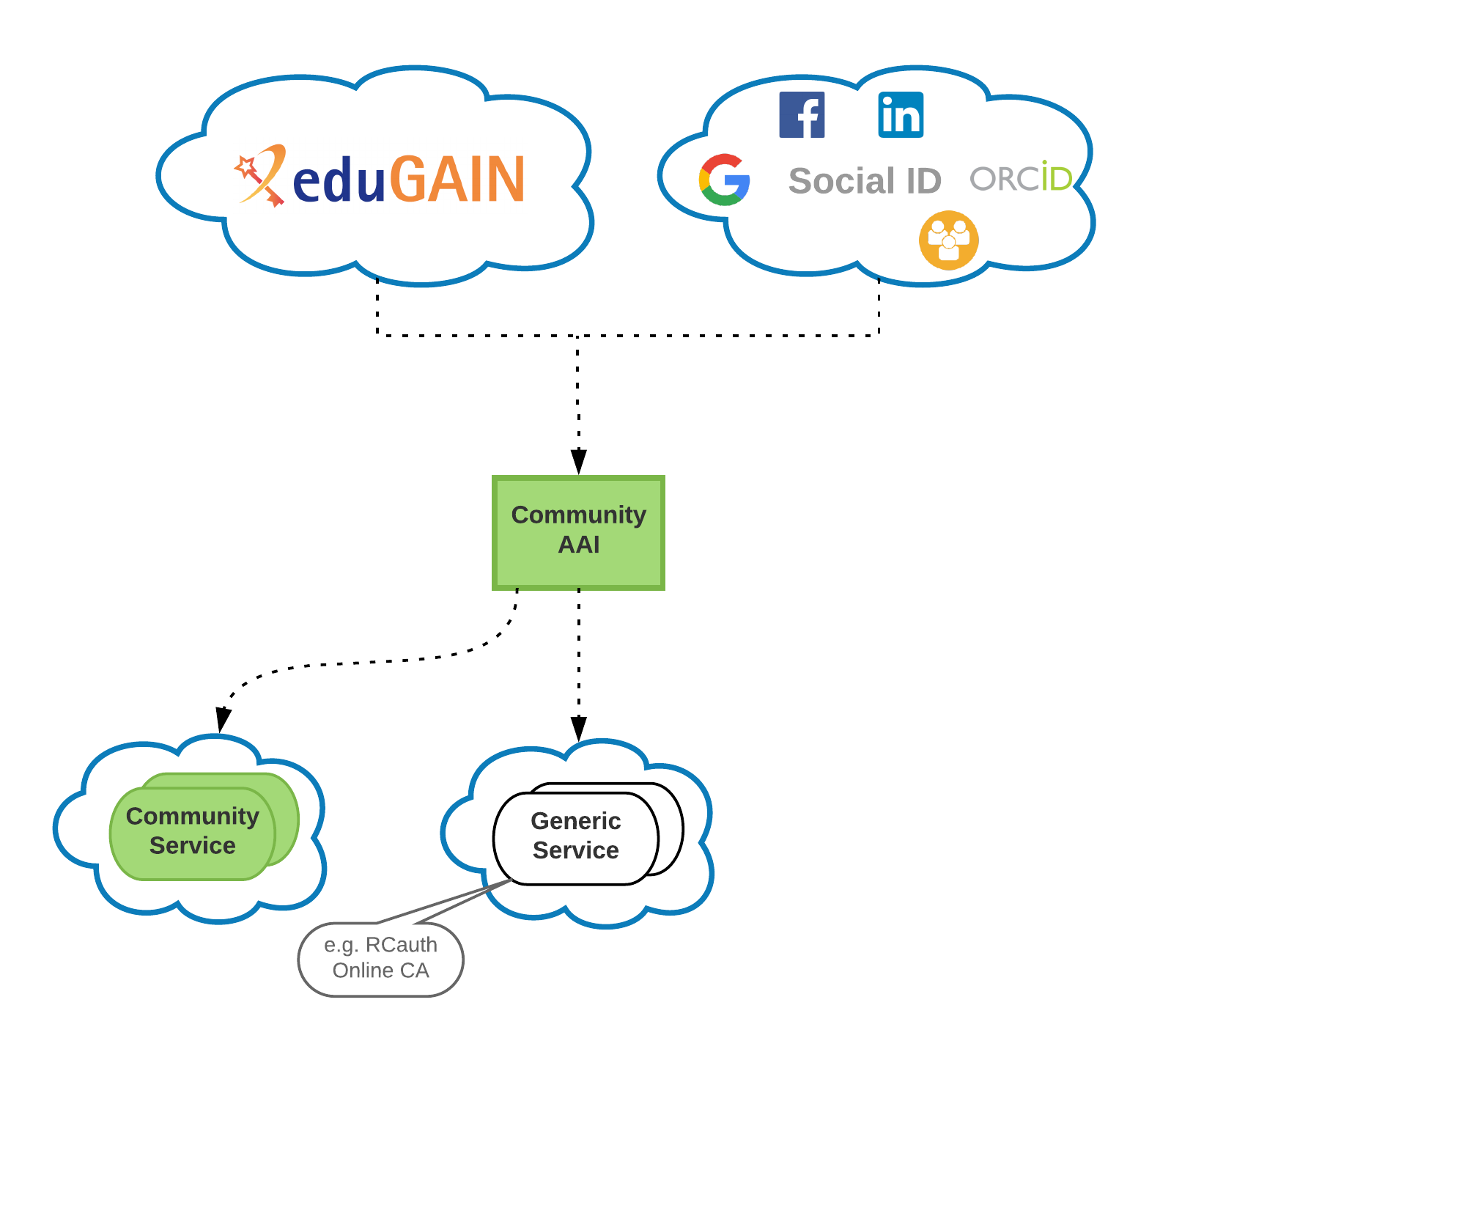
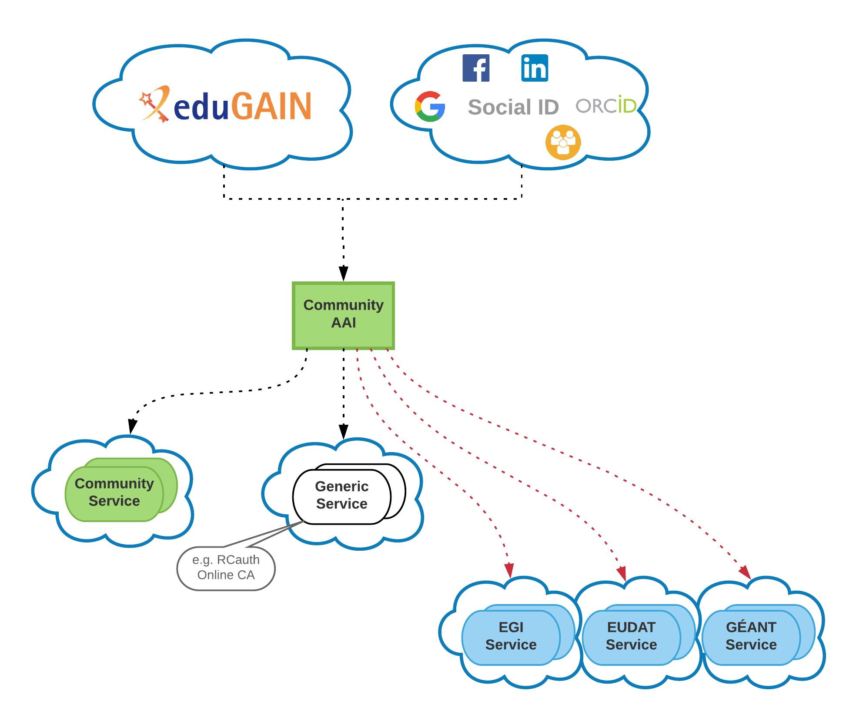
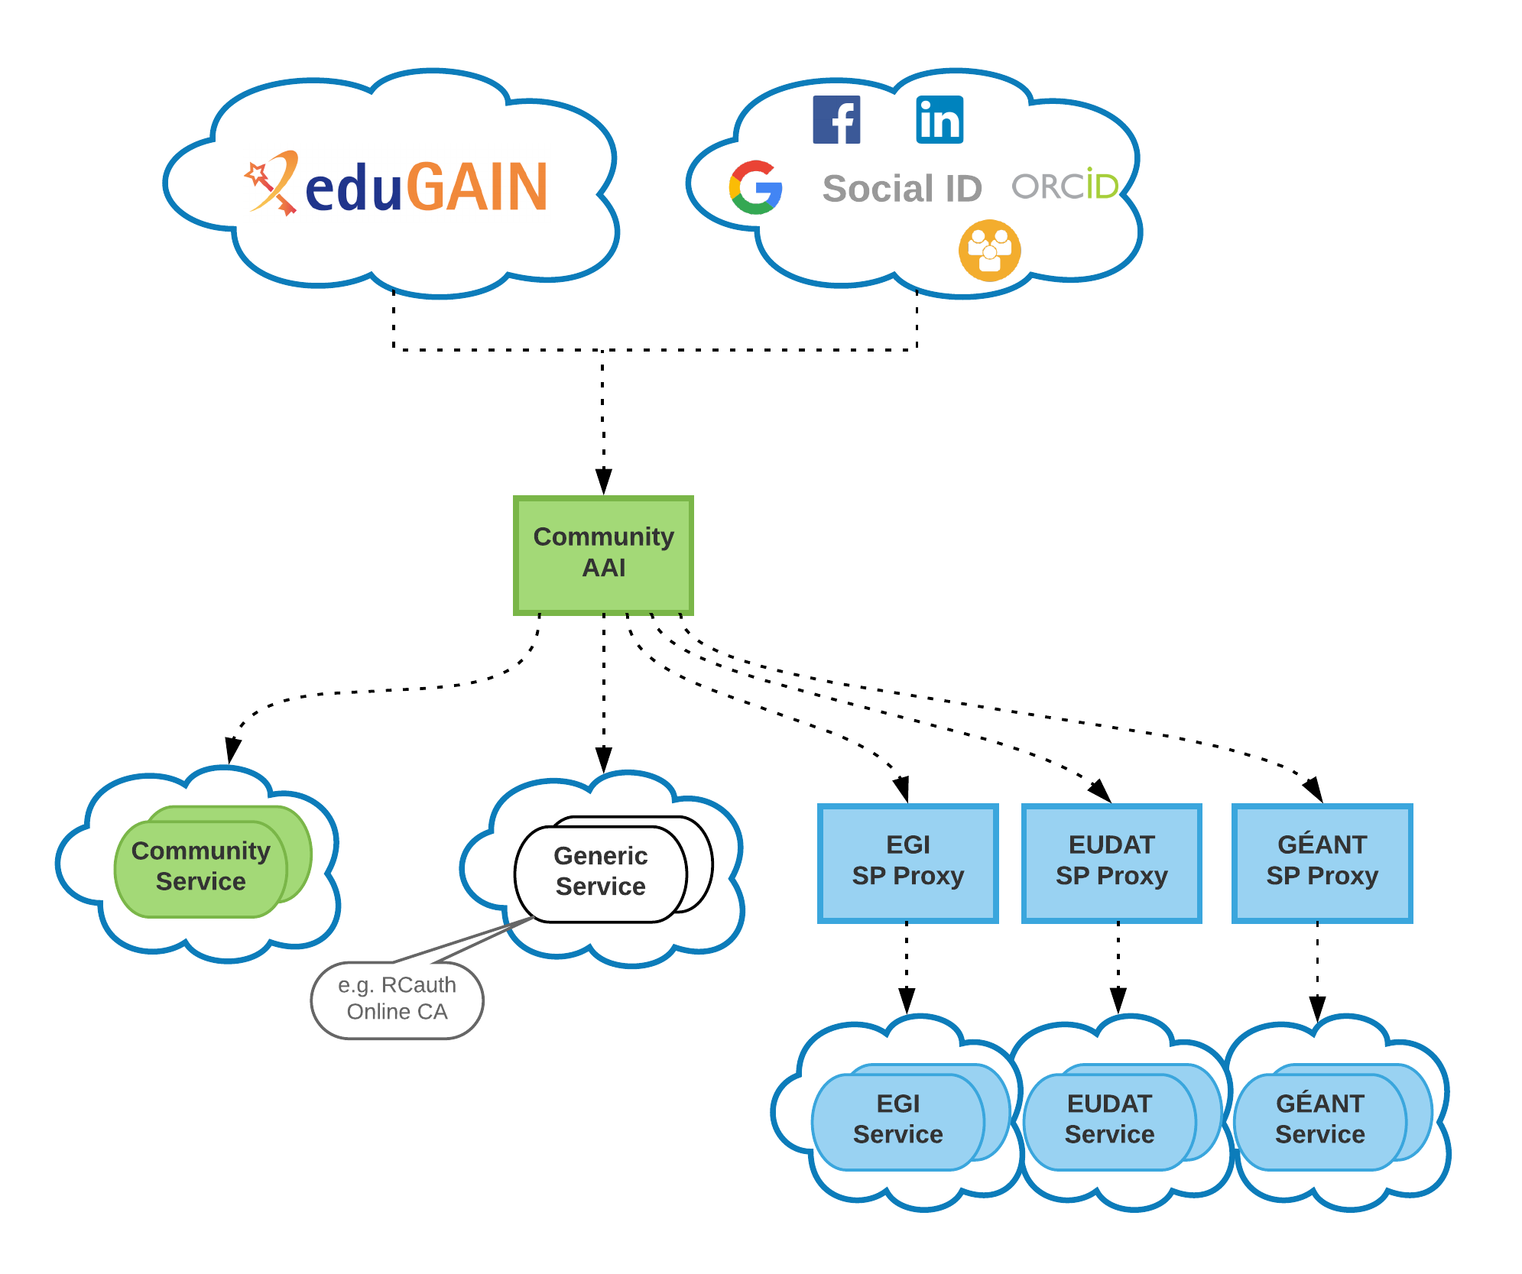
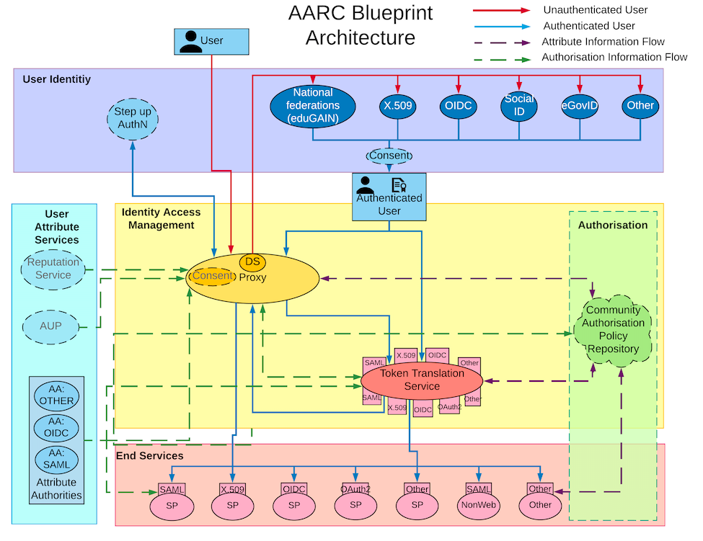
EOSC-hub AAI
High-level Architecture

Slide 5
EOSC-hub AAI
High-level Architecture
Researchers sign in using their institutional (eduGAIN), social or community-managed IdP via their Research Community AAI
Community-specific services are connected to a single Community AAI
Generic services (e.g. RCauth.eu Online CA) can be connected to more than one AAI proxies
e-Infra services are connected to a e-infra SP proxy service gateway, e.g. B2ACCESS, Check-in, Identity Hub, etc

Slide 6
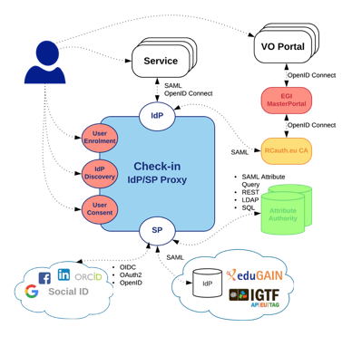
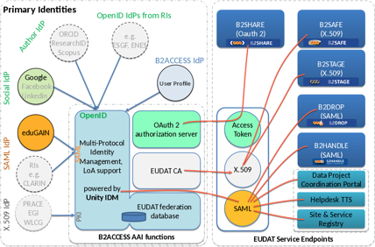
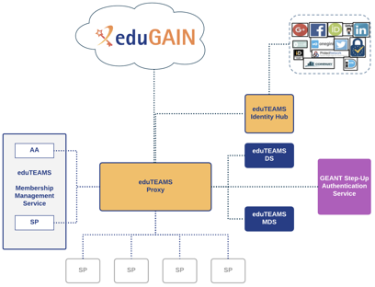
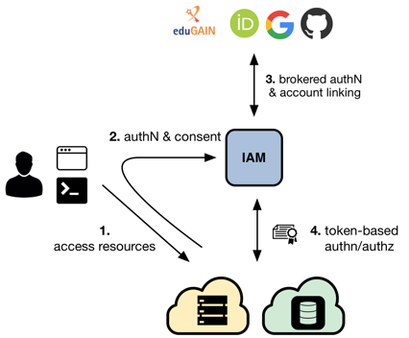
EOSC-hub Community AAI services

Slide 7
EOSC-hub AAI
Common guidelines & best practices
Uniform representation of unique user identifiers
Standardised way of expressing group membership & role information
Non-web-browser-based access (e.g. SSH/SFTP or HTTP APIs via OAuth2 tokens and X.509 certs)
Delegation (e.g. via token exchange)
Security Incident Response Trust Framework for Federated Identity (Sirtfi)
Evaluation and combination of assurance information
<uid>@<scope>
<NAMESPACE>:group:<GROUP>[:<SUBGROUP>*][:role=<ROLE>]#<GROUP-AUTHORITY>
https://aarc-project.eu/guidelines/

Slide 8
EOSC-hub AAI
Next steps
Complete integration activities between EOSC-hub AAI services
Adopt upcoming AARC architecture & policy recommendations on
Attribute harmonisation (e.g. affiliation and assurance information)
AUP alignment
EOSC-hub T5.1 and T6.1 will collaborate with GN4-2 (jointly through WP10) on the evolution of the EOSC-hub AAI service components and the available AAI service offerings for communities
Enable interoperability between the GÉANT Step-up Authentication Service and the EOSC-hub AAI, so that communities and service providers in EOSC-hub can use multi-factor authentication
Investigate the possibility of creating bespoke AAI Solutions, which might include individual Components from the GÉANT eduTEAMS, EGI Check-in, INDIGO IAM, EUDAT B2ACCESS, and PERUN

