Slide 1
PRACE Perspective towards EDI & Link with EuroHPC
Serge Bogaerts
PRACE Managing Director

Slide 2
Outline
PRACE Proven Recipe for the HPC Ecosystem
Addressing Exascale Challenges
PRACE and EuroHPC

Slide 3
PRACE | HPC ecosystem in EU
Proven Recipe of PRACE
Hosting Members (HMs) provide access to Tier-0 systems as in-kind participation to the PRACE Research Infrastructure (RI)
General Partners fund (PRACE 2 fee) High-Level Support Teams (HLST) providing tailored user support on HMs’ Tier-0 systems
Mature scientific peer review process, well-known to users in Science
All 26 PRACE members contribute to high-value services including training (PTC), DECI, Implementation Projects, Peer Review, and Communication - with the support of the European Commission
All 26 PRACE members together have a wealth of procurement expertise (involved directly or indirectly in PCPs and PPIs)

Slide 4
PRACE | achievements
652 scientific projects enabled
>19 000 000 000 (billion) core hours awarded since 2010
Of which 63% led by another PI nationality than the HM
R&D access to industrial users with >50 companies supported
>11 500 people trained through PRACE Training
~110 Petaflops of peak performance on 7 world-class systems
26 PRACE members, including 5 Hosting Members (France, Germany, Italy, Spain and Switzerland)
PRACE is the only e-infrastructure Landmark on the ESFRI Roadmap 2016
Notes:
The number of projects and the total core hours awarded are up to and including the 17th Call for Proposals for Project Access

Slide 5
PRACE access mechanisms
Distributing resources via various access mechanisms
All targeting excellence in science + support to industry/SMEs
Project Access (bi-annual calls)
For a specific project; award period 1 to 3 years
For individual researchers and (international) research groups
Requires to demonstrate technical feasibility of project
Share for Centres of Excellence (CoE)
Preparatory Access
Optionally with support from PRACE experts
Prepare proposals for Project Access
SHAPE projects receive Preparatory Access
DECI (Tier-1)

Slide 6
PRACE Peer Review know-how
Scientific Excellence
Know-how accumulated over 8+ years
Processes under continuous improvement
Scientists driving the ranking across disciplines (on the ERC model)
Accounting for technical requirements
Accounting for PRACE 2 Programme settings
Preparatory Access under revision

Slide 7
Addressing HPC Exascale challenges
Aim at scientific excellence and improve application scaling and throughput
Focus on PRACE Scientific Case
Computing requirements (capability-, capacity-, real-time-, burst-, cloud-computing, …) and most of all: throughput
Data management (distributed (big) data processing, storage, HPDA, …)
Networking requirements (AAA, SDN, QoS, …)
Application development (portability, tools, libraries, …)
Specific exascale challenges
Parallelism of software, data movement, reliability, energy consumption, …
System integration, software-, hardware-, services- and skills-development
Exascale performance only through combination of improvements
Pan-European collaboration is needed
Release date 17 Oct 2018

Slide 8
EDI Architectural Requirements
Offer a variety of system architectures to enable traditional scientific simulations
General purpose HPC centers and topical centers
Also addressing the convergence of HPC, HTC, HPDA and AI
How to handle the large volume of data generated
Generated centrally at large RIs or distributed (e.g. sensor networks)
Rethink data movement (from edge to the data center) :
Local (at data source) processing facilities for data reduction
Central or distributed storage
How to support end-to-end workflows
How to provide HPC/HTC capacity to large scale scientific instruments
Need for an even tighter coordination of national infrastructure procurements in EU

Slide 9
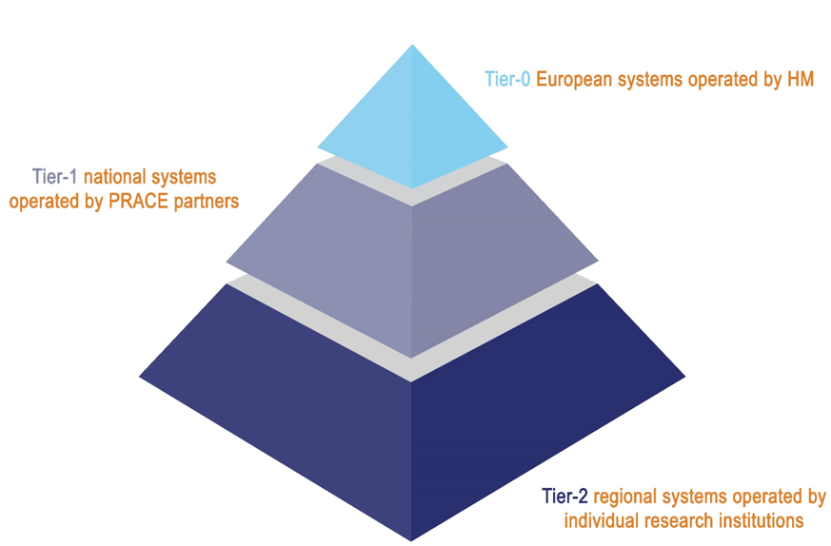
Strengthening the HPC pyramid
?
EuroHPC systems
(exa- and pre-exascale)
Importance of Tier-1:
National Stepping Stone
Data reduction at RIs
Industry access
Pilots
Address various needs with full pyramid

Slide 10
Recipe for a data-centric approach
Need to address the convergence of HPC, HTC, HPDA and AI
Handle the large volume of data generated
Offer computing capacity to large scale scientific instruments
Enhance integration of the Tiers and connect to EOSC
Anticipated key role of the GÉANT networking services (AAA, SDN, QoS, …) and FENIX and EUDAT for data management and processing
Piloting in Call 18

Slide 11
Extend PRACE activities → EDI
PRACE as main contributor to EDI with GÉANT
Access to JU- & Tier-0-infra provided by HMs for Open R&D for science & industry
Offer training, code enabling, communication, Tier-1 for Tier-0 services provided by PRACE partners & AISBL office
Extend services towards industry (SHAPE-Fortissimo), and to the public sector
Local support across Europe
new HPC services
new data services
new services to industry
new network services
New extended services provided by partners
EDI as a one-stop-shop for all EU project/infra on HPC and data
EOSC as potential vehicle to offer services to wider communities

Slide 12
PRACE & EuroHPC
EuroHPC Joint Undertaking funding instrument
EC- & MS-lead initiative
Procure (pre-)exascale systems and more in Europe
Support development of European technology
PRACE and its partners
Continued PRACE 2 Programme until 2020
Share know-how
Provide services, support, and training adapted to user communities
Stay tuned !

Slide 13
THANK YOU FOR YOUR ATTENTION
www.prace-ri.eu

