Slide 1
SVG communication and evolution plans
Linda Cornwall, STFC

Slide 2
Contents
Proposed new ‘Purpose’
Main reasons for revision
Scope of SVG
Communications from last meeting
New procedure
Where to start, what to do in coming weeks

Slide 3
Had a go at a document
Largely based on the meeting in April at CERN
Not quite complete /polished yet
Details are really for SVG to discuss
But must satisfy what CSIRT wants

Slide 4
Proposed new purpose
"To minimize the risk to all service providers, infrastructures, users and other parties which interact with the EOSC-hub arising from vulnerabilities in software deployed on the constituents of the distributed infrastructure.”

Slide 5
Most important reasons for revision
Proliferation of software and lack of homogeneity
SVG members cannot be experts in everything
Difficult to give clear advice, depends on how software is deployed
This was breaking SVG issue handing before EOSC-hub
Need to deal with EOSC-hub services
Again SVG members cannot be experts in all the services
Need to put requirements on services in catalogue to work with SVG.

Slide 6
Scope
Linux operating system on which Distributed infrastructures are based
Commonly used software which enables the sharing of distributed resources
Grid enabling, Cloud enabling, Docker…
Software used on Services in the service catalogue
Assuming OLA, including contact and willingness to participate in SVG investigations
Software used by any participants in the infrastructure
Again assuming OLA, contact, participation
Depends much more on participation of those using, developing, selecting software than previously
To deal with non-homogeneity, proliferation, EOSC-hub services

Slide 7
Communications
Much greater dependency on being able to communicate with other participants
Along with those developing or selecting software for use being willing to participate
Similarly we need to communicate with those responsible for services in the EOSC-hub service catalogue, and they need to be willing to participate
Discussed at CERN
Planning to do a nice diagram – haven’t done it yet

Slide 8
Definitions – from April’s meeting
Responsible/Manager
Person with overall responsibility for a service
Planner
Person who may allocate resources, work out what to do
Operator
Person with keyboard, e.g. who receives an advisory and acts on it
Security Contact?
Could be a planner or an operator? Security Planner/expert plus a Security Operator?

Slide 9
Roles related to SVG process
SVG – Handles the overall process, makes sure agreed procedure followed
Plus when unanticipated/unusual situation occurs decides what to do
REPORTER – person who reports a vulnerability to SVG
May be that they have ‘discovered’ it
May be that they ‘alert’ us to one that has been announced publicly/or not publicly from collaborating projects.
Anyone may report an issue

Slide 10
Roles related to SVG process (2)
USER – person who uses services on the infrastructure
SVG hasn’t so far communicated with Users, but should consider whether a vulnerability on the infrastructure affects users
Don’t define VM operators as Users, they are VM operators?
VM Operators – Person who instantiates and runs VMs
VOs/Research Communities
Within these Responsible, Planner, Operator…
No simple way contacting all confidentially
VA creators (va-creators @ mailman.egi.eu)
Possibly consider the creation of VA a deployment of software?
Or is it software?

Slide 11
Roles related to SVG process (3)
INFRASTRUCTURES EGI/EUDAT
Sites are part of this infrastructure
Software experts who select software to be deployed on the infrastructure (FedCloud, RAT members expertise in Grid)
At times we communicate with managers, e.g.
critical/no easy solution
Possibly if GDPR breach with no easy solution.
PEER INFRASTRCUTURES - e.g. OSG
Collaborate/exchange info
SOFTWARE PROVIDERS – EXTERNAL
Software released publicly – e.g. linux related
Some we still have relationship with/contact
SOFTWARE PROVIDERS – INTERNAL
UMD/CMD……

Slide 12
Roles related to SVG process (4)
EOSC SERVICE CATALOGUE SERVICE PROVIDERS
Those who provide services available in the catalogue
Need Contact for Manager/Responsible
Need contact for Person who investigates vulnerabilities in their service
This could be nominated by planner
Need security contact – for OPERATOR to receive

Slide 13
Service Catalogue
https://confluence.egi.eu/display/EOSC/EOSC-hub+service+catalogue
Distinguishes between
Common Services
Cloud container, CVMFS, BDII, ,,,…
Collaborative services
AppDB, Marketplace
Thematic Services
For scientific fields
Federation services
GOCDB, checkin, GGUS,….

Slide 14
Service Management System (SMS) Supplier management DB
Matthew Viljoen suggested this as means of getting contacts
the Supplier Management Database in the Service Management System (SMS) - the SUPPM DB in FitSM parlance
‘This database contains the list of all suppliers of software that we care about, and within the SMS we provide the mapping between the respective software components, usually services that are run, but this could extend to other software that is run by users themselves in the e-Infrastructures, but may not be provided as a traditional service’
the SUPPM DB with contacts of software technical experts
SVG needs access to this

Slide 15
For EOSC-hub
Need software contacts
And need service contacts
Hopefully from same database?
Infrastructure? Some services on EGI/EUDAT infrastructures? Some elsewhere?
Still not all clear.

Slide 16
Have I missed anything?
Concerning who we need to communicate with?

Slide 17
Procedure changes
Don’t want to lose what we already have
Just because changes happening mean the current procedure doesn’t quite work, don’t want to throw everything away

Slide 18
Main Changes needed
sub-SVG as discussed at the CERN meeting in April, to handle specific issues which are due to EOSC-hub, proliferation etc.
Needs to be easy to contact the right people, less ad-hoc, more procedural.
More that SVG co-ordinates and ensures that the appropriate investigation happens.
We have a lot set up, we start with what we have otherwise, templates etc., and add new ones, evolve
I’d also like it to work better if I’m not available

Slide 19
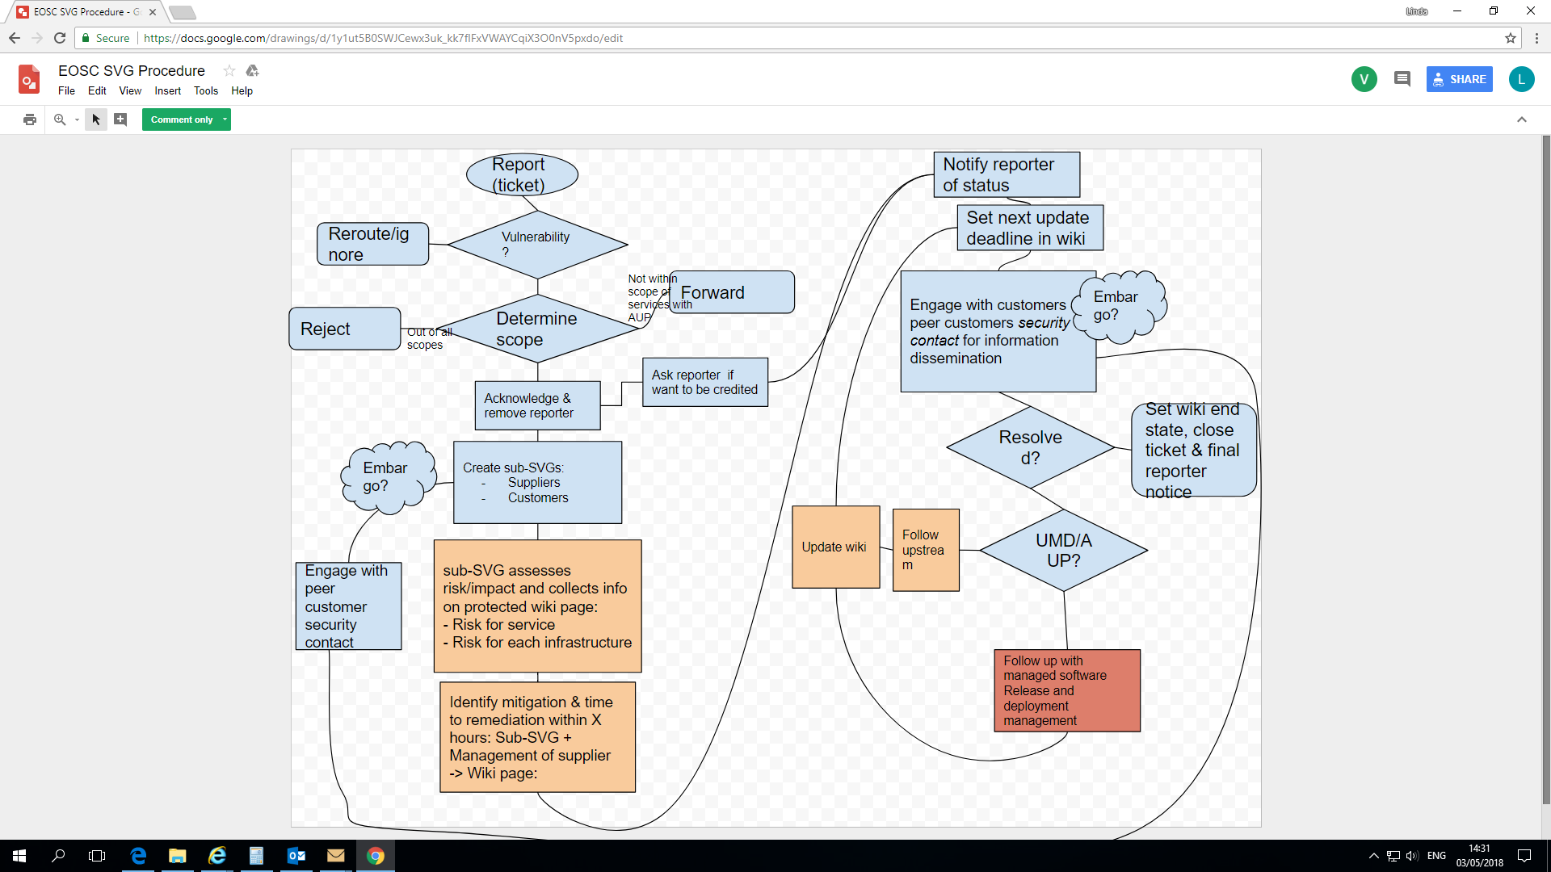

Slide 20
Reporting and initial actions
REPORTER reports a vulnerability
Ticket Created
SVG acknowledges the reporter
SVG looks at the report
Is it in scope?
If no, inform REPORTER and close
Is it a concern/policy violation rather than a vulnerability?
If so re-route, inform REPORTER and close
Is it a valid software vulnerability?
If no, inform REPORTER and close
May not be able to determine, may have to wait for sub-SVG

Slide 21
Infrastructure peer consideration
May it be of interest to PEER INFRASTRUCTUES
If so SVG notifies PEER INFRASTRUCTURES
Include EMBARGOED if it is

Slide 22
sub-SVG
Actions described here not polished
sub-SVG or sub-RAT (as Maarten and I prefer) actions need better describing
This is the key to the changes, those who have expertise in software, or deploy it in their services, are the main people who investigate the problem and what to do in their particular service.
Rather than the SVG-RAT

Slide 23
sub-SVG creation
Contact as appropriate:--
VO research communities
EOSC-hub Catalogue service providers
Software providers (if relationship)
Software responsible (as appropriate)
Use those to create appropriate sub-SVG
Consider whether it is appropriate to include the reporter in the investigation
If so, add to sub-SVG

Slide 24
sub-SVG handling
Is this a software vulnerability?
If not, inform REPORTER and close ticket
Investigate the effect on services in the infrastructure
Contacts from services investigate their own
Carry out Risk Assessment for various services
Critical, High, Moderate, Low
If not fixed, and relationship with software provider, set TD to highest of the risks
For now ‘High’ 6 weeks, ‘Moderate’ 4 months, ‘Low’ 1 year
Inform Software Provider if not fixed
Inform Reporter

Slide 25
sub-SVG handling – contd.
Is the issue ‘Critical’ and not fixed/unlikely to be fixed quickly
Special procedure, update the one from 2017
Define actions to be taken
This may be different for different services
Draft advisory
May again be different for different services
Inform peer infrastructures
Send advisory if/when fixed or other action recommended
If not fixed by TD, contact software provider
Consider what other action to recommend.

Slide 26
Priorities
Get things in place to allow us to form sub-SVG
This will not be easy
Need to understand better how the service management system is going to work, how that relates to the EOSC-hub catalogue.
Services will need to participate
We need to get software responsible too.
SVG private wiki
Should not be too difficult
Will make life easier for us

Slide 27
Later/ maybe in parallel -Templates
Advisory – look at others, what people want
Many seem happy with what we do at present
At CERN meeting in April a desire for very short advisories to Operators
More info on-line
Possible compromise
top in a box –what the problem is, what to do, how to do it
Rest of info below.

Slide 28
Other points
I reckon sub-RAT is better than sub-SVG
What do others think?
Evolution of SVG is SVG task
But must meet CSIRTs needs

Slide 29
Other points
Need to be realistic
How good things can be depends on getting more participation work
Can’t do the sort of job that requires 10 FTEs with a handful of people spending a fraction of their time on the work

