Slide 1
e-Infrastructure in Europe: Attributes and Metaphors for Diffusion
Christian Burgers, PhD
Associate Professor
Ellen F. Droog, MSc
Researcher
Kerk F. Kee, Ph.D.
Associate Professor
School of Communication
Chapman University
Orange, California
Department of Communication Science
Vrije Universiteit Amsterdam
Amsterdam, Netherlands

Slide 2
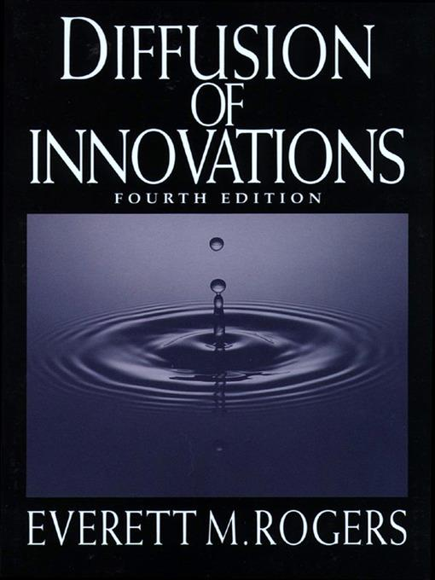
Notes:
Slide 2: KERK
One way to systematically study Science Gateways is to use the lens of a widely researched communication model called the “diffusion of innovations” by the late Everett Rogers. As the name of the model implies, it is about the natural spread of a new technology within a social system, such as the spread of Science Gateways within a scientific community. The diffusion model has been extensively applied in the field of organizational communication to understand the adoption and spread of workplace innovations. We believe science gateways can also be regarded as a ‘workplace innovation’ for science and engineering researchers.
I like the cover of Rogers’ book, because it visually captures the essence of the model, which suggests that the introduction of an innovation can have a ripple effect on a given system.

Slide 3
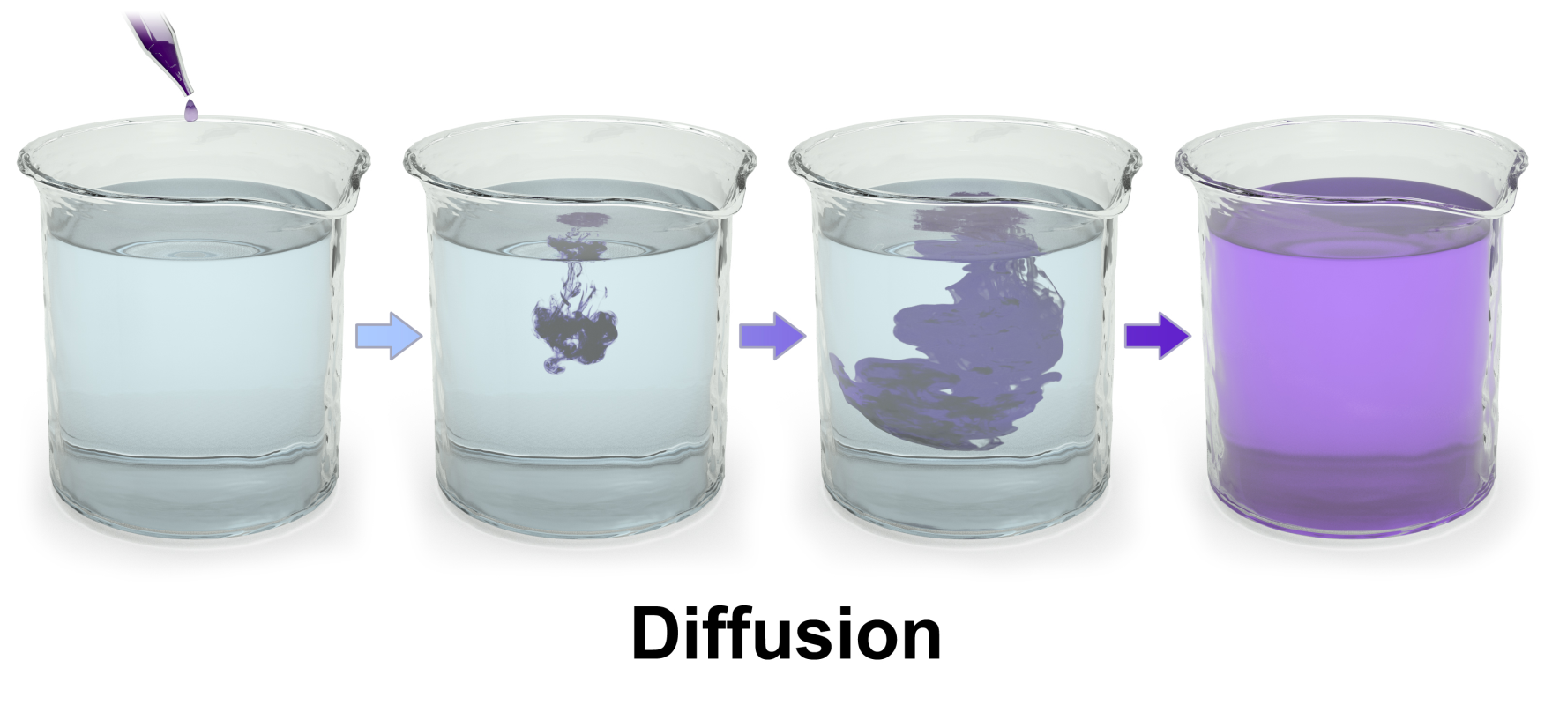
Notes:
Slide 3: KERK
This next visual shows how a drop of colored ink can slowly diffuse and eventually change the color of water in the beaker. This image represents a potential trajectory of Science Gateways spreading through the community.

Slide 4
Diffusion – The Spreading of an Innovation

Slide 5
NSF VOSS: Virtual Organizations as Sociotechnical Systems
NSF ACI #: 1322305
kee@chapman.edu
What VO Attributes?
What Macro Conditions in the Scientific Community?
(conditions can be, for example, social, organizational, community, economic, technological, political, cultural, etc.)
Virtual Organization (VO) #1 in e-Science
What Tool Attributes?
Tool
Virtual Organization #4 in e-Science
Virtual Organization #2 in e-Science
Tool
Tool
Tool
Virtual Organization #3 in e-Science
Virtual Organization #5 in e-Science
Note: The shapes representing VOs and tools change in colors to represent adaptation and evolution over time.

Slide 6
Methodology
13 survey responses with a diverse range of stakeholders, including developers, users and educators.
Domain of the digital service:
Life Sciences, Earth Sciences, Climate Science, Space Physics, Biodiversity Science, Ecology, Service covering all faculties of a University, Computer Science, Physics, Humanities and Social Sciences
Range of experience with digital services: 1-25 years.
Range of tool age: 3-20 years.
The gender of participants was 75% male, 8.3% female and 16.7% would rather not say.

Slide 7
Data Collection
7 survey responses were recruited from EOSC-hub Meeting in Malaga (Spain), April 2018
6 survey responses were recruited from ENVRI Conference in Zandvoort aan Zee (The Netherlands), May 2018

Slide 8
NSF VOSS: Virtual Organizations as Sociotechnical Systems
NSF ACI #: 1322305
kee@chapman.edu
What VO Attributes?
What Macro Conditions in the Scientific Community?
(conditions can be, for example, social, organizational, community, economic, technological, political, cultural, etc.)
Virtual Organization (VO) #1 in e-Science
What Tool Attributes?
Tool
Virtual Organization #4 in e-Science
Virtual Organization #2 in e-Science
Tool
Tool
Tool
Virtual Organization #3 in e-Science
Virtual Organization #5 in e-Science
Note: The shapes representing VOs and tools change in colors to represent adaptation and evolution over time.

Slide 9
Findings: Tool Attributes (N = 13)
Tool Attributes | Scores (range: 1 - 7)
Driven by Needs | 6.00
Documentation | 5.92
Community Driven | 5.85
Ease of Use/Simplicity | 5.77
Perceived Compatibility | 5.77
Trialability | 5.70
Relative Advantage | 5.70
Visibility/ Observability | 5.15
Organized Access | 4.92
Adaptability | 4.92

Slide 10
Findings: Tool Attributes (N = 13)
Tool Attributes | Scores (range: 1 - 7)
Driven by Needs | 6.00
Documentation | 5.92
Community Driven | 5.85
Ease of Use/Simplicity | 5.77
Perceived Compatibility | 5.77
Trialability | 5.70
Relative Advantage | 5.70
Visibility/ Observability | 5.15
Organized Access | 4.92
Adaptability | 4.92

Slide 11
Perceived Needs
“Does this tool meet my needs?”

Slide 12
Documentation
“Is the tool well-documented with a track-record and user-guides?”

Slide 13
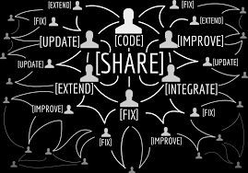
Community Driven
“Is there an active community that will carry this tool forward?”

Slide 14
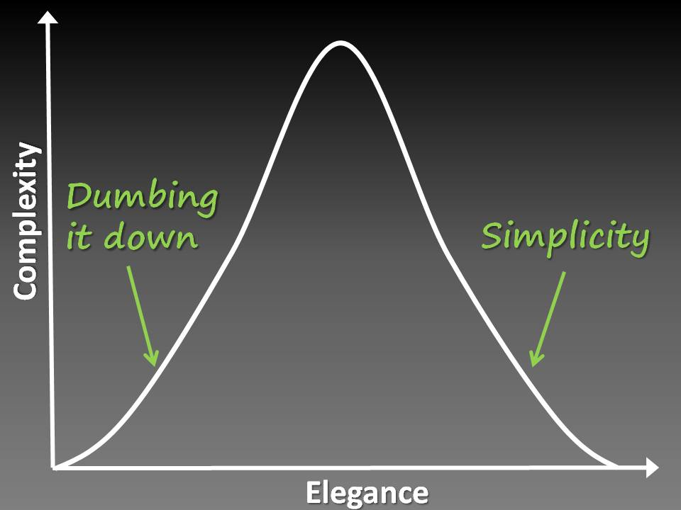
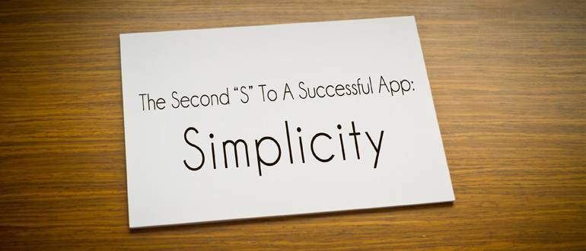
Simplicity
“Is this tool easy to use?”
Notes:
It should not be a surprise that design simplicity is a key attribute. No matter how powerful the tool is, if it is very complicated, less users will get on board.
There are two sides of simplicity – dumbing it down or simplicity. The difference is that simplicity is also elegant!

Slide 15
Compatibility
“Can I easily integrate this tool into my existing routine and collaborations?”
“Is this tool aligned with the norms of my domain as a whole?”

Slide 16
Findings: Tool Attributes (N = 13)
Tool Attributes | Scores (range: 1 - 7)
Driven by Needs | 6.00
Documentation | 5.92
Community Driven | 5.85
Ease of Use/Simplicity | 5.77
Perceived Compatibility | 5.77
Trialability | 5.70
Relative Advantage | 5.70
Visibility/ Observability | 5.15
Organized Access | 4.92
Adaptability | 4.92

Slide 17
NSF VOSS: Virtual Organizations as Sociotechnical Systems
NSF ACI #: 1322305
kee@chapman.edu
What VO Attributes?
What Macro Conditions in the Scientific Community?
(conditions can be, for example, social, organizational, community, economic, technological, political, cultural, etc.)
Virtual Organization (VO) #1 in e-Science
What Tool Attributes?
Tool
Virtual Organization #4 in e-Science
Virtual Organization #2 in e-Science
Tool
Tool
Tool
Virtual Organization #3 in e-Science
Virtual Organization #5 in e-Science
Note: The shapes representing VOs and tools change in colors to represent adaptation and evolution over time.

Slide 18
Findings: Attributes of the Virtual Organization (N = 13)
Organizational Attributes | Scores (range: 1-7)
Having Bridging Liaison | 6.17
Growing Organizational Capacity | 5.91
Engaging User Feedback | 5.83
Raising Sustainable Funding | 5.67
Maintaining Staff Continuity | 5.67
Meeting Face-to-Face | 5.50
Having Clear Roles | 5.42
Setting Shared Goals | 5.33
Using a Common Language | 5.33
Having Multidisciplinary Expertise | 5.17
Establishing Productive Routines | 5.00
Demonstrating Altruistic Leadership | 5.00

Slide 19
Findings: Attributes of the Virtual Organization (N = 13)
Organizational Attributes | Scores (range: 1-7)
Having Bridging Liaison | 6.17
Growing Organizational Capacity | 5.91
Engaging User Feedback | 5.83
Raising Sustainable Funding | 5.67
Maintaining Staff Continuity | 5.67
Meeting Face-to-Face | 5.50
Having Clear Roles | 5.42
Setting Shared Goals | 5.33
Using a Common Language | 5.33
Having Multidisciplinary Expertise | 5.17
Establishing Productive Routines | 5.00
Demonstrating Altruistic Leadership | 5.00

Slide 20
Having Bridging Liaisons
“Do we have a transdisciplinary individual who can bridge the gap between the users and the developers on the same team in creating a robust tool?”

Slide 21
Growing Organizational Capacity
Do we have the (human, technical, and financial) capacity to carry out the project?

Slide 22
Engaging User Feedback
How are we engaging (internal and external) users for feedback?
How can we engage them more frequently and strategically?

Slide 23
Raising Sustainable Funding
Would it be possible to bring in continuing funding to sustain the work?
If not, how can we create a bridge to our next funding?

Slide 24
Maintaining Personnel Continuity
Are we able to keep our staff and/or maintain continuity, smooth transition, and knowledge management?

Slide 25
Findings: Attributes of the Virtual Organization (N = 13)
Organizational Attributes | Scores (range: 1-7)
Having Bridging Liaison | 6.17
Growing Organizational Capacity | 5.91
Engaging User Feedback | 5.83
Raising Sustainable Funding | 5.67
Maintaining Staff Continuity | 5.67
Meeting Face-to-Face | 5.50
Having Clear Roles | 5.42
Setting Shared Goals | 5.33
Using a Common Language | 5.33
Having Multidisciplinary Expertise | 5.17
Establishing Productive Routines | 5.00
Demonstrating Altruistic Leadership | 5.00

Slide 26
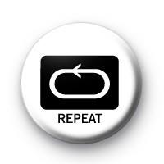
Findings: Attributes Mentioned in Open Questions
Attributes Repeated from Closed Questions
Documentation [Tool Attribute]
Raising Sustainable Funding [VO Attribute]
User-Centered Attributes
Willingness to Experiment
Co-Designing
Appropriate Service Level Agreement
Good Training and Instruction

Slide 27
Metaphors of e-Infrastructure

Slide 28
Metaphors of e-Infrastructure
Main results of previous analysis (USA)
Cyberinfrastructure presented as either:
Similar to ‘regular’ Internet metaphors
Huge disruption of current practices

Slide 29
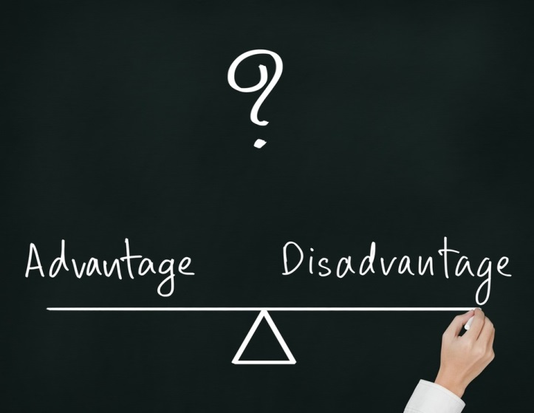
Metaphors and Diffusion Attributes

Slide 30
Metaphors Generated in Survey (N = 13)
e-Infrastructure metaphors similar to regular Internet metaphors

Slide 31
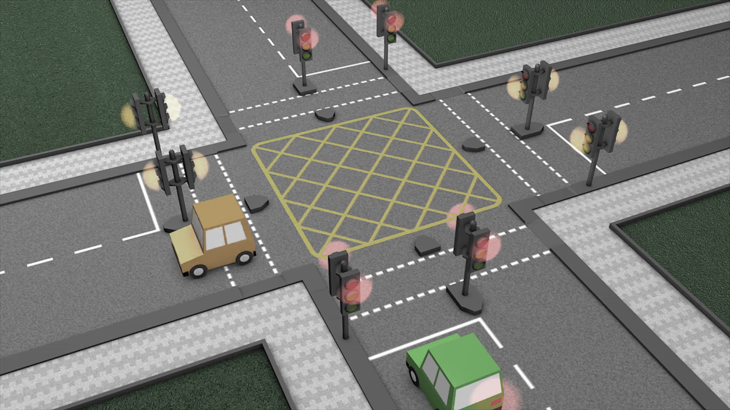
Metaphors Generated in Survey (N = 13)
Exploit metaphoricity of the word ‘infrastructure’:
“Like the road network. It supports all kinds of different vehicles for all kinds of different purposes - going to visit Grandma in a car, going to the shops on a bus, moving food in lorries from the farms to the supermarkets, riding bicycles. There's a set of rules, like traffic lights and roundabouts, and all driving on the same side that everyone must follow. As long as they follow the rules, then their vehicle can go on the roads. The roads are looked after by the Government, otherwise they'd just be muddy tracks like in the fields and everyone would be stuck and there'd be no-one to open the gates to let the traffic through”

Slide 32
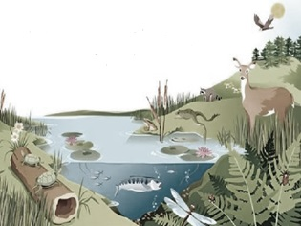
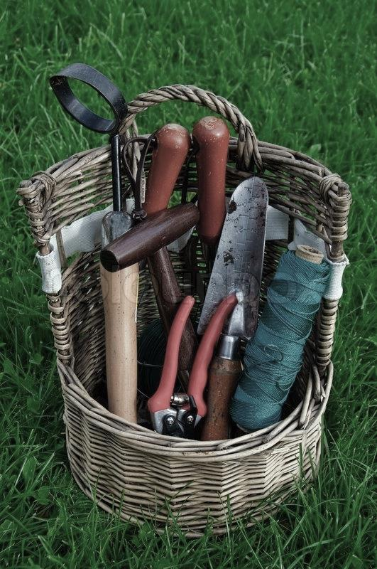
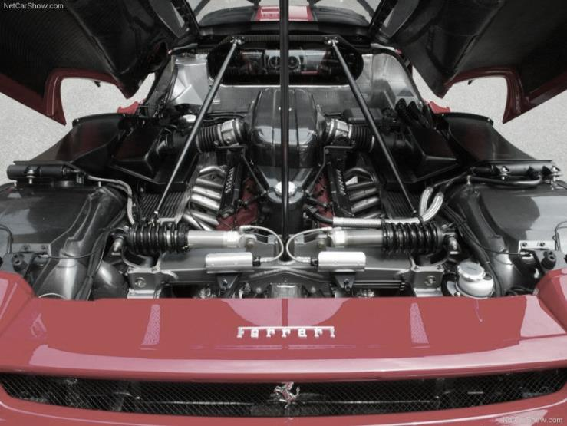
Metaphors Generated in Survey (N = 13)
New metaphors
Ecosystem
Car engine
Basket with tools

Slide 33
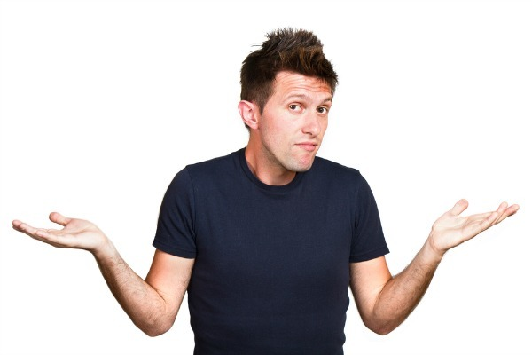
Only 4 (out of 13) Could Sensibly Explain e-Infrastructure
Statements by others who struggle:
“Read the documentation dude ! I am a developer”
“Don't know”
“I don't know i am a developer”
“Something with computers”

Slide 35
Kerk: kerk.kee@gmail.com
Homepage: www.ekerk.com
Kerk’s Research Team: www.octgroup.org
Christian: c.f.burgers@vu.nl
Ellen: e.f.droog@vu.nl
Homepage: www.christianburgers.wordpress.com
Christian’s research group: www.metaphorlab.amsterdam
This presentation is based upon work supported by the National Science Foundation under Grant No. ACI 1322305.

Slide 36
e-Infrastructure in Europe: Attributes and Metaphors for Diffusion
Christian Burgers, PhD
Associate Professor
Ellen F. Droog, MSc
Researcher
Kerk F. Kee, Ph.D.
Associate Professor
School of Communication
Chapman University
Orange, California
Department of Communication Science
Vrije Universiteit Amsterdam
Amsterdam, Netherlands

