Slide 1
EGI TF10
Technical Forum
14-17 September 2010
Amsterdam

Slide 2
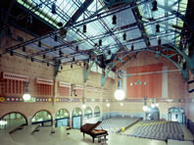
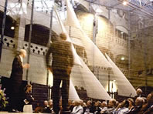
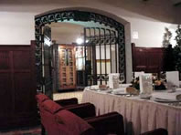
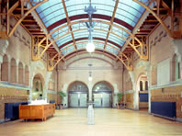
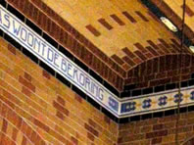
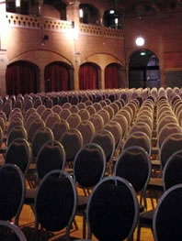
Hosting EGI TF10
‘Beurs van Berlage’, 13-17 Sep 2010.

Slide 3
General
Budget will be fixed soon
then registration can be opened
Block booking for hotel rooms
Outline of programme ready
5 parallel sessions
Details requested (conveners, abstracts)
Discussion on overlap and missing items
https://www.egi.eu/indico/conferenceDisplay.py?confId=48

Slide 4
Room overview
Big Room for exhibition, breaks, dinner
5 Lecture rooms
530 , 200, 180(2x), 130 seats
8 Small meeting rooms
16 (U-shape) – 50 (theatre style) seats

Slide 5
meeting overview
Project meetings (internal)
EGI-InSPIRE
EMI
IGE
E-Science Talk
Collaborations
Topical meetings (open/closed)

Slide 6
meeting overview
Topical meetings (open)
Operations
Community
Technology
Training
Security
Make content as attractive as possible to attract a large audience

Slide 7
meeting overview
Topical meetings (closed)
Operational Security coordination meeting between OSG/EGI/WLCF
More?
Closed room meeting procedure:
Request : time, size and indicate topics not to overlap with

Slide 8
Requested from you
Discussion on overlap
Discussion on missing topics
Call for confirmation on allotted time
Call for abstracts (deadline 21/5?)
AOB

