Slide 1
SA1 requirements review
P. Solagna, T. Ferrari

Slide 2
SA1 requirements dashboard
Dedicated dashboard collecting the requirements analysed and approved by OMB:
https://wiki.egi.eu/wiki/Track_UMD_Requirements
Contains the requirements flagged TCB Status: Submitted
Dashboard containing all the requirements tickets collected within the operations community
https://rt.egi.eu/rt/Dashboards/1749/SA1 Middleware requirements
It contains also the new tickets submitted but not yet discussed by the OMB

Slide 3
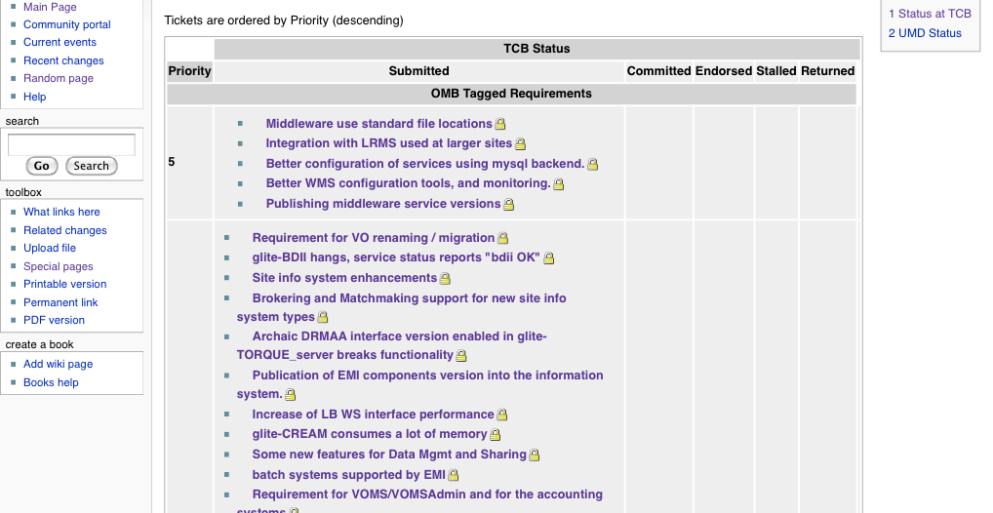
SA1 requirements dashboard <2>
High priority tickets

Slide 4
High priority tickets
Middleware uses standard file locations
Logs in /var/log temporary files in /tmp
Integrations with LRMS used at larger sites
PBS/Torque, SGE, LSF, Slurm, Condor
LRMS plugins have to collect the information needed in the GLUE 2.0 schema, as soon as it will be implemented in the Ces.
Better configuration of services using mysql backend.
Advanced MySQL server configuration file should be provided to improve services performances.
Better WMS configuration tools, and monitoring.
Implement configurations tips for known issues directly in production releases
Publishing middleware service versions
Automatic gathering of resource information, WNs OS, arch, etc; Correct publication of "service version" for all services

Slide 5
Globus
Support of GLUE?
GLUE 1.3
GLUE 2.0
Accounting
Messaging?
Usage records format?
Information discovery capability?

