Slide 1
Linked Challenges
Increasing the diversity of the users
Provide more diverse services for more users
Scale out the support model
Increasing the flexibility of the infrastructure
Move control back towards the users
Scale out the different environments
Virtualisation has a key role to play….

Slide 2
Federated Environment
EGI: Collaborations of resource providers
EGI.eu: Provides the European coordination
Standards (e.g. OGF, DMTF, SNIA, …)
European Intergovernmental Research Organisations (EIROs)
National Grid Initiatives (NGIs)
National Grid Initiatives (NGIs)
Resource
Centre
Resource
Centre
Resource
Centre

Slide 3
Resource Centre View
Experts
End-User
GLUE 2.0
Information Services
SAML
VM
VM
VM
VM
Wide Area Access Control
OCCI
OVF
Management Control
VM Management Layer
CDMI
VM Image
Repository
Compute
Resources
Storage
Resources
Network
Resources
Resource
Centre
Wide Area Message Bus
JMX
UsageRecord

Slide 4
What does this mean?
No ‘big-bang’ migration
Gradual change transparent to the end-user
Clearly identify the role of the expert
Already residing in the NGI and VRCs
Increase the flexibility of the infrastructure
Allow experts to configure resources
Meet the immediate needs of their users
Experts from other communities have access
Demonstrate resources accessible to all

Slide 5
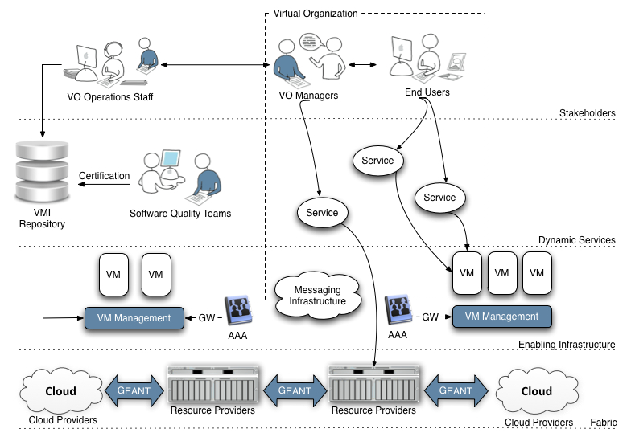
A Virtualised Future?
Experts
(Communicating between users & providers)
VO Specific Operations Staff
End-Users
(National, European & Global Collaborations)
End-User Technology Experts
(National, European & Global Collaborations)
Virtual Research Community
Infrastructure
Providers
Infrastructure Providers
(Research & Commerical – National, European & Global)

Slide 6
A Virtualised Ecosystem
EMI & IGE
VO Specific Operations Staff
EDGI
NGIs
EIROs
VOs
EGI-InSPIRE
StratusLab
VENUS-C
NGIs
EIROs
VOs
Commercial

Slide 7
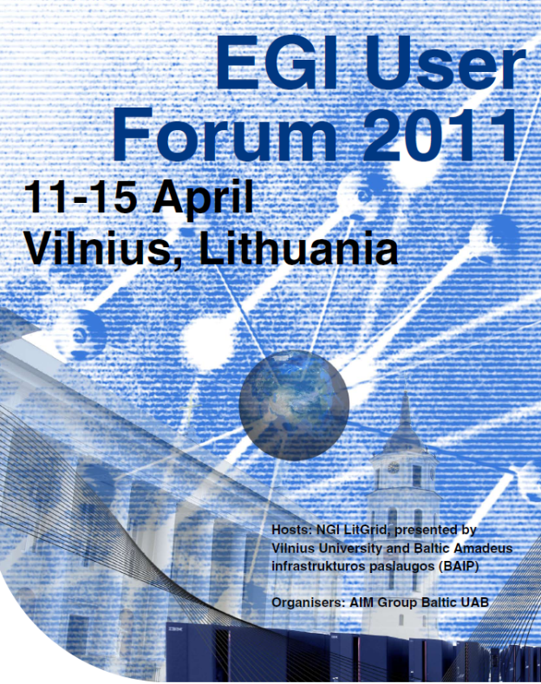
Next Steps
EGI User Forum, Vilnius
Virtualisation and cloud track
Tutorials: StratusLab & VENUS-C
EGI User Virtualisation Workshop
12-13th May 2011, Amsterdam
Cloud: how, when & where for EGI
http://go.egi.egi/uvw1
EGI Technical Forum, Lyon
Adoption of virtualisation by EGI
How to provision resources at scale

