Slide 1
EGI User Virtualisation Workshop
Steven Newhouse & Michel Drescher
EGI.eu

Slide 2
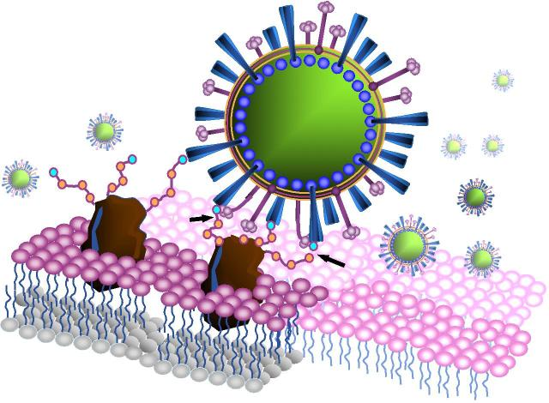
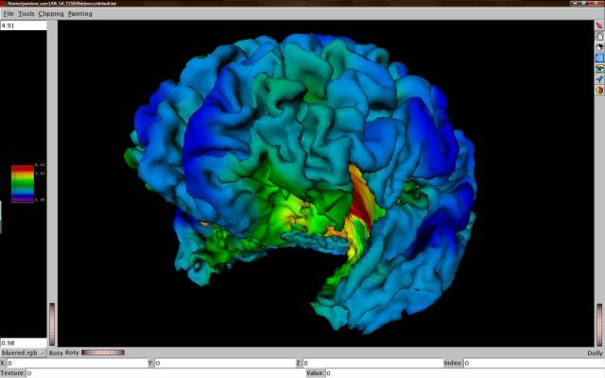
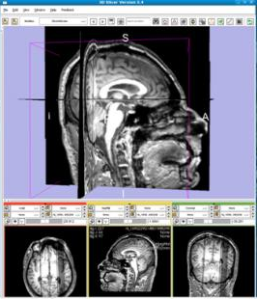
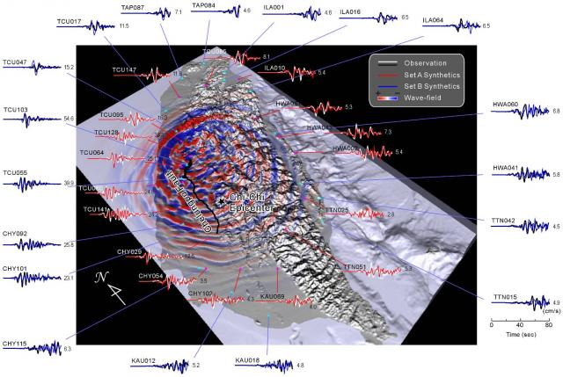
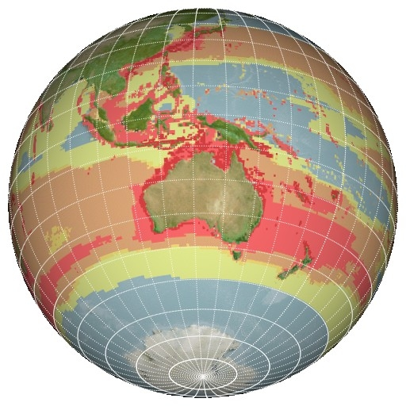
C21: Digital Research
Extracting Knowledge from the Data Deluge

Slide 3
Linked Challenges
Increasing the diversity of the users
  Provide more diverse services for more users
  Scale out the support model
Increasing the flexibility of the infrastructure
  Move control back towards the end-users
  Scale out the different environments
Virtualisation has a key role to play in EGI….

Slide 4
This is why we are here…
Is virtualisation internal to the data centre?
  Enterprise VMM solutions
Is virtualisation just for providing different batch execution environments?
  CERN, CNAF and others
Should virtualised resources be exposed and accessible as for other resources?
  Yes… the question is how…

Slide 5

Starting Points…
EGI: Collaboration of resource providers
Virtualised Resources will be federated
Standards (e.g. OGF, DMTF, SNIA, …)
European Intergovernmental Research Organisations (EIROs)
National Grid Initiatives (NGIs)
National Grid Initiatives (NGIs)
Resource
Centre
Resource
Centre
Resource
Centre

Slide 6
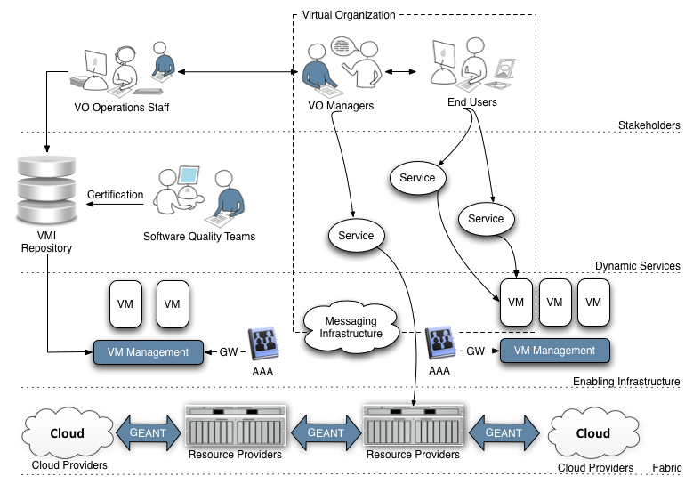
The Virtualised Future
Experts
(Communicating between users & providers)
VO Specific Operations Staff
End-Users
(National, European & Global Collaborations)
End-User Technology Experts
(National, European & Global Collaborations)
Virtual Research Community
Infrastructure
Providers
Infrastructure Providers
(Research & Commerical – National, European & Global)

Slide 7
A Virtualised Ecosystem
EMI & IGE
VO Specific Operations Staff
EGI-InSPIRE
StratusLab
VENUS-C

Slide 8
What does this mean?
No ‘big-bang’ migration
  Gradual change transparent to the end-user
Clearly identify the role of the expert
  Already residing in the NGI and VRCs
Increase the flexibility of the infrastructure
  Allow experts to configure resources
  Meet the immediate needs of their users
Experts from other communities have access
  Demonstrate resources accessible to all

Slide 9
Diving into the details…

Slide 10
Some Constraints
We have a production infrastructure
  Reuse the operational elements & model
We have a federated model
  Virtualised resources will not change this
  May see consolidation
  May see other (commercial?) providers
Need to expose this capability to others
  Completely to the end user? Probably not now
  To identified individuals in VOs? Probably yes

Slide 11
Key Usage Scenarios
Running a pre-defined VM Image
Running my VM Image (with my data)
Deciding which virtualised resource to use
Accounting across resource providers
Reliability/Availability of the resource
State change notification from the VM manager

Slide 12


Resource Centre View
Experts
End-User
GLUE 2.0
Information Services
SAML
VM
VM
VM
VM
Wide Area Access Control
OCCI
OVF
Management Control
VM Management Layer
CDMI
VM Image
Repository
Compute
Resources
Storage
Resources
Network
Resources
Resource
Centre
Wide Area Message Bus
JMX
UsageRecord

Slide 13
Interoperable Interfaces

Slide 14
This Morning
Assert there are 6 basic core use cases
  Is this true?
Which of these are the most important?
Are there more?
  Certainly…. Are they basic?
  Maybe… Discussion to follow.

Slide 15
Breakouts This Afternoon
How should they be monitored?
  What does up & working mean?
How should they be accessed?
  What elements of the VMM can be exposed?
How should use be accounted for?
  Work in JRA1 to adapt operational tools
  What data needs to be collected and how?
How are they discovered?
  What will users (& services) select on?

Slide 16
For all breakouts
Are there standards we should be using?
Are there best practices we should adopt?
What is the maturity of the software?
What is the availability of the software?
What are the priorities?
Where are the gaps, issues & concerns?
  What work is needed to remove these?

Slide 17
Bringing it Together
Start with reports from the breakouts
  15 mins each
  Answer the previous questions
Consolidation across the groups
  What are the global issues and concerns?
  What are our global priorities?

Slide 18
The way ahead…
Response from the technology providers
  Are you able to address these concerns?
  If so when?
Response from the resource providers
  Engagement in a testbed of virtualised resources?
  How does integration into EGI work?
Response from end-users (or reps!)
  Your interest and ability to use the testbed?

Slide 19
Outputs
Slides, session notes & workshop summary
  Beginning of June
Roadmap
  What do we need to do next?
Testbed
  Establishing resource for use
  Not as adhoc islands… but as an infrastructure

Slide 20
Core Usage Scenarios

Slide 21
Scenario 1
Running a pre-defined VM Image
VM Image known and accessible
VM Instance start, stop, dispose
Federated AAI restricts access to instance
Services
  VMM, AAI, Remote access
Notes:
Guidelines
========
Add as many references for further reading as required
This should at least include references to scenarios that either match, or extend existing EGI use cases.

Slide 22
Scenario 2
Running my data and VM in the Infrastructure
VM Image is generated by the user
VM Image upload, snapshot download
Data resident with provider
Runtime link to data by configuration
Services
  Data staging, VM Image configuration
Notes:
Guidelines
========
Add as many references for further reading as required
This should at least include references to scenarios that either match, or extend existing EGI use cases.

Slide 23
Scenario 3
Integrating multiple resource providers
Many resource providers
Comparable service descriptions
Integration at user level
Services
  Service description (Information)
Notes:
Guidelines
========
Add as many references for further reading as required
This should at least include references to scenarios that either match, or extend existing EGI use cases.

Slide 24
Scenario 4
Accounting across Resource Providers
Unique user identification across resource providers
Resource usage is accounted
Shared resource accounting profile
Services
  Accounting
Notes:
Guidelines
========
Add as many references for further reading as required
This should at least include references to scenarios that either match, or extend existing EGI use cases.

Slide 25
Scenario 5
Reliability/Availability of Resource Providers
Provider reliability and availability statistics
Historic accounts, and current figures
Regular publication of statistics
Services
  Monitoring, Reporting (Information?)
Notes:
Guidelines
========
Add as many references for further reading as required
This should at least include references to scenarios that either match, or extend existing EGI use cases.

Slide 26
Scenario 6
VM/Resource state change notification
Reactive/proactive management
VM Instance state change management
Real-time notification constraints
Services
  Notification (infrastructure, endpoints)
Notes:
Guidelines
========
Add as many references for further reading as required
This should at least include references to scenarios that either match, or extend existing EGI use cases.

Slide 27




Grid and Cloud Operations Interoperability – An overview
Alberto Di Meglio (CERN, EMI)
Morris Riedel (FZJ, EMI)
Shahbaz Memon (FZJ, EMI)
Cal Loomis (CNRS/LAL, StratusLab)
Davide Salomoni (INFN, WNoDeS)

Slide 28
ISGC Paper IAAS/PAAS/SAAS
The trend is foreseen to continue over the next years, forcing a greater integration between existing production grid infrastructures and the ability to provision resources „on-demand‟ that characterises the emerging cloud models [5].
The use of virtualisation to deliver „Infrastructure as a Service‟ (IaaS),
  hosted environments to provide a „Platform as a Service‟ (PaaS) and
  hosted applications to access „Software as a Service‟ (SaaS)
  promise to facilitate access to the research infrastrustructure to growing numbers of researchers and lower the deployment and maintenance costs for resource and middleware providers.

Slide 29
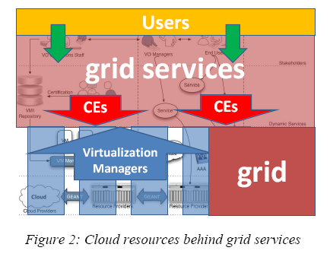
ISGC Paper Model 1
Scenario 1: Cloud resources behind grid services
Standardization plays a limited role in this scenario, since it concerns the interface betwenn CEs and VMs, where a standard API would allow to separate CE and VM implementations.

Slide 30
Model 1: Grid with private clouds
Users
grid services
CEs
CEs
grid resources
Virtualization Managers
grid

Slide 31
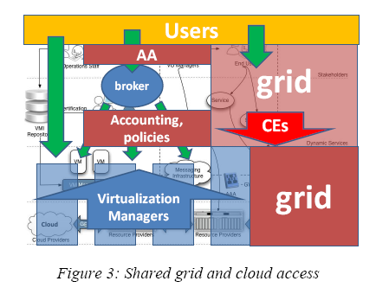
ISGC Paper Model 2
Scenario 2: Shared grid and cloud access
Remote access can be based on existing Virtual Organization principles and make use of existing Authentication, Authorization and Accounting (AAA) technology already extensively used by grid services, like VOMS, Argus or APEL.
The Infrastructure part is relatively simple to implement, but the access model requires extension of existing grid AA policies and technologies, accounting and brokering mechanisms to the cloud systems.
Standardization plays an important
role in in the AAA services and
in the Data Access services
in case data sharing between
the grid and the cloud services required

Slide 32
Model 2: Grid and cloud access
Users
grid services
grid
AA
broker
Accounting, policies
CEs
grid
Virtualization Managers

Slide 33
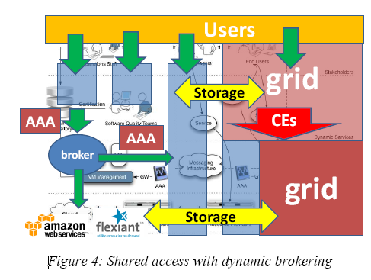
ISGC Paper Model 3
Scenario 3: Shared access with dynamic brokering
The infrastructure part of this scenario is more complex to implement than previous cases.
The access model requires extensions to the cloud virtualization managers of the AA policies and technologies and of the accounting and brokering mechanisms already used in the grid.
In addition potentially complex accouting and billing systems have to be put in place to interact with commercial public providers.

Slide 34


Model 3: Grid and hybrid cloud access
Users
grid
Storage
AAA
CEs
AAA
broker
grid
Storage

Slide 35
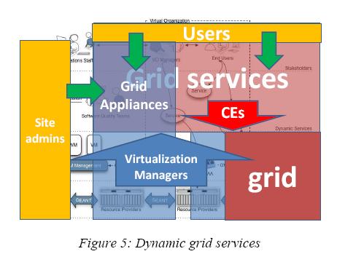
ISGC Paper Model 4
Scenario 4: Dynamic grid services
…the full potential of cloud can be exploited by realizing that grid services are indeed just services that can be provisioned according to the standard cloud approach
This model is based on the assumption that grid services are specialized services needed by specific communities, but do not differ from a “business” point of view from other services required by other communities and provisioned using the dynamic capabilities of clouds
in their PaaS or SaaS declinations
The grid services, or suitable subsets
of the current grid services, can
therefore be instantiated on demand
using pre-packaged appliances or by
deploying and configuring the services
on base virtual machines according to specific user communities requirements and then disposed of when not needed anymore.

Slide 36
Model 4: Virtual grid services
Grid services
Users
Site admins
Grid Appliances
CEs
Virtualization Managers
grid

