Slide 1
Accounting Breakout
John Gordon
EGI Virtualisation and Cloud Workshop
Amsterdam 12th May 2011

Slide 2
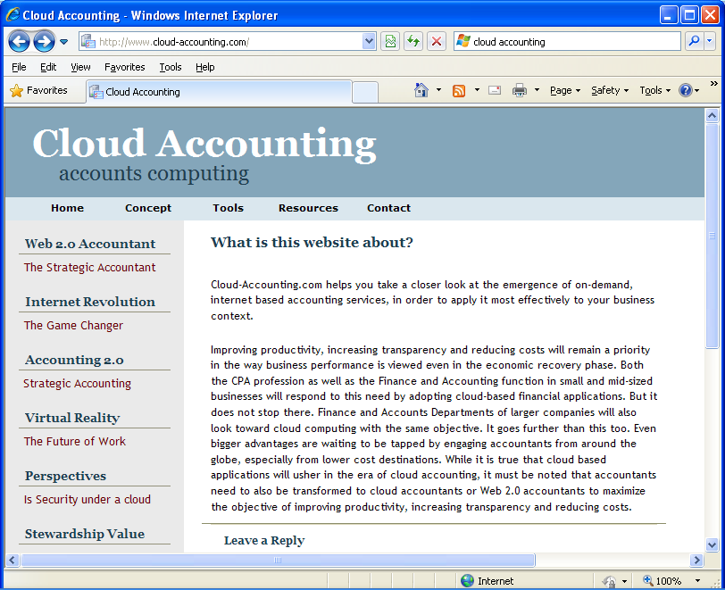

Slide 3
My View
My high level view of cloud accounting can be summarised as:-
Accounting for work done in a virtual machine can be done by traditional methods.
as long as you make sure any logging you need is persistent beyond the end of the VM.
I don’t think we need to spend much, if any, time of this today.
Accounting for the use of a VM instance is similar to that of a job, in that the resource you are accounting has a defined lifetime like a job and most of the resources you would account on like cpu, memory, i/o, networking, were foreseen in the OGF UR even though no-one has actually implemented them all yet (AFAIK).
Extend PGF UR?
Both the above need to be done but one risks double billing.
Eg both the VM owner and end user get charged
Notes:
----- Meeting Notes (5/12/11 13:37) -----
DW: Accounting for the service provider not for the end user.

Slide 4
software,
standards,
use,
gaps,
issues

Slide 5
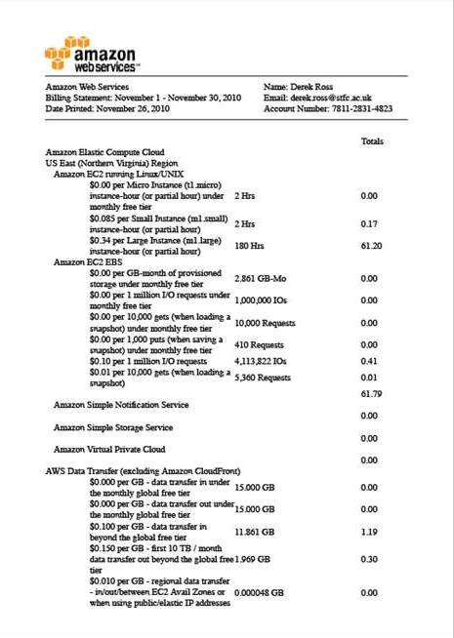
Software
EGI has infrastructure in place to collect accounting records
Hypervisors keep logs
Amazon etc produce bills
Other projects?
FLESSR

Slide 6
Features and requirements
Accounting for VM
Are a VM accountable like a job?
For VM (e.g services) running for months you don’t want to wait for the shut down of the machine (as for grid jobs) to bill for it. You need intermediate bills (e.g. weekly) for that VM usage.
If you account for a VM you account for all the time (with all the cores) the machine runs, either if it is idle or not
Accounting for storage
Accounting for a service more than the usage of the disk space. The persistence storage is reserved also after the VM is shut down
Currently there is no usage record for storage, as soon as it is available it could be used for both virtual and physical storage usage.

Slide 7
Standards
Start from the OGF current standard: Usage Record
Extend the current standards to account virtual resources
Standards for network accounting?
Account for reservation of resources and for actual usage
Notes:
----- Meeting Notes (5/12/11 14:09) -----
Usage record is the standard at the moment. The extensions to represent Virtual instances are very small.
Siena roadmap: is to extend current standards (like OGF) for VM accounting

Slide 8
Use
Account the actual CPU power available for the VM. That is what the user gets.
The provisioning of a instance defines the major part of the accounting, not the actual usage

Slide 9
Gaps
VM usage record
Storage accounting
Network accounting
Currently wrap into the job accounting
Data usage accounting
# of I/O operations (who’s billed?)

Slide 10
Issues
Identity management
Normalization
Billing
Fairness and capacity (out of scope)
Agreements and policies

