Slide 1
Accounting Breakout
John Gordon
EGI Virtualisation and Cloud Workshop
Amsterdam 12th May 2011

Slide 2
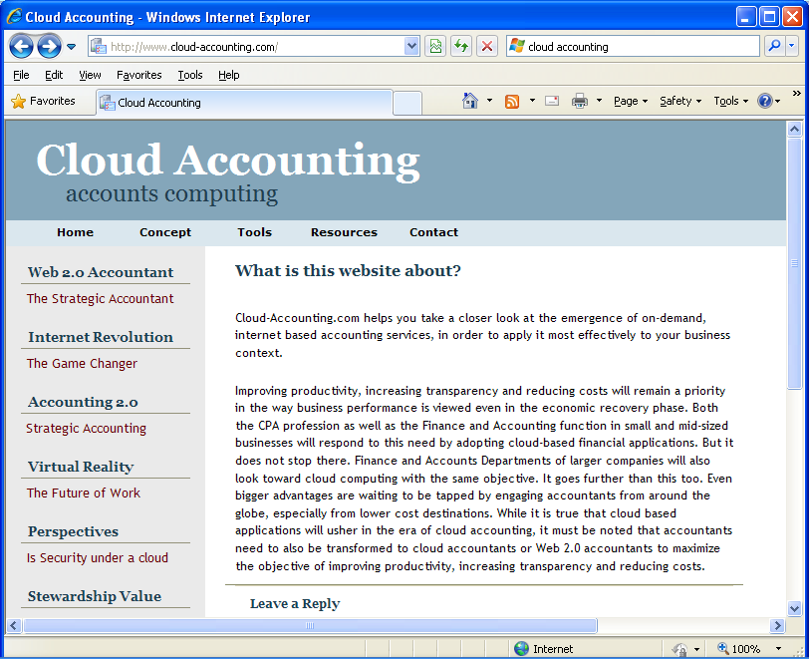

Slide 3
My View
My high level view of cloud accounting can be summarised as:-
Accounting for work done in a virtual machine can be done by traditional methods.
as long as you make sure any logging you need is persistent beyond the end of the VM.
I don’t think we need to spend much, if any, time of this today.
Accounting for the use of a VM instance is similar to that of a job, in that the resource you are accounting has a defined lifetime like a job and most of the resources you would account on like cpu, memory, i/o, networking, were foreseen in the OGF UR even though no-one has actually implemented them all yet (AFAIK).
Extend PGF UR?
Both the above need to be done but one risks double billing.
Eg both the VM owner and end user get charged

Slide 4
software,
standards,
use,
gaps,
issues

Slide 5
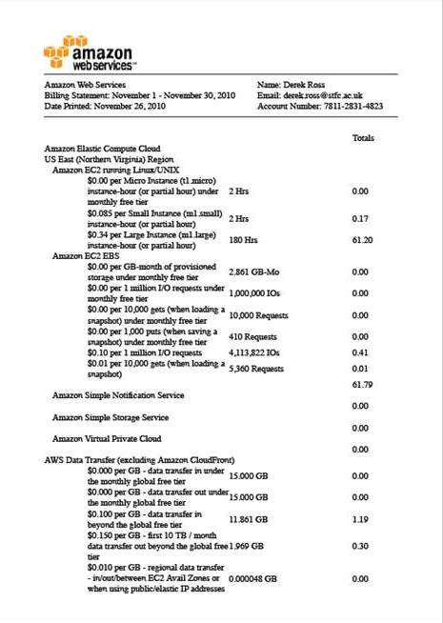
Software
EGI has infrastructure in place to collect accounting records
Hypervisors keep logs
Amazon etc produce bills
Other projects?
FLESSR

Slide 6
Standards
?

Slide 7
Use

Slide 8
Gaps

Slide 9
Issues

