Slide 1
Accounting Standup
John Gordon
EGI Virtualisation and Cloud Workshop
Amsterdam 13th May 2011

Slide 2
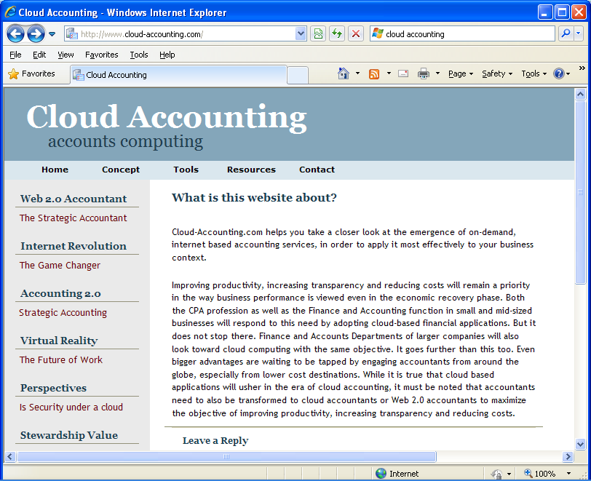
What is Cloud Accounting?

Slide 3
Scope
Accounting for work done by users inside a virtual machine should be done by traditional methods. Out of Scope
Eg an elastic WN will report its accounting back through a real or virtual CE
just make sure any logging you need is persistent beyond the life of the VM.
Cloud Accounting should be for the use of a VM instance by the person(?) who instantiates it. In Scope.
If they wish to carry out more granular accounting within the VM for recharging that is their prerogative but is Out of Scope
Storage Accounting
Elastic Storage in VM In Scope
Persistent Storage Out of Scope. Cloud and Grid Storage should cut the same accounting record.
Residual issue of adding storage accounting capability to purely cloud-based persistent storage
Network Accounting
Some network use can be accounted to the VM but things like virtual switches don’t fit there.
Notes:
----- Meeting Notes (5/12/11 13:37) -----
DW: Accounting for the service provider not for the end user.

Slide 4
Accounting for the VM
The lifecycle of a VM has many similarities with that of a job.
It has a defined lifetime and most of the resources you would account for (cpu, memory, i/o, networking), were foreseen in the OGF UR even though no-one has actually implemented them all yet (AFAIK).
Majority view that one should charge for the footprint of the VM times lifetime
E.g. #cores*(endtime-starttime)
NOT actual cpu used by VM.
Q can we have big enough clouds with sufficient overprovision that an instantiated but inactive VM can attract zero or very low charges?

Slide 5
Software
EGI has APEL infrastructure in place to collect accounting records
Extensible to include new record types like VM.
Hypervisors keep logs, OpenNebula has tools to gather these.
FLESSR has defined a schema of VM characteristics which it has harvested from Eucalyptus

Slide 6
Standards
Start from the OGF current standard: Usage Record
Extend the current standards if required to account virtual resources
Siena roadmap: is to extend current standards (like OGF) for VM accounting
Standards for network accounting?
Account for reservation of resources and for actual usage
Notes:
----- Meeting Notes (5/12/11 14:09) -----
Usage record is the standard at the moment. The extensions to represent Virtual instances are very small.
Siena roadmap: is to extend current standards (like OGF) for VM accounting

Slide 7
Use
FLESSR has collected accounting records
No evidence of real work from other cloud projects although they all show willing.
Examples exist of local clouds accounting their use in various ways.

Slide 8
Gaps
VM usage record
Kick off with OGF in existing UR-WG
Storage accounting
Check whether there are virtual storage types to be instrumented.
Network accounting
Data usage accounting
# of I/O operations (who’s billed?)
Probably out of scope for cloud. Same solution as traditional data centres – no standard

Slide 9
Issues
Standard hooks in Hypervisors to provide the information
Identity management
Current infrastructures don’t use the same ones as grid.
Sites need to identify who endorses and instantiates images
Normalization
The power of a virtual cpu is not so well-defined
Billing
How long have you got?
Fairness and capacity (out of scope)
How is overcommitment and pre-emption treated for accounting?
Agreements and policies
Framework for recharging agreements.
Policies for exchange of data, pricing definition

Slide 10
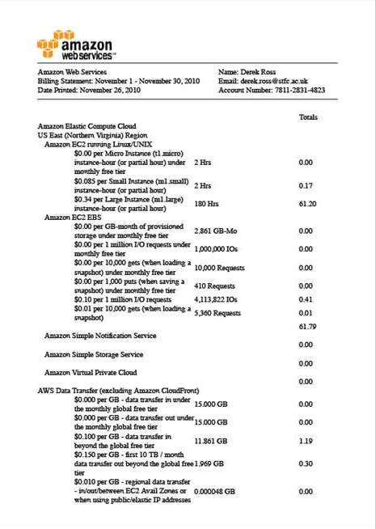
Just to show it can be done.

