Slide 1
Monitoring Session Summary
EGI Virtualization Workshop
12-13 May, Amsterdam
Thanks to all the participants, Peter Solagna for slide editing and Vangelis Floros for notes!

Slide 2
Structure
9 RP, 9 D (uh oh), 2 U
Four parts:
Why Monitor
What to Monitor for 1.
How to Monitor 2.
Required questions based on 3.
Spent almost all time on 1 and 2

Slide 3
"You've got to be very careful if you don't know where you are going, because you might not get there."
Yogi Berra

Slide 4
Why Monitor
What is “problem needing solution”
Lots of scope discussion
Monitoring != Measurement : monitoring concerns answer to question “functioning correctly?” Lots more things being measured than monitored …

Slide 5
Scope
User monitoring : done by users; just make sure we don’t make it hard for them
Site admin monitoring (bare metal) : use what we already have
Security monitoring perhaps is more important in virtual world; we did not explore this. Somebody should look at whether we need to do anything (nb we don’t do this now either).

Slide 6
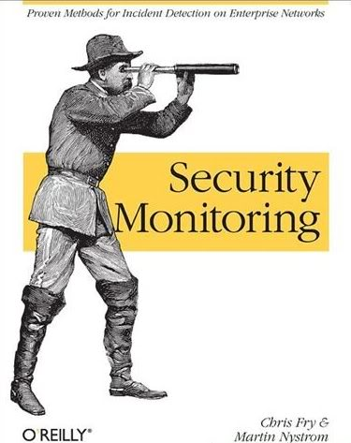

Slide 7
What’s left of why
Determine whether the service is functioning correctly
Basic info on activities of VM
Amazon provides:
Avg & peak net in/out, cpu utilization, disk reads/writes
Understand whether there are contention problems within farm
May be handled by VM mgt layer?

Slide 8
What’s
Do not monitor what is happening inside the VM
Inspecting VM internal behavior raises privacy issues
Fuzzy line between monitoring and information

Slide 9
Open questions
What monitoring of VMs is provided by various VM mgt systems? Is this enough?
If not, do we want to develop community probes (ganglia?) aimed at detecting contention?

Slide 10
What to do
Service level tests of VM gateway service
External tests “submit a VM and see what it does” akin to current job submit tests
Nagios framework already exists; use this!

Slide 11
Answers to the needed questions at infrastructure level
Standard
De facto standard: Nagios
Best practices: Nagios
Maturity level of the software: ok
Availability of the software: ok
Priorities : develop the two plugins.
Gaps, issues and concerns
Somebody needs to write the plugins

Slide 12
Answers for Security Monitoring
Inform ourselves first on best practice
If nothing new is needed, develop nothing
To 0th order should need nothing new since a VM is just an application

Slide 13
Issues identified but out of scope
Users want to know which VMs they have started and what is their status
We assume that the VM management layer is rich enough to have internal monitoring where necessary (eg can I shut down host Z in ten minutes?)
Large class of things to be measured for scheduling purposes!!! When will my VM run, how many VMs can I run, etc.
Where is the data closest to my job?

