Slide 1
OMB Jul 2018
Matthew Viljoen – EGI Foundation
EGI Operations Manger

Slide 2
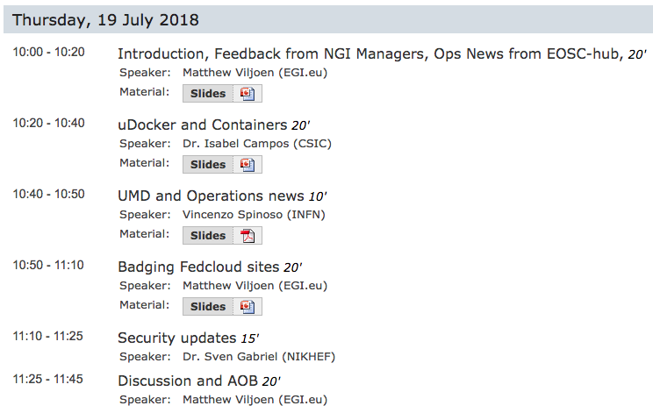
Agenda

Slide 3
Feedback from NGI Managers
Face-to-face or virtual meetings with NGI(/ROC) managers to: get feedback, future plans, identify problems with EGI/Operations
So far meetings with:
NGI-CN
NGI-CZ
NGI-GE
IberGrid
CERN
A few common themes
  managing distributed infrastructure with limited effort
  lack of recognition of resource contribution to EGI
  lack of recognition of strongly performing Fedcloud SPs

Slide 4
Feedback from NGI Managers – follow-up
  Managing distributed infrastructure with limited effort
    - improved use of reliable tools for centrally managed service automation
    - more consistent use of reliable deployment tools
    through better documentation, templates provided by EGI Central Operations team
Lack of recognition of resource contribution to EGI
  - improved citation of work contributed by EGI resources
  - stress importance of VO managers of citation in publications
  - better enforcement of citation
Lack of recognition of strongly performing SPs
  - revisit the concept of ‘badging’ Fedcloud Fedcoud sites (talk later)

Slide 5

Operations News from EOSC-hub – Harmonization of operations
Three focus areas:
  1. Operations Governance
  method to oversee service delivery
  2. Service Monitoring
  common procedures, reducing duplication & spreading best practice
  3. Collaboration between member e-Infrastructures
  common operations procedures, tools

Slide 6
Operations News from EOSC-hub – Harmonization of operations
Proposals agreed upon regarding harmonization of 3 key areas:
  1. Operations Governance
  new body similar to OMB reporting to AMB, covering operations and development of EOSC-hub SMS processes. Writing ToR to be ready for launch of first EOSC-hub services (Marketplace, XGUS)
  2. Service Monitoring
  common procedures based on ARGO. need for consistent OLAs across eInfrastructures. Being prepared.
  3. Collaboration between member e-Infrastructures
  peering MoU, initially between EGI and EUDAT. In preparation.

Slide 7
Operational Requirements for Entry to the EOSC-hub Catalogue
D4.1 Operational Requirements for entry to the catalogue now ready for submission
Level of Integration
Internal Catalogue
Supporting services. EOSC-hub SMS
HIGH
External Catalogue
Services from participating e-Infrastructures
Thematic services
Other services wishing to participate in EOSC-hub
MEDIUM
LOW
D4.1 specifies requirements ordered by FitSM process & operational coordination (SHALL/SHOULD…)

Slide 8
EOSC-hub Rules of Participation Task Force
co-chairs: Mark van de Sanden, Matthew Viljoen
Three working groups:
#WG1 Development of the Service Description template (Mark)
and its relation to the eInfraCentral Service Description template
#WG2 Operational requirements (Matthew)
initial output is D4.1 Operational Requirements
#WG3 Defining the contours of the RoP (Damien Lecarpentier)
3 scenarios: fully integrated, semi integrated, service promotion

Slide 9
Defining the contours for the EOSC-hub RoP
Entering the EOSC
How high must be the bar
Service
Promotion
Semi-Integrated
Fully Integrated

Slide 10

Upcoming events
DI4R, 9-11 Oct 2018, Lisbon, Portugal
https://www.digitalinfrastructures.eu/
Jointly organised by EOSC-hub, GÉANT, OpenAIRE and PRACE
27 Jul Draft programme online
17 Aug Early bird closes
24 Sep Registration closes

Slide 11
Next OMB
Next OMB?
  Matthew, Alessandro on leave last 2 weeks of Aug
  20 Sept?
To be confirmed on ML

