Slide 1
Badging of Fedcloud sites
Matthew Viljoen – EGI Foundation
EGI Operations Manger

Slide 2
Background
EGI Fedcloud consists of multiple members – range of Service Provider (SP) maturity and abilities
Difficult for users to distinguish between more mature and less mature SPs
Lack of ready recognition for well performing SPs
Lack of incentive for sites to improve among other fedcloud SPs

Slide 3
Proposed solution – ‘Badging’
Badging – a recognition scheme for the most mature SPs
Easily recognised incentive to be grouped among the best performing SPs
Helping to foster…
Continuous service improvement via carrot (rather than stick) approach
Transparent key metric results
Easier site setup documentation

Slide 4
Proposed criteria
‘Gold’ badge awarded to SP which fulfil the following targets:
≥98% AR running average over previous 3mo
&&
Running a supported CMF*
&&
No ‘long-standing’ tickets waiting on SP*
Results of sites may be determined at a fixed day each month
*details to be defined

Slide 5
Proposed implementation
Badges can be logos used for marketing and SP selection tools (e.g. VMops Dashboard)
Higher (platinum) or lower (silver, bronze) badging could be introduced later
Critical points:
Need for very clear and well understood defining criteria from the beginning
Need for documentation and assistance for sites to achieve targets

Slide 6
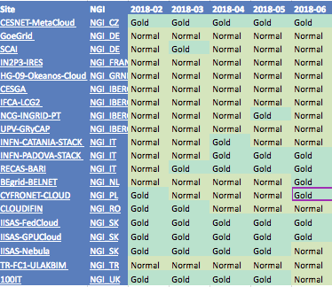
Example results (just AR)

Slide 7
Next steps
Obtain feedback/concerns from Fedcloud SPs DONE see next slide
Present the work to OMB for approval to proceed
Finalize badging criteria & provide documentation how to obtain targets
Implementation and publicise

Slide 8
Feedback from Fedcloud SPs
Agreed to the idea in principle but needs to see more detailed criteria
“Running a supported CMF” – Difficult to achieve due to high upgrade frequency
-> “Running a supported/recent CMF”
Could consider other points to test for “added value” given by Fedcloud – interoperability?
->Can evolve/improve criteria over time

