Slide 1
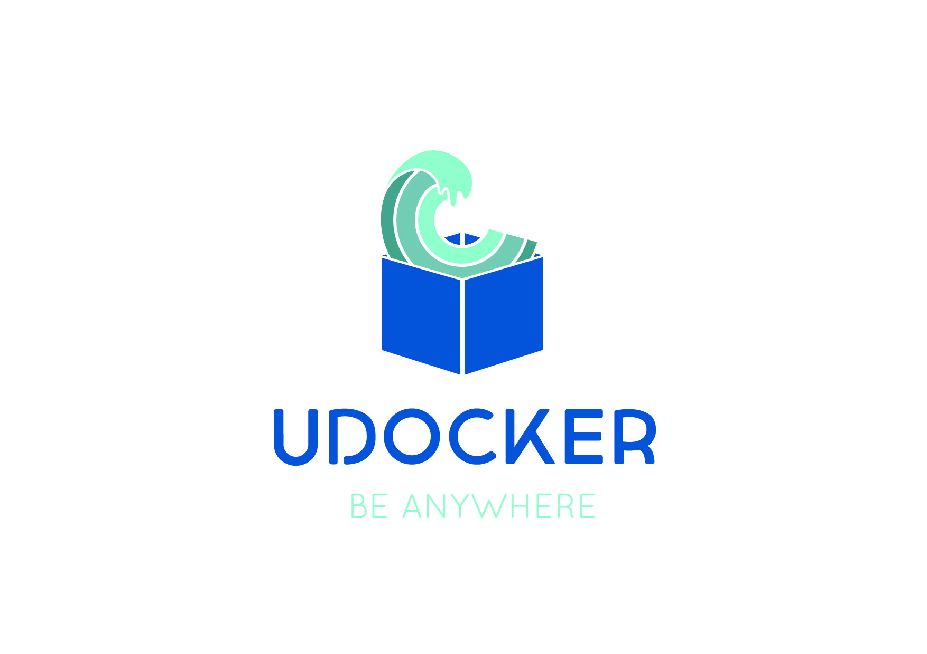
A basic user tool to execute simple docker containers in batch or interactive systems without root privileges
Developed by: Jorge Gomes @LIP (jorge@lip.pt)

Slide 27
REFERENCES
“Enabling rootless Linux Containers in multi-user environments: the udocker tool”
Computing Physics Communications (Open Access)
https://doi.org/10.1016/j.cpc.2018.05.021
More detailed presentations on the IBERGRID page at:
https://wibergrid.lip.pt/site/containers/

