Slide 1
T10.3 Community Requirement Analysis and Technical Support Record requirements in JIRA Diego Scardaci (EGI F.) AMB Co-Chair and T10.3 leader
11 July 2018

Slide 2
CHM JIRA queue customized for service requirements
EOSC-hub service → “component” in JIRA
From the service catalogue
Service owner will be notified
Service components
Project tasks
Multiple selection possible
TCOM area
list of TCOM areas
Multiple selection possible
Link to the Community Requirement DB entry
GAP
Yes/No
Description

Slide 3
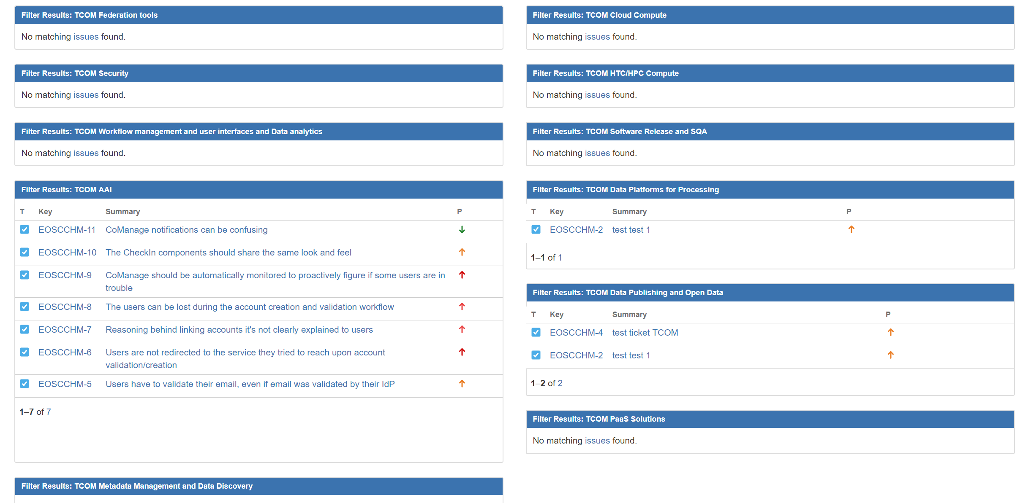
Dashboards
WP5, WP6, WP7
Technical areas (TCOM)

Slide 4
Workflow
Workflow to process the tickets under definition
Involvement of the technical groups according to the TCOM areas of the ticket
Requirements with ‘no GAP’ will be managed by the Change Management (CHM) process
Requirements with ‘GAP’ will be managed by T10.4 in conjunction with Continual Service Improvement (CSI) process
Please, start to record the identified requirements in the queue!!!

Slide 5
Any Questions?

