Slide 1
Integrating and managing services for the European Open Science Cloud
Project updates for WP8
Gergely Sipos
Customer and Technical Outreach Manager (EGI Foundation)

Slide 2
CLARIN
CMS (DODAS)
Climate (ECAS)
GEOSS
OPENCoastS
WeNMR
EO Pillar
DARIAH
LifeWatch
CyberHAB (SME: Ecohydros)
Moxoff (3 SMEs + CINECA)
Bot Mitigation Engine (2 SMEs + PSNC)
Suite5Pilot (2 SMEs + CINECA)
ACTION Seaport (SME: Bentley Systems)
DS-DRACO (SME: Hidronav + CESGA)
Service adoption
ELIXIR
Fusion (ITER)
Marine
EISCAT_3D
EPOS-ORFEUS
LOFAR
ICOS-eLTER
Disaster Mitigation
EOSC federating core
Thematic services (9)
WP5
WP6
WP5
WP7
Federation Services
AAI, Accounting, Monitoring, Operations, Security
Added value services
Compute, data, software management, curation & preservation
Open Collaboration Services
Application/software repository, Configuration management, Marketplace
WP10
integration
WP6
Basic infrastructure
Compute and storage
integration
integration
Engagement and support for new communities
integration
WP10
TS from M19:
Marine
EISCAT_3D
WP10
incubate
WP10
Provide
Integrate & Consume
incubate
Competence Centres (8)
Business pilots (6)
New communities
WP3
WP4
WP8
WP9

Slide 3
Community requirements odyssey
Focus in 2018: 23 existing communities
We built a truly community proposal (using open calls)
Community events (~every months)
Kickoff meeting; EOSC-hub Week, DI4R, …
1-on-1 engagement teleconferences
WP10 tech support
Tech-talks → Area-specific consultancy web-meetups
Storage; AAI; Cloud-Containers-Orchestration
Webinars
Cost efficient training
→ Confluence-based DB for tracking and analysis

Slide 4
Topics
Updates from WP10 (Requirement tracking; AAI; Cloud, etc.)
Sharing data in EOSC: expectations, suggestions, possibilities, opportunities
EOSC portal, launch event, demos
Upcoming events: DI4R; Community events
Planning next monthly meetings

Slide 5
WP10 – Formalising stories, capturing reqs. for service providers
Write user stories into Requirements DB: https://wiki.eosc-hub.eu/display/EOSC/Community+requirements+DB
User stories (informal description of a system from the user perspective)
Use cases (list of actions and interactions by ‘roles’)
Derive requirements from these and record them in Jira: https://jira.eosc-hub.eu/projects/EOSCCHM/summary
I suggest the first candidate to be ELIXIR
The 'user story' is already described in a recent doc we sent to the EOSC 2nd HLEG.
Some requirements are already captured:
Community/project separation in FTS (EGI FTS service at CERN/RAL)
Having Kubernetes as a Service from EOSC

Slide 6
Use cases - Competence Centres (WP8)
 | Challenges | Relevant EOSC-hub services
ELIXIR CC | Establish a federation of cloud providers to replicate ELIXIR Core Datasets and Applications Bring these cloud-data providers into EOSC Enable federated AAI across life science and EOSC services | Federated Cloud AAI Operational policies Experience with Virtual Access Code of Conduct for sensitive data
Fusion CC (ITER) | Port fusion workflows to federated compute environment Federate and enable access to distributed datasets Application and data provenance | AAI Data and compute federation (containers) Workflow management Monitoring, helpdesk, PIDs, ...
Marine CC (Ifremer, Euro-Argo) | Cloud-based data subscription and data delivery service (from EMSO, Argo, SeaDataNet, etc.) Enabling users’ simulations to run within custom environments on ‘subscribed data’ Operate the setup as an EOSC service | Storage and compute clusters Data discovery and staging (B2Find, B2Stage) Jupyter service (24/7) FitSM (IT service management)
EISCAT_3D CC | Make EISCAT data accessible via a ‘data webshop’ Enable online data analytics for researchers (based on community and custom applications) Operate the data-compute portal as an EOSC service | B2Share (metadata schema management) DIRAC file catalogue and application manager for researchers Federated compute sites (cloud) User authentication, authorisation (VOMS, Perun) FitSM (IT service management)

Slide 7
Use cases - Competence Centres (WP8) (cont)
 | Challenges | Relevant EOSC-hub services
EPOS - ORFEUS CC | Effective transfer and staging of big data Harmonised data management policies at seismic observatories Enable researchers to analyse data, create and publish ‘user-defined data products’ | AAI Data staging and transfer services Federated compute services Jupyter (data access and analytics environment) Data Management good practices
Radio Astronomy CC (LOFAR→ SKA) | Enable researchers to find, access and process data from the LOFAR Telescope Support application developers in deploying workflows for researchers Support research users in data analytics on federation of compute clusters | B2Find - B2Share B2Stage B2Safe B2Handle (PIDs) Jupyter Federated compute and storage resources
ICOS-eLTER CC | Enable researchers to find, access and process data from ICOS and eLTER Integrate ICOS Portal and analysis tools with large-scale storage and compute resources Support research users in data analytics on federation of compute clusters | B2Safe B2Find B2Stage Federated cloud
Disaster Mitigation Plus CC | Setup simulation web portals for simulation of natural hazards (storm surge, dust transportation, forest fire, flood) Federate environmental data from agencies in Asia-Pacific region | Federated compute resources (HTC and cloud) Operational tools FitSM
Notes:
AAI survey – To complete based on learnings from

Slide 8
Distilled use cases (WP8)
Distilled use case | Implementation by | Relevant services
Application and data platform (portal/mobile) | EISCAT_3D ICOS-eLTER | DIRAC B2Stage, B2Share B2Safe | EOSC-hub AAI Fed.Cloud Containers Storage (online, archive)
Data and application replication ‘backbone’ | ELIXIR EPOS-ORFEUS | FTS, B2Stage Kubernetes Life science AAI; EPOS AAI
‘Dropbox with pattern-matching’ for data streams | Marine | B2Find, B2Stage Jupyter
User workflows over distributed data and compute | Fusion Radio astronomy Disaster Mitigation | DODAS OneData Jupyter

Slide 9
Requirements so far
CC | Story | New requirement
ELIXIR | Replicate ELIXIR Reference Data from EBI to partner clouds (CSC, CESNET) → FTS Enable users to run data processing VMs in local cloud → Kubernetes | Community/project separation in FTS Baptiste (EGI FTS) Kubernetes as a Service Enol
Radio astronomy | Provide access to LOFAR ‘big data’ on compute facilities with large workspace Enable users to deploy and run CWL workflows | Support for Singularity on compute clusters ? Support for CWL workflows ? Q: Is/will SURFnet Science Collaboration Zone pilot supported in EOSC-hub ?
Note: Many requirements are addressed within the CCs (Service providers are in the CCs!)
More ‘non-addressed’ requirements are expected to emerge soon:
Monthly WP8 task leaders meetings
Start the work towards M8.1 - Technology assessment, architecture integration & validation plan for CCs

Slide 10
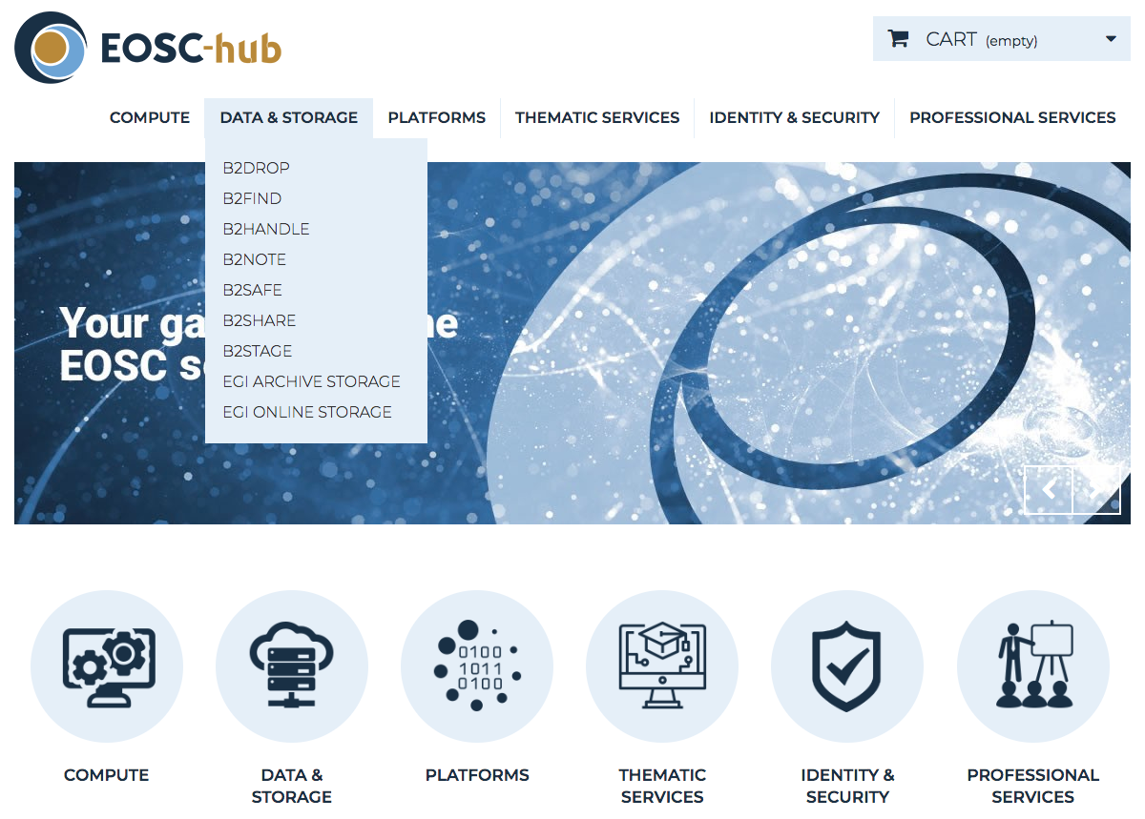
Sharing data in EOSC
+ Data(sets)
Which data? RI?
Mode of access?
What protocols?
…
Expectations
Suggestions
Possibilities
Opportunities

Slide 11
EOSC portal launch event (Nov 2018)
The EOSC Portal will be composed of three online platforms:
A website providing general information about EOSC
A marketplace, providing an online delivery channel of services for science (EOSC-hub Marketplace)
A catalogue to compare services (~eInfraCentral)
Demos at the event – Under discussion. Candidates:
Generic researcher (browse, compare)
WeNMR: App. Portal (with HTC), EUDAT storage (result)
OpenCoastS:
SMEAR (ENVRI): Jupyter, GitHub, Zenodo (results)
Others: ELIXIR, ENES, LifeWatch, ICOS, EOSCpilot SDs
Interest from the others?

Slide 12
Upcoming events
DI4R: EOSC-hub, GEANT, OpenAIRE, PRACE (9-11 Oct)
28 abstracts from EOSC-hub
Plenaries in the morning + 4 parallel tracks
Each organiser to have a dedicated session to fill
Programme to be published late this week
Should we co-locate a WP8 CC leaders' f2f meeting?
Other events (from https://wiki.eosc-hub.eu/display/EOSC/Events)
ICOS science conference: September 11-13
ICRI: Sept 12-14
EISCAT radar school: October
EPOS-IP annual meeting: October (clash with DI4R)
CORBEL AGM: Oct 16-17 (ELIXIR CC contrib?)

Slide 13
Planning next meeting
RACC meeting in late Aug/early Sep
Other CC meetings?
WP8 leaders’ call: early-Sep? Mid-Sep?

Slide 14
Thank you for your attention!
Contact:
www.eosc-hub.eu
Gergely.sipos@egi.eu
Questions?

