Slide 1
AMB Rules of Particpation TF meeting 20180713

Slide 2
AMB Task force on RoP
3 Working groups
  Harmonizing Service Description template for EOSC-hub
  Defining Operational requirements for production services
  Defining the contours for the RoP framework

Slide 3
WG1: Harmonizing Service Description template
https://wiki.eosc-hub.eu/display/EOSC/Service+Portfolio+Entry+Template
Based on eIC Service Description template: einfracentral.eu/sites/default/files/ServiceDescriptionTemplate/1.00.xlsx
Template categories
  Basic information
  Service Maturity
  Service Classification
  Service Management
  Service Contract
  Service dependencies
  Service Options -> mainly needed for MP options
  Service Attributes
  Service Components
  Service Level Target
  Service Access Policy
  Service Provider
Missing a service category on data management
  Backup and/or Archiving policies
  Compliance to FAIR principles
  Features as: Metadata, PIDs, data management policies, ….
Missing KPI
  eIC is working on a proposal for KPI’s to be collected
  Specific KPI’s for VA are excluded, Mal is collected these herself

Slide 4
Harmonizing Service Description template

Slide 5
WG2: Defining Operational requirements for production services
Matt

Slide 6
WG3: Defining the contours for the RoP framework
Entering the EOSC
How high must be the bar
Service
Promotion
Semi-Integrated
Fully Integrated

Slide 7
Collaborations outside of the project
EOSCpilot
  This study aims to identify and propose a preliminary set of Rules of Participation for Service Providers and Users in EOSC
  Preliminary analysis and consultations (since May 2017)
    Analysis of 7 e-Infrastructures, 11 Research Infrastructures, 2 commercial cloud providers and scientific initiatives established on the basis of charters/codes of conduct.
  Documentation
    https://www.eoscpilot.eu/content/d53-eosc-federated-service-management-framework
    https://docs.google.com/document/d/1MXOV8_kTzy8-wh9pK6ZEmzouvNqQs4Kr2ci_FDS568s/edit

Slide 8
Possible Scenarios
Federation type
Loose
Scenario 1: Service Promotion
Independent ITSM processes
Mainly for service promotion
Agree to EOSC RoE; Service Description template
Scenario 2: Semi integrated
Services that are partly relying upon components operated by other service providers, such as EOSC federating core services.
ITSM focus is limited to strategic interfaces to ensure regular operation of the service(s)
  e.g. OLAs, incident handling and problem management of component dependencies)
Scenario 3: Fully integrated
Services being offered as part of EOSC supported services.
Services that are fully integrated to the EOSC federating core services.
All ITSMS processes are managed via the EOSC SMS
  e.g. services definition follow a structured approach, consumers of the services can request services directly via the EOSC Portal, incidents and changes are centrally managed
Tight

Slide 9
Rules of Participation for Service Providers
Main rule of Participation: EOSC services shall be ​registered in an EOSC compliant or compatible service catalogue visible to the global EOSC gateway.
Machine-readable metadata: All services must include machine readable metadata and be identifiable by means of a common and persistent identification. Minimal information should be provided to the appropriate catalogue to allow users to assess the service providers (e.g. quality indicators, FAIR indicators, licences, etc).
Terms of Use/Access Policies: All EOSC services must have Terms of Use and/or Access policies displayed publicly online and/or via the EOSC Service catalogue(s).
Accessibility: EOSC Service Providers must describe how they ensure accessibility and provide information in the appropriate service catalogue on, e.g. their metadata, APIs, standards, protocols, etc..
Portability: The legal and technical infrastructure should enable the portability of data and services. Service providers (e.g. tools service providers) should enable the deployment and execution of their service by users in compatible cloud instance.
Access costs and charging model: Service providers may apply user charges/fees, which could vary by type of service, type of service provider and location of users. This information must be made clear to users online and via the appropriate EOSC service catalogue. Underlying costs could be indicated, e.g. for data-related services, service providers could indicate maintenance costs, curation, stewardship, etc.
Quality of service: Service providers should conform to the quality guidelines that are being developed within EOSC. Services that provide “Excellence-based access” - where research groups are allocated resources based on competitive processes - should operate with transparent expert peer-review.
Relation to users: Service providers must convey information on data management mechanisms they use to store-process-publish content. If applicable, service providers
  must publicly indicate if they provide the users with the means, and list them, to apply FAIR principles to research data.
  must publicly indicate if they offer the mechanisms, and list them, to ensure sustainability and reproducibility of data.
  must publicly disclose details on what data about users is collected and how the user statistics is tracked, managed and used for service improvement.
  must publicly indicate if they offer the mechanisms to apply data protection rules according to the General Data Protection Regulation, especially in terms of Data Protection by Design and Data Protection by default, using relevant shields and information.
All services must be accompanied by corresponding support and training material and possibly a helpdesk.

Slide 10
Collaborations outside of the project
eInfraCentral
  Providing the European e-Science Services Gateway
    Service Catalogue
  Partners: EGI, EUDAT, PRACE, GEANT, OpenAIRE, EFIS, JNP, Leibniz University, University of Athens
  Template for service descriptions
    http://einfracentral.eu/sites/default/files/ServiceDescriptionTemplate/1.00.xlsx
  Beta Service Catalogue
    http://beta.einfracentral.eu/home
  API for harvesting service catalogues
    http://beta.einfracentral.eu/developers
  Work on defining KPI for services

Slide 11
2nd HLEG on EOSC
One of the key objectives of the EOSC Governance is to identify and propose a minimal set of Rules of Participation for Service Service Providers, Technology Providers and Users in EOSC, necessary for EOSC participation and functioning.
The aim of this EOSC Open Consultation is to allow all stakeholders to comment on the draft ‘Rules of Participation of EOSC', share information on relevant activities and commitments and to reflect on the steps ahead to ensure an effective participation in EOSC.
  https://ec.europa.eu/info/sites/info/files/conferences/eosc_summit_2018/eosc_hleg_recommendations.pdf
In order to gather a Consultation platform on Rules of participation in the EOSC was launched on June the 11th during the 2nd EOSC Summit celebrated in Brussels.
https://eoscpilot.eu/open-consultation
The consultation allows also to express agreement, disagreement and priority vote on the recommendations of the interim report of the EOSC HLEG.
The Consultation closes on August the 5th, the presentation of final results will take place at the EOSC event in Vienna on 23rd of November.
The EOSC HLEG will present a status report at DI4R.

Slide 12
Open Consultation
Recommendations on
  Implementation – 12 questions, 3 priorities, comment field
  Engagement – 5 questions, 1 priority, comment field
  Steering – 4 questions, 1 priority, comment field

Slide 13
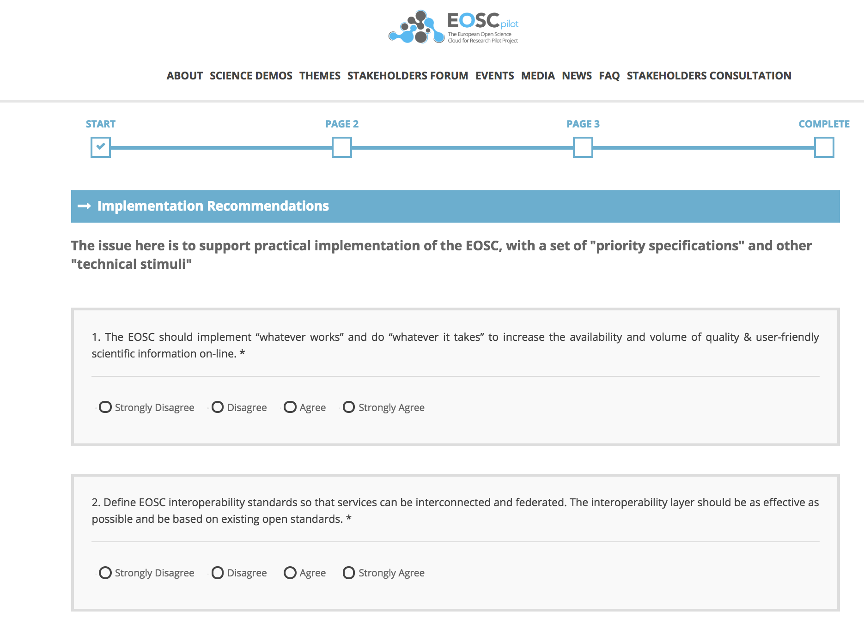
Open Consultation
Asked for textual version, easier to use to gather feedback

Slide 14
Rules of Participation
Entering the EOSC
Service
Promotion
Semi-Integrated
Fully Integrated

Slide 15
Rules of Participation
Architecture
Service Promotion
Full integration

Slide 16
Rules of Participation
For SP to promote service in Service Catalogue
For SP providing
EOSC-hub Core services
Focus on the edges
Entering the EOSC
Service
Promotion
Semi-Integrated
Fully Integrated

