Slide 1
Publishing data and metdata From iRODS to repositories
Christine Staiger (SURFsara)
https://github.com/chStaiger/iBridges

Slide 2
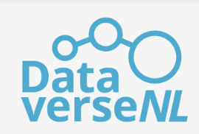
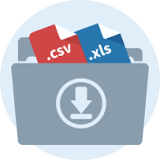
External repositories
Data Management Platform
Off-Site Storage
On-Site
Storage
Object Store
Notes:
There are already many repository services:
Commercial services: Figshare, ZENODO → generic services not tailored towards a community or special data type
Services for academics in NL: DANS EASY, DATAVERSE NL, 4TU repository, YODA (as technology) → community specific or offer data quality checks
European infrastructure repositories: B2SHARE → generic services not tailored towards a community or special data type
Community repositories: EMBL-EBI services, NCBI (Biology), CLARINO, LINDAT (Lunguistics)

Slide 3
Why interfacing with external services
Scientists are familiar with services
Services are built for special use cases and are tailored towards them
Communities have preferred services, ensures:
Data visibility
Trustworthiness of data, specific validation pipelines implemented in repository
Specific data representation
Data upload is complicated, which metadata to attach, when is data well annotated, licenses? → Researcher mainly left alone with questions
Do not reinvent the wheel
It is impossible to account for all use cases in one implementation or framework
Help users to easily upload and download data to/from repositories

Slide 4
Gain
Researcher prepares data during research in data management platform
Automated quality checks before upload to repository
Automated data upload or guided upload to repository
Data management platform implements different roles with respect to data:
Data generator
Data user
Data steward
Preparation of data can be coordinated between roles
Separation of concerns

Slide 5
Data publication workflow

Slide 6
Example iRODS ←→ Repository
Publication Repositories
Figshare
DataVerse
Zenodo
SURF Digital Rep
EUDAT B2SHARE
EUDAT B2FIND (only Metadata)
Metalnx Metadata Templates
/zone/home/user/collection
+ metadata
/zone/repository/collection
+ metadata
+ access for data steward
Workspaces
Public/Data steward
Notes:
1. User uploads data via web interface to iRODS; web interface needs to support metadata.
Metalnx as web interface also provides metadata templates, which a data steward can prepare to capture all relevant metadata for a repository.
2. After user prepared data, he moves it to specific section in the iRODS zone which is dedicated to the repository
3. Data steward closes collection so that users cannot change it any longer, but they can still view data here
4. Data steward prepares upload to repository and publishes the data.
→ Separation of work and responsibilities

Slide 7
Data steward workflow
Data steward:
Close collection for user
Check collection properties
(Optional) Create ticket or PID for anonymous external access
Create draft and add metadata
If data is small upload to repository
(Optional) Publish
Publication Repositories
Figshare
DataVerse
Zenodo
SURF Digital Rep
EUDAT B2SHARE
EUDAT B2FIND (only Metadata)
Python publication client
Create deposit
Retrieve DOI
/zone/repository/collection
+ metadata
+ access for data steward
Public/Data steward
Notes:
Data steward workflow.

Slide 8
Example: B2SHARE

Slide 9
Metadata mapping for B2SHARE
iRODS key | value | B2SHARE access
TITLE | String or collection name | /titles
--- | --- | /description
ABSTRACT | String | "description_type":"Abstract"
TICKET | Ticket: | "description_type":"TableOfContents"
TECHNICALINFO | {"irods_host": "", "irods_port": 1247, "irods_user_name": "anonymous", "irods_zone_name": ""}; iget/ils -t <ticket> <path> | "description_type":"TechnicalInfo"
OTHER | http endpoint for iRODS, e.g. Metalnx | "description_type":"Other"
CREATOR | String (names of creators and authors) | /creators
Data PIDs | http://hdl.handle.net/<PID> | /alternate_identifiers; "alternate_identifier_type": "EPIC + path"
Data TICKETs | String, <ticket>, <path> | /ResourceTypes, resource_type, resource_type_general = Dataset
Notes:
Metadata mapping from iRODS metadata to B2SHARE metadata template (generic template)

Slide 10
Example: Dataverse

Slide 11
Metadata mapping for Dataverse
iRODS key | value | Dataverse access
TITLE | String | 0 title
ABSTRACT | String | 7 dsDescription
PID/TICKET for collection | iRODS Ticket or PID to iRODS data | 4 otherId
TECHNICALINFO | {"irods_host": "", "irods_port": 1247, "irods_user_name": "anonymous", "irods_zone_name": ""}; iget/ils -t <ticket> <path> | 27 dataSources
OTHER | http endpoint for iRODS, e.g. Metalnx | 3 alternativeURL
CREATOR | Surname, First name | 5 author
Data PIDs | http://hdl.handle.net/<PID> | 29 otherReferences
Data TICKETs | String, <ticket>, <path> | 29 otherReferences
SUBJECT | controlled vocabulary | 8 subject
Notes:
Metadata mapping from iRODS metadata to Dataverse metadata template (citation template)

Slide 12
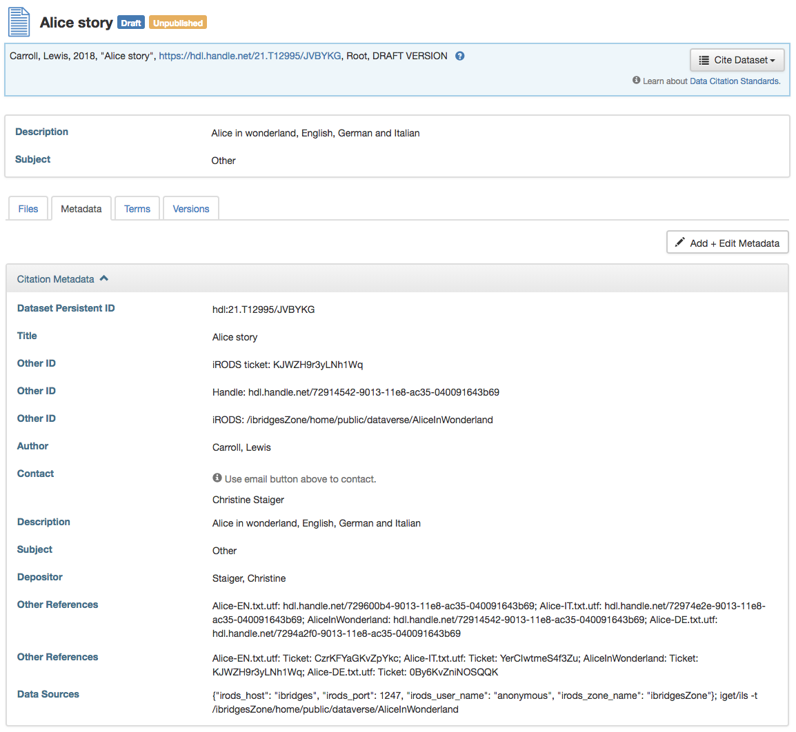
Example CKAN record
Abstract
Collection Ticket
Collection Handle
Abstract
Handles for data objects
Tickets for data objects
iRODS access info or webdav endpoint
Notes:
Metadata mapping from iRODS metadata to Dataverse metadata template (citation template)

Slide 13
Example: CKAN (metadata only)

Slide 14
Metadata mapping for Dataverse
iRODS key | value | CKAN access
TITLE | String | title
ABSTRACT | String | notes
PID/TICKET for collection | iRODS Ticket or PID to iRODS data | Extras/iRODS ticket
TECHNICALINFO | {"irods_host": "", "irods_port": 1247, "irods_user_name": "anonymous", "irods_zone_name": ""}; iget/ils -t <ticket> <path> | Extras/anonymous access
OTHER | http endpoint for iRODS, e.g. Metalnx | Extras/Metalnx access
CREATOR | Surname, First name | author
Data PIDs | http://hdl.handle.net/<PID> | Extras/PIDs for data objects
Data TICKETs | String, <ticket>, <path> | Extras/iRODS tickets for data objects
Notes:
Metadata mapping from iRODS metadata to Dataverse metadata template (citation template)

Slide 15
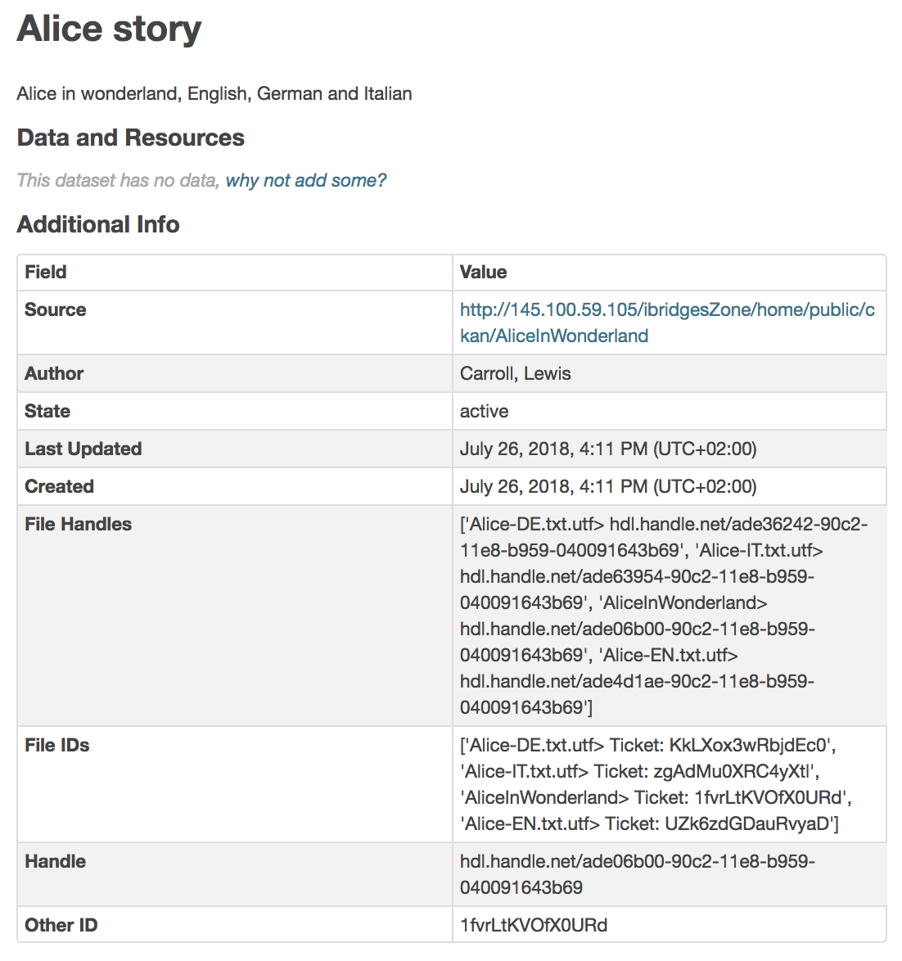
Example CKAN record
Abstract
Webdav access
Handles for data objects
Tickets for data objects
Collection Handle
Collection Ticket
Notes:
Metadata mapping from iRODS metadata to Dataverse metadata template (citation template)

Slide 16
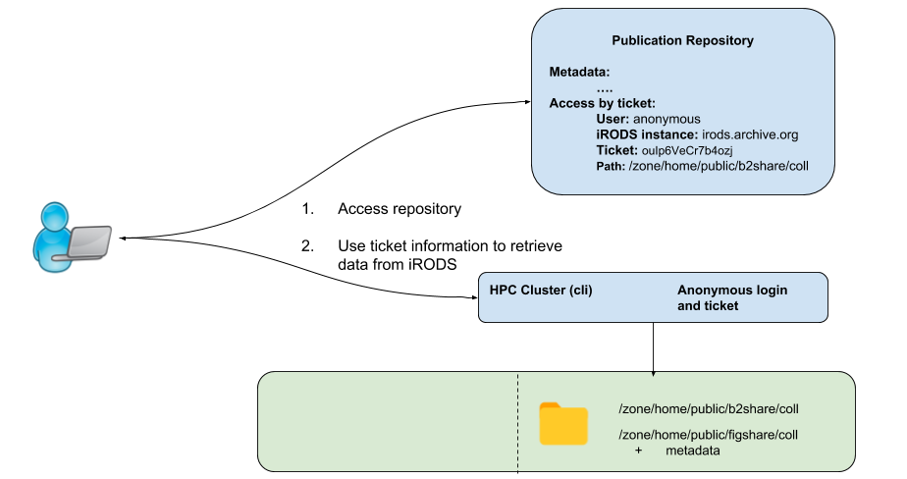
Retrieving published data from iRODS
Retrieval of large data by iRODS native protocol through iRODS tickets and anonymous user.
Retrieval of small data by webdav/davrods
→ No authentication needed to access
data in iRODS
Risk:
Decoupling of metadata from data
Clear agreements between maintenance
of data on iRODS and repository
Notes:
Data steward workflow.

Slide 17
iBridges Class structure

Slide 18
Python classes
irodsPublishCollection.py
Get metadata from iCAT and probide as python dictionary
Update iRODS metad ata e.g. with PID from repository or publishing link
Validate collection: no nested or empty collection
Open/close collection for original owner
Draft classes
Create draft or entry in repository
Patches draft with general metadata
Patches draft with information on PIDs and tickets
Uploads data (B2SHARE, Dataverse)
Publishes draft with data (B2SHARE, Dataverse)
CKAN: packages are automatically publicly available
Repository class:
Uses instances of both classes
Checks whether iRODS metadata matches expected repository metadata

Slide 19
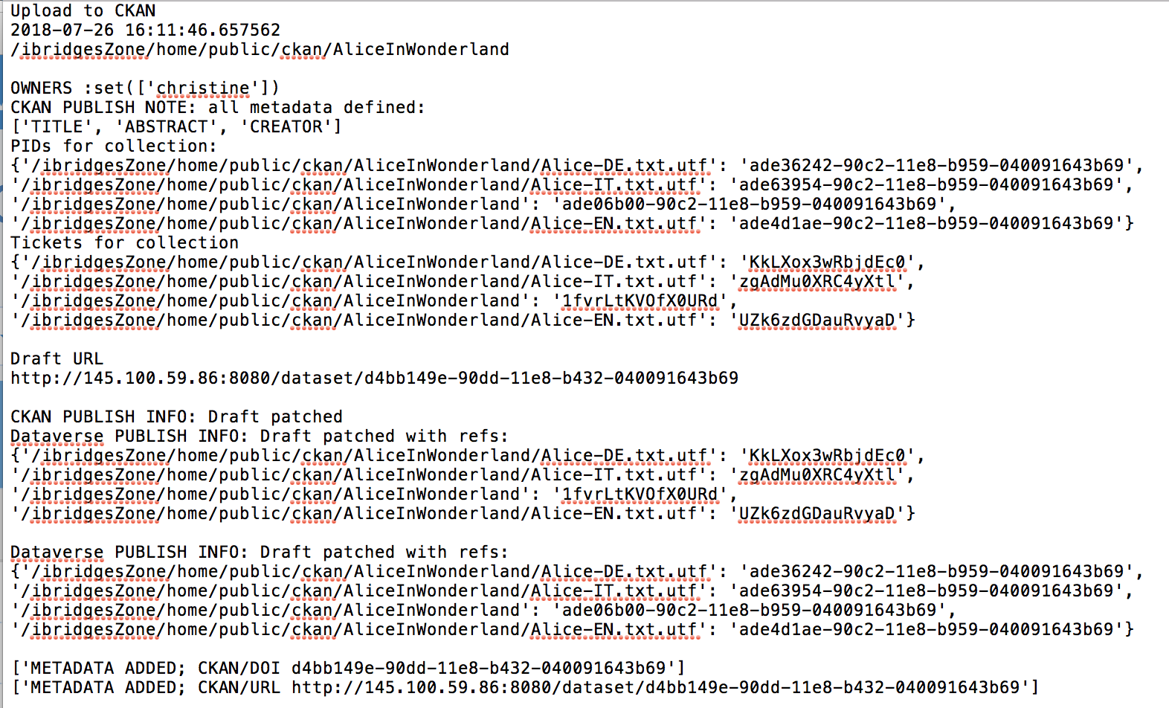
Python client – data steward process
Python clients execute data steward process interactively
Produces report for data owner, stores it in iRODS
Repository and iRODS information
Owner information
Metadata check and creation
Draft URL (for later manual editing)
Publication information
(DOI/ID and public repository entry)

Slide 20
Todo
Currently: extraction and mapping of technical and access metadata
Extract community metadata
From iCAT → iRODS collection python class
Metadata file (e.g. METS) → Own class
File can be provided externally or can be located in iRODS collection
Map community metadata to repositories
CKAN: extras
Dataverse: keyword
B2SHARE: Own community metadata templates

