Slide 1
Interfaces between WP10, WP4 and the CHM, RDM and WP2 SPM processes
Małgorzata Krakowian
Dissemination level: Public

Slide 2
Background
WP2 Strategy and Business Development
The goal is to support evolution of services by managing the service roadmap, service portfolio and service catalogue, in collaboration with the Technology Committee.
WP2.2 Service roadmap, service portfolio and service catalogue
WP4 Federated Service Management
The goal is to implement ITSM best practices across the federation.
WP4.6 Configuration Management, Change Management, Release and Deployment Management
WP10 Technical coordination
The goal is to provide technical coordination within the project.
WP10.1 Technical Roadmap (TCOM)
WP10.2 Service Catalogue Technical Evolution
WP10.3 Community Requirement Analysis and Technical support
WP10.4 Common service building requirements and gap analysis

Slide 3
Goal
Define interfaces and way of collaboration between different tasks to:
Avoid duplication
Avoid confusion
Simplify communication with developers
Avoid implementation of processes detached from the project activities
Team: M. Krakowian, P. Weber, G. Donvito, D. Scardaci, M. Viljoen, J. Pina, I. Bierenbaum, S. Holsinger

Slide 4
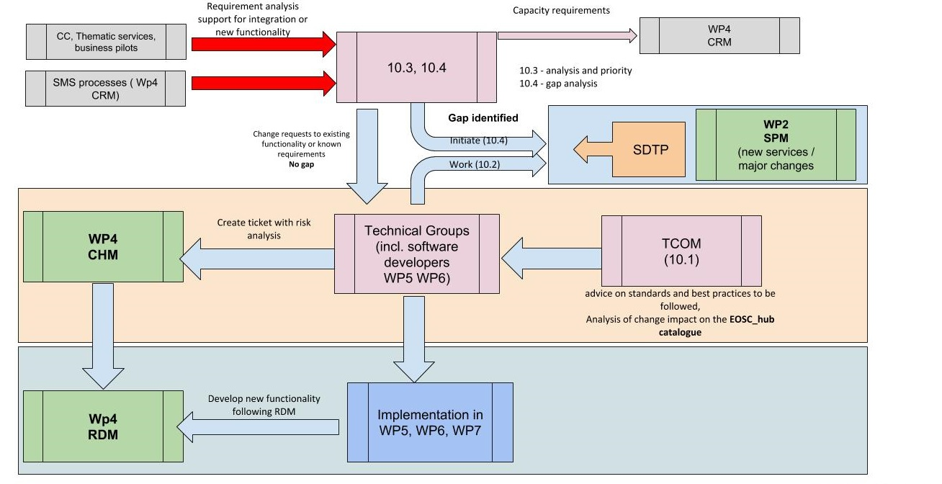

Slide 5
WP 10 Requirements gathering
Requirements gathering from CC, TS, BP and CRM (customer reviews)
Analysis of the requirements and gap analysis
In case of capacity needs -> Order management

Slide 6
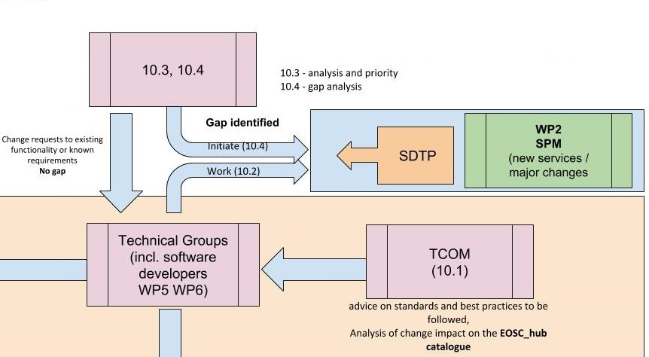
WP10 and SPM
In case of GAP identified, new SDTP will be initiated by T10.4 and supported by T10.2
TCOM will advice on standards and best practices to be followed and general impact on EOSC-hub catalogue (big picture)
In case of no GAP identified, there will be no need for new SDTP and requirement will be evaluated by Technical groups

Slide 7
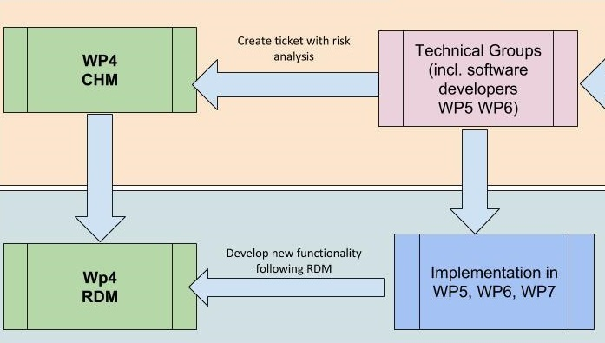
WP10 and CHM and RDM
In case of no gap, Technical Groups will perform initial risk analysis of the change request and register them as change request in CHM process to be evaluated and prioritize.
Implementation of changes and new functionalities will be organized and managed within WP5 WP6 and WP7 (by software developers)
Deployment of new release will follow RDM policy and procedures

Slide 9
Implementation
JIRA project to record all the technical requirements:
https://jira.eosc-hub.eu/projects/EOSCWP10
Service providers (WP5, WP6, WP7) should follow-up the requirements in collaboration with the EOSC-hub technical support activities (WP10). The technical roadmap of each service should take into account these requirements.
JIRA project for Change requests:
https://jira.eosc-hub.eu/projects/EOSCCHM

Slide 10
Implementation
Jira dashboards to simply monitor the requirements per WP/Task/Technical Area, see below: - WP5 dashboard
https://jira.eosc-hub.eu/secure/Dashboard.jspa?selectPageId=10304
WP6 dashboard
https://jira.eosc-hub.eu/secure/Dashboard.jspa?selectPageId=10305
WP7 dashboard
https://jira.eosc-hub.eu/secure/Dashboard.jspa?selectPageId=10306
Technical areas dashboard
https://jira.eosc-hub.eu/secure/Dashboard.jspa?selectPageId=10300

Slide 11
JIRA dashboard

