Slide 1
EOSC-Hub Training Catalogue
How to use EOSC-hub online training catalogue

Slide 2
Outline
Training Catalogue Basic principles
Training Materials
Training Events
Training Admin
Future

Slide 3
Motivations
EOSC WP11, T11.1
Maintain a catalogue holding:
Training events
Training materials
Deployable training environments
VMs
Containers
Datasets
The overall architecture of the catalogue is based on the EOSCpilot (D7.2)
EOSC-hub GA-777563, page 67 (WP11 Training and Services for Service Operators, Researchers and Higher- Education)

Slide 4
Accessing Training Catalogue
Available from the EOSC-hub web site (www.eosc-hub.eu).
Drupal CMS
Currently it provides content related to EOSC’:
Training Materials https://www.eosc-hub.eu/training-material/
Reference, Recycle.
Training Events https://www.eosc-hub.eu/training-events/
Advertise, History, Stats.
Content is publicly available for reading and searchable by several key filters
Changes can be done only by registered people having one of the specific roles:
Training Admin (Full grants)
Training Editor (Low level rights)
Complete instructions available in the complete guidelines for training

Slide 5
Training Catalogue Roles
Training Editor
Can only insert and modify contents (Events/Materials).
Training Admin
Same rights above, plus moderation on training material publication and content deletion.
Grant or deny roles to other members.
Role Request
email to: training@mailman.eosc-hub.eu.

Slide 6
Notes on Drupal
EOSC-hub web site uses Drupal v7.58
Drupal is one of the most diffused CMSes
PHP based, easily to manage and configure
Easily customizable through pluggable modules
Training Catalogue uses essentially three Drupal entities
Content Type (Contact, Training Event, Training Material)
Defines fields of any inserted entry
Taxonomy (Keywords, Language, License, Professional groups, Tags, Target Groups, Topic, Type)
Finite set of values for a given field
Fixed/Growable
Content
Values of a specific content type

Slide 7
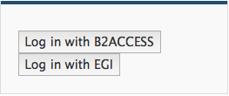
LogIn
Login to the portal from Training Material or Training Events
Two available authentications
Third option exists (Not suggested)
Authenticate using login and password using Login button at the bottom of the page
Once logged, accordingly to the user rights a different menu appears at the top of the page
1
*
2
+
3
…
* Identified issues with B2ACCESS, at the moment is suggested to use EGI Federated Authentication
+ To join EGI community follow https://aai-dev.egi.eu/signup

Slide 8
Contacts
Content entry for:
Training Materials: Author(s)
Training Events: Contact(s), Trainers
Fill required fields (see Appendix 1 in the training guidelines doc)
Contact identifier*, User title, Name*, Surname*, email*, URL(s)
Contact Identifier
Field used during Training Materials and Training Events insertion.
* Mandatory field

Slide 9
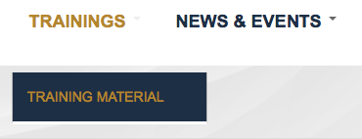
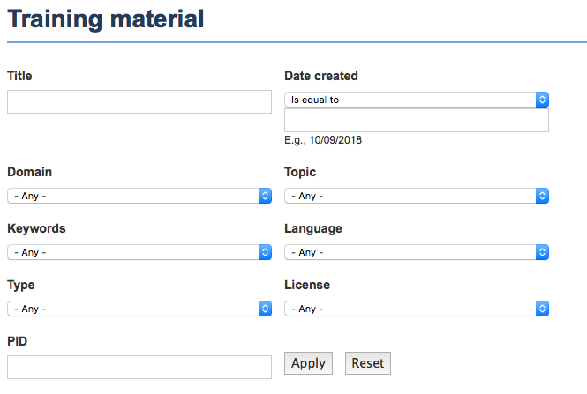
Training Materials
Access Training Materials https://www.eosc-hub.eu/training-material
Filtering

Slide 10
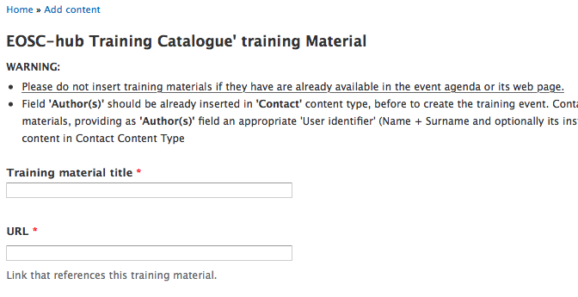
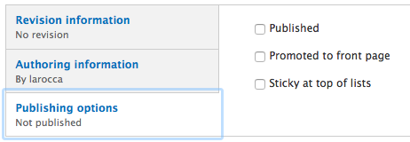
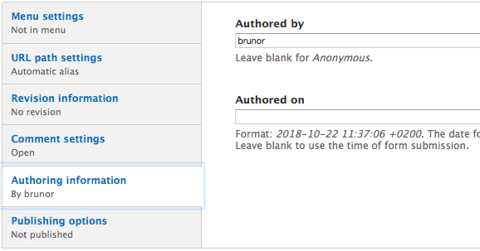
Insert Training Materials
Author(s) field refer to other content types
A good practice foresees to fill this value before the Training Material
Insert the Training Material
Fill required fields (see Appendix 1 in the training guidelines doc): Title*, URL*, License*, Version, Language, Domain*, Topic*, Type*, Keywords*, Date Created*, Data modified, PID, Authors
Final publishing flag is up to the moderator (Training Admin)
Properly configure the Training Material authorship
Insertion user by default.
* Mandatory field

Slide 11
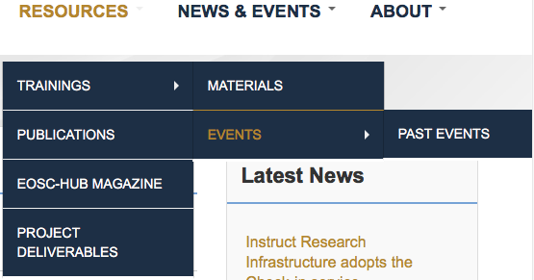
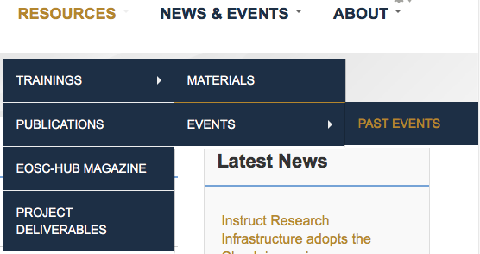
Training Events
Advertise incoming events
https://www.eosc-hub.eu/training-events
Produce a historical view of past events https://www.eosc-hub.eu/past-training-events
Filtering

Slide 12
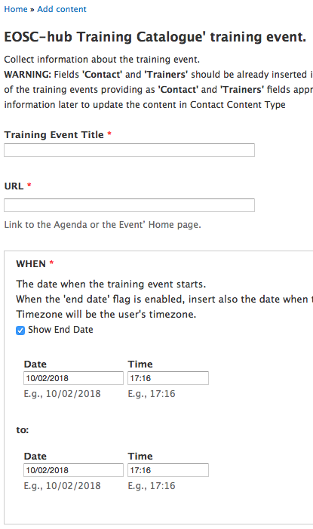
Insert Training Events
Some fields of Training Event content type refer to other contents
Contacts, Trainers, Training Materials
A good practice foresees to fill these values before the Training Event
Insert the Training Event
Fill required fields (see Appendix 1 in the training guidelines doc)
Title*, URL*, When* (From-To), Format*, Description*, Learning goal*, Contacts*, Venue, Address, Target group*, Trainers, Training Materials, External Training Materials, Training Feedback
Finally publish the new content enabling the flag
* Mandatory field

Slide 13
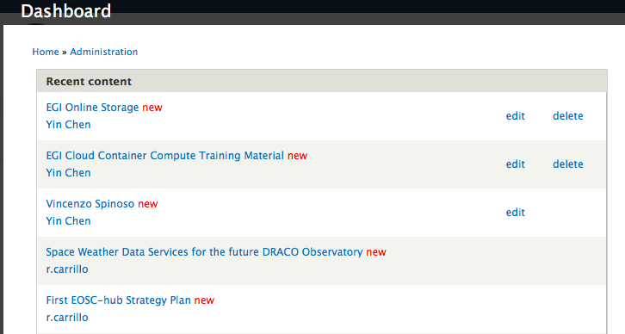
Dashboard
Detailed view of any change applied to the portal.
Useful tool for moderation activities, content check, change or deletion
Possible actions are depending on user rights.
…
Actions

Slide 14
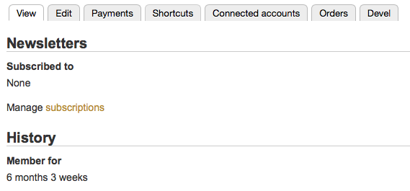
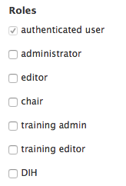
Training Admin (TA)
Moderation on top of Training Materials
Establish a direct contact with the publisher (mail flow)
Once approved, publish content
Training Admin
Grant training roles to other members
1
2
3
4

Slide 15
Training Material consistency
Protect Training Materials
No more used
Updates
Obsolescence
Timely remind publishers to keep training materials consistent over time
Drupal cron job periodically check inserted content
List of training materials to check, sent to the publishers* via email
* see training material authorship

Slide 16
Future
Training Environments
Virtual Machines
Set of remote accounts
host, username, password, vnc, RDC, etc.
Virtual clusters
Automated testing procedures
Validate VMs functionality
Validate exercises
Datasets
Just act referencing data like training materials
Aim to reuse published content for training

Slide 17
riccardo.bruno@ct.infn.it
More Info
https://confluence.egi.eu/display/EOSC/HowTo%3A+Training+Catalogue

