Slide 1
Train the Trainer
WP11 requests for EOSC-hub Trainers
Dissemination level: Public
Yin Chen, EGI Foundation, yin.chen@egi.eu
Oct 2018

Slide 2
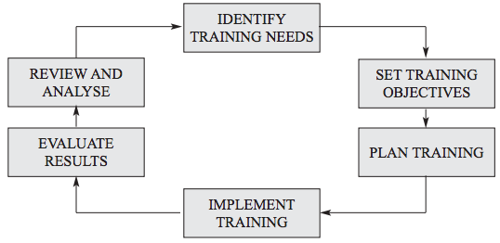
Systematic Approach to Training (SAT)
Figure is from “Guide for trainers – A manual on techniques of training in precursor control”, United Nations Office on Drugs and Crime, Chapter 2

Slide 3
WP11 process for managing trainings
Collect training requirements from TSs, CCs
1PY: support TSs, CCs
2PY: support TSs, CCs + their communities
3PY: external communities
Evaluation & analysis
Report training
Training plans on M3, M12, M24
Training delivery by EOSC-hub trainers

Slide 4
WP11 Guidelines and Best Practices on Training Delivery
https://confluence.egi.eu/display/EOSC/Guidelines+and+Best+Practises+on+Training+Delivery

Slide 5
WP11 requests for EOSC-hub trainers
STEP 1: Plan for training
Provide your training plan at google sheet by M3, M12, M24
https://docs.google.com/spreadsheets/d/1dYZk12kJg3oQM7HjMTG_C7lz0WgSbksHGXQNCfPMdH0/edit?usp=sharing

Slide 6
WP11 requests for EOSC-hub trainers
STEP 2: Prepare for training
Inform WP11 the upcoming trainings
To
training@mailman.eosc-hub.eu specifying:
The title of the event
The date of the event
The place of the event
Website providing information on the training (if applicable)
The type of the event
The organiser and a key contact
The target audience
Ask for supports (training e-Infra, feedbacks, promotion, finance), if needed
Register the event/materials in the training catalogue

Slide 7
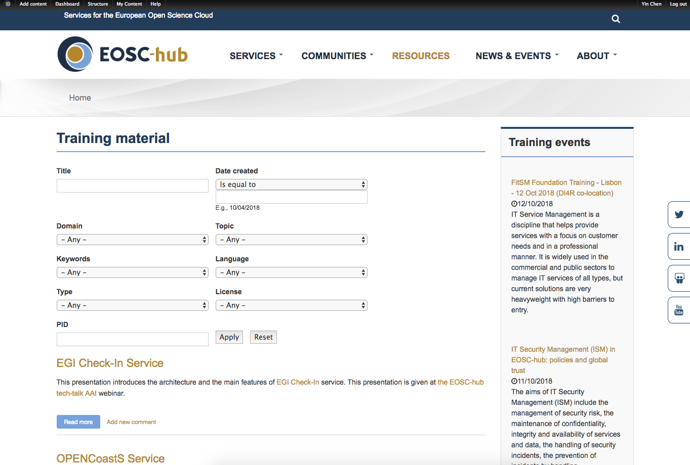
EOSC-hub online Training Catalogue
https://www.eosc-hub.eu/training-material

Slide 8
WP11 requests for EOSC-hub trainers
STEP 3: Develop training materials
Refer to Best practices for developing training materials
STEP 4: Deliver trainings
Refer to Best practices for running training event
Template and tools
https://confluence.egi.eu/display/EOSC/Guidelines+and+Best+Practises+on+Training+Delivery#GuidelinesandBestPractisesonTrainingDelivery-DeliverTraining

Slide 9
WP11 requests for EOSC-hub trainers
STEP 5_1: Report for training
Training Attendance record, 1 print out, distribute at the beginning of the event, collect at the end
Collect training feedback: Training_Evaluation_Form, fill the part marked as [RED], n-print out, distribute at the beginning, make sure to collect before people leave
Report training: Training_Event_Report_Form, summary report after the event, sent back within 2 weeks
https://documents.egi.eu/public/ShowDocument?docid=3296
giuseppe.larocca@egi.eu

Slide 10
WP11 requests for EOSC-hub trainers
STEP 5_2: Report for training
Populate the list of EOSC events
https://wiki.eosc-hub.eu/display/EOSC/Events
Populate the list of EOSC dissemination activities
https://wiki.eosc-hub.eu/display/EOSC/Dissemination+Activities

Slide 11
http://www.quiz-maker.com/Q8HEZXB

