Slide 1
Train the Trainer
Best Practices for training Delivery
Dissemination level: Public
Yin Chen, EGI Foundation, yin.chen@egi.eu
Oct 2018

Slide 2
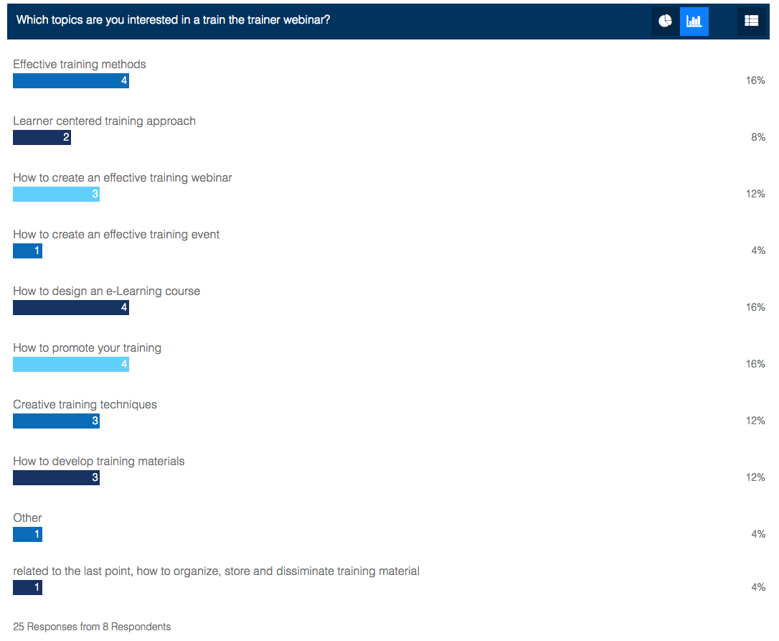
Which topics to cover?
Vote for interested topics:https://www.quiz-maker.com/Q9UD6FS
Results: https://www.quiz-maker.com/Account-Quiz-Results?qp=273895x2C80597c-4#tab-1

Slide 3
Why training is important?
Help potential users to understand the technology
Successful training leads to adoption and impacts
RIs (urgent) needs for building or updating ICT system
Increasing needs for individual re-skilling
EOSC’s focus
Market specificities
Training reports total 2017 U.S. training expenditures rose significantly, increasing 32.5% to $90.6 billion
Technavio forecast the global IT training market will be accelerating growing of nearly 6% in 2018-2022

Slide 4
What is training?
Training is a systematic process through which learners gain knowledge and develop skills by instruction and practical activities that result in improving performance
Danger Zone
Training outcomes, e.g. trainees will:
have better practical understanding of the key concepts
confidently use what was learned
change the ways of doing things
change attitudes or the ways of thinking
Purpose of training is to produce changes in…
Skills (HowTO, Steps)
Knowledge (critical thinking, decision making)
Attitudes (ethics/values, behaviour)
Challenge/Learning Zone
Comfort zoon

Slide 5
Observations of current EOSC-hub trainings
A similar format: presentation + exercises
Not well promoted
A similar methods for interactions
A similar teaching methods
Teaching centric
Not well study learner’s needs
Limited tracking of training feedbacks
Not distinguish from teaching lecture, technical talk
Some simple techniques can help to improve …

Slide 6
Understand your (adult) learners
Various motivations (e.g., knowledge, job enhancement, self-development, forced by managers/funders)
Experienced -- a rich resource for learning. Hence teaching methods include discussion, problem-solving etc.
Want to see immediate benefit of learning (understand the big picture)
Learning is problem-centered (rather than content-centered)
Expect to answer questions partially from experiences
Expect to have a voice in the learning process
Learning is interactive-based (exchange between facilitator and learner)
Learns what they need to know, so that learning programmes should be organised around life application
The Adult Learning Theory, Malcolm Shepherd Knowles (1913-1997)

Slide 7
Figure from The Adult Learning Theory, Malcolm Knowles
Notes:
The Adult Learning Theory, Malcolm Shepherd Knowles (1913-1997)
Knowles’ 4 Principles Of Andragogy
Adults need to be involved in the planning and evaluation of their instruction.
Experience (including mistakes) provides the basis for the learning activities.
Adults are most interested in learning subjects that have immediate relevance and impact to their job or personal life.
Adult learning is problem-centered rather than content-oriented. (Kearsley, 2010)
Application of Andragogy in Personal Computer Training
Knowles provides an example of applying andragogy principles to the training design:
There is a need to explain the reasons specific things are being taught (e.g., certain commands, functions, operations, etc.)
Instruction should be task-oriented instead of promoting memorization -- learning activities should be in the context of common tasks to be performed by the others.
Instruction should take into account the wide range of different backgrounds of learners; learning materials and activities should allow for different levels/types of previous experience with computers.
Since adults are self-directed, instruction should allow learners to discover things and knowledge for themselves without depending on people. However, learners should be offered guidance and help when mistakes are made.

Slide 8
What is learner-centered training?
The key focus is to assist participants in developing their own answers through applying tools/techniques, using reference materials and tapping into their own (and their colleagues) resources to reach solutions that work in the training and on the job
Advantages
Appeal to adult learning styles
Motivate the learners by allowing them to control (part of) training process
Increase training transfer rates
Decrease design and training time
Encourage collaboration
Creative Training Techniques, Robert, W. Pike, 2015
Notes:
Focus on learners
Maximize the usage of resource of learner’s experiences
Principles:
Context: Learning tasks should have a real world application that allows learners to connect personally with what they are learning.
Construction: Learners should be able to link their own experiences and prior knowledge with new learning.
Collaboration: A problem-solving scenario allows learners to develop, test, and analyze their ideas while being exposed to others' opinions. Each learner will arrive at an individual conclusion after collaboration is completed.
Conversation: Communication with and within learners is essential to effective eLearning courses. Learners should spend time in conversation while planning and make sense of new learning

Slide 9
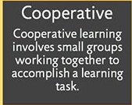
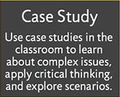
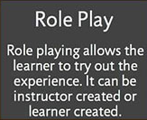
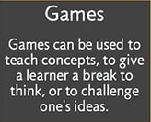
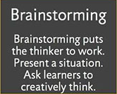
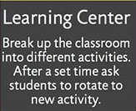
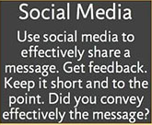
What are effective learner-centered training methods?
Figures from Learner-centered Instruction methods
Notes:
Small group discussion
Case studies
Active summaries
Q&A sessions
Quizzes
Question cards
Role-playing
Individual/team exercises
Games/competition (e.g., scavenger/treasure hunt)

Slide 10
Example training formats
Lectures/courses
Webinars
Workshops
“What’s in it for me” (dedicated to the researcher’s perspective)
Carpentry workshops (take rough, raw use cases/data to create service solution/neatly organized and tidy data)
Clinic workshop (for data, software service, use cases)
Train the trainer
World café (simple, effective, flexible format for hosting large group dialogue)
Summer school
Mozilla Study groups (communities of peers committed to learning and teaching each other)
E-Learning
Notes:
Carpentry workshop: Carpentry is the process of taking rough pieces of wood and working with care, diligence and precision to create a finished product. A carpenter does not hack at the wood at random. He or she will inspect the raw material and select the right tool for the job. In the same way data carpentry is the process of taking rough, raw and to some extent randomly arranged input data and creating neatly organised and tidy data.
World café: A quick reference guide http://www.theworldcafe.com/wp-content/uploads/2015/07/Cafe-To-Go-Revised.pdf

Slide 11
How to develop train materials?
Step 1: What is the need for this training?
Step 2: Write the objectives that can realistically achieve
Step 3: Write the evaluation materials
Step 4: “What do the learners need to learn to pass the evaluation exercise?”-- The answer is a list of subjects that becomes the outline of the training material
Step 5: Write the contents, also include variation of approaches/interactive methods
Step 6: Consider to include an ‘icebreaker’ activity
Step 7: Rehearsal/”work-through” with some colleagues
WP11 Best Practices on developing training materials
Notes:
20 Icebreaker games to make your next meeting fun: https://www.projectmanager.com/blog/20-icebreakers-make-next-meeting-fun

Slide 12
How to promote your trainings?
Tip 1: Choose a date that works for your audience
Don’t compete with similar events
Send out save the dates early
Build your schedule/agenda early and communicate to your audience
Avoid holidays and Fridays (Tue and Thursdays make for good meeting days
Tip 2: Write an attractive and convincing message
Consider who are your main targets
A message that attractive (one-lines, joke, visual)
Convincing (“What is in it for me”, quotes from participants, well known/respected trainers)
Tip 3: Promotion time
Not too late/early – 3 week in advance for webinars, 4 months for events
Send reminder (1 week, then 1-day before)
Tip 4: Promote via right communication channels
Ask your joint organisers, speakers, attendees, partner projects…
Promote at conferences, mailing lists,
Use flyers, posters, social media (twitter, Linkin, google ad)
Consistently updates including registration page
Notes:
Tip 1: Choose a date that works for your audience: Tuesdays and Thursdays make for good meeting days, avoid holidays and Fridays. Don’t compete with similar events. Send out save the dates early. Build your schedule/agenda early and communicate it to your audience
Tip 2: Write an attractive and convincing message. Consider who are your main targets audience (industry, senior, academic, PhD/PostDoc), write a message that attractive (one-lines, joke, visual), and convincing ("what is in it for me", well know/respected trainers, quotes from participants, 'bring your own data/use cases/work')
Tip 3: Promotion time: 3 weeks in advance for webinars -- people get next two-week calendar full. But don’t be too early either -- people will forget. Send Reminder one-week, then 1-day before. For face-to-face events, at least 4 months in advance for small to medium size events.
Tip 4: Promote via right communication channels. Ask your joint organisers, your speakers, attendees, partner project or organisations for help with the promotion. Promote at conferences, mailing list; Use flyers, posters, etc. Advertise on social media and consistently updates with information about your events including registration page. Using google ad (small cost to put your adv at the top), twitter, LinkIn, etc.

Slide 13
What are E-Learning’s pros & Cons?
Pros
Cheaper than training events
Individualized instructions, Self-learning, self-improvement
Easy access, get trained anywhere, anytime
Qualitative
Able to link to various resources, different learning styles
online/offline/live interaction
Cons
No self-discipline
No face-2-face interaction
Lack of input from trainers
Slow evolution
Lack of transformation power
No peripheral benefits

Slide 14
How to design E-Learning courses?
Tip 1: Put goal-setting skills into practices
Tip 2: Develop research-based eLearning activities
Tip 3: Encourage online Leaners to evaluate their cognitions
Tip 4: Stress the importance of time management
Tip 5: Incorporated a broad range of eLearning activities
Tip 6: Develop personal learning paths
Tip 7: Incorporate online group collaboration activities
Tip 8: Invite online learners to step out of their comfort zone
Notes:
Tip 1: Put goal-setting skills into practices
online learners are most productive when they strive toward a specific goal. They're able to keep track of their progress, which engages and inspires them to do their best. For this reason, it's important to facilitate goal-setting skills through your eLearning course design. Encourage them to create personal (long-term) goals in the beginning. This should include milestones and short-term goals that are easier to manage.
Tip 2: Develop research-based eLearning activities
What is the best way to address this problem? How can I improve my productivity at work? What is the proper way to perform the task? The learning process starts with a question or problem that needs to be solved. As such, your online learners must be able to carry out research on their own to arrive at a solution. They have to know which resources are available and how to use these resources effectively. Create eLearning activities that involve online research skills and content curation. For example, invite your online learners to solve a real world case study by examining the facts and researching possible outcomes.
Tip 3: Encourage online Leaners to evaluate their cognitions
An online learner may not even be aware that their beliefs and opinions are holding them back. However, you can encourage them to evaluate their current cognitions by challenging their assumptions. Ask compelling questions that prompt online learners to evaluate their limiting beliefs and perspectives. Develop online group collaboration activities that help them see things from a different viewpoint. The goal is to break down the barriers that are preventing lifelong learning.
Tip 4. Stress The Importance Of Time Management Skills In eLearning
Busy schedules, everyday distractions, and personal obligations can stand in the way of online learning. If online learners don't have time for breakfast, they probably don't have much room in their schedule for reading and research. This is why time management skills are essential. You can facilitate this in eLearning by setting deadlines for eLearning assignments and developing timed eLearning activities. For example, an eLearning simulation that gives online learners 10 minutes to complete 3 different tasks. Every second counts and online learners must manage their time wisely to accomplish the goal.
Tip 5. Cater To Diverse Learning Behaviors
Everyone has their own way of absorbing and assimilating information. Some prefer visual activities, such as online presentations and eLearning videos. While others get more out of tactile serious games and branching scenarios. Try to incorporate a broad range of eLearning activities and assessments to cater to different learning preferences. This allows online learners to pursue their goals on their own terms, without having to keep up with their peers.
Tip 6. Develop Personal Learning Paths
Empowerment is the most important pillar of lifelong learning. Online learners must know that they are in charge. Allow online learners to choose their own eLearning activities, modules, and assessments. Ask them to develop personal learning objectives and give them the resources they require. Personal learning paths are customized to meet the needs of the individual instead of the group. As a result, online learners feel more connected to the subject matter and get more value from the eLearning experience.
Tip 7. Incorporate Online Group Collaboration Activities
There are a variety of benefits associated with online group collaboration activities. Online learners have the ability to interact with their peers, gather feedback, and learn from their eLearning experiences. It also makes the learning process more engaging and exciting by integrating a social element. Group members get the chance to explore different perspectives while expanding their knowledge. Lastly, it draws attention to the fact that people are also a valuable source of information. Online learners can use their extensive network of friends and colleagues to deepen their understanding.
Tip 8. Invite Online Learners To Step Out Of Their Comfort Zone
Some of the most powerful eLearning experiences occur when we step outside of our comfort zone. Encourage online learners to something that makes them feel uncomfortable or seems out of character. For example, invite them to host a webinar if they are afraid of public speaking. Ask them to assess their performance and pinpoint strengths and weaknesses. Pushing past these boundaries can transform their perspective and become lifelong online learners. Just make sure that you don't force them out of their confort zone, as this may have an adverse effect.
Reference: https://elearningindustry.com/tips-design-elearning-courses-promote-lifelong-learning

Slide 15
How to choose a Learning Management Systems (LMS)
Popular Open-Source LMSs
Moodle
Chamilo
Totara Learn
Canvas
Open edX
Tips for choosing a LMS
Is it scalable
Can you add rich media, e.g., podcasts, videos etc.
Can you add assessments as past of your course
Can you issue certificates of completion
Can you brand the course in the way your choose
Notes:
1. Moodle
Moodle is widely known among open-source LMS solutions. It features detailed guides on how to set up your own Learning Management System, tips on how to create online training courses and teach with Moodle, as well as a large community of Moodle users who interact on various topics. Most importantly, it’s entirely free of any charge and comes with a mobile application as well.
2. Chamilo
An open-source LMS, that is here to improve access to online training. Backed up by the Chamilo Association, aiming to promote the software, maintain a clear communication channel, and build a network of service providers and software contributors. Chamilo offers easy-to-use authoring tools for creating online training that meets all leaning preferences.
Mobile Friendly
Chamilo offers mobile learning support, allowing users to learn at their own pace, accessing the online training material whenever they find convenient.
Customizable Interface
Camillo offers intuitive language and media embedding settings with plenty of options, so that you can customize the User Interface to reflect your brand.
3. Totara Learn
Totara Learn meets all the requirements related to your employees’ roles, training needs and objectives through effective delivery of individual learning plans. It provides for rich functionality, which can be implemented quickly and with a significant cost reduction, comparing to proprietary solutions. This award-winning open-source learning platform is designed for helping you to develop, train, manage and engage your staff.
Learning On The Go
Fully responsive in terms of design. The user interface adjusts seamlessly depending on device. Mobile apps are also available through partner network, that can be extended or fully-branded to be in harmony with the way your LMS looks and interacts.
Learning Plans
Learning plans are available that show all the learning, competencies, and objectives employees are currently working on. Through learning plans, learners can monitor their progress and directly access the respective online training activities. You may manage the process with approval workflows, comment boxes, and notifications.
Flexible Authoring Options
Totara Learn combines instructor-led, self-paced, and social learning, offering a blended approach, all in a single online training course. It is a very flexible system that permits full control over roles and permissions, course progression, group-based online training activities, and much more.
4. Canvas
An open-source LMS that is free for instructors. It makes teaching and learning easier in terms of implementation, adoption, customer support, and success. It is adaptable, reliable, and customizable. Designed to get out of your way, and let you do your thing. Its interface and features are crafted to save you time and effort, resulting in getting adopted faster and deeper than many other Learning Management Systems.
Powerful Community
Over 300,000 Canvas users are involved in sharing, collaborating, and shaping Canvas.
Easy To Use, With Personalized Support
Up to the standards of online learners and instructors. Easily accessible from mobile devices as well. A time-saver, that gets adopted in growing rates. Plus, in-house Canvas experts are there, to ensure the speediest, most frictionless interactions.
Easy Plug-In For Third-Party Tools
Its extensive, open API, published to the world, paves the way for third-party apps to plug right into Canvas.
5. Open edX
The Open edX is a tool empowering learners to access online course content, including videos and textbooks, plus checking their progress in the online training course. The Open edX LMS also has a discussion forum and a wiki at your disposal, that both learners and course team members can contribute to. There is also a dashboard through which the online instructor can enroll online learners, produce reports, and administer an online training course as it runs.
Open edX Studio
The tool for building your online training courses, creating structure and then adding course content. You also manage the course schedule and the course team, set grading policies, publish each part of your online training course, and more.
Community Support
There’s a discussion forum, and the Open edX Insights. Those will prove to be of great help, by being a part of the community structure and benefit from the interaction with experienced members. Open edX community includes webinars, upcoming events, and blog posts.
Accessibility
The emphasis is firstly on learner-facing interfaces, and then content management. Practical guidance is enhanced, for making course teams self-sufficient in producing accessible online training content and identifying accessibility defects. EdX has an eye for finding out accessibility checkpoints and requirements into key business processes.
Reference: https://elearningindustry.com/the-20-best-learning-management-systems

Slide 16
What are latest trends for E-Learning?
Mobile Learning (m-Learning)
Social and Collaborative learning
Microlearning
Gamification
Improved tracking
Emphasizing Quality over quantity
MOOC (Massive Open Online Courses)
TED
Virtual Reality (VR) and Augmented Reality (AR)
Google whisper course
AI has entered

Slide 17
Where to find more information?
Creative Training Techniques Handbook: Tips, Tactics, and HowTo’s for delivering effective training. (2003) Robert, W. Pike, Human Resource Development Press.
The Adult Learner. (2012) Malcolm S. Knowles, Routledge.
Training Material Development Guide. (2012) Mo Hamza. ISBN 978-91-7383-303-5
eLearning Industry: https://elearningindustry.com/

Slide 18
Future “Train the Trainer” Courses
Webinars and invited talks
Creative Training Techniques
How to develop training materials
Design a eLearning course
Organize a successful summer school
Gamification
Badging and certification
Workshops
Design an activating training
Practice different training methods
Handle difficult situations
How to reduce training costs
RI’s Roadmap for training the community

