Slide 1
Bulgarian Grid Consortium http://www.grid.bas.bg
Emanouil Atanassov
Grid infrastructure manager
Head of Department of Grid Technologies and Applications
IPP-BAS

Slide 2
Founders: Institute for Parallel Processing (IPP-BAS, former CLPP-BAS) and Institute for Nuclear Research and Nuclear Energy (INRNE-BAS) – (Agreement signed in September 2002)
Joined by:
Institute of Mathematics and Informatics (IMI), Bulg. Academy of Sciences
Institute of Mechanics (IM), Bulgarian Academy of Sciences
Faculty of Mathematics and Informatics (FMI), Plovdiv University
Computer Science Department (CSD), American University in Bulgaria (AUBG)
Department of Information Technologies at the Faculty of Mathematics and Informatics (DIT-FMI), Sofia University.
Institute of Electrochemistry and Energy Systems (IEES), BAS.
Institute of Astronomy, BAS
University of Mining and Geology
Geophysical Institute ( GPhI), BAS
Faculty of Physics – Sofia University
Institute of Organic Chemistry with centre of Phytochemistry
University of National and World Economics
Main purposes:
Sharing of resources and expertise in Grid technologies
Development of Grid applications

Slide 3
National Grid and related Projects
Several Grid and related projects were funded by the Bulgarian National Science Fund in 2008/2009
Main Grid Infrastructure project:
“High Performance Computing Grid for Advanced Scientific Applications” ( coord. Emanouil Atanassov, IPP-BAS, consortium 6 Institutes from BGGC, 300K Euro for 3 years)
Applications projects:
Advanced Quasi-Monte Carlo Grid Computing – Framework, Libraries, Pilot Grid Applications”, (coord Karaivanova, IPP-BAS)
“Towards National Chemical Weather Forecast”, coord. D. Syrakov, NIMH-BAS, consortium 3 Institutes
Related Infrastructure project:
Computer System for Advanced Studies in Molecular Design, New Materials and Nanotechnology, (coord. P. Ivanov, IOCCP-BAS, participation from more than 20 institutes and universities) – 2 years
Related application projects:
Several thematic projects partly related to Grid
2 young scientists projects with Grid related themes

Slide 4
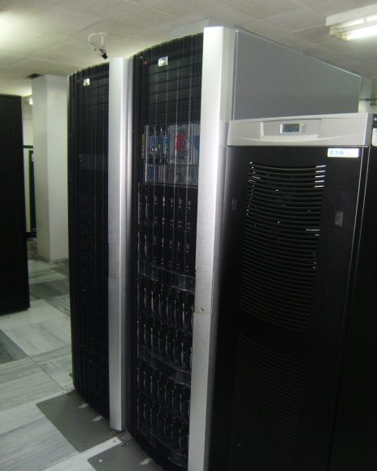
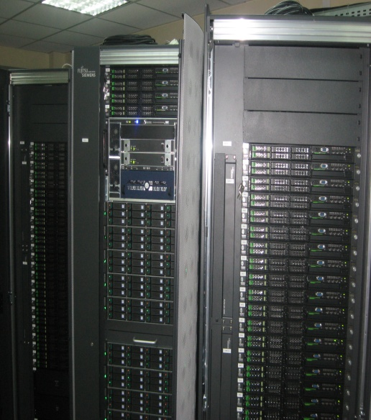
Bulgarian Grid resources
Sites | CPU | Storage
BG01-IPP | 636 | 25 TB (48TB)
BG02-IM | 21 | 1 TB
BG-INRNE | 80 | 1 TB
BG03-NGCC | 200 | 8 TB
BG04-ACAD | 80 | 2 TB
BG05-SUGrid | 28 (160) | 1 TB
BG06-GPHI | 44(80) | 1 TB (15TB)
BG08-MADARA | 800 | 24TB(108TB)
Total | 1853 | 61 TB
The biggest Bulgarian Grid clusters have low-latency DDR Infiniband interconnect and achieve more than 90% efficiency in the LINPACK Benchmark (>3 TF each), which makes them especially suitable for parallel (MPI) applications from computational chemistry, environmental modelling, etc.
Thanks to the two NSFBG infrastructure projects Bulgaria became a leader in CPU resources in South Eastern Europe at the end of EGEE III project.

Slide 5
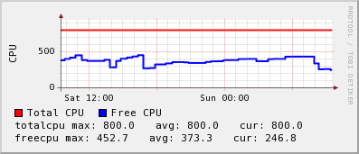
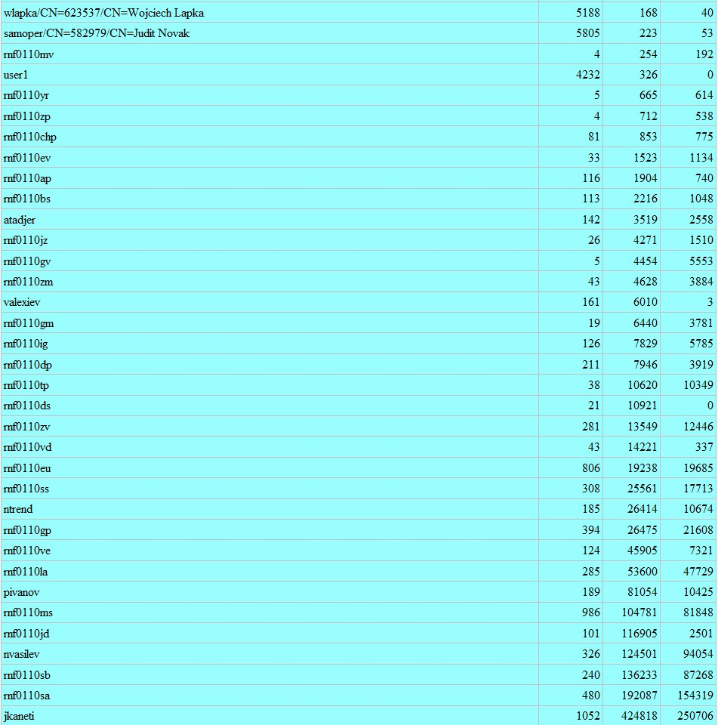
Computer System for Advanced Studies in Molecular Design, New Materials and Nanotechnology
BG08-MADARA is used exclusively for modeling and simulations in the field of chemistry and materials science by Bulgarian scientists.
More than 1 million CPU hours delivered since certification in EGEE III.
Most popular job type – 16 CPUs for 29 hours on average, 662959 hours total, next one in popularity – 32 CPUs for 37 hours on average, 179772 hours total

Slide 6
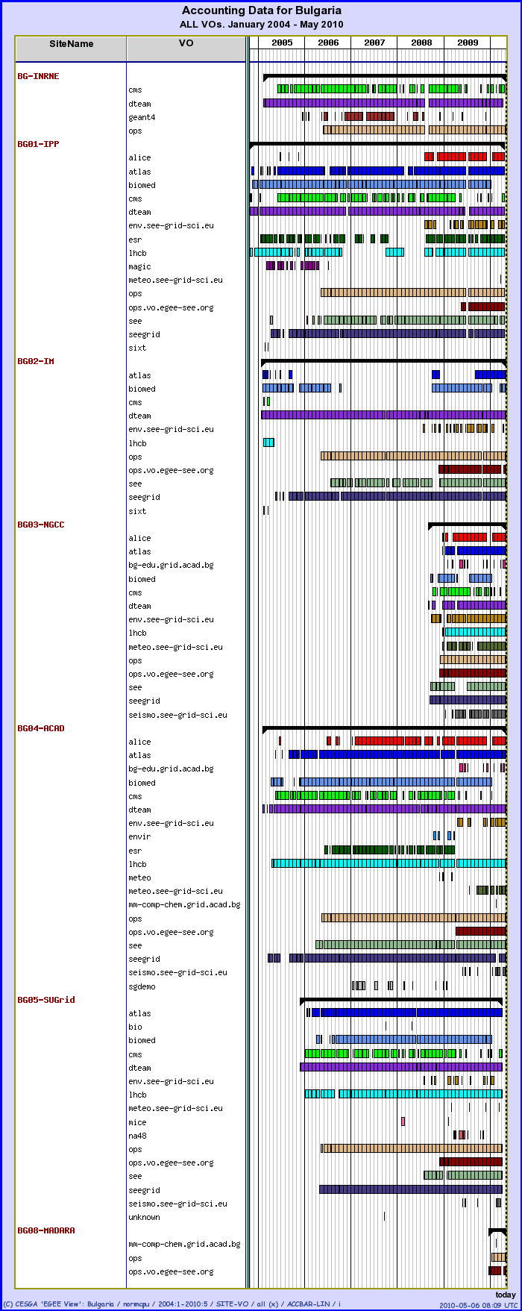
Supported Virtual Organizations
Bugarian Grid sites support the major HEP VOs – CMS, Alice, Atlas, LHCb, na48, geant4
Other EGEE VOs supported:
ESR, Biomed, MAGIC
Regional VOs: seegrid, see, env.see-gri-sci.eu,
meteo.see-grid-sci.eu, seismo.see-grid-sci.eu
National:
mm-comp-chem.grid.acad.bg
bgedu.grid.acad.bg, …

Slide 7
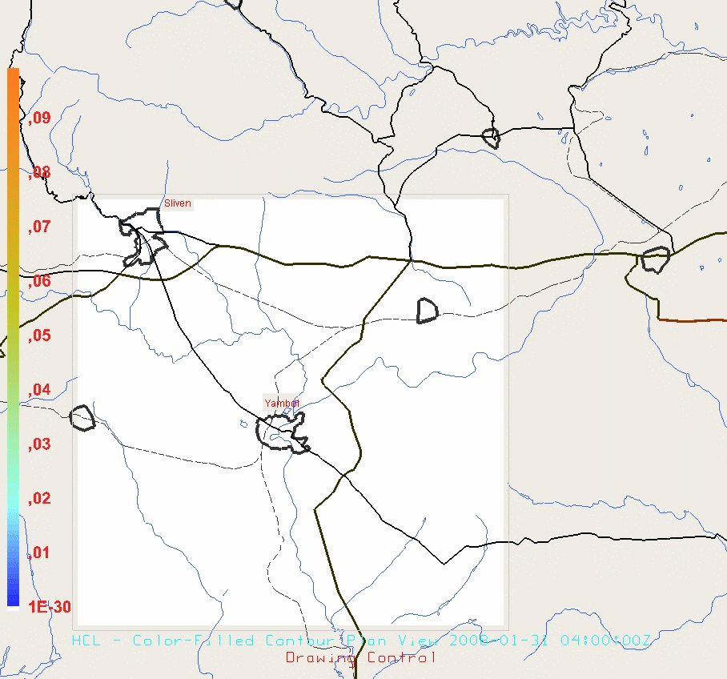
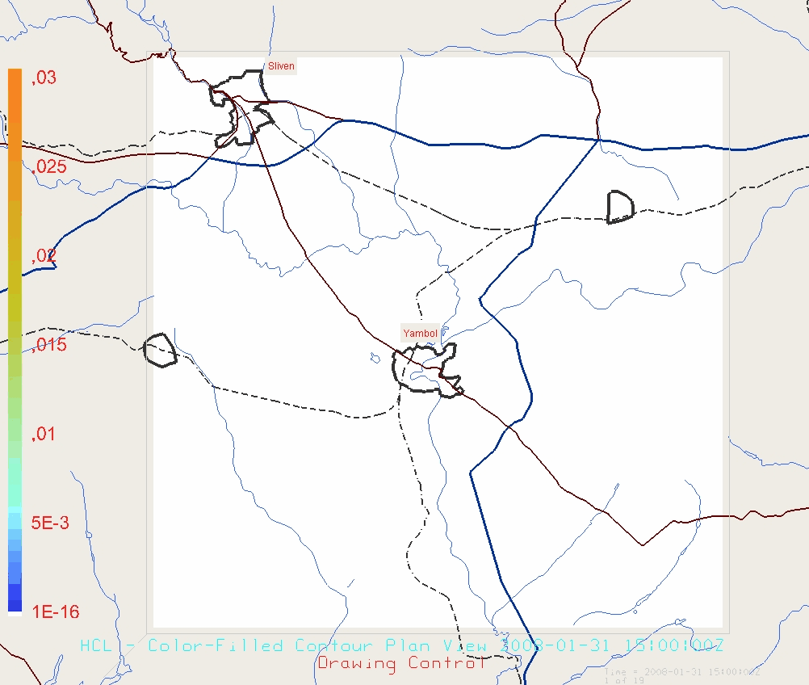
MSERRHSA: modelling accidental Chlorine release in “VEREJA-HIM” JAMBOL – averaged surface HCl concentrations for January 2008 for two release times

Slide 8
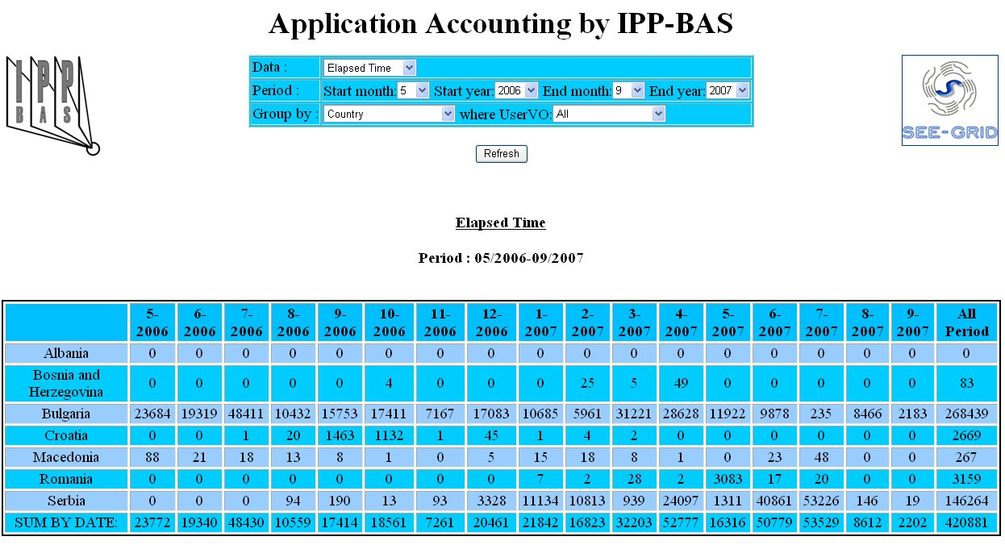
Bulgarian NGI Features
More than 80 % of the BG Grid resources are in the two new HPC-type clusters, equipped
with low-latency Infiniband. We are evaluating co-existance of gLite and other types of
middleware, like UNICORE or globus.
Experience in Application accounting – determine Grid usage per application, also correct accounting of MPI jobs
One of the ESFRI projects with Bulgarian participation is CLARIN -
http://www.clarin.eu/external/.
Initial training and grid porting discussion for CLARIN users/developers held.

Slide 9
Transition
Plans to depart from existing ROC and become independent
Roadmap and timing
Open issues related to the transition
Which activities will be run autonomously, which ones will rely on the collaboration with other NGIs?
We plan to accomplish the transition to full independence in the next two months
In the transition period we continue to perform the ROD role for SEE

Slide 10
Becoming part of EGI: Governance
Governance
Is the NGI committing itself to participate to the NGI Operations Managers meeting (1 meeting per month)? yes
Is the NGI operations staff committing to participate fortnightly operations meetings for discussion of topics related to the middleware (releases, urgent patches, priorities...) based on need
Is the NGI interested in contributing to the Operations Tool Advisory Group – OTAG – to provide feedback and requirements about operational tools to JRA1?
Suggestions to improve your NGI representation in operations meetings and boards

Slide 11
Becoming part of EGI: Infrastructure
Is the NGI expected to increase its infrastructure (number of sites, resources)?
Is the NGI planning to integrate sites running non-gLite middleware? Open issues?
Planning to use other types of middleware (UNICORE?) in current gLite sites
Is the NGI planning to integrate itself with local Grids? Issues?

Slide 12
Becoming part of EGI: Procedures and policies
EGEE procedures/policies
Is the NGI familiar with existing procedures/policies? yes
Does the NGI think procedures can be further streamlined? Suggestions...
If the NGIs deploys different mw stacks (gLite, ARC, other...): what EGEE procedures need to be adapted?
Does the NGI deploy own procedures that are not integrated with EGEE ones? no
Are the (EGEE) procedures well documented? Feel free to provide suggestions for improvement

Slide 13
Becoming part of EGI: Support
Does your NGI have enough manpower
for support to Grid site managers - yes
for grid oversight (monitoring shifts) - yes
How support activities are/will be internally organized? on duty rotation.

Slide 14
Becoming part of EGI: Tools
Which “regional” tools is the NGI interested in deploying directly rather than using a central instance/view:
O-N-1 national Grid configuration database (GOCDB or equivalent tool) in the long run
O-N-2 national accounting infrastructure (repositories and portal) yes
O-N-3 NGI monitoring infrastructure - yes
O-N-4 operations portal - yes
O-N-7 helpdesk: interested in using a central “NGI view” of GGUS or deploying own system? How is it going to be interfaced to GGUS? one-or-zero based helpdesk
Which own tools (if any) does the NGI deploy? JTS for managing priorities, own accounting developments.
Is the NGI planning to run Scientific Gateways for VOs? Yes, in the long run

Slide 15
Availability and Operations Level Agreements
What overall level of functional availability/reliability is the NGI ready to commit?
WIll the NGI be able to comply to EGI Operations Level Agreements defining for example
Minimum availability of core middleware services (top-BDII, WMS/LB, LFC, VOMS, etc.) yes
Minimum availability of core operational services such as: nagios-based monitoring, helpdesk yes
Minimum response time of operations staff to trouble tickets yes
Minimum esponse time of the NGI CSIRT in case of vulnerability threats? yes

Slide 16
Training
Is the NGI ready to provide training to its own site managers and operations staff?
If yes: Is the NGI willing to share training material/training events with other NGIs yes
We have certified trainers from EGEE and experienced operations stuff
If no: would you be interested in attending events organized by other NGIs? difficult to finance

Slide 17
Your best knowhow
Is there any specific Grid operations field where your NGI feels advanced/expert, and about which your NGI is willing to provide guidance to other NGIs?
BG NGI has most of its resources of HPC type, 3 sites with low-latency infiniband and myrinet interconnection. It is important for us that access to these resources through gLite is improved.

Slide 18
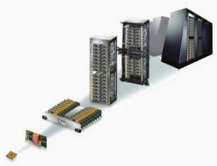
Future directions
IBM Blue Gene/P with 2048 PowerPC 450 processors - a total of 8192 cores at the Executive Agency for Electronic Communication Networks and Information Systems
The most powerful computational resource in SEE region.
Extension of the SuperCA project to include
both supercomputing and Grid applications
SEERA-EI will capitalise on this momentum and link national-level programme managers and provide an open forum for information exchange, in order to enable coordination of national programmes in eInfrastructures, and to set the framework for a common regional agenda.
Currently a new program for development of the Information Society in Bulgaria is being drafted and we expect it to cover also the research e-Infrastructure.

