Slide 1
The eXtreme-DataCloud project
Baptiste Grenier on behalf of Daniele Cesini and XDC
baptiste.grenier@egi.eu
info@extreme-datacloud.eu
www.extreme-datacloud.eu

Slide 2
XDC Consortium
ID | Partner | Country | Represented Community | Tools and system
1 | INFN (Lead) | IT | HEP/WLCG | INDIGO-Orchestrator
2 | DESY | DE | Research with Photons (XFEL) | dCache
3 | CERN | CH | HEP/WLCG | EOS, DYNAFED, FTS
4 | AGH | PL |  | ONEDATA
5 | ECRIN | [ERIC] | Medical data
6 | UC | ES | Lifewatch
7 | CNRS | FR | Astro [CTA and LSST]
8 | EGI.eu | NL | EGI communities
8 partners, 7 countries
7 research communities represented + EGI
XDC Total Budget: 3.07Meuros
XDC started on Nov 1st 2017 – will run for 27 months until Jan 31st 2020

Slide 3
XDC Use cases
Lifewatch
Lifecycle management of data related to Water Quality
Involving heterogeneous data sources (Satellite, Real-time monitoring, meteorological stations)
CTA
Complex and Big Data management in a distributed environment
Automatic metadata extraction/management
Data Quality Assurance
ECRIN
Distributed files and data objects across different repositories
Metadata heterogeneity
Sensitive Data
LHC
Data management at a high scale for HL-LHC
Code, computing, storage and infrastructure evolution
“Data Lakes”, Distributed storage, caching…

Slide 4
XDC Technical Topics
Intelligent & Automated Dataset Distribution
Orchestration to realize a policy-driven data management
Data distribution policies based on Quality of Service supporting geographical distributed resources (cross-sites)
QoS beyond disk vs tape: availability, reliability, durability, latency
Data lifecycle management
Data (pre)processing during ingestion
Storage Notifications based on events
Smart caching
Transparent access to remote data without the need of a-priori copy
Metadata management
Data management based on access patterns
Move to ‘glacier-like’ storage unused data, move to fast storage “hot” data
at infrastructure level
Sensitive data handling
secure storage and encryption

Slide 5
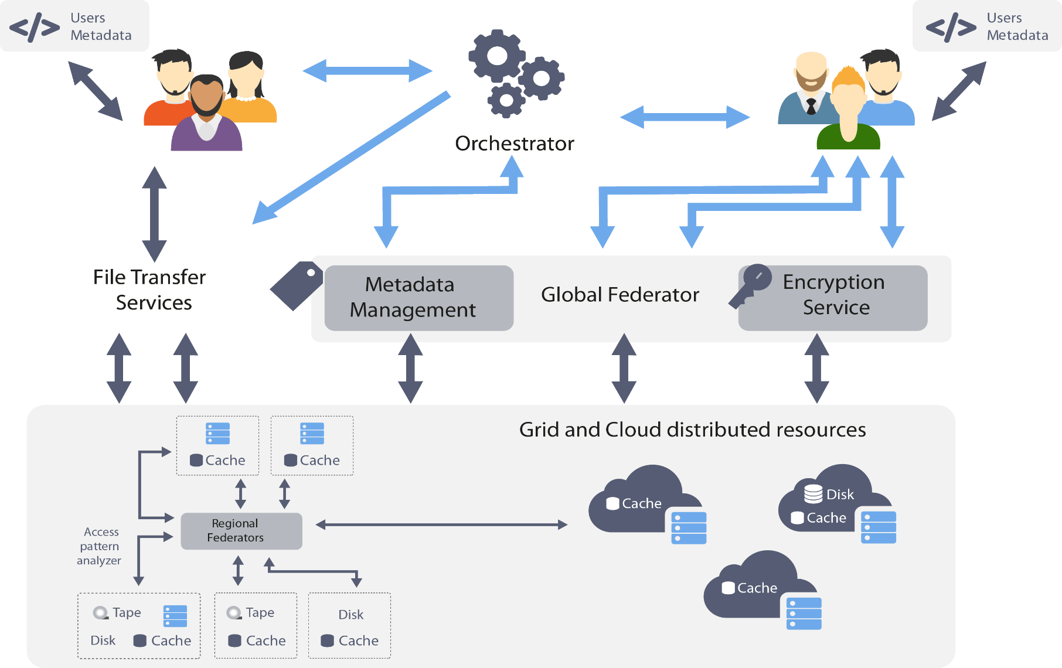
XDC high level architecture

Slide 6
XDC Toolbox
Orchestration
c
c
Storage
Rucio
dCache
INDIGO
Orchestrator
QoS
CDMI
HTTP
Cache
xRootD
Cache
Indigo-IAM
Federation

Slide 7
Expected Control Flow for Orchestration and Policy Driven Data Management
Rucio
INDIGO
Orchestrator
TOSCA
Control
Control
Quality of
Storage
Data Location
Location
dCache
Notes:
User describes its needs using a TOSCA template
The TOSCA template is sent to the INDIGO Orchestrator
The INDIGO orchestrator interacts with RUCIO to to put in place a data management policy (Rucio enables policy-driven data management using rules)
Based on the selected Quality of Storage Rucio will plan transfers between the different storage solutions
Those transfers will be managed by FTS
And Dynafed is used to provide an aggregated view on the data

Slide 8
Expected Control Flow for Orchestration and Policy Driven Data Management
Rucio
INDIGO
Orchestrator
TOSCA
Control
Control
Quality of
Storage
Data Location
Location
PaaS
Orchestration
dCache
Notes:
- The Orchestrator can orchestrate the deployment of an infrastructure used for processing data at ingestion

Slide 9
Expected Control Flow for Orchestration and Policy Driven Data Management
Rucio
INDIGO
Orchestrator
TOSCA
Control
Control
Quality of
Storage
Data Location
Location
PaaS
Orchestration
dCache
Notes:
- An user can still directly interact with the storage endpoitns, and this will trigger an even that will be received by the orchestrator so that it can trigger processing on the deployed infrastructure

Slide 10
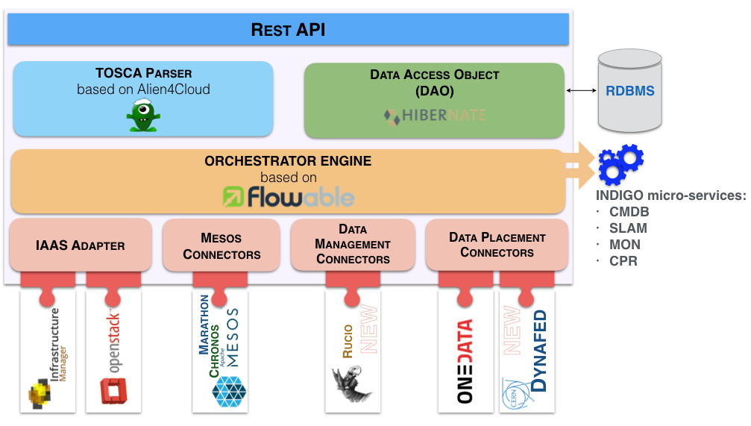
INDIGO Orchestrator Overview
The Orchestrator accepts TOSCA requests
It can run three main workflows in the PaaS:
Deploy
Undeploy
Update
The Orchestration layer is being extended in order to address the new requirements:
move data between distributed storages
specify different QoS for replicas
launch and monitor user defined processing jobs at ingestion time
XDC extensions

Slide 11
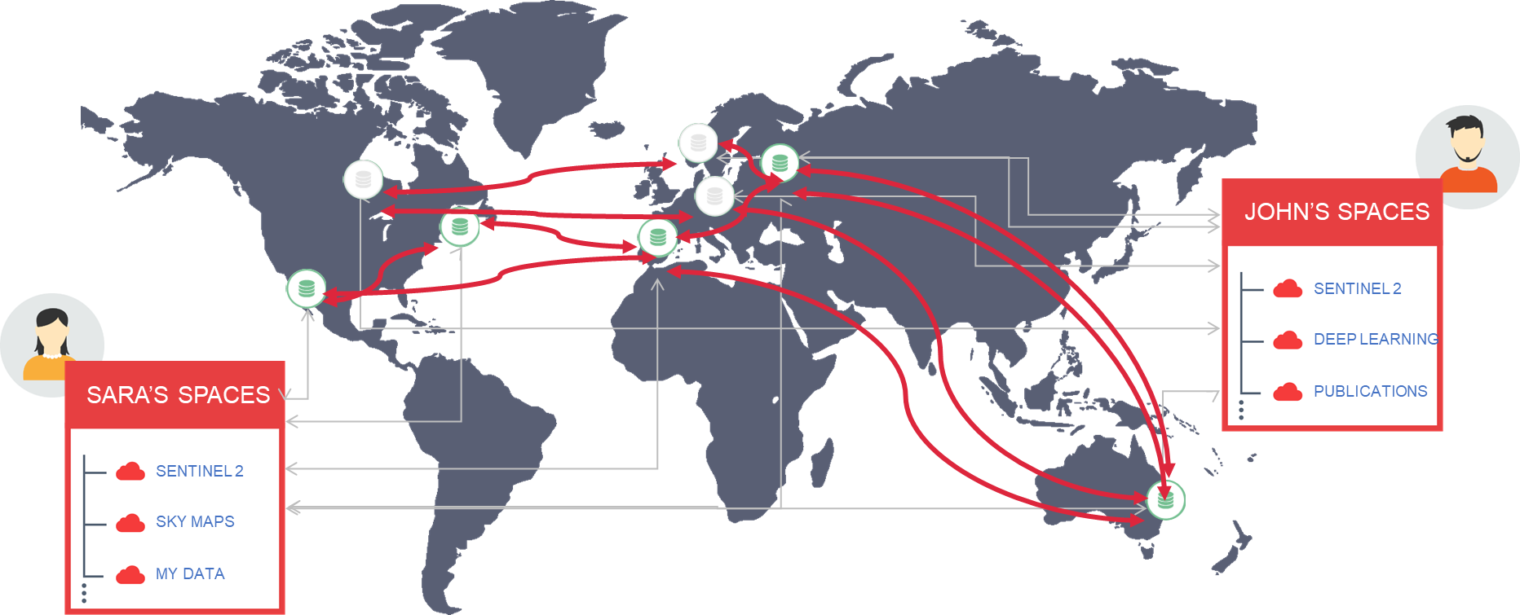
Data in Hybrid Cloud Environments: Onedata
ONEDATA is a storage federator that allows to use resources backed by providers worldwide
Providers deploy Oneprovider services near physical storage resources
Users use
Onezone web interfaces
APIs available
Local POSIX mounting on users machines available
Storage is organized into Zones
federations of providers
EGI DataHub
enable the creation of closed or interconnected communities
https://onedata.org

Slide 12
XDC – Release 1
Release date: 2018/11
Component | XDC functionalities
EOS | Caching with XCache for geographic deployment: XCache deployed at a remote centre to accelerate its local CPU External storage adoption (Through an S3 or a WebDAV interface) External data adoption (Data already present on a system described above can be incorporated into EOS)
dCache | - New QoS types integration, aggregated QoS for storage federations - OpenIDConnect support in dcache_view - dcache storage events (SSE notifications): Allow non-dCache agent to get notified that something of interest happen inside dCache
FTS+gfal | QoS support: can now accept a QoS job OpenIDConnect support QoS in gfal (gfal with basic cdmi client) – python bindings available
Dynafed | Integration of OIDC authentication
Caching infrastructure based on XCache or http | - deployment receipts for geographically distributed caches (via XCache) - deployment receipts for scalable local caches (via XCache and http)
PaaS Orchestrator | - Implementation of Dynafed plugin – interaction via INDIGO IAM oauth2 token - Enhancement of ONEDATA plugin
ONEDATA | - Performance and stability improvements - new RADOS driver

Slide 13
XDC Contacts
Service Providers Board
An advisory body of XDC
Open to Providers outside of XDC
Interested?
Contact Baptiste Grenier <baptiste.grenier@egi.eu>
Facilitate communication between Service Providers and Product Teams
Presenting XDC components
Providing feedback and requirements
Terms of Reference: https://nextcloud.extreme-datacloud.eu/s/tx9dCrt7MrJ52Ki
Website: www.extreme-datacloud.eu
@XtremeDataCloud on Twitter
Mailing list: info@extreme-datacloud.eu

