Slide 1
Accounting Update
John Gordon
STFC
OMB 26 July 2011

Slide 2
EGI Infrastructure
New types of Resource
EMI
Accounting Portal
Input Wanted

Slide 3
1. EGI Accounting Infrastructure
Our redesign of the APEL infrastructure:-
A STOMP-based message publisher/consumer (SSM)
Multiple UR per message; signed and encrypted.
On the production AMQ bus.
Summary Record publisher/consumer
For regional and other repositories to publish to the central repository and to send to the accounting portal.

Slide 4
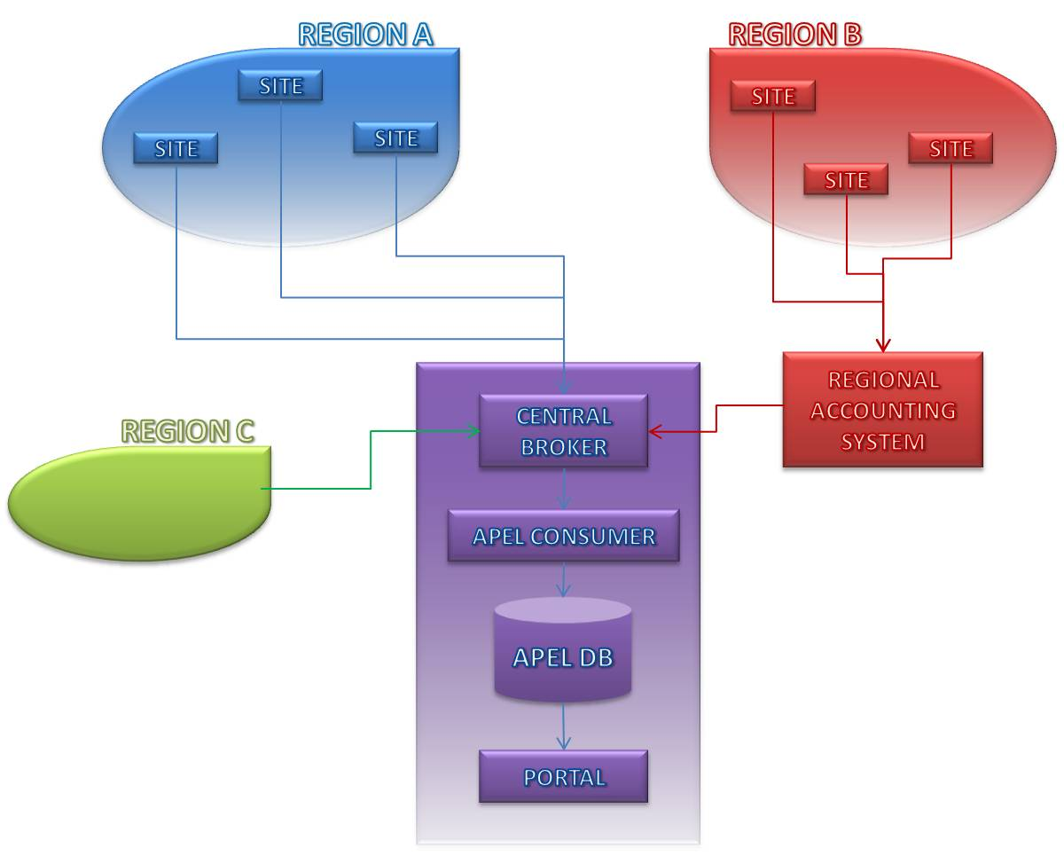
Regionalisation - Plan
All regions to publish via ActiveMQ
Provide regional accounting system
Allow regions to continue using central system
Collect records from other grids/tools via same interface

Slide 5
Regions
A. Continue publishing direct to the centre as now.
B. Use regional APEL repository
C. Use an alternative NGI repository
SGAS, DGAS, OSG(Gratia), D-Grid, Polish Unicore, CERN, GridSafe(IGE), France, NIKHEF, ARC
Any other alternatives?

Slide 6
Migration
Migration to the new central repository requires all the existing alternatives to migrate to the new STOMP publishing before we can migrate the database and accept the new data in production.
New database will continue to accept the old AMQ publishing (EMI-1) during migration
Distribution of Regional repository after it has proven itself centrally.
New client via EMI

Slide 7
Progress
A prototype SSM exists
Existing and potential Region C developers have been contacted.
Some have started testing.
Chasing the rest

Slide 8
2. New Types of Resource
New repository can handle multiple record types.
This is required for schema evolution in CPU
But allows multiple types of resource to be accounted.
MS706 – explains

Slide 9
Potential new resources
Storage
EMI defined StAR
Clouds
See EGI Virtualisation and Clouds Workshop output
Applications
CPU
Local Jobs
MPI
Data Use – remote access to data, by user, not owner
Services? Suggestion that ALL services be accounted.

Slide 10
Potential New Resources
1. Gather requirements
2. Define and agree a Usage Record
3. Develop Software to collect information, cut accounting records, and publish them into the infrastructure
We can help with the last.
4. Decide how to process and present the data
Still need input on requirements and priorities
Engagement with user communities

Slide 11
3. EMI
EMI Data Group defined Storage Accounting Record (StAR)
Proposed to OGF
Needs an EGI profile
EMI Storage providers will implement
Need commitment from others.
EMI Compute Group working on a revised CPU Usage Record
Good to converge with other accounting systems in areas where OGF standard
Don’t want radical changes now
EMI trying to take responsibility for apel-parsers on various batch systems
emi-apel client patch to publish to new consumer.
EMI Messaging Group working on messaging for all middleware
No cross-cutting Accounting thread

Slide 12
4. Accounting Portal
Roadmap contains multiple release cycles with opportunities to add new resources
Need to feed in requirements for other resource types

Slide 13
5. What can you do?
1. Are there any NGIs with their own accounting solutions that we don’t know about?
2. Do you have requirements for other types of resource to be accounted?
You=NGI or projects in your country
3. Do you have national cloud services/projects that could work with us on defining a Cloud Usage Record

