Slide 1
EGI infrastructure for the monitoring of uncertified Resource Centres

Slide 2
Current Situation
All NGIs perform site certification using their own infrastructures
The certification should not take place on the production infrastructure in order not to affect the end users
Small NGIs often do not have the resources to operate separate infrastructure (TOP-BDII, WMS/LB) for the certification of new sites

Slide 3
EGI Catch All Certification Infrastructure
TOP-BDII (bdii-cert.hellasgrid.gr)
Includes all the production sites from GOCDB
Includes sites that are registered to the EGI catch-all certification service
WMS/LB ({wms,lb}-cert.hellasgrid.gr)
Use of bdii-cert.hellasgrid.gr as TOP-BDII

Slide 4
EGI Catch All Certification Service
NGI Managers (and deputies) will be able to request for an uncertified site to be added to the EGI Catch All Certification Service
Each NGI Manager can add/remove uncertified sites in her/his scope
Login using personal certifications
Roles and scope are retrieved from GOCDB

Slide 5
EGI Catch All Certification Service
Login using personal
Certificate

Slide 6
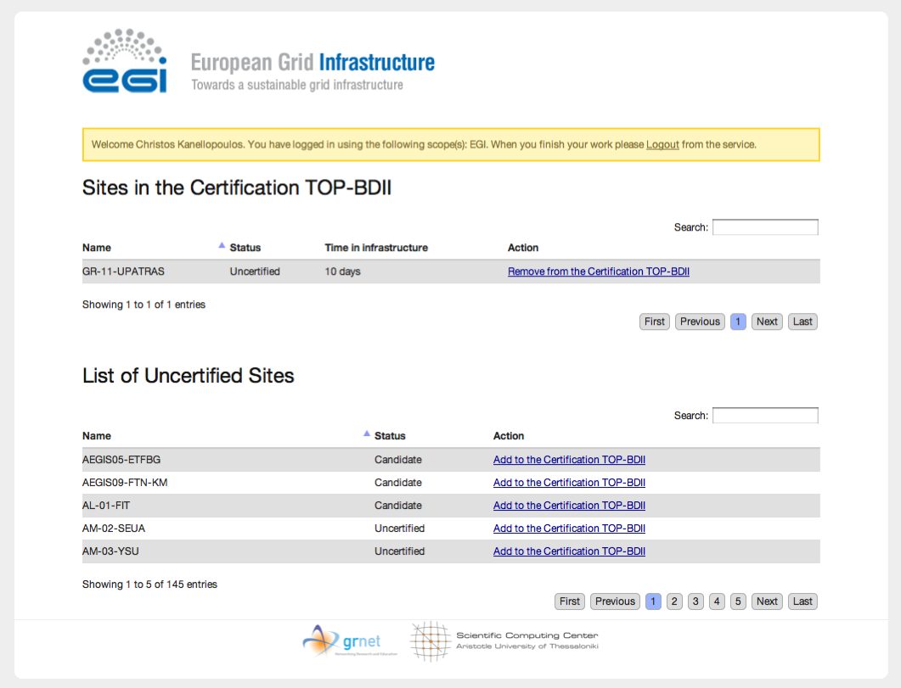
EGI Catch All Certification Service
Uncertified sites in
the certification TOP-BDII
List of uncertified sites
(not included in the cert
BDII)
Remove site
Add site

Slide 7
EGI Catch All Certification Service
Demo instance available at:
https://cert-devel.grid.auth.gr (sites will actually be added and removed to/from bdii-cert.hellasgrid.gr)

