Slide 1
EOSC Portal Editorial Board
Najla Rettberg on behalf of the board

Slide 2
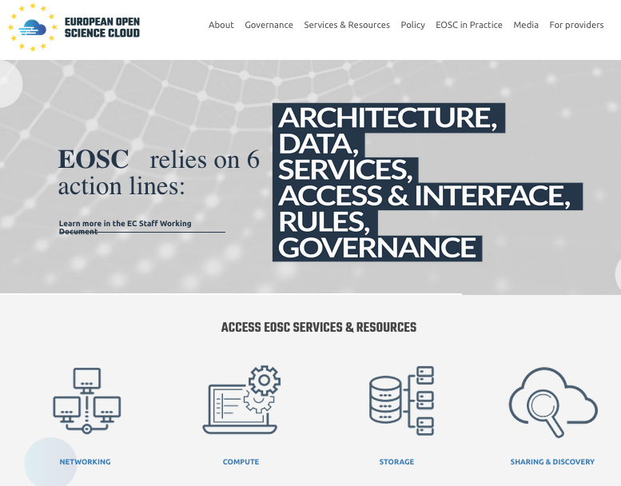
The EOSC Portal Editorial Board
Responsible for
Developing, selecting and maintaining content in the website with EC support and supervision
Producing promotional resources
EOSC Portal communications and logistics in the EOSC launch event
Four participating projects
Notes:
Should we widen tomore projects?

Slide 3
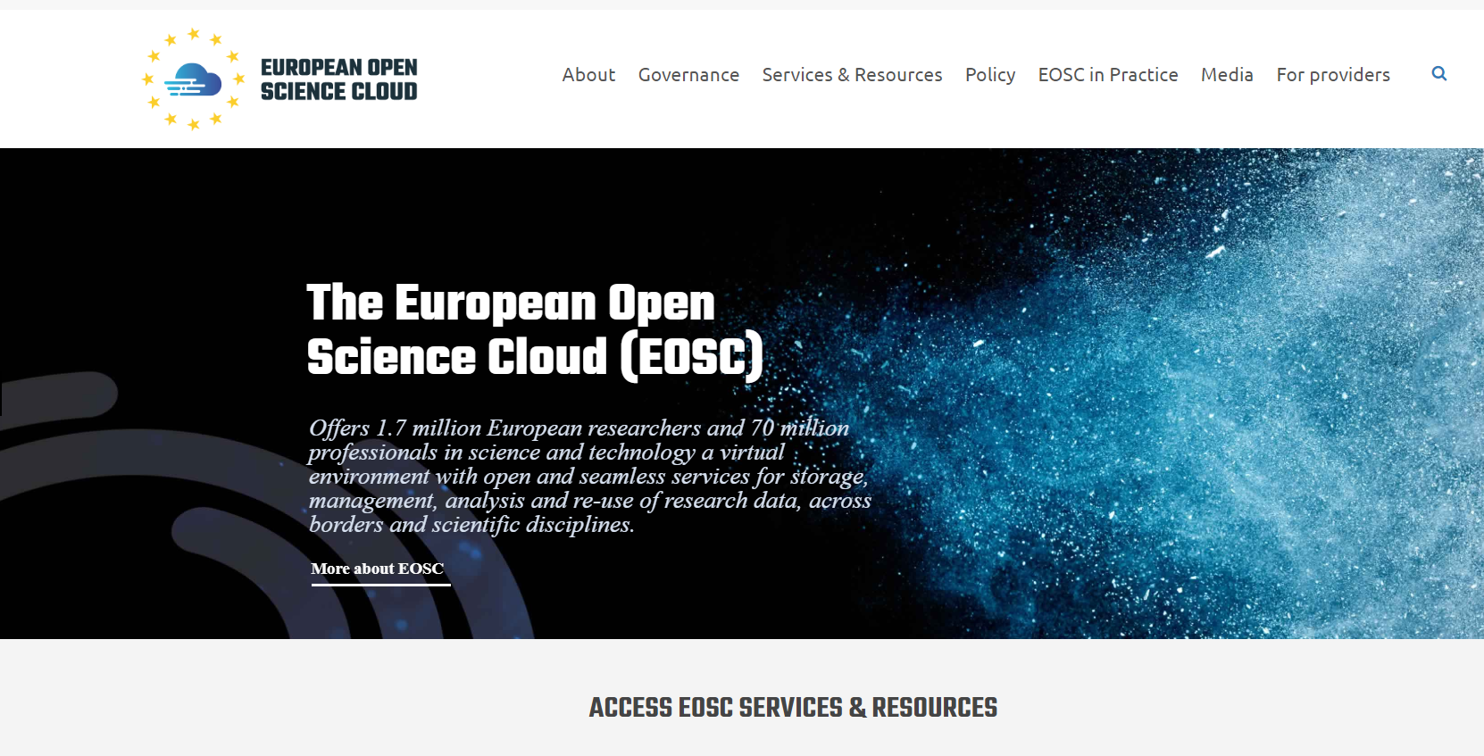

Slide 4
Activities
Contribution to the definition of the EOSC Launch event programme
Production of EOSC Portal related material
EOSC Portal presentation video
Booth
Definition and selection of demonstrations: the CLARIN use case and the pufferfish case
Booklet
Communications and dissemination activities about the EOSC Portal
Management of EOSC Portal social media

Slide 5
Launch Activities
Booklet completed based on stakeholder stories
3 videos
CLARIN demonstrator
Pufferfish demonstrator
EOSC Portal introductory video
Preparation of booth programme
(Heath and medicine) Structural biology for health (WeNMR)
(Ecology) Sustainable Development Goals (GEOSS)
(Atmospheric research) Particle formation
(Photon and Neutron science) Pharmacology patrick.fuhrmann@desy.de and volker.guelzow@desy.de
(Fusion) PROMINENCE
Notes:
Leverage
endorsements

Slide 6
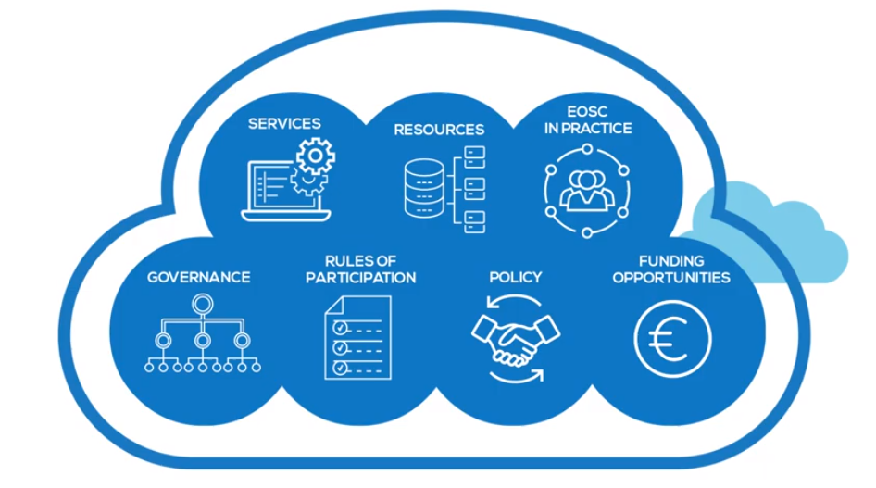
Communications Team role in EOSC launch
Common purpose communication

Slide 7
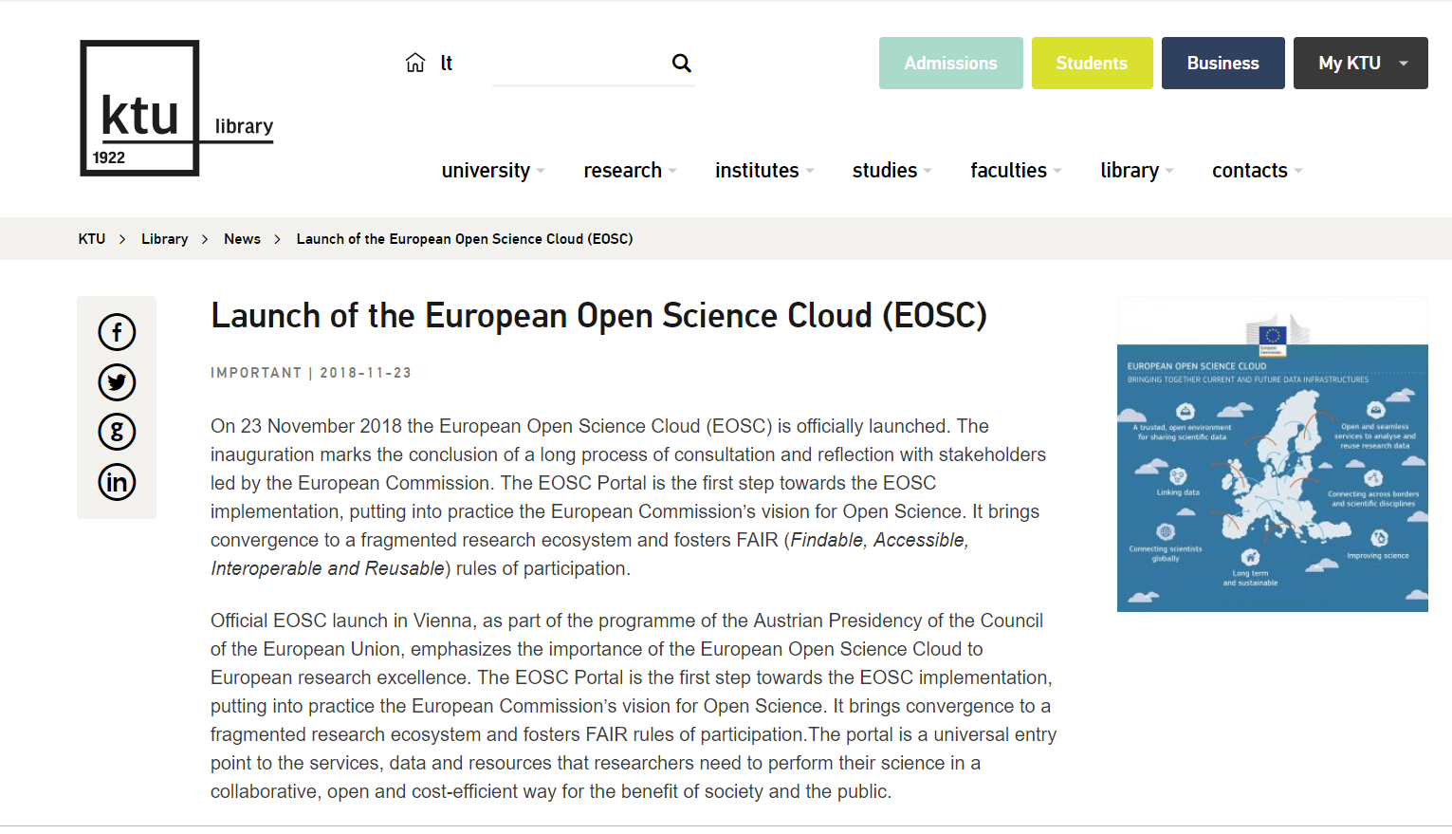
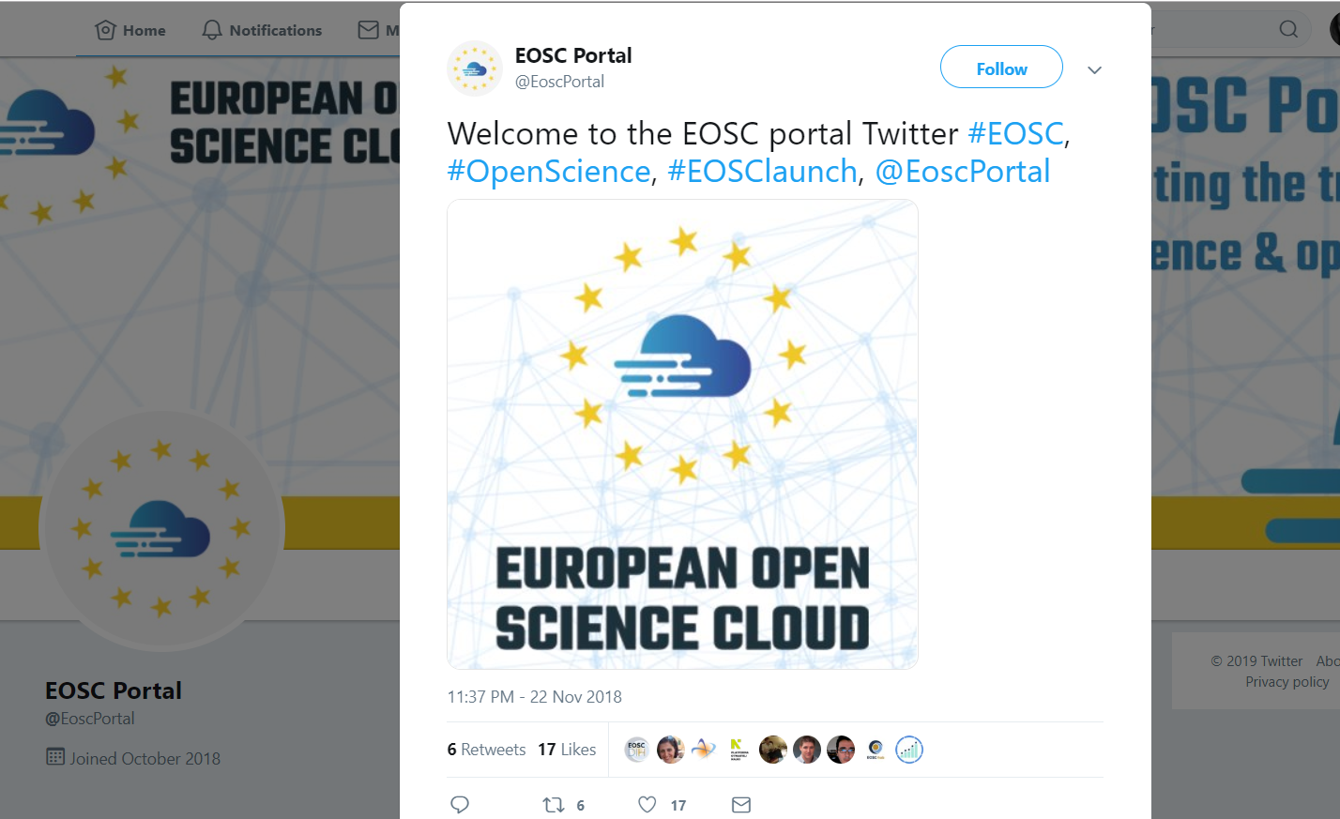
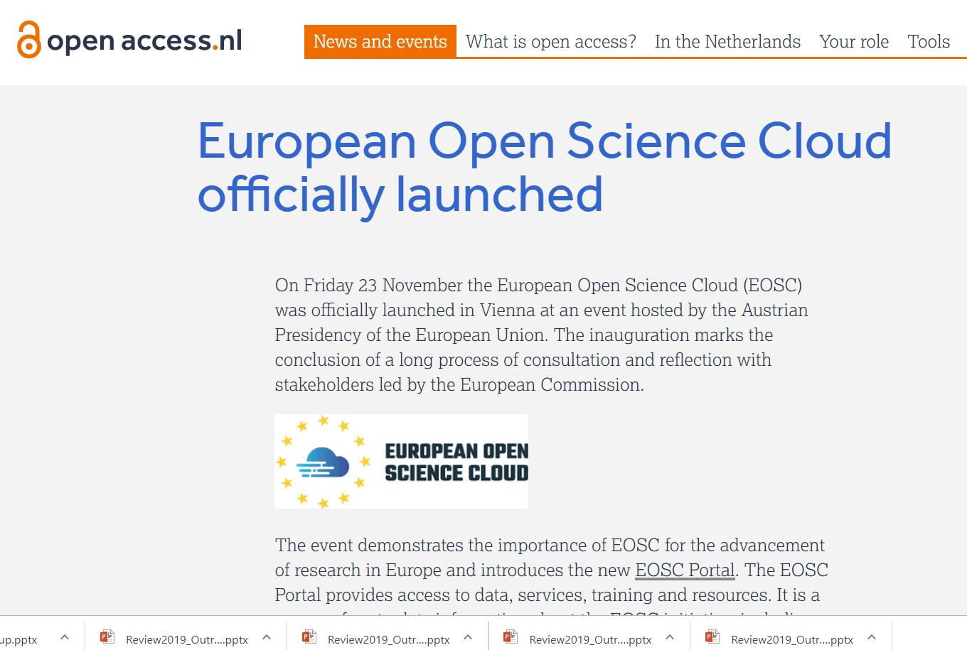
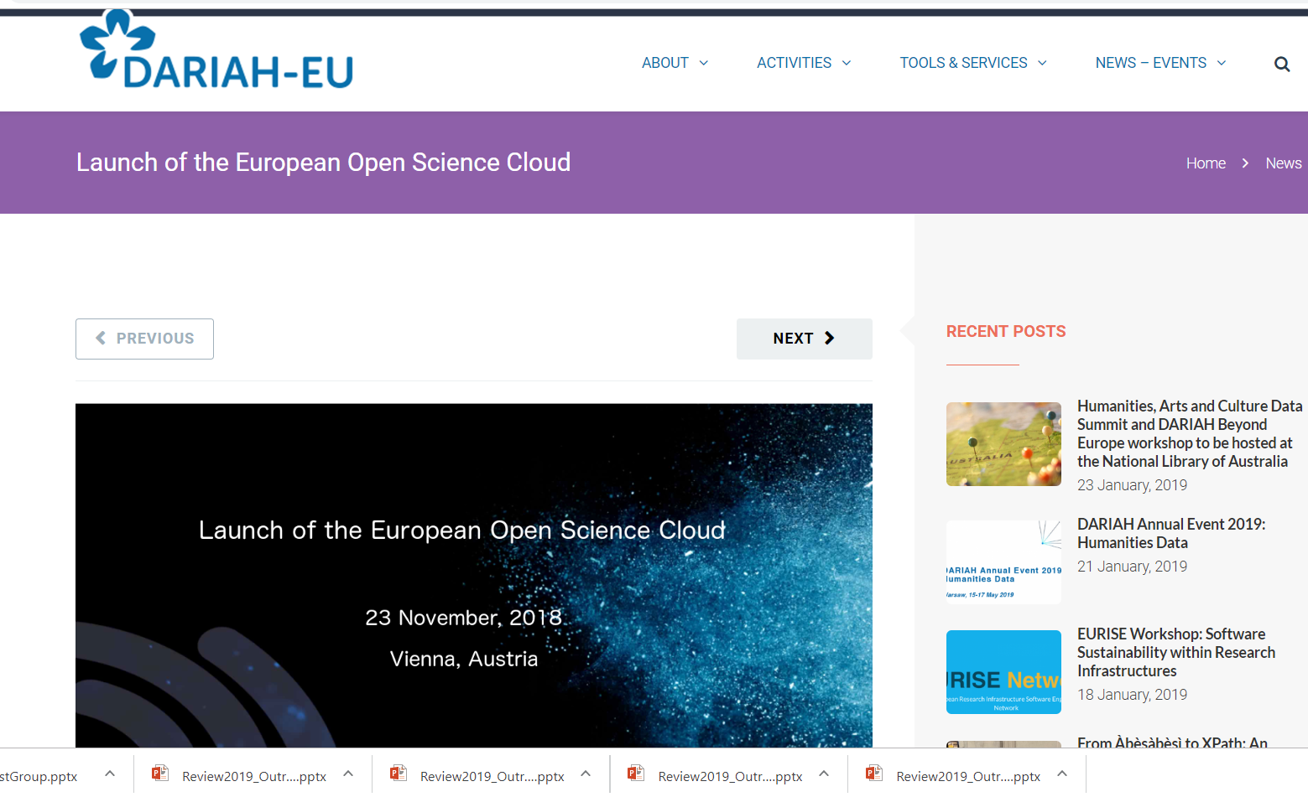
PR Campaign

Slide 8
EOSC Portal Editorial Board (EEB)
Set up during the summer 2018 to create the content for the EOSC Portal
Meets virtually every 3 weeks
Composed by representatives of the projects working on building the EOSC Portal, namely OpenAIRE, EOSC-hub, eInfraCentral and EOSCpilot
Members | Project
Jelen Angelis | eIC
Sara Coelho | EOSC-hub
Ilaria Fava | EOSCpilot/OpenAIRE
Sara Garavelli | EOSC-hub
Kalliroi Mavrantoni | OpenAIRE

Slide 9
Content Publication Rules
Content needs approval
Meetings to identify/agree
24h ‘objection’ phase to add new
Regular updates

Slide 10
EEB – Social media management
Set up two social media channels for the EOSC Portal:
Twitter (@EoscPortal)
YouTube
Rotation → 3-week cycle involving:
Twitter (min. 2 posts per week)
Requests management (enquiries specifically related to content)
Each project represented in the EEB is in charge of one rotation cycle.

Slide 11
Next Steps
Next steps: further editorial work
MS pages: strategy to streamline
All infrastructures to contribute – a comprehensive overview
Should we add more projects to the editorial board?
Promote the EOSC in practice use cases and collect more examples
Visibility of Training Materials

Slide 12
Thank you!
Najla Rettberg, OpenAIRE
on behalf of the EEB

