Slide 1
Report on project EOSC Portal Development and Integration Activities
Tiziana Ferrari / Project Coordinator
Dissemination level: Public

Slide 2
Mission
The EOSC-hub project mobilises providers of pan-European relevance offering services, software and data for advanced data-driven research and innovation.
These resources are offered via the Hub – the integration and management system of the European Open Science Cloud, acting as
a European-level entry point for all stakeholders.
EGI Federation
EUDAT
INDIGO-DataCloud
Research Infrastructures

Slide 3
Key Exploitable Results
The Hub
A system with: Federation & collaboration services; Processes & policies; Business models & procurement experience; Strategy & Technical Service Roadmap, etc.
EOSC Service Portfolio
Competence Centre
Common &Thematic services; Business models for individual services; Rules for participation, etc.
Service integration,
training, documentation
and best practices
EOSC Digital Innovation Hub

Slide 4
Service Portfolio and Service Catalogue
Service portfolio
Internal list that details all the services offered by a service provider [EOSC], including those in preparation, live and discontinued
Catalogue
Customer-facing list of all live services offered along with relevant information about these services
EOSC Service
Portfolio

Slide 5
EOSC-hub Service Portfolio
External
Internal
The set of customer-facing services that are publicly offered by the EOSC Hub
The set of supporting services needed to operate the EOSC Hub
The EOSC-hub project governance does not control the functional evolution of the service
The main control is on:
the verification of the compliance with the rules of participation
the interface with the EOSC hub according to the selected level of integration
These services need to fulfill the requirements to operate the EOSC hub
The EOSC-hub project governance retain a high-level of control on the planning, design and release of the services

Slide 6
Service Portfolio and Catalogue Management → WP2 and WP4
Service Catalogue management
A service catalogue shall be maintained
Service levels shall be defined, agreed and monitored (MEDIUM/HIGH LEVEL)
Service Portfolio management
A service portfolio shall be maintained [HIGH LEVEL]
Design and transition of new or changed services shall be planned [HIGH LEVEL].
Plans for the design and transition of new or changed services shall consider timescales, responsibilities, new or changed technology, communication and service acceptance criteria (internal catalogue) .
The organisational structure supporting the delivery of services shall be identified, including a potential federation structure as well as contact points for all parties involved [ALL levels].
Marketplace, Jira and helpdesk as integrating and collaborating tools which support relevant service management processes
70% EC funding, 30% partner funding
The Hub

Slide 7
Vienna, 23 Nov

Slide 8
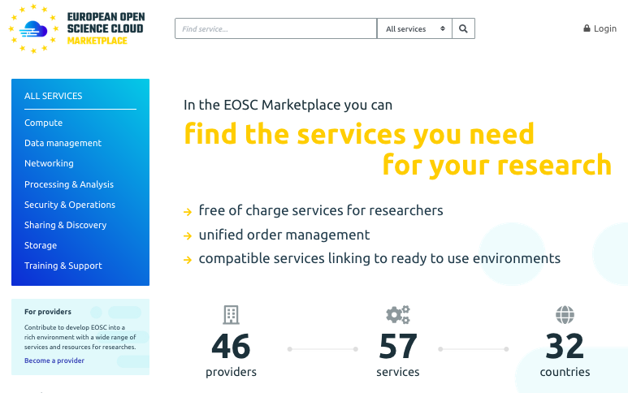
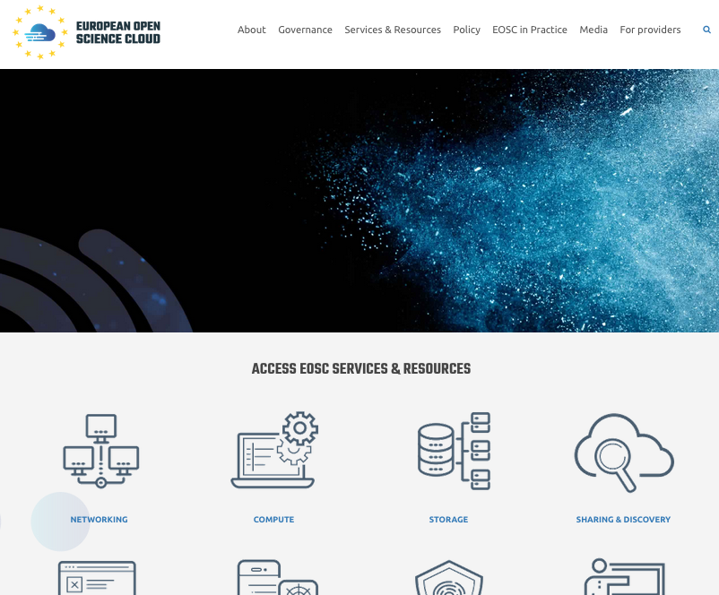
Marketplace interface to the Hub operators
Customers and users
Hub daily operations (WP2-WP4)
Customer relationship mgm
Service level mgm
Service report mgm
Supplier mgm
Incident mgm
Service request mgm
Service Order mgm
…
Service Providers of Research Enabling Services

Slide 9
The Marketplace/Service Provider interface
Marketplace
Service Providers of Research Enabling Services
Co-design
Integrate
Support users
Register
Provide and manage orders
Report (accounting/service levels)
EOSC resource/service providers

Slide 10
The Marketplace/User interface
Marketplace
Customers and users
Browse
Personal dashboard
Apply for access
Interact with service providers – Submit requirements
Submit orders
Bundle services to own research projects

Slide 11
Report on Marketplace and EOSC AAI

Slide 12
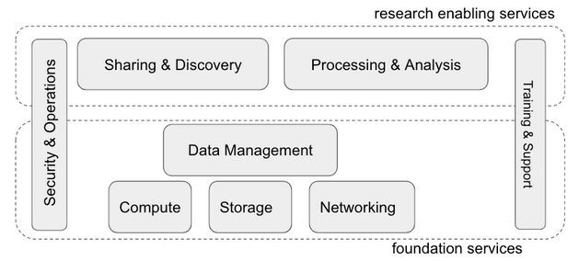
New service categorization in production
Grouping of services by capability to simplify service browsing
Oct 2018: revision and harmonization of service categories across e-InfraCentral and EOSC-hub
Adoption of new service categorization and remapping of existing services

Slide 13
Revision and Extension of Service Template & GUI
Towards a single service template Nov 2018 – work in progress
Comparison of status of service templates of EOSC-hub and eInfraCentral ➔ result of analysis
Agreement on structure: core (eInfraCentral) with EOSC-hub extensions
Rebranding of Marketplace
New EOSC look and feel and brand

Slide 14
New Service Description Template
Basic information
Classification
Support info
Contractual information
Performance indicators
Options
Order management
Maturity
Access management
Base template
Extension for the marketplace

Slide 15
Service provider onboarding procedure
Definition of common Service Provider onboarding form (EOSC Portal website)
Plug Marketplace into the new channel
Rules of Participation task force
Future identified needs (work in progress)
Revision of service information gathering: pull vs pull
Joint helpdesk with single team providing first line support
EOSC-hub teams: WP3 (engagement), WP4 (support), WP2 (service portfolio management)
Tracking system of service provider requests ➔ EOSC-hub Jira
Joint service provider support and validation procedure (in progress)
EOSC branded service provider documentation (in progress)

Slide 16
Setup and Testing of production infrastructure
Oct – Dec 2018
Preparation of website and marketplace HA setup (CYFRONET/WP5)
Decommissioning of EOSC-hub branded marketplace
Execution of DoS tests for the three EOSC Portal components
Marketplace, Catalogue and Website
Preparation of website high availability setup (in progress)
Definition of GDPR Data Controller roles in the EOSC Portal
Definition of EOSC Portal terms of use and EOSC portal policy on processing of personal data
Definition of service level targets for each of the three components

Slide 17
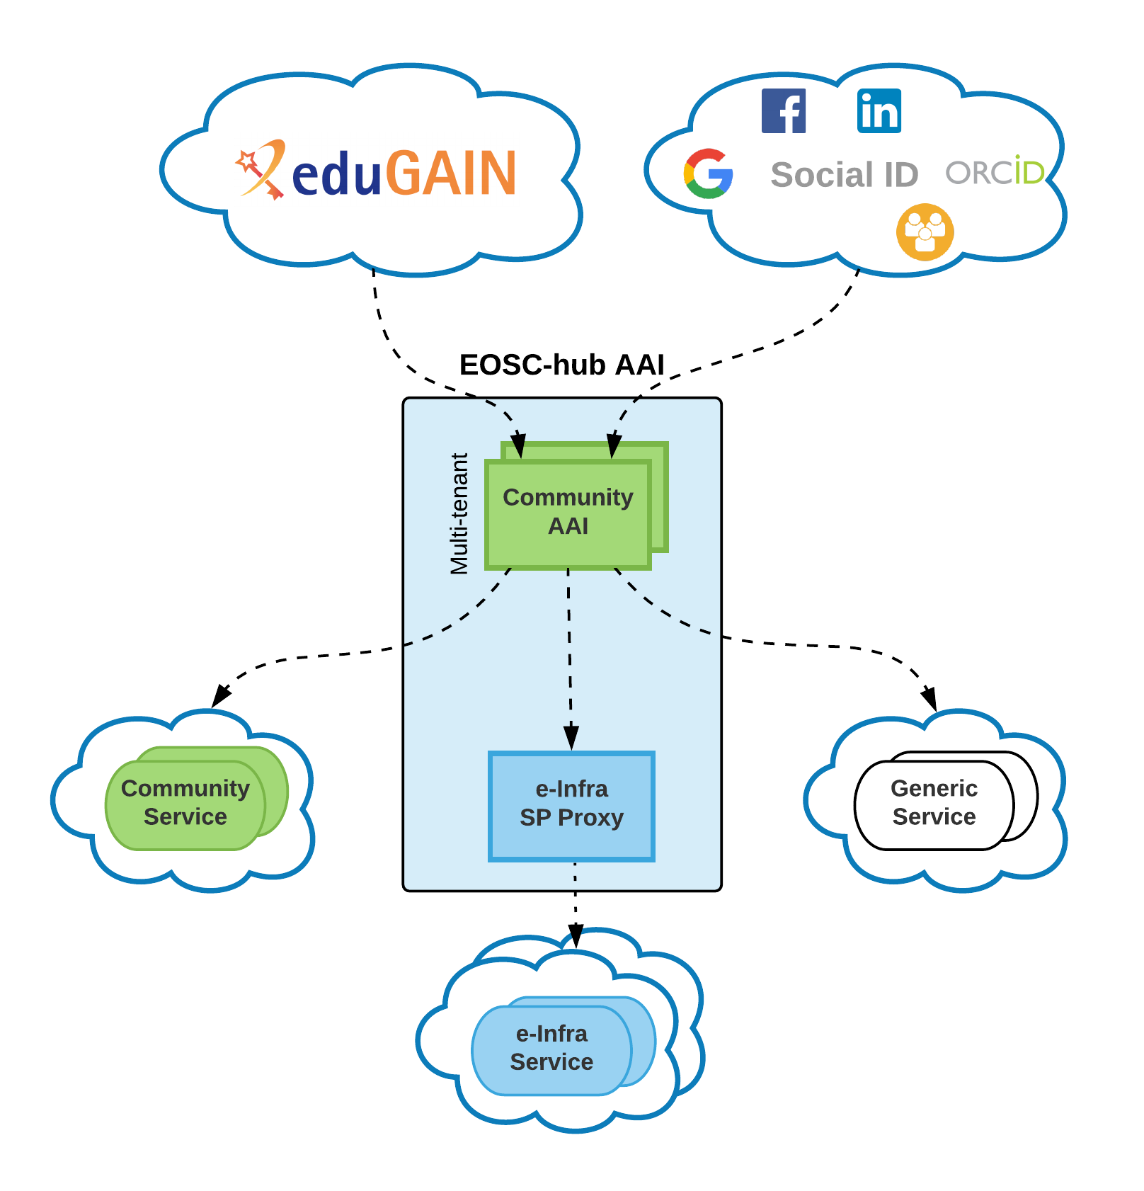
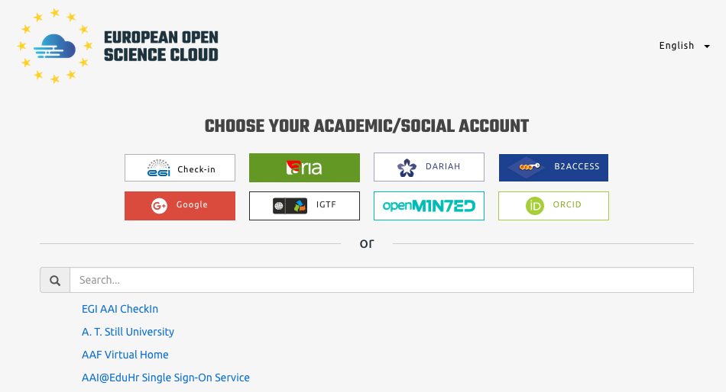
EOSC AAI
July 2018: Provisioning of AAI managed service supporting
Authentication and authorization of EOSC Portal users (website/marketplace & catalogue) with single sign on
Delegation of user credentials to services published in the marketplace ➔ SSO during the entire workflow, from portal access to service authorization

Slide 18
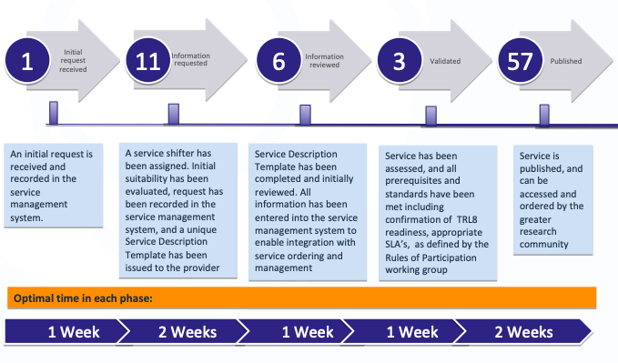
Onboarding pipeline / Jan 2018

Slide 19
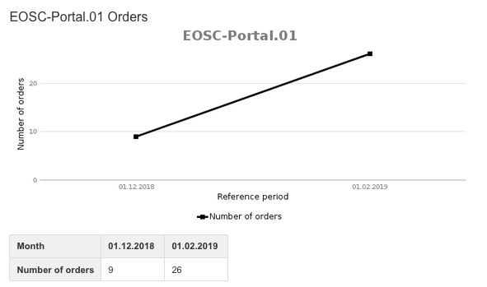
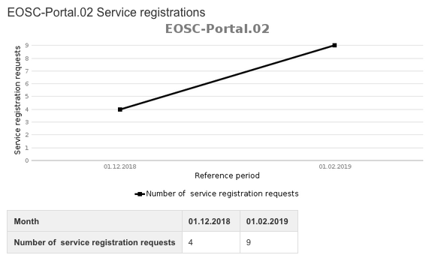
Metrics Dec 2018 – Jan 2019
https://wiki.eosc-hub.eu/display/EOSC/EOSC+Portal+Metrics
3811
Website visits
1381 MP
user sessions with AAI
2106 MP
single visits

