Slide 1
Overview and Key Exploitable Results
Tiziana Ferrari, Project Coordinator
Dissemination level: Public

Slide 2
Outline
Vision and mission
Project objectives and Key Exploitable Results
Project structure
Contribution to EOSC
Overview and Key Exploitable Results

Slide 3
A project overview
20 digital research infrastructures,
EGI, EUDAT CDI and INDIGO-DataCloud
jointly offering services, software and data
for advanced, data-driven research & innovation

Slide 4
Vision
Researchers from all disciplines
have easy, integrated and open access to the advanced digital services, scientific instruments, data, knowledge and expertise they need
to collaborate to achieve excellence
in science, research and innovation
100 partners
36 months
33 million Euro

Slide 5
Mission
The EOSC-hub project mobilises providers of European relevance offering services, software and data for advanced data-driven research and innovation.
These resources are offered via the Hub – the integration and management system of the European Open Science Cloud, acting as a European-level entry point for all stakeholders.
EGI Federation
EUDAT
INDIGO-DataCloud
Research Infrastructures

Slide 6
About the European Open Science Cloud
The federated infrastructure and supporting initiative providing
all researchers, innovators, companies and citizens
with seamless access to an open-by-default, efficient and cross-disciplinary environment
for storing, accessing, reusing data, tools, publications and other scientific outputs for research, innovation and educational purposes
Credits: EOSCpilot (https://eoscpilot.eu/)
Overview and Key Exploitable Results

Slide 7
EOSC-hub response to EOSC objectives
EOSC Objectives | Actions
Increase the ability to exploit research data across scientific disciplines and between the public & private sector | > Publish, discover, access services and resources for all scientific disciplines > Open to national, regional, pan-European providers, and supports different exploitation models (e.g. free at point of use, commercial)
Increase interoperability, interconnect the existing and the new research digital infrastructures across Europe | > Provide thematic services integrated with European compute/data platforms for data exploitation > Single sign on, integrated access and order
Support open science | > Services to share and discover research artefacts (publications, datasets, software, workflows etc.), research artefacts data sources (publication repositories, publishers, data archives, software archives, etc.)
Overview and Key Exploitable Results

Slide 8
Objectives
O1
O2
O3
O4
O5
O6
Increase innovation capacity of Research e-Infrastructures
Provide a knowledge hub.
Widen the access to services to all user groups including researchers, high-education, business organizations and expand the user base.
Consolidate e-Infrastructures by expanding capacity and capabilities and improving service quality.
Remove fragmentation of service provisioning and access to high-quality digital services in Europe and beyond through the technical integration and adoption of standards for interoperability of compute, storage, data and software platforms.
Simplify access to a broad portfolio of products, resources and service provided by the major pan-European and international organizations through an open and integrated service catalogue.
Overview and Key Exploitable Results

Slide 9
Key Exploitable Results - Overview
EOSC Digital Innovation Hub
Competence Centre
EOSC Service Portfolio
Service integration,
training, documentation
and best practices
The Hub
Overview and Key Exploitable Results

Slide 10
Simplify Integrate & Consolidate
[O1] Simplify access to a broad portfolio of products, resources and service provided by the major pan-European and international organizations through an open and integrated service catalogue
[O3] Consolidate e-Infrastructures by expanding capacity and capabilities and improving service quality
EOSC service portfolio [KER2]
Service portfolio management
Common services
Thematic services
New Services entering in the EOSC-hub
Trainings on how to use the services
Business models identified for the individual services (to be defined by the service providers)
Technical Service Roadmap
Rules for participation (ensure that services meet a certain quality)
Overview and Key Exploitable Results

Slide 11
EOSC-hub Service catalogue
Arts and Humanities
Medical and Health Sciences
Physical Sciences Earth Sciences
Biological Sciences
Data Lifecycle Management, Compute,
Scientific Applications
Research
Enabling
Services
The
Hub
Access
Enabling
Services
e.g. Marketplace, EOSC AAI
Accounting and Monitoring
Helpdesk, Collaboration Platforms
https://www.eosc-hub.eu/catalogue/
Overview and Key Exploitable Results

Slide 12
Support to the Research Data Lifecycle
4
Access, Deposition & Sharing
Application DB (software & VM)
B2DROP (data)
B2Note (data)
B2SHARE (data)
DataHub
1
Data Management, Curation & Preservation
Federation Services
Discover & Reuse
B2HANDLE
B2SAFE
European Certified Trusted Repository
Federated AAI. monitoring, accounting
SLA and order Management
Security incident response and policies
Technical support & Training
B2FIND (data)
Marketplace (Services)
3
Processing & Analysis
2
Applications on Demand
Federated HTC & Cloud Compute IaaS & PaaS
Processing of sensitive data
Jupyter Notebook
Thematic data analytics
Scientific Workflow Management, Orchestration (DIRAC, PaaS Orchestrator)

Slide 13
Services by area
e-Infra
EGI Federation
EUDAT CDI
Humanities
Language and literature (CLARIN)
Arts (DARIAH)
Engineering
Environmental engineering (sea vessels, LNEC)
Civil Engineering (Disaster Mitigation)
Medical and Health Sciences
Biological Sciences (ELIXIR)
Structural biology (WeNMR)
Natural sciences
INDIGO-DataCloud
PHYSICAL SCIENCES
Astronomy (LOFAR)
Fusion (ITER)
High Energy Physics (CMS and VIRGO)
Space Science (EISCAT-3D)
EARTH SCIENCE
EO Pillar
GEO
Climate Research (ENES)
Seismology (ORFEUS, EPOS)
BIOLOGICAL SCIENCES
Marine and freshwater biology (IFREMER)
Biodiversity conservation (LifeWatch)
Ecology (ICOS)
Overview and Key Exploitable Results

Slide 14
Remove fragmentation
[O2] Remove fragmentation of service provisioning and access to high-quality digital services in Europe and beyond through the technical integration and adoption of standards for interoperability of compute, storage, data and software platforms
The Hub [KER1]
The EOSC Service management Federation and collaboration service and tools
Processes and policies
Business models and procurement experience
Strategy and roadmap
Technical Service Roadmap
Professional services
Sustainability model for the Hub
Overview and Key Exploitable Results

Slide 15
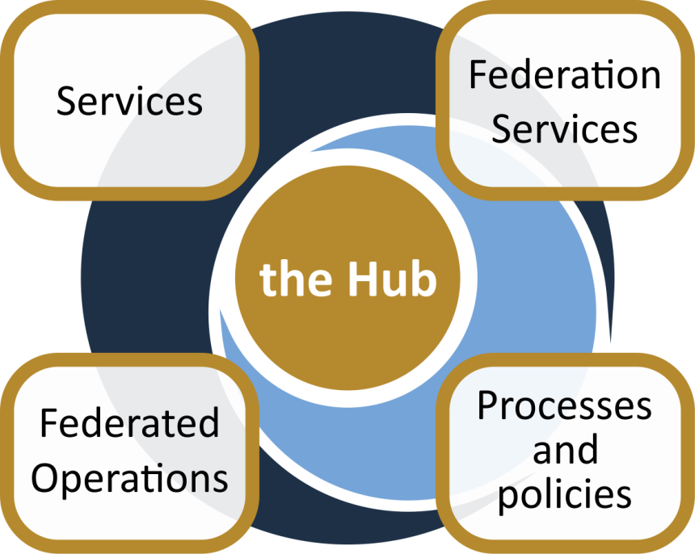
The Hub
From the consortium AND from external contributors
Data
Applications & tools
Baseline services (storage, compute, connectivity)…
Training, consultants
Usage according to Rules of Participation
Marketplace
AAI
Accounting
Monitoring
…
Security regulations,
Compliance to standards,
Terms of use,
FAIR implementation guidelines
…
Lightweight certification of providers
SLA negotiation
Customer Relationship Management
…
Based on FitSM
Overview and Key Exploitable Results

Slide 16
Widen User Base and Innovation Capacity
Digital Innovation Hub [KER3]
A platform that allows facililtates engagement between private industry and public institutions participating in the EOSC
Competence Centres [KER5]
Research communities, service providers and experts contributing to
Co-design: Requirements, gap analysis and technical development
Piloting and pre-production
[O4] Widen the access to services to all user groups including researchers, high-education, business organizations and expand the user base
[O6] Increase innovation capacity of Research e-Infrastructures Solutions successfully adopted by user communities will be supported for broader exploitation by external stakeholders. In addition to the DIH, the project stimulates engagement via large research collaborations and infrastructures via 8 Competence Centres
Co-design
Requirements and Gap Analysis
Piloting and pre-production service provisioning
Technical development and service deployment
Overview of key exploitable results

Slide 17
Knowledge hub
[O5] Provide a knowledge hub
Access will be opened to all to overcome the current funding and policy barriers
The project engages adjacent, but fragmented, scientific communities in Humanities, Physical Sciences, Earth Sciences, Biological Sciences, and Medical and Health Sciences
Service integration, training, documentation and best practices [KER4]
Best practices, use cases and EOSC success stories
Training resources
Innovation Management
Service Management
IT Security
Data management
EOSC services
Overview and Key Exploitable Results

Slide 18
Project Structure
100 Partners, 76 beneficiaries (75 funded)
3830 PMs, 106 FTEs, +150 technical and scientific staff involved
€33,287,542 of which the European Commission funds €30,000,000
36 months: Jan 2018 – Dec 2020

Slide 19
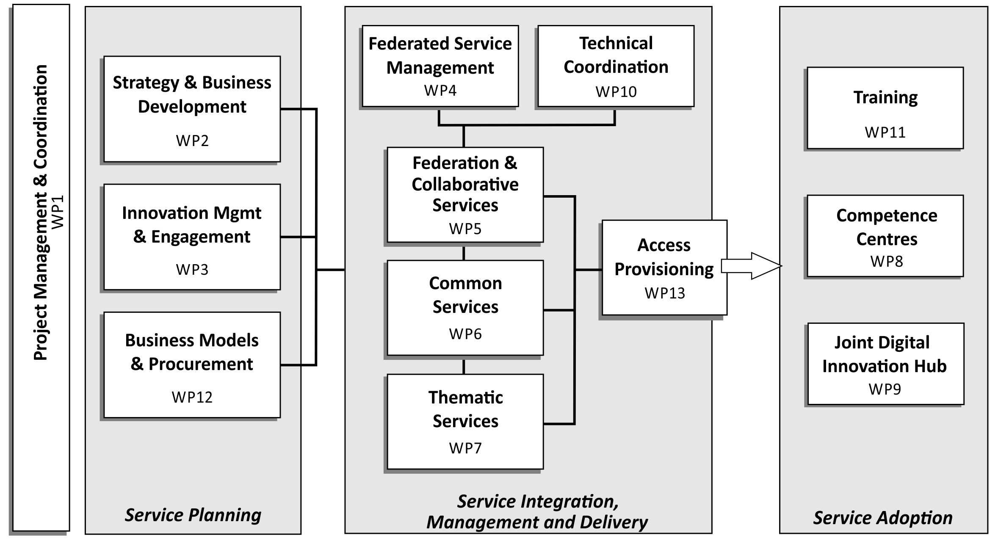
Work Package Structure
Overview and Key Exploitable Results

Slide 20
Innovation cycle
Maintain enabling technologies
Provide → support → access → consume
Engage with external user communities and providers
Integrate services
Overview and Key Exploitable Results

Slide 21
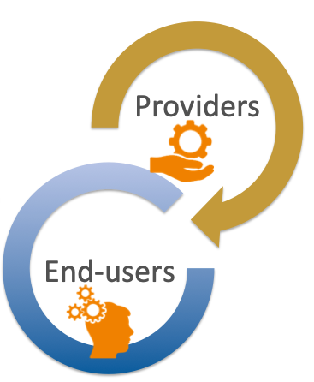
Value proposition of Users and Providers
Users
Discover services through a secure online catalogue with a central access point.
Access services via harmonised access policies and Service Level Agreements. Depending on the customer’s needs, access will be provided through a centrally managed credit-based allocation system and/or through long-term resource allocation.
Leverage a large portfolio of generic and thematic services via standard interfaces
Providers
Contribute to EOSC with services based on a harmonised corpus of access, security and provisioning policies.
Federate services by relying on harmonised processes and tools for service integration and management.
Scale-up in-house capacity by procuring services via a centrally run procurement and purchase framework.
Overview and Key Exploitable Results

Slide 22
EOSC stakeholder roles in the project
Service/Product providers
Contribute to the portfolio & Integrate
Promote, Train, Exploit
Manage the Hub
Consumers
Credit allocation & exploit
Support
Improve with feedback
technical support, exploit
Early adopters
Pilot
Use
Co-develop
Overview and Key Exploitable Results

Slide 23
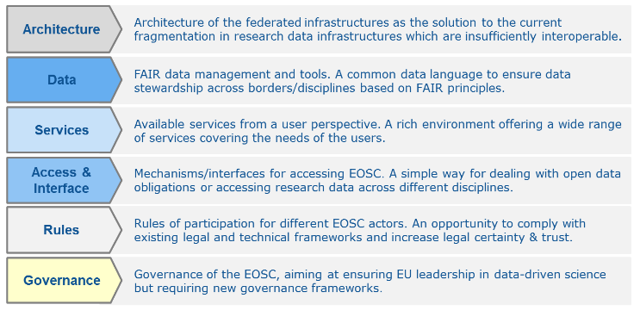
Project Contribution to EOSC
Input to the EOSC implementation roadmap (SWD, 03/2018)

Slide 24
Main EOSC-hub assets for EOSC
EOSC Portal website and website
EOSC AAI
Processes e.g. IT security mgm and quality verification
Accounting Monitoring
Helpdesk
Polices Users/Provider
(input to RoP)
Service Portfolio and technical roadmap
Service integration processes, support and training
Engagement with users and service providers
Overview and Key Exploitable Results

Slide 25
EOSC-hub contributions to the EOSC roadmap 1/5
EOSC strategic actions
Architecture | Provides a framework (the Hub) to manage services sourced from a number of service providers and plays the role of service integrator
EOSC-hub KERs | The Hub
Overview and Key Exploitable Results

Slide 26
EOSC-hub contributions to the EOSC roadmap 2/5
EOSC strategic actions
Data | Through data registries, provides a discovery and access channel to FAIR-accredited datasets
EOSC-hub KERs | EOSC Service Portfolio
Overview and Key Exploitable Results

Slide 27
EOSC-hub contributions to the EOSC roadmap 3/5
EOSC strategic actions
Services | Contributes to the definition of a participatory and lightweight service portfolio management process in collaboration with the participating service providers, including RIs
EOSC-hub KERs | EOSC Service Portfolio
Overview and Key Exploitable Results

Slide 28
EOSC-hub contributions to the EOSC roadmap 4/5
EOSC strategic actions
Services | Engages with the demand and supply side of the EOSC, and will co-develop and operate a marketplace as one entry point to EOSC.
EOSC-hub KERs | Competence Centres, Digital Innovation Hub EOSC Marketplace
Overview and Key Exploitable Results

Slide 29
EOSC-hub contributions to the EOSC roadmap 5/5
EOSC strategic actions
Rules of Participation | Collaborates with partners and external projects/initiatives to establish and maintain a corpus of policies that is attractive and provides value for both service providers and service users.
EOSC-hub KER | The Hub
Overview and Key Exploitable Results

Slide 30
EOSC-hub review agenda 22-23 Jan

Slide 31
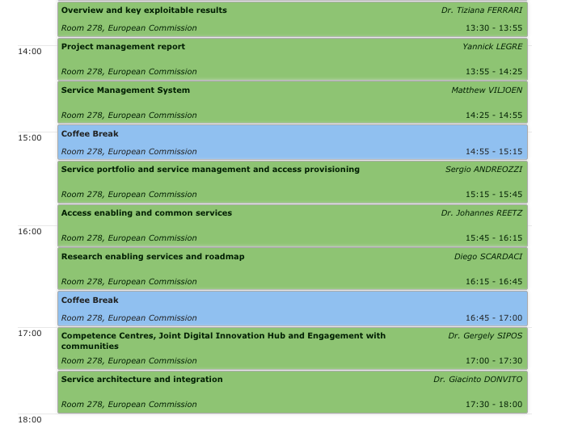
Agenda and WPs
WP2, WP12
WP1
WP3
WP4
WP2, WP4, WP5, WP12
WP5, WP6, WP13
WP7, WP13
WP8, WP9, WP3
WP10
Overview and Key Exploitable Results

