Slide 1
EOSC-hub Review
Service Management System
WP1 (T1.3), WP2 (T2.2), WP4
Matthew Viljoen, EGI Foundation
Dissemination level: Public

Slide 2
Presentation Outline
Overview of the EOSC-hub SMS
EOSC-hub SMS Process Updates
Operations Coordination
Summary

Slide 3
Overview of the EOSC-hub SMS

Slide 4
Service Management System – what is it?
The management system controlling/supporting the management of services
Policies
Governance level
Control level
Process:
Inputs
Activities and roles
Outputs
Operational level
Procedures
Person (in a role)

Slide 5
EOSC-hub Service Management System (SMS)
Fundamental requirements for EOSC-hub Service Delivery:
Professional, sustained delivery of services
Good stakeholder (customer, supplier) relations
Established service lifecycle (strategy, design, transition, operation, improvement)
Enabled by defining and implementing a complete SMS
Why FitSM*?
Lightweight standard based on the industry adopted ITIL best practices
Heterogeneity helped by using common vocabulary
Open, accessible and ... free!
Service Portfolio Management (SPM)
Service Level Management (SLM)
Service Reporting Management (SRM)
Service Availability and Continuity Management (SACM)
Capacity Management (CAPM)
Information Security Management (ISM)
Service Order Management (SO) and Customer Relationship Management (CRM)
Supplier and Federation Member Relationship Management (SFRM)
Incident and Service Request Management (ISRM)
Problem Management (PM)
Configuration Management (CONFM)
Change Management (CHM)
Release and Deployment Management (RDM)
Continuous Service Improvement (CSI)
EOSC-hub Service Management System
Policies
Processes
Procedures
https://fitsm.itemo.org/

Slide 6
EOSC-hub SMS - FitSM Process Model
Service Portfolio Management (SPM)
Most strategic
Service Level Management (SLM)
Service Reporting Management (SRM)
Service Availability and Continuity Management (SACM)
More tactical
Capacity Management (CAPM)
Information Security Management (ISM)
Customer Relationship Management (CRM)
Supplier and Fed Member Relationship Management (SFRM)
Incident and Service Request Management (ISRM)
Problem Management (PM)
Configuration Management (CONFM)
More operational
Change Management (CHM)
Release and Deployment Management (RDM)
Continual Service Improvement (CSI)

Slide 7
EOSC-hub SMS Approach for Services
Level of Integration
Provider
responsibilities
Internal Catalogue
Supporting services. Federation Services
Follows EOSC-hub processes
HIGH
EOSC-hub SMS
External Catalogue
Services from participating e-Infrastructures
Thematic services
Other services wishing to participate in EOSC-hub
HIGH
MEDIUM
Runs own SMS but integrates with EOSC-hub SMS (SPM, SLM, CRM, RDM, SACM, ISM, ISRM)
External SMS
LOW
Supports EOSC-hub SMS processes (SPM, SLM, CRM, RDM, SACM, ISM, ISRM)
Approach proposed in D4.1 https://www.eosc-hub.eu/deliverable/operational-requirements-services-catalogue
More information about the Service Catalogues: https://wiki.eosc-hub.eu/display/EOSC/EOSC-hub+service+catalogue
Overarching aim: promotion of consistent high-quality ITSM approach across all participating organizations

Slide 8
Level of integration - LOW
Who is it aimed at?
Any service provider, anywhere! Academic, domain specific, SME, ...
Benefits?
Exposure to new users
One-stop shop for service discovery, order management and helpdesk
First step for integration with other EOSC-hub services
Exposure to EOSC-hub Operations coordination via the Service Provider Forum and IT Security expertise within the project
What’s needed?
Mature service, at least TRL8
Description of service
Contact for support and orders
Security contact

Slide 9
Level of integration - MEDIUM
Who is it aimed at?
Service Providers wanting closer level of integration with EOSC
Benefits? Same as LOW plus:
Assistance with integration of EOSC-hub core services (e.g. AAI, helpdesk)
Membership of Service Management Board (SMB) and providing input in evolving EOSC-hub operations and policies
Integration with EOSC-hub service management processes
What’s needed? Same as LOW plus:
Mature Service Management System, already meeting FitSM* (or equivalent) requirements
Clear intention to integrate with EOSC-hub core services (e.g. AAI, helpdesk)
* https://fitsm.itemo.org/

Slide 10
Level of integration – HIGH
Who is it aimed at?
Service Providers wanting the closest level of integration with EOSC
Benefits? Same as LOW and MEDIUM plus:
Maximum service management harmonization with EOSC-hub
What’s needed? Same as LOW and MEDIUM plus:
Already integrated with EOSC-hub core services (e.g. AAI, helpdesk)
Willingness to follow EOSC-hub service management processes

Slide 11
EOSC-hub SMS Process Updates

Slide 12
Service Portfolio Management, Service Order + Customer Relationship Management, Service Level Management
The range of service delivered, dealing with service orders and customer communication and ensuring service levels are maintained
Marketplace populated with production services
Procedures written for onboarding new services, with onboarding team and rota in place
Service orders management procedures now defined using Jira, to deal with different order types:
one service
multiple services of arbitrary providers
OLA harmonized across participating e-Infrastructures

Slide 13
Service Availability and Continuity Management
Ensuring services are available and are resilient
Agreed on approach to define Service Availability and Continuity (SAC) plans in Confluence for services focussing on testing recovery scenario. Procedures now written
Completed for EOSC-hub helpdesk service. Plan to write (and test) SAC plan for each service in internal catalogue
Approach for Capacity Management now being developed

Slide 14
Information Security Management
Ensuring confidentiality, integrity and accessibility of information
Coordination of a project wide Incident Response Task Force
Handling of security events & vulnerabilities
Managing day-to-day security activities
Development of new project-wide policies & procedures
Top-level security policy for the internal catalogue services
Service Operations security policy
Data Protection policy framework
Updating of the Security Monitoring framework
Interaction with worldwide security initiatives

Slide 15
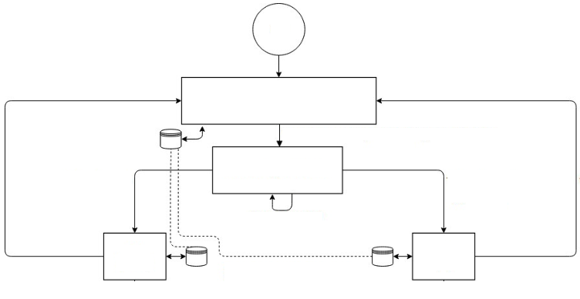
Incident and Service Request Management
Helpdesk provision and restoring services after incidents occur
Successfully developed a consistent helpdesk system, integrating participating e-Infrastructures
1st and 2nd level support
New interface (xGUS) dedicated to EOSC-hub
Plans now to integrate with the new Problem Management process and efficiently track known errors
User
xGUS
EOSC-hub 1st
level support
eInfra
support
eInfra
support
EOSC-hub 2nd
level support
EOSC-hub 2nd
level support

Slide 16
Change Management & Configuration Management
Managing changes and controlling the configuration of services
Change Management process defined based on Jira
Change risk levels proposed and adopted
Change Advisory Board up and running
Release and Deployment workflow integrated into Change Management
Definition of the configuration items types and attributes has been defined together with a proposal for a new topology based on GOCDB

Slide 17
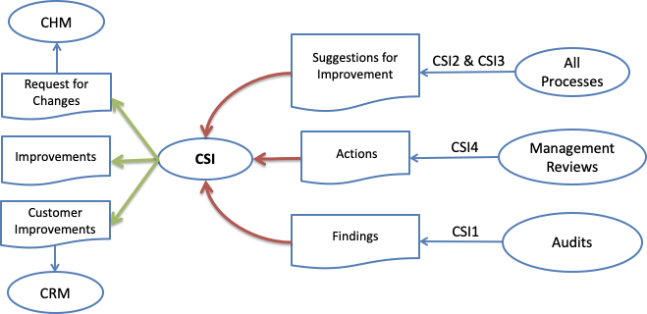
Continuous Service Improvement
Managing improvements to services and to the SMS
All CSI pages have been fully drafted with process overview (goals, roles, requirements, inputs/outputs and interfaces), Policy and Procedures.
A dedicated queue in Jira has been set up for tracking CSI related actions
Audit Programme
An initial structure to the audit programme has been provided
The 1st Internal Audit under preparation, which will take place 11-15 March in Amsterdam.

Slide 18
Operations Coordination

Slide 19
Service Management Board and Service Provider Forum
Operations Coordination is critical; dedicated task for it (T4.1)
SERVICE PROVIDER FORUM
Aims (LOW,MEDIUM,HIGH)
lightweight communication (Mailing list)
requirements
increasing awareness of services
access to users
SERVICE MANAGEMENT BOARD
Aims (MEDIUM, HIGH)
as above plus
regular meetings
discussion of problems involving operations
discussion and approval of non-strategic changes to operational policies
onboarding process (operations)
Communication needs
Project
Service Providers
News
project news
major operational news
security threats
upcoming events
Increasing awareness of access enabling services
Requirements collection
General concerns
Feedback to project (SPs and users)

Slide 20
Summary, Results so far and Plans
SMS
EOSC-hub SMS development well under way
Essential processes already usable
SMS audit plans well advanced
Remainder of project to refine and finalize process procedures/policies
Operations Coordination
Service onboarding and user facing processes already defined and usable
Service Provider Forum and Service Management board ready to go

