Slide 1
Access enabling and common services
WP5, WP6, WP13
Johannes Reetz, MPCDF, EOSC-hub AMB co-chair
Luxembourg, 22 January 2019

Slide 2
Outline
Scope of access enabling
Federation and Collaboration services
Common Services
Access Enabling and Common Services via Virtual Access

Slide 3
Scope of Access enabling
Access enabling services to operate and provide access to the Hub
Federation and Collaboration Services
Marketplace, AAI, IT-Service Management tools, Business & Operations support tools
operationally reliable, integrated into the EOSC-hub SMS
Research enabling services
Common Services generic compute, storage, data management services
operationally reliable, integrated into the EOSC-hub SMS
Thematic Services scientific data, data analytics, scientific simulations, scientific metadata management
scientifically reliable, interoperable or integrated into the EOSC-hub SMS

Slide 4
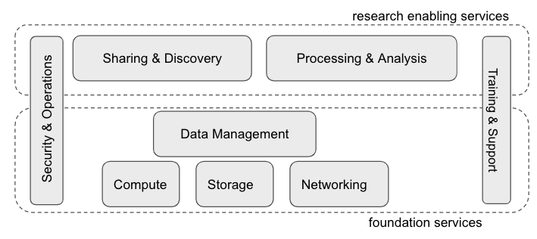
Access Enabling and Common Services
Federation & Collaboration Services
Common Services

Slide 5
Federation & Collaboration Services and tools
Service | Description | Main Components | Category | Service Owner(s)
Perun | identity and access mngmt system (IAM) on top of an existing infrastructure | Perun Core, … | Federation: AAI | EGI / CESNET
Check-in | AARC BP compliant EGI Identity and Access Management proxy solution | Comanage | Security&Operations | EGI / GRNET
B2ACCESS | AARC BP compliant EUDAT Identity and Access Management proxy solution | Unity IDM | Security&Operations | EUDAT / JUELICH
WaTTS | Token Translation Service (TTS), supporting IGTF compatible (IOTA) X.509 certificates. | Erlang OTP | Federation: AAI | INDIGO / KIT
RCauth.eu | TTS that can issue PKIX credentials on the fly and in real-time |  | Federation: AAI | EGI / Nikhef, GRNET, STFC
Marketplace | user-facing platform to promote, discover, order and access EOSC-hub services | Ruby-on-rails App | Collaboration | EOSC-hub Cyfronet
SPMT | full list of services, to manage service descriptions according FitSM guidelines | Agora | Collaboration | EOSC-hub GRNET
Ops Portal | VO management and operations support tool for the daily operations of EGI | Vapor App | Federation | EGI / CNRS
DPMT | business and operations support tool to manage projects and services topologies. | Plone, python | Federation | EUDAT / MPCDF
DMP Tool | Data Mngmt Planning tool for creating and updating data management plans. |  | Federation | EUDAT / SIGMA2
GOCDB | Registry to record information about the complete e-Infrastructure topology. |  | Federation | EGI / STFC
SVMON | Information aggregator and provider on software versions installed. | Spring App | Federation | EUDAT / KIT
Accounting Portal | framework for monitoring status, availability and reliability provided by infrastructures |  | Collaboration | EOSC-hub / CESGA
ARGO Msg | messaging Service | ARGO | Federation | EOSC-hub GRNET / SRCE
Pakiti, SECANT | monitors the patching status on Linux systems; security cloud assessment framework |  | Federation | EGI / CESNET
ARGO monitoring | monitoring status, availability and reliability provided by infrastructures | ARGO | Federation | EOSC-hub / GRNET
APEL accounting | collects, aggregates, stores, displays compute, storage, and cloud resource usage data | APEL | Federation | EOSC-hub / STFC
EUDAT RT Helpdesk | EUDAT ticketing system based on Request Tracker | RT | Collaboration | EUDAT / BSC
XGUS Helpdesk |  |  | Collaboration | EOSC-hub / BSC
GGUS Helpdesk |  |  | Collaboration | EGI / KIT
AppDB/UMD | Application data base, enabling EGI Cloud infrastructure through a VMOps dashboard |  | Collaboration | EGI / IASA

Slide 6
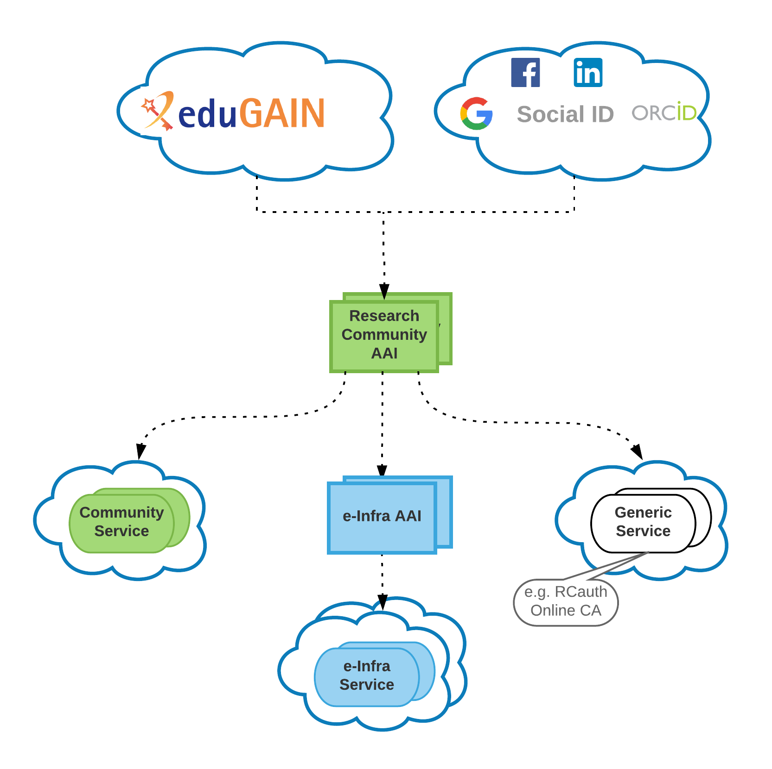
Federation Services: EOSC-hub AAI
EOSC-hub AAI architecture
Definition of the first version of the EOSC-hub AAI high-level architecture
Based on the “community-first” approach of the AARC Blueprint Architecture (BPA)
Collaborate with GN4-2 on the evolution of the EOSC-hub AAI
EOSC-hub AAI integration workplan
Workplan for RCauth Online CA High Availability Support
Workplan for integration with OpenAIRE AAI
Specification of AAI integration use-cases [ONGOING]

Slide 7
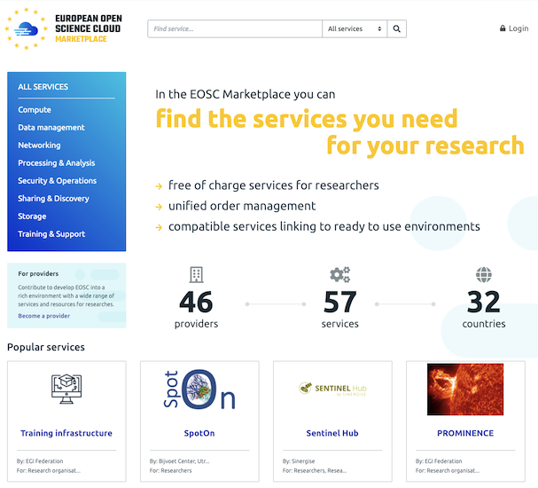
Federation Services: SPMT, Marketplace
Service Portfolio and Catalogue Management Tool
Marketplace Service marketplace.eosc-portal.eu
Achievements
EOSC-hub SPMT instance linked to www.eosc-hub.eu/catalogue and the Marketplace
Enhanced API
Improved role model and authorization
Achievements:
Flexible catalogue functionality implemented
Enhanced search and service filtering
Form to contact a service provider;
User profile-sensitive service search engine;
Intuitive service ordering path for the user;
Custom ordering forms for services;
Users’ orders are recorded in a JIRA ticketing system
Dedicated user dashboard to check status of the orders;
Service Rating;
Integration with the EOSC-hub AAI.

Slide 8
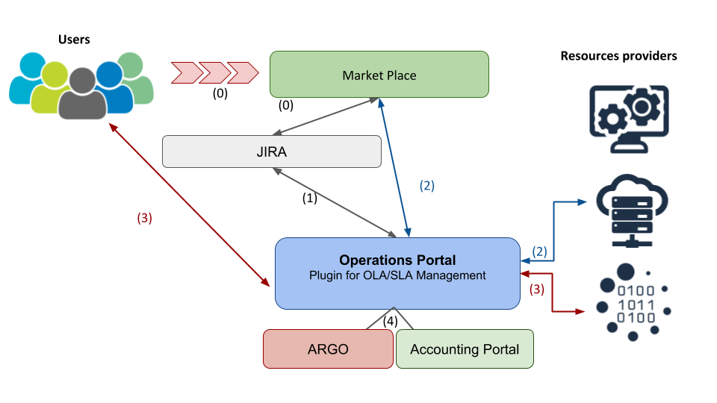
Federation Services: Order & SLA/OLA management
Service Providers
Achievements
Marketplace Front Office enabled (integration with JIRA)
Development of the MP backoffice in progress.
Operations portal is able to aggregate detailed information from the service providers.
under development

Slide 9
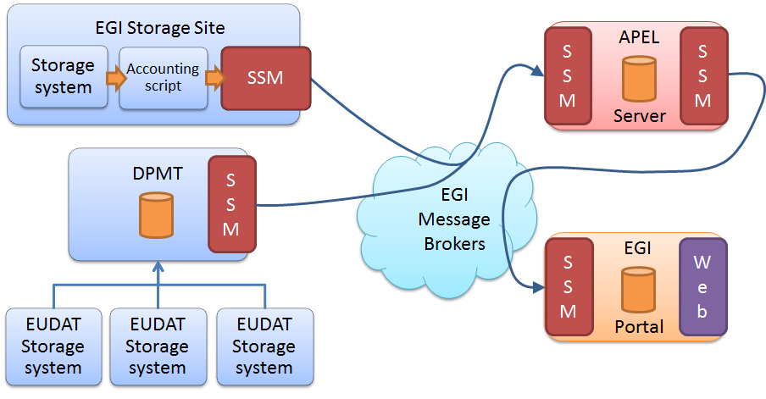
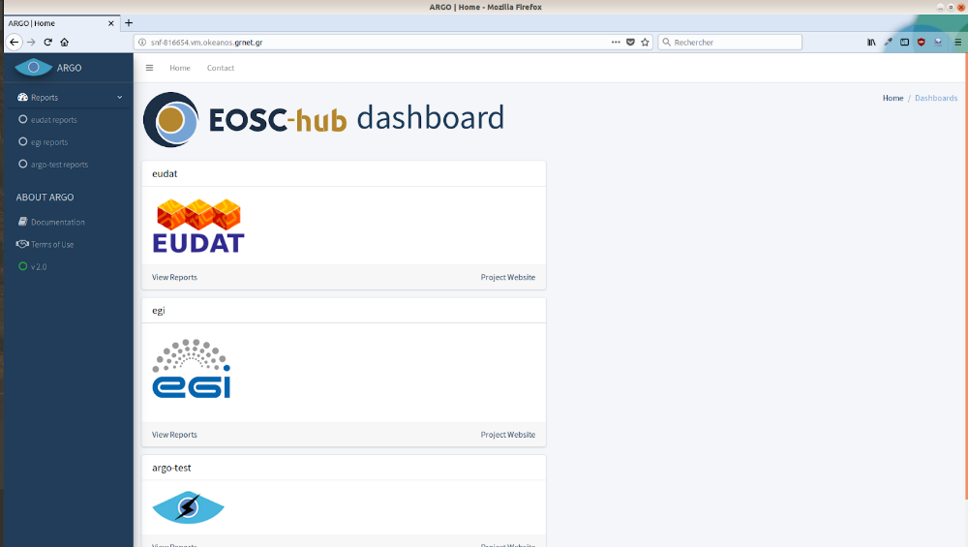
Federation Services: Accounting, Monitoring
Accounting
Monitoring
Achievements
Integration of the EGI and the EUDAT accounting systems thanks to the GOCDB interoperability layer of the DPMT
under preparation and
improvement
Activities
Pilot version of a harmonised Status web interface for EUDAT and EGI monitoring information
Simplified customisation of the monitoring service per customer (customer self-service)

Slide 10
Common Services and Components
Service | Description | Main Components | Category | Service Owner(s)
EGI DataHub | Datasets efficiently consumed from EGI compute services | Onezone, Oneprovider | Sharing, Storage | EGI / CYFRONET
B2FIND | Metadata based data-discovery service | CKAN, Solr, enhancements | Data Discovery | EUDAT / DKRZ
B2DROP | Data exchange service for researchers | Invenio, enhancements | Sharing, Storage | EUDAT / FZJ
B2STAGE | Transfer of data between data resources and external computational facilities | gridFTP/HTTP-API | Data Management | EUDAT / CINECA
Indigo IAM | AAI enabling service for user communities | iam-login-service, client …. | AAI | INDIGO / INFN
EGI HTC Compute | Execute thousands of computational tasks to analyze large datasets | CREAM | Compute | EGI / INFN
EGI Cloud Compute | Run virtual machines on demand with control over computing resources | cloud-info-provider | Compute | EGI / many partners
EGI Cloud Container | Run Docker containers in a lightweight virtualised environment | EGI Docker Images | Compute | EGI
DIRAC4EGI | Workload management service to manage distributed tasks on cloud and HTC | DIRAC | Compute | EGI / IN2P3, Cyfronet
EGI Online Storage | Store, share and access your files and their metadata on a global scale | cloud-info-provider | Sharing, Storage | EGI / many partners
Advanced IaaS | Common Docker solutions for OpenStack, OpenNebula and for HPC clusters. | udocker | Compute | EGI / LIP
BDII | Information system that collects information about distributed resources | BDII | Resources Discovery | EGI / INFN
CVMFS | Application software distribution service | CVMFS | Compute | EGI / STFC
TOSCA for Heat | Support for the TOSCA templates in the OpenStack heat component | TOSCA OpenStack Heat | Processing & Analysis | INDIGO / CSIC
IM | Infrastr. Mngr to deploy TOSCA templates over heterogeneous clouds | IM service | Processing & Analysis | INDIGO / UPV
PaaS Orchestrator | TOSCA-based deployment orchestration on multiple IaaS | Orchestrator, CMDB, SLAM | Processing & Analysis | INDIGO / INFN, Cyfronet
FutureGateway | Generic Web Frontend for building Science Gateways | APIServerDaemon, … | Processing & Analysis | INDIGO / PSNC, INFN
B2HANDLE | Persistent Identifiers management (ePIC) | CNRI Handle, pyhandle, … | Data Management | EUDAT / DKRZ, SURsafa, GRNET
B2SAFE | Distribute and store large volumes of data managed based on data policies | iRODS, B2SAFE-core, DPM | Data Management | EUDAT / CINECA, SIGMA2, SURFsara
B2SHARE | Store and publish research data | B2SHARE | Data Management | EUDAT / CSC
B2NOTE | Data annotation service | SPARQL | Data Management | EUDAT / eSDF, BSC
ETDR | European certified Trusted Digital Repository | B2SAFE / B2SHARE + LTP | Data Preservation | CINES, DANS / EUDAT
TSD | Storage and Processing Platform for Sensitive Data |  | Sensitive Data | SIGMA2 / UiO / EUDAT
ePouta | Secure IaaS cloud at CSC |  | Sensitive Data | CSC / EUDAT

Slide 11
Common & Federated Services adopted by TS
Common Service | e-Infrastructure Provider | Service Type | Used by Thematic Services
EGI Cloud Compute | EGI | Compute | VLO (CLARIN), GEO DAB (GEOSS), OPENCoasts(LNEC), WeNMR(UoU), EO Pillar services, DH Science Gateway (DARIAH), Invenio(DARIAH)
DIRAC4EGI | EGI | Compute | WeNMR(UoU)
EGI HTC | EGI | Compute | WeNMR(UoU), GEO DAB (GEOSS), OPENCoasts(LNEC)
INDIGO IM | INDIGO | Compute | ECAS(ENES), Invenio(DARIAH), DODAS(CMS), OPENCoasts(LNEC), ECAS(ENES)
INDIGO Orchestrator | INDIGO | Compute | ECAS(ENES), Invenio(DARIAH), DODAS(CMS), OPENCoasts(LNEC), ECAS(ENES)
INDIGO udocker | INDIGO | Compute | WeNMR(UoU)
EGI Cloud Container | EGI | Compute | GEO DAB (GEOSS)
CVFMS | EGI | Compute | DODAS(CMS)
EGI DataHub | EGI | DataMngmnt | DODAS(CMS), ECAS(ENES), GEO DAB(GEOSS), WeNMR(UoU),
B2DROP | EUDAT | DataMngmnt | LRS (CLARIN), ECAS(ENES), WeNMR(UoU)
B2HANDLE | EUDAT | DataMngmnt | ECAS(ENES)
B2SAFE | EUDAT | DataMngmnt | OPENCoasts(LNEC),
B2SHARE | EUDAT | DataMngmnt | LRS(CLARIN), VLO (CLARIN), VCR (CLARIN), ECAS(ENES), EO Pillar services
B2STAGE | EUDAT | DataMngmnt | VCR (CLARIN), GEO DAB(GEOSS), OPENCoasts(LNEC),
Federation Service |  |  | DARIAH repo (DARIAH), VLR(CLARIN)
EGI Check-in | EGI | AAI | DODAS(CMS), GEO DAB (GEOSS), WeNMR(UoU), OPENCoasts(LNEC)
B2ACCESS | EUDAT | AAI | VCR (CLARIN), LRS (CLARIN), ECAS(ENES)
INDIGO IAM | INDIGO | AAI | DODAS(CMS), Invenio (DARIAH)
Accounting | EOSC-hub | Accounting | GEO DAB (GEOSS), EO Pillar services, DODAS(CMS), DH Science Gateway (DARIAH)
Monitoring | EOSC-hub | Monitoring | GEO DAB (GEOSS), EO Pillar services

Slide 12
Achievements on Common Services
Focus on maintenance in the 1st project year
rolling maintenance plan defined with 6-monthly updates (M6.1)
1st year maintenance activities reported in deliverable D6.1
Rolling integration plan defined with the technical team
service integration started according to the initial plan (M6.2)
service integration support for thematic services where necessary
Accounting and monitoring probes developed and updated (M6.3)
Every common service is linked to and can be accessed via one of the IdP proxies of the EOSC-hub AAI (M6.5)

Slide 13
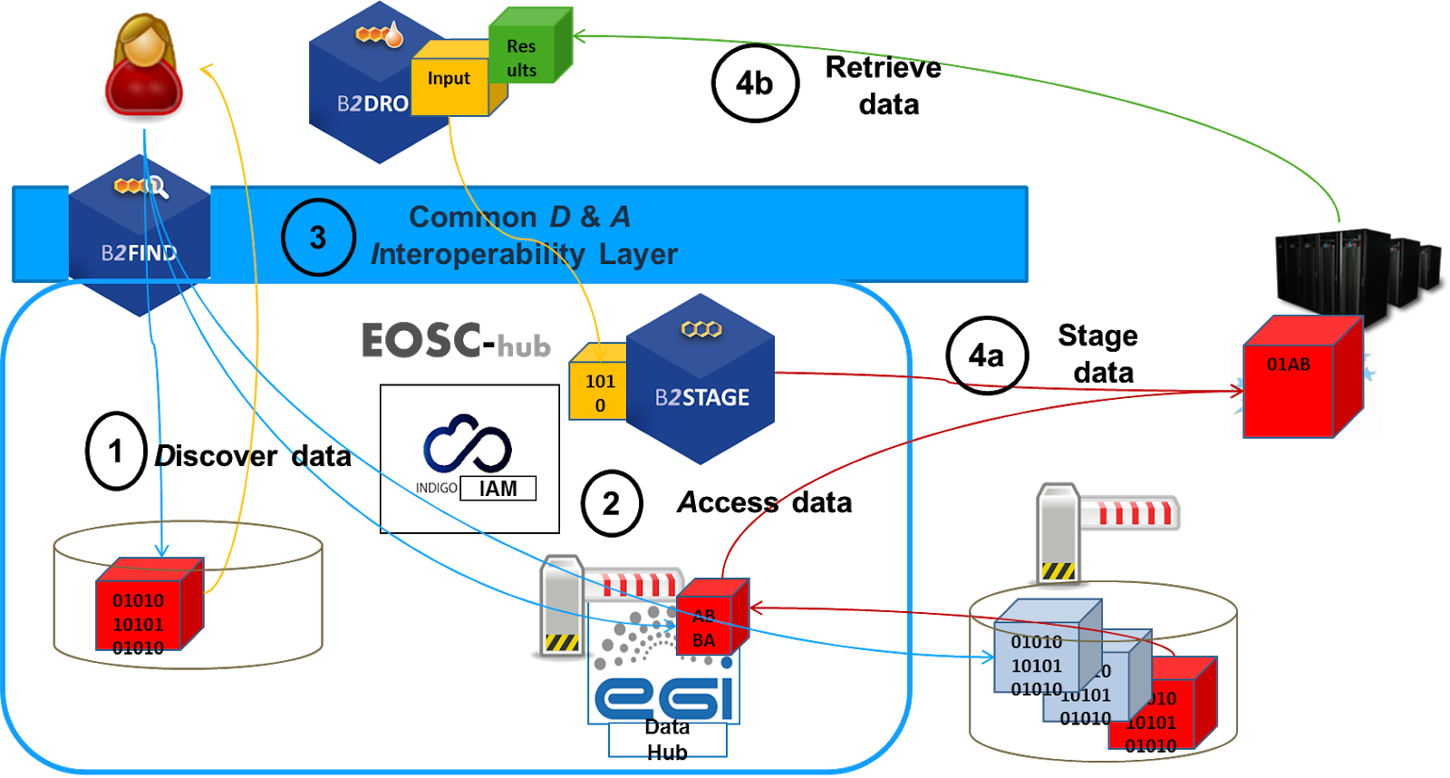
Common Services: Discovery and Access
[F] search for distributed data in EOSC-hub and beyond
[A] seamless access to distributed data resources where ever they are located
[I] usage of open standards and domain agnostic tools and interfaces
[R] reuse, exchange and staging of data (depending on use case)
Achievements
EGI Data Hub is MD-harvestable for B2FIND (enabled OHI-PMH interface)
B2FIND: ongoing MD harvesting projects; MD harvestable from B2SAFE/iRODS and EGI Data Hub
B2DROP: new upgrades; final switch from LDAP to B2ACCESS-based authentication.

Slide 14
Common Services: Federated Compute
Cloud Compute | Cloud Container Compute | High Throughput Compute
PaaS, IaaS, Multi-cloud IaaS | Kubernetes on top of EGI Cloud Compute | Distributed computing, a scalable batch system
Virtual Machines | (Docker) Containers | Compute Jobs
Lift and shift existing applications Specific OS (kernel) requirements | Cloud-native containerised applications | Execution of distributed computing tasks to analyse large datasets.
Achievements:
Deprecating the use of OCCIa as main API supporting native APIs.
EGI Federated Cloud is supporting and promoting EGI Checkin insetad of purely x.509 certificates based AAI.
New Kubernetes recipes for Ansible and the Infrastructure Manager (simplyfies the deployment of Kubernetes)
New Cloudkeeper version released that also simplifiesthe interaction with new (commercal) cloud providers (e.g. AWS).

Slide 15
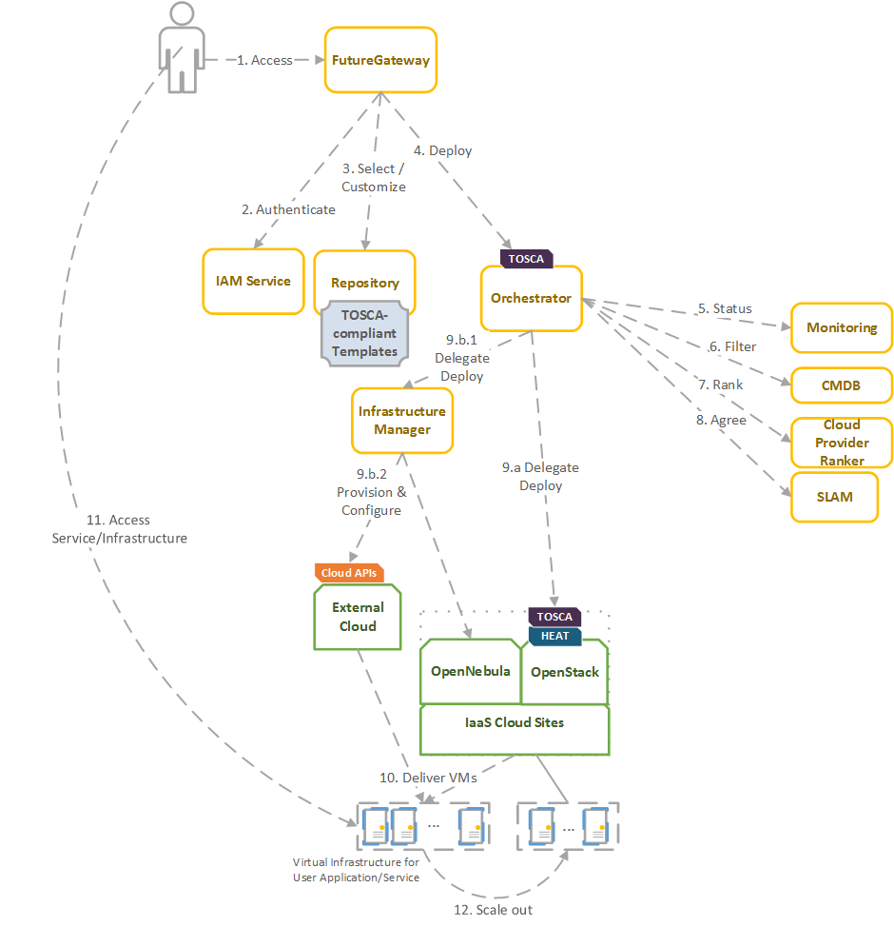
Common Services: Processing and Orchestration
Achievements
Exoscale provider (https://www.exoscale.com/) (CloudStack API) has been added to access this platform as part of a collaboration with HNSciCloud project (https://www.hnscicloud.eu/).
Orchestrator: it has been decided to replace the current workflow engine (jBPM) with the Flowable Open Source workflow engine to ensure better stability and support.
Future Gateway has been enhanced regarding stability and code testing.

Slide 16
Common Services: Data and Metadata Mngmnt
Achievements
Maintenance of the initial data and metadata service components: B2SAFE, B2SHARE, B2HANDLE. (The B2NOTE-B2SHARE bridge is currently being improved)
Initially planned integration activities: B2SHARE – B2SAFE bridge
Data policies defined for the Herbadrop and for the CompBioMed communities.
B2SHARE: collecting further statistical information for the LOFAR community.
B2HANDLE: Handle system upgrade of all CDI Handle nodes.

Slide 17
VA KPIs - Federation & Collaboration Services M1-8
Service | Access | Service Provider | Category | KPI 1 [metric value:baseline] | KPI 2 [metric value:baseline] | KPI 3 [metric value:baseline]
Perun |  | EGI / CESNET | Federation: AAI
Check-in | VA | EGI / GRNET | Security&Operations | # registered users 461:92 | # connected services 31:18 | # countries 49:15
B2ACCESS | VA | EUDAT / JUELICH | Security&Operations | # registered users 1328:1065 | # connected services 21:12 | # countries 48
WaTTS |  | INDIGO / KIT | Federation: AAI
RCauth.eu | VA | EGI / Nikhef, GRNET, STFC | Federation: AAI | # users 51:46 | # user communities 3:3 | # issued certificates 297:195
Marketplace |  | EOSC-hub Cyfronet | Collaboration
SPMT | VA | EOSC-hub GRNET | Collaboration | # registered users 30:0 | # services in catalogue 43:0 | # countries reached 34:3
Ops Portal | VA | EGI / IN2P3 | Federation | # users 1082:1000 | # page visits/period 73k:45k | # countries reached 59:45
DPMT | VA | EUDAT / MPCDF | Federation | # users 170:130 | # projects/services: 80/63:70/60 | # countries reached 18:18
DMP Tool |  | EUDAT / SIGMA2 | Federation
GOCDB | VA | EGI / STFC | Federation | # users 1552:1551 | # service providers 695:694 | #queries/24h 98.7k:79.2k
SVMON | VA | EUDAT / KIT | Federation | # users 60:30 | # product services 25:20 | # countries 8:10
Accounting Portal | VA | CESGA | Collaboration | # user DNs 8997:9092 |  | # countries 47:47
Argo Msg | VA | EOSC-hub GRNET, SRCE | Federation | # services using 2:2 | # messages 515k : 300k | # countries 3:3
Pakiti, SECANT | VA | EGI / CESNET | Federation | # pakiti reporters 188 | # secant reports 15 | # countries (pakiti) 43
ARGO monitoring | VA | EOSC-hub / IN2P3,GRNET,SRCE | Federation | # probes 78:65 | # service providers 277:300 | # services 1581:1000
APEL accounting | VA | EOSC-hub / STFC | Federation | (see Accounting Portal)
EUDAT RT Helpdesk | VA | EUDAT / BSC | Collaboration | # users 507 : 500 | # tickets/period 166 : 150
XGUS Helpdesk |  | EOSC-hub / BSC | Collaboration
GGUS Helpdesk |  | EGI / KIT | Collaboration
AppDB/UMD | VA | EGI / IASA | Collaboration | # users 1023 : 988 | # could service provider 19:18 | # uptd virtual appliances 28:15

Slide 18
VA KPIs - Common Services M1-8
Service | Access | Service Provider | Category | KPI 1 [metric value:baseline] | KPI 2 [metric value:baseline] | KPI 3 [metric value:baseline]
EGI DataHub |  | EGI / CYFRONET | sharing, Storage
B2FIND | VA | EUDAT / DKRZ | Sharing & Discovery | Communities 19:19 | visits/week 30:20 | usage/week 100:50
B2DROP(*) | VA | EUDAT / FZJ | Sharing & Discovery | # of users 1807 : 1350 | # files: 3.0M : 1.8M | # countries 21 : 48
B2STAGE |  | EUDAT / CINECA | Data Management
Indigo IAM |  | INDIGO / INFN | AAI
EGI HTC Compute |  | EGI / INFN | Compute
EGI Cloud Compute |  | EGI / many providers | Compute
EGI Cloud Container |  | EGI | Compute
DIRAC4EGI | VA | EGI / IN2P3, Cyfronet | Compute | # of users 524 : 500 | # jobs 4.7M : 4.5M | # countries 12:10
EGI Online Storage |  | EGI / many providers | Storage
Advanced IaaS |  | EGI / LIP | Compute
BDII |  | EGI / INFN | Resources Discovery
CVMFS |  | EGI / STFC | Compute
TOSCA for Heat |  | INDIGO / CSIC | Processing & Analysis
IM |  | INDIGO / UPV | Processing & Analysis
PaaS Orchestrator |  | INDIGO / INFN, Cyfronet | Processing & Analysis
FutureGateway |  | INDIGO / PSNC, INFN | Processing & Analysis
B2HANDLE(*) | VA | EUDAT / GRNET | Data Management | not provided until M9
B2SAFE-DPM(*) | VA | EUDAT / SIGMA2 | Data Management | # of DPM users 1:1 | # policies 1:1 | # countries: 1
B2SHARE(*) | VA | EUDAT / CSC | Data Management | # of users 469:370 | usage 2150:788 | # countries: 48
B2NOTE | VA | EUDAT / BSC | Data Management | # of users 8:10 | # of annotations 15:15
ETDR(*) | VA | CINES, DANS / EUDAT | Data Preservation | # of users 1:1 | # of data sets 4M:4M | # countries: 6
TSD(*) | VA | SIGMA2, UiO / EUDAT | Storage | # of projects 507:450
ePouta(*) | VA | CSC, EUDAT | Processing & Analysis | # of users/day 36.9:28.3 | memory per VM 22.2 : 11.1 TiB | # countries: 2:1
(*) in addition to the VA the service and service instances are provided by more providers via different channels and mechanisms (projects, commercial)

