Slide 1
Service portfolio management and access provisioning
Sergio Andreozzi, EGI Foundation
Contribution from: WP2, WP4, WP5, WP10
Dissemination level: Public

Slide 2
Outline
EOSC-hub service portfolio
Service categories
Service description template
Internal services
External services
Joining the EOSC external service portfolio
Why join
Rules of participation
Onboarding procedure
EOSC marketplace and order management procedure

Slide 3
EOSC-hub Service Portfolio
External
Internal
The set of customer-facing services that are publicly offered by the EOSC Hub
The set of supporting services needed to operate the EOSC Hub
The EOSC-hub project governance does not control the functional evolution of the service
The main control is on:
the verification of the compliance with the rules of participation
the interface with the EOSC hub according to the selected level of integration
These services need to fulfill the requirements to operate the EOSC hub
The EOSC-hub project governance retain a high-level of control on the planning, design and release of the services

Slide 4
Service Description Template
Basic information
Classification
Support info
Contractual information
Performance indicators
Options
Order management
Maturity
Access management
Base template
Extension for the marketplace
* service category definition agreed with eInfraCentral for the launch of the EOSC portal - will be evolved in the near future

Slide 5
Service categories
research enabling services
Sharing & Discovery
search and discover data, publications, tools and other resources useful for your research
Processing & Analysis
Software, platforms and tools and end-user applications offered as-a-service
Security & Operations
identity management, security or management services to support the operations of your infrastructures
Training & Support
Grow skills with specialised trainings or seek dedicated professional support
Data Management
Service to manage your data
Compute
Access virtual machines, containers and job processing
Storage
use storage for your data
Networking
Ultra-fast connectivity and ubiquitous access
foundation services
* the base template contains common attributes to the eInfraCentral template, work on a common template is planned

Slide 6
EOSC service portfolio: internal services
Security & Operations
Accounting | Helpdesk
ARGO | SPMT
GOCDB | DPMT
Marketplace | SVMon
Operations Portal | BDII
RC Auth | EGI Check-In
WaTTS | B2Access

Slide 7
EOSC service portfolio: external services
Sharing & Discovery (13)
B2Find
GEOSS Web Portal
Virtual Language Observatory
...
Processing & Analysis (13)
Chipster
DARIAH Science Gateway
Dynamic On Demand Analysis Service
...
Security & Operations (2)
B2Access
EGI Check-In
Training & Support (2)
FitSM
Training Infrastructure
Compute (9)
EGI High-Throughput Compute
EGI Cloud Compute
PaN FaaS
...
Storage (8)
EGI Online Storage
B2Drop
TDS
...
Data Management (10)
B2Handle
B2Note
EODC Data Catalogue Service
...

Slide 8
Joining the EOSC-hub external service portfolio

Slide 9
Why join as a service provider
Promote service(s) and widen the user base
Leverage shared functions for interacting with customers
e.g. order management, helpdesk, federated authentication
Get statistics about access requests and customer feedback
Access knowledge and best practices on services for research

Slide 10
Rules of participation
Broaden user base
the service is accessible by users outside its original community
Common service description
service described with a common template with value proposition and functional capabilities
Production ready
at least one service instance running on a production environment available
Documentation available
release notes and documentation available
Helpdesk available
for support, bug reporting and requirements gathering
Service management alignment
alignment on the interface with the Hub depending on selected level of integration
Order management via the Hub (opt)
order requests through the EOSC marketplace as additional channel

Slide 11
Main steps from the service provider viewpoint
Submit the request via the EOSC Portal
Information gathering
Validation
Provide evidence of compliance with the rules of participation as requested by the EOSC onboarding team
Fill the form available in the EOSC portal
Publication
Approve the publication of the service
Provide the service description and other information as requested by the EOSC onboarding team

Slide 12
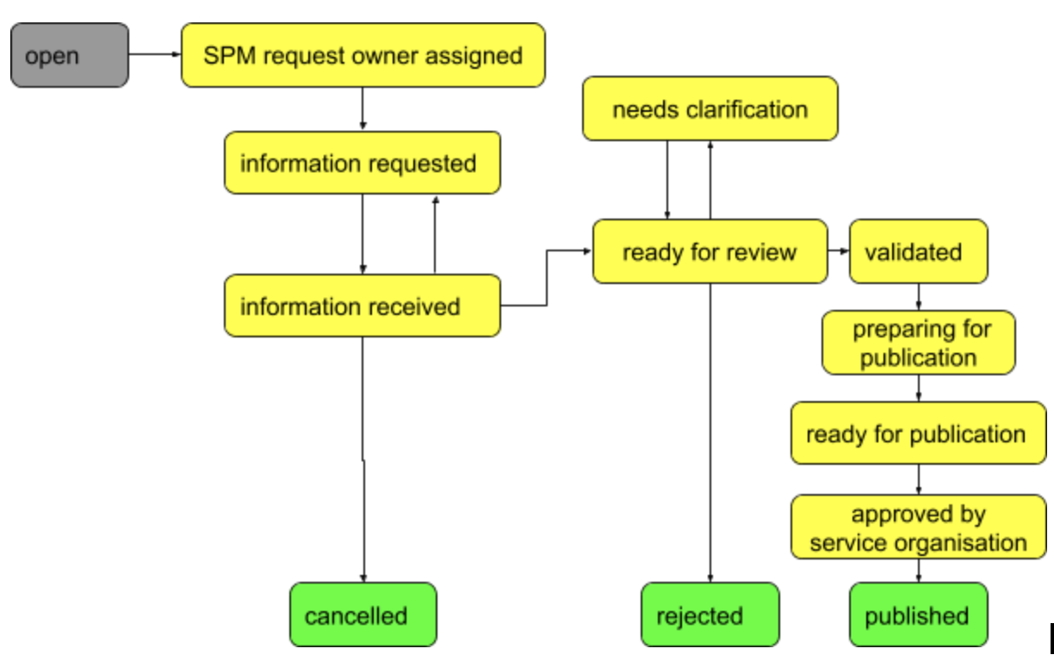
Onboarding procedure: state diagram

Slide 13
EOSC-hub marketplace and order management

Slide 14
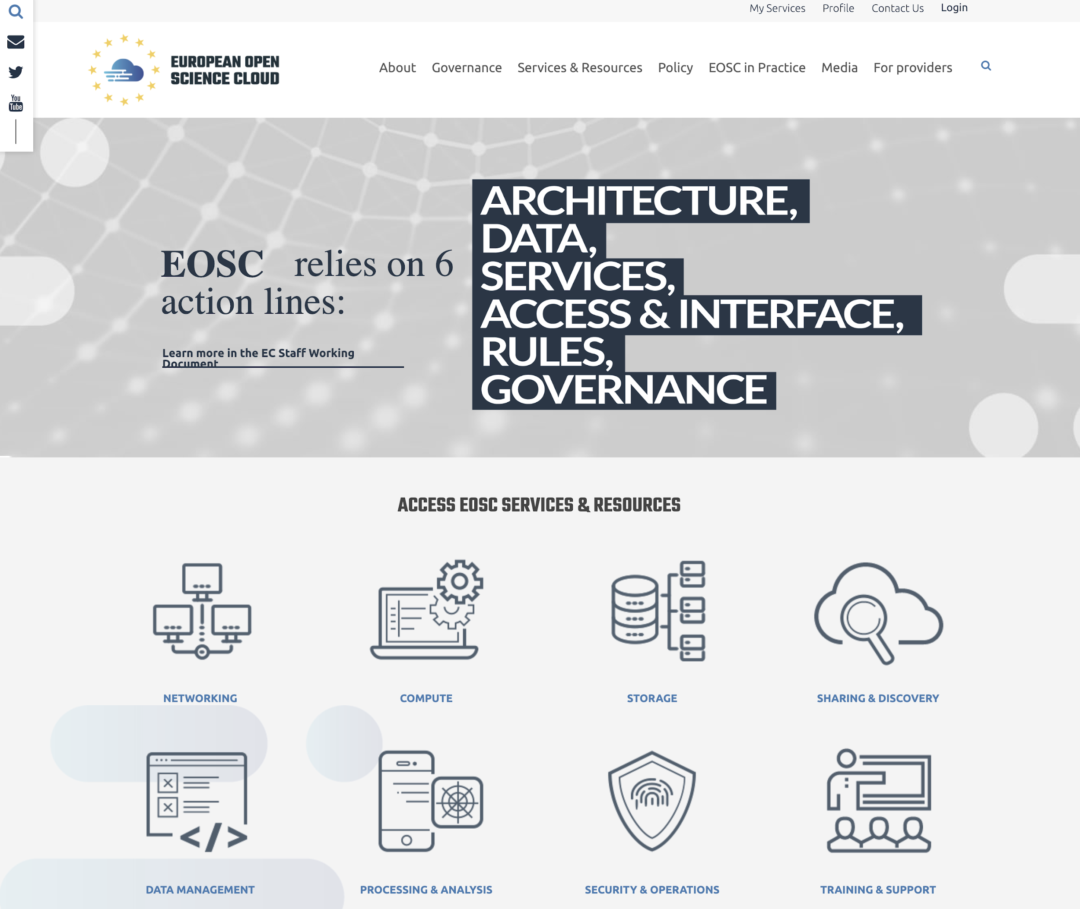
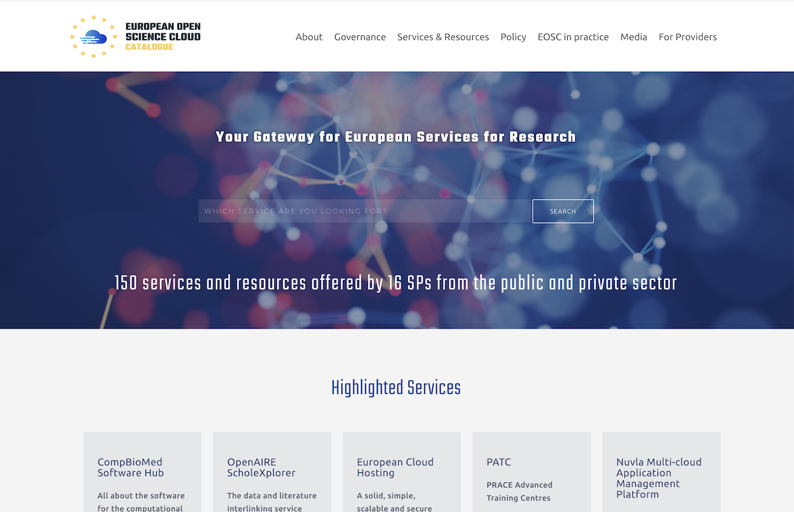
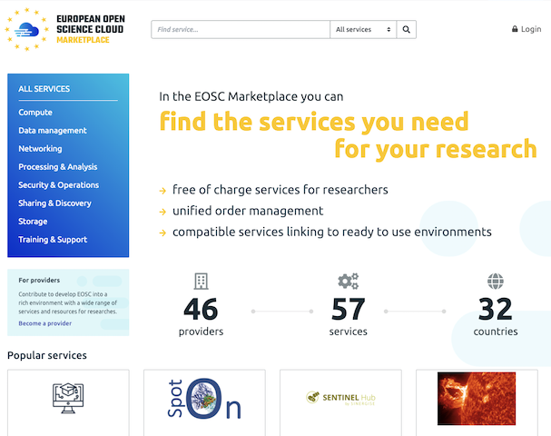
Relationship between the EOSC portal, the EOSC-hub based marketplace and the eInfraCentral-based EOSC catalogue
http://www.eosc-portal.eu/
http://catalogue.eosc-portal.eu/
http://marketplace.eosc-portal.eu/

Slide 15
EOSC marketplace
Platform where services can be:
Promoted
Discovered
Ordered
Accessed
3 steps process for users
Authentication & registration
Product discovery and specification
Ordering and request processing

Slide 16
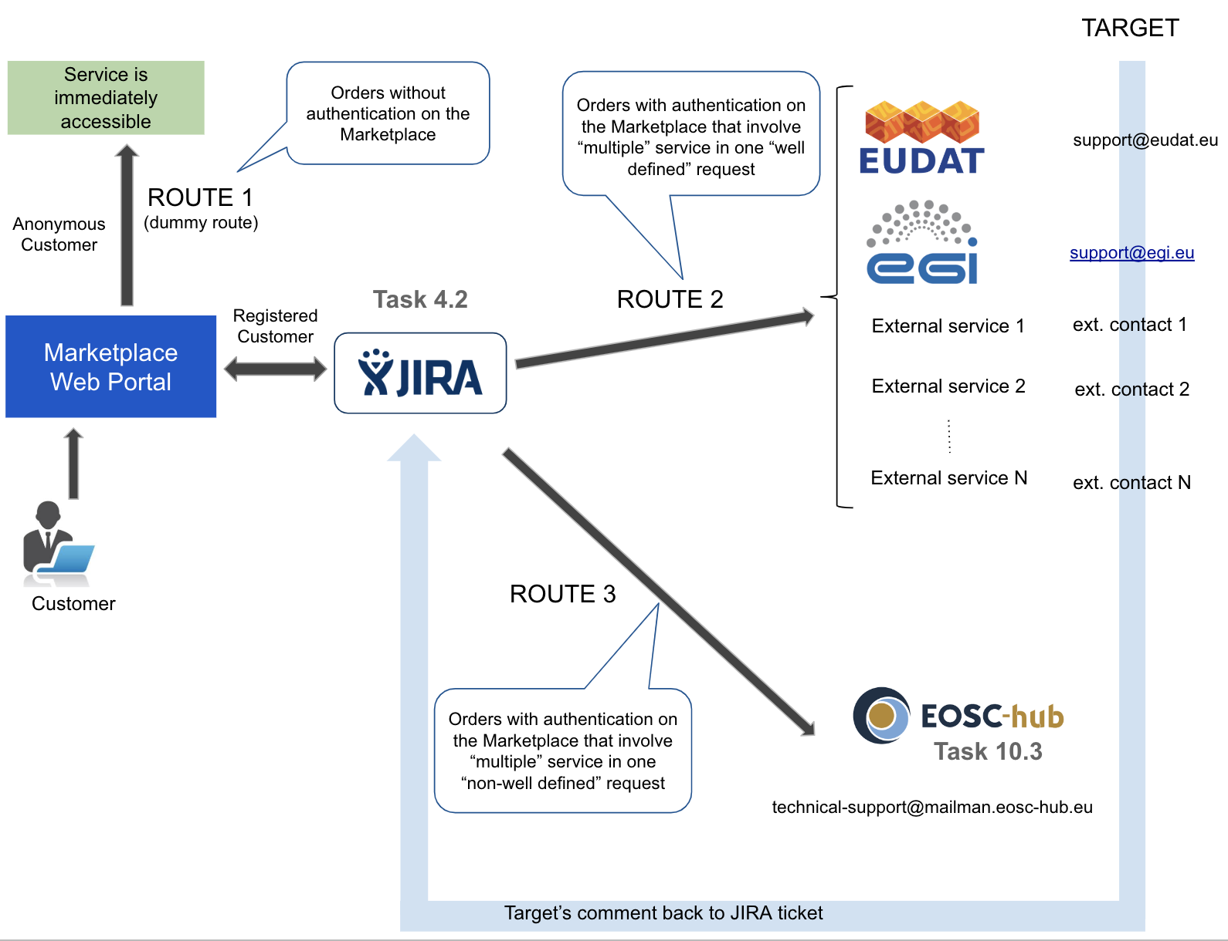
Order management

Slide 17
Summary of main results
Established the service portfolio management process with the following elements
Agreed service categories with eInfraCentral
Expanded the service description template
Defined an initial onboarding procedure that is operational with related supporting tools
Defined practical rules of participation
Collected information about 74 services
Contributed to the successful launch of the EOSC portal
Established the ordering management procedure to handle service orders

Slide 18
Future plans
Improve/automate the onboarding procedure based on the experience
Improve/automate service order procedure based on the experience
Unify service portfolio management across eInfraCentral and EOSC-hub for the EOSC portal
Harmonise template
Evolve service categories
Unify process
Create joint team
Improve service portfolio management tools

