Slide 1
Competence Centres,
Joint Digital Innovation Hub and community engagement – WP3, 8, 9, 11
Gergely Sipos – WP8 coordinator, WP3, 4, 9, 10, 11 member (EGI Foundation)
Dissemination level: Public

Slide 2
Outline
Community engagement and support
The big picture
Competence Centres (WP8)
Digital Innovation Hub (WP9)
New communities (WP3)
Training (WP11)
Use of resources
Future plans

Slide 3
Community engagement via services – Big picture
EOSC federating core
Thematic services (9)
WP5
WP6
WP5
WP7
Federation Services
AAI, Accounting, Monitoring, Operations, Security
Added value services
Compute, data, software management, curation & preservation
Open Collaboration Services
Application/software repository, Configuration management, Marketplace
WP10
integration
WP6
Basic infrastructure
Compute and storage
incubate
integration
integration
integration
WP10
WP11
WP10
WP11
WP10
WP11
Competence Centres (8)
Digital Innovation Hub Business pilots (6)
New communities
WP3 Engagement
WP4 Orders
WP8
WP9

Slide 4
Competence Centres
ESFRI landmark
ELIXIR
Disaster mitigation
Fusion
ESFRI landmark
Competence Centres
ICOS-eLTER
Marine
ESFRI landmark
ESFRI project
Radio astronomy
EISCAT_3D
ESFRI landmark
EPOS-ORFEUS
ESFRI landmark
ESFRI landmark

Slide 5
Use cases
Simplified use case | Implemented by
Application and data portal with compute and data management back-end | EISCAT_3D ICOS-eLTER
Data and application replication backbone for community centres | ELIXIR EPOS-ORFEUS
‘Dropbox-like’ access to diverse and scattered data | Marine
User workflows over distributed data and compute resources | Fusion Radio astronomy Disaster Mitigation

Slide 6
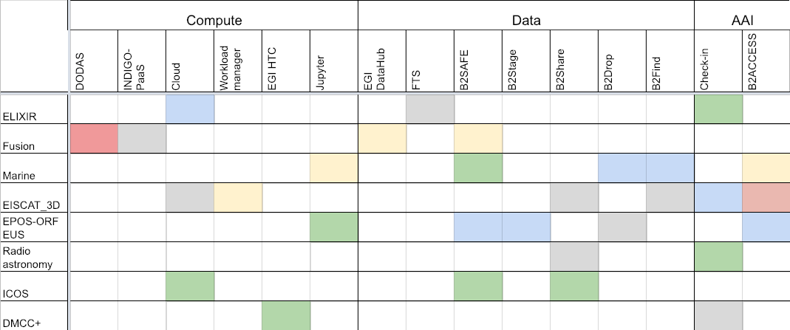
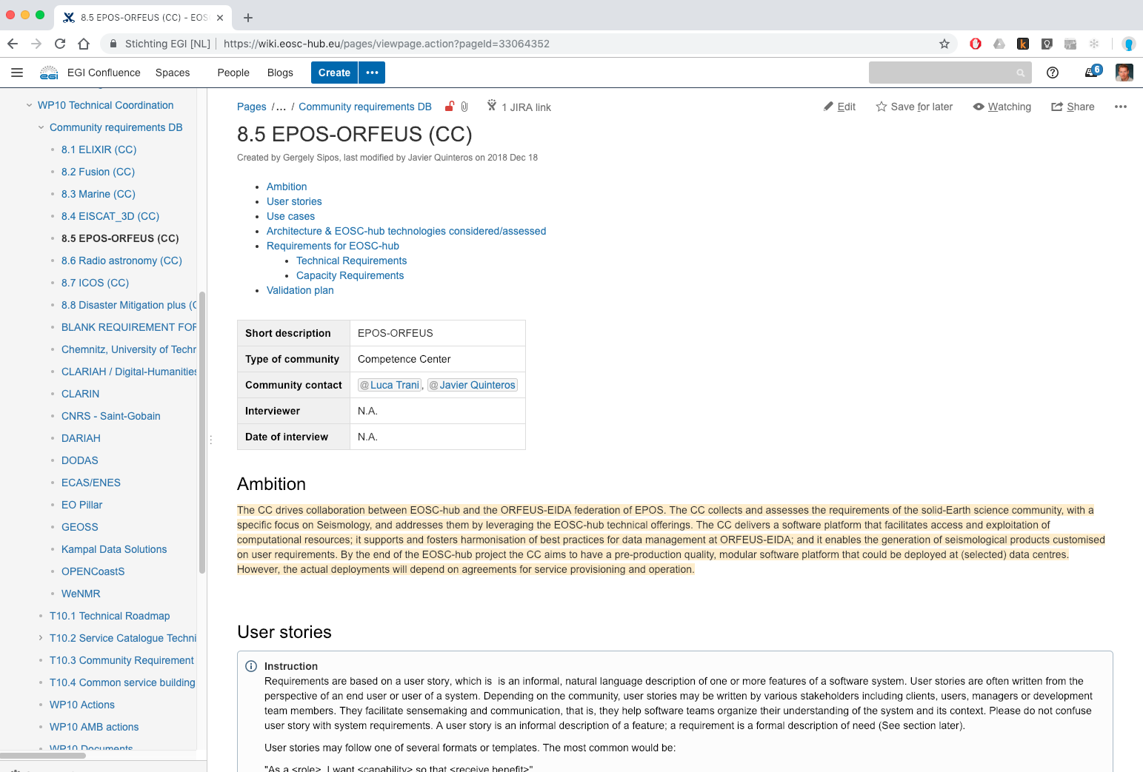
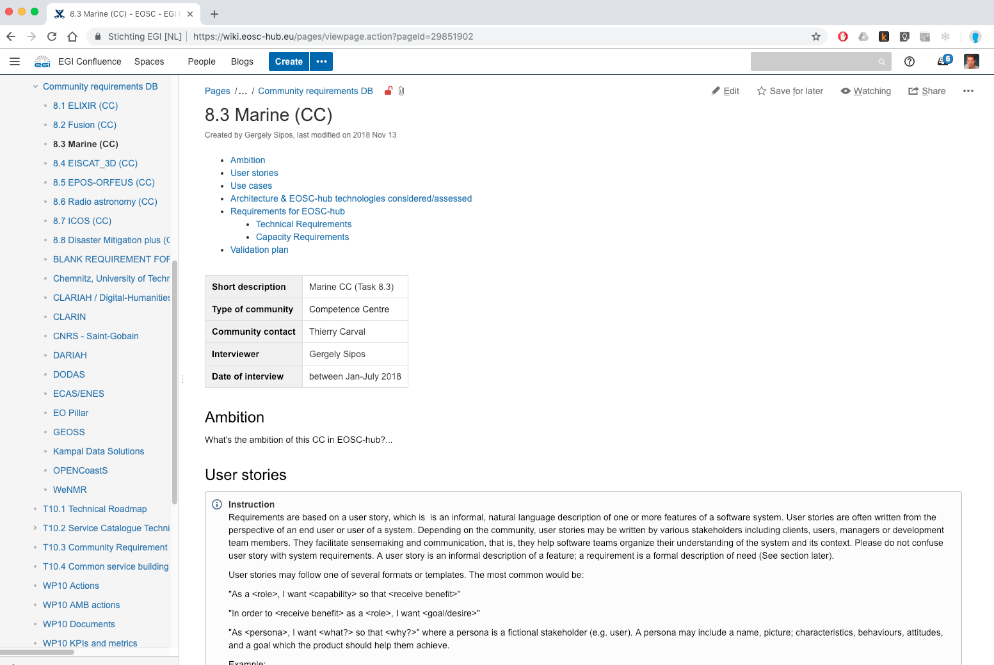
Planning & tracking service integration
CC leaders’ meetings
2 face-to-face meetings
Monthly teleconference
WP10 requirements DB:
User stories
Use cases
Service requirements
GREY - considered for adoption, but the integration is yet to start
YELLOW - integration is ongoing
BLUE - technology is integrated and assessment is yet to finish
RED - technology was assessed and was found unsuitable
GREEN - technology is integrated and positively evaluated
Notes:
GREY - technology/service is considered for adoption, but the integration and assessment work is yet to start
YELLOW - integration is ongoing
RED - technology was assessed and was found unsuitable
BLUE - technology is integrated and assessment is yet to finish
GREEN - technology is integrated and positively evaluated

Slide 7
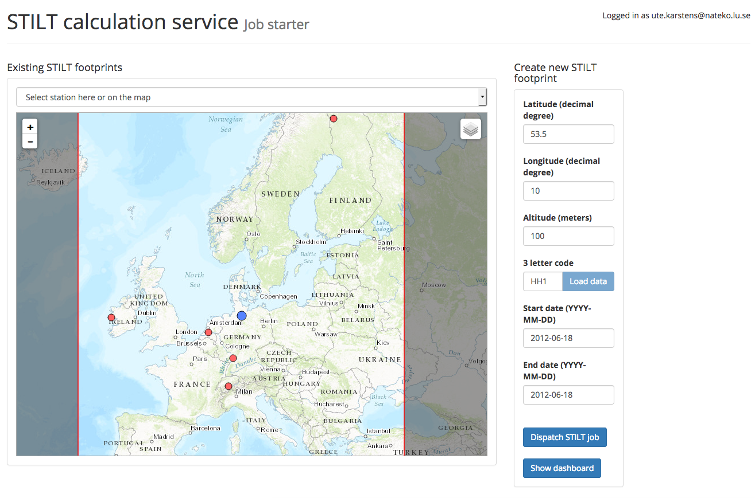
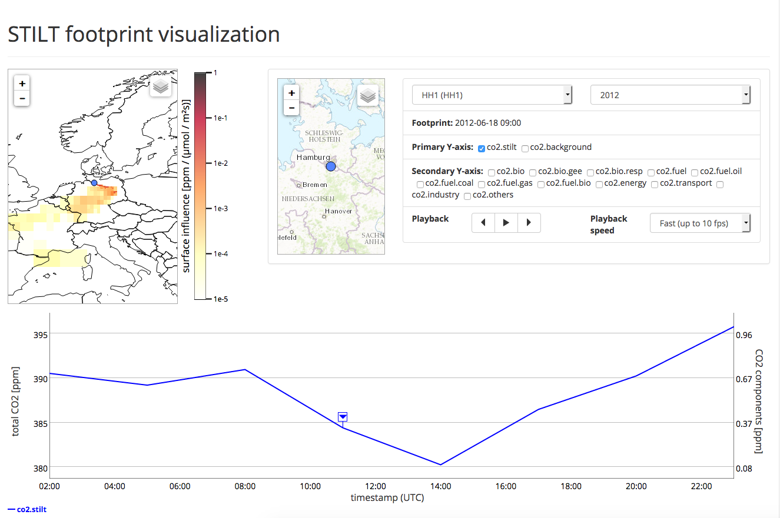
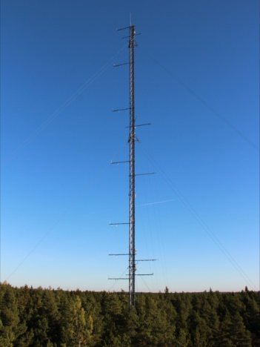
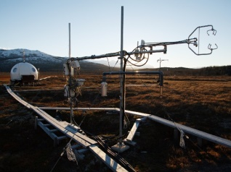
Integrated Carbon Observation System
A pan-European research infrastructure for quantifying and understanding the greenhouse gas balance of the European continent
Users: Scientists; Engineers; Policy makers
Compute requests
Results
Cloud (CSC, CESNET, Juelich)
ICOS Carbon Portal
External HTC and HPC services
Data products
STILT
Lagrangian transport model
(Uni of Lund)
ICOS repository (data & metadata)
B2Safe (CSC)
iRODS (PDC)
Ecosystem thematic centre
Athmospheric thematic centre
Oceanic thematic centre
Sensor data (near real-time)
Measurement stations

Slide 8
EOSC Digital Innovation Hub (DIH)
What are Digital Innovation Hubs?
An ecosystem of start-ups, SMEs, large industries, researchers, accelerators and investors that fosters the creation of partnerships to stimulate innovation.
200+ DIHs registered comprising both regional and European ones that focus on a variety of sectors and topics
The EOSC DIH
To onboard industrial partnerships within the European Open Science Cloud
Focused on (not limited to) start-ups and SMEs
To persist beyond the life of the project
Notes:
Can go through the points on the slide as you did in the rehearsal
Changed to 200+
Could highlight here or later in Slide 10 that we are positioning the EOSC DIH as “the” mechanism for industry to engage with the European Open Science Cloud

Slide 9
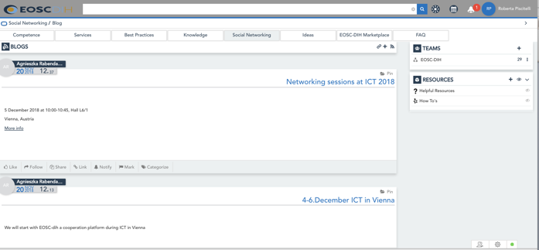
Activities
Defined Services for Industry
Service Vouchers Mechanism
Piloting and co-design
Technical access
Pilots/proofs of concepts
Service/Product design
PaaS/SaaS Integration
Performance verification
Testing
Compute (HTC, HPC, Cloud)
Storage (Online/Archive)
Data management
Research data
Tools & applications
Visibility
Currently running
Training & Support
Media Exposure
Participation to events
Promotional print material
Inclusion in marketplace
Networking
Technical consultancy
Service management
Commercialization and business coaching
Brokerage to funding and opportunities
€5,000 Award
Winner selected from ICT 2018 Session; support Univ. spin-off
Outreach and Support
Long-term Collaboration Platform Analysis
Promotion Material and Event Participation
Business pilots technical support
Commercialization Webinar for pilots and CCs
Establishing partnerships, onboarding new pilots
Notes:
The main activities carried out over the first year have been:
Defining the service areas available for industry such as piloting and co-design, technical access, training and support as well as providing visibility which is often difficult for small companies to obtain
We’ve established a voucher mechanism as a means to onboard new pilots to ensure project service provider support as the project doesn’t have cascading funding available
This kicked off with a fully automated initial free trial offer for cloud services worth ~€250
As well as a one time giveaway, selecting a winner from participants of the networking session at ICT 2018, here we will support a university spin-off from Spain.
This will be expanded into PY2 with different packages and support for larger use cases
Additional activities have been preparing promotional material, participating at events, supporting the initial 6 business pilots, and starting a series of commercialization webinars for the pilots and CCs
Though planned more for PY2, several partnerships and potential new pilots are already in various stages of development

Slide 10
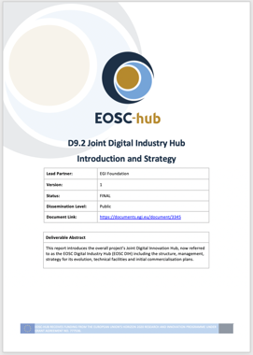
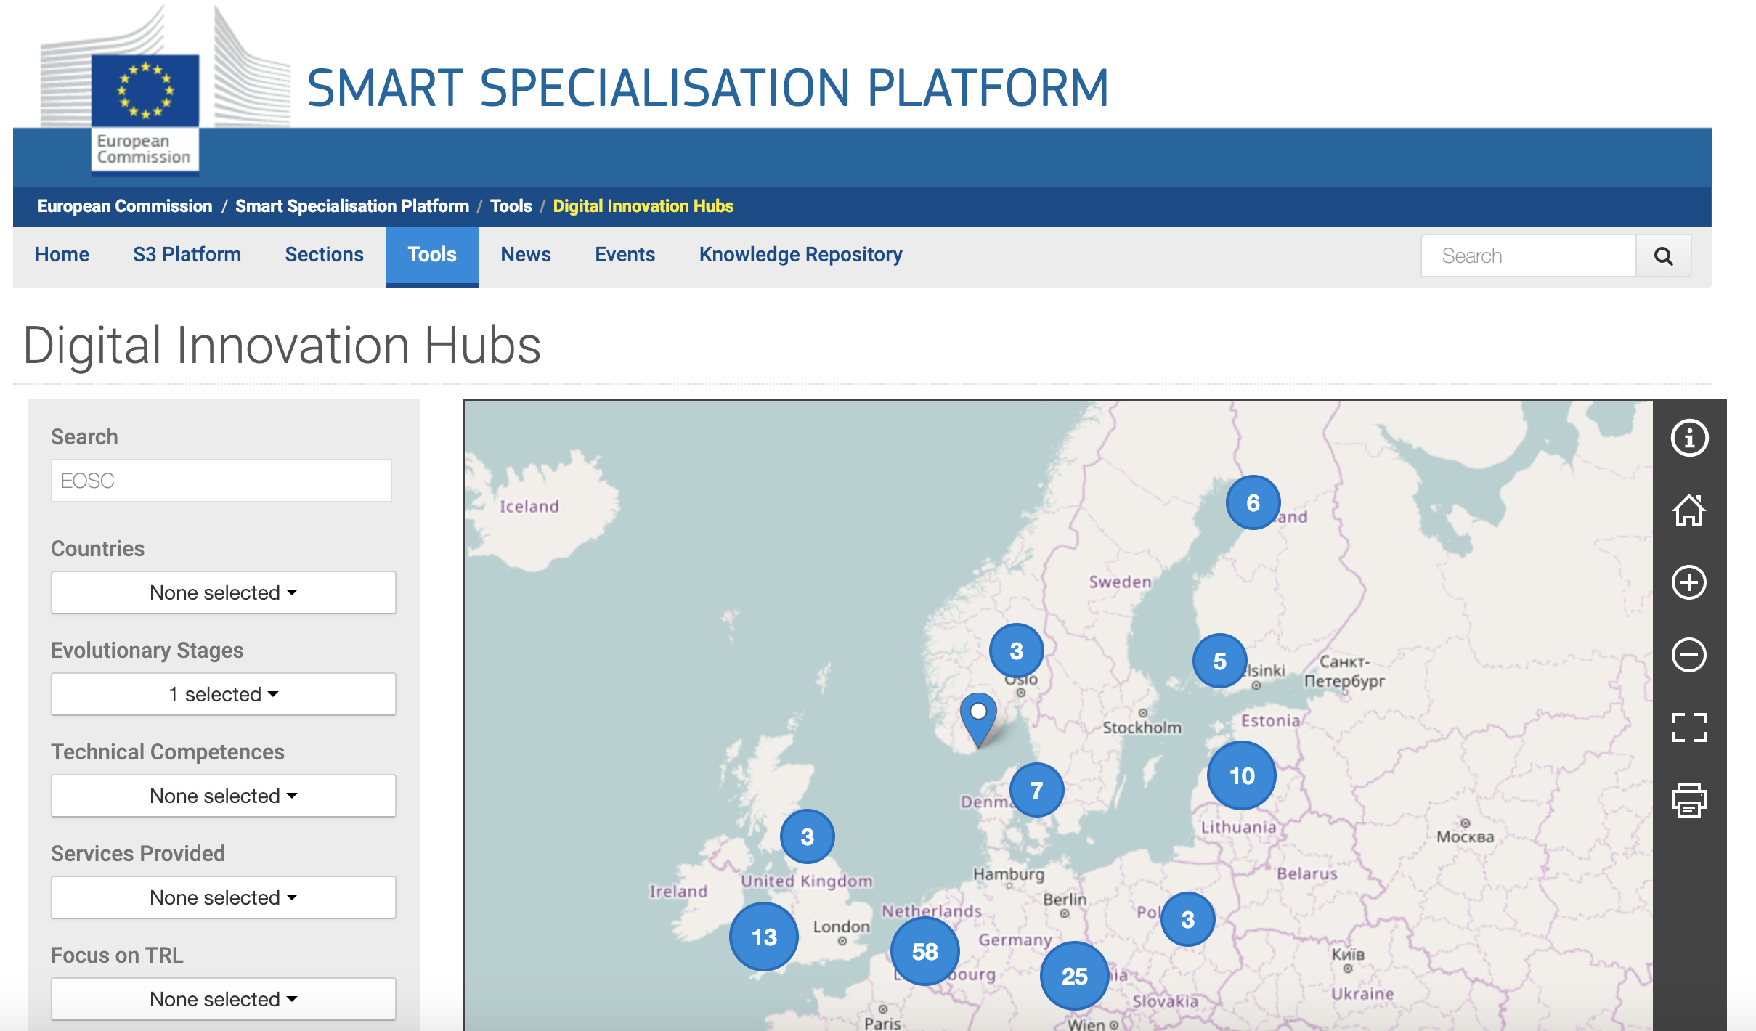
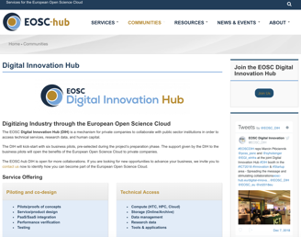
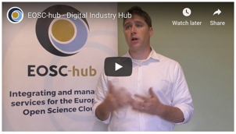
Promotion, events, collaboration
Strategy
“EOSC DIH”, as the mechanism for industry to engage the EOSC; live beyond the life of the project, applied as official DIH
D9.2 "Joint Digital Innovation Hub Intro and Strategy" (M6 – Jun)
Recognition in EC DIH Catalogue
Promotional Material
EOSC-hub website DIH page content
Video interview (DIH intro) + ICT 2018 promo video
EOSC-hub Magazine DIH article (issue 1)
Usable slide decks, brochure, poster
Dedicated DIH logos, URL and Twitter account
Events
ICTFOOTPRINT.eu “Green ICT” (Amsterdam – Mar): Presentation + Panel
EC DIH Working Group Meetings (Feb, May, Jul)
BDVA Group Meetings (Brussels - Mar, Apr, Jun, Sep) + Meetup (Sofia - May)
DI4R 2018 (Lisbon – Oct): Organised a session “DIHs for Industry Engagement”
ELIXIR Innovation and SME Forum (Frankfurt – Oct): Lightning talk
EC DIH Annual Event (Warsaw – Nov)
ICT 2018 (Vienna – Dec): Networking session; Joint DIH Booth participation
New Collaborations (ongoing)
Notes:
(This slide would look better once you move it to 16:9)
Using as a transition from the last slide; Here, this slide provides a bit more detail in the promotion and outreach, such as:
Having defined an initial strategy for the DIH
Getting formally recognized in the EC DIH Catalogue
Preparing dedicated promotional material tailored to the EOSC DIH such as logos, twitter account, url, video interviews and written articles/brochures
Organizing and attending events such as the
EC DIH Working Group meetings and Annual Event (Warsaw – Nov)
ICT 2018 with a networking session and joint DIH Booth participation
Say “i won’t go into detail here, but these logos are a few of the ongoing collaborations with commercial companies and industry related projects that will be formalized as we move into in PY2

Slide 11
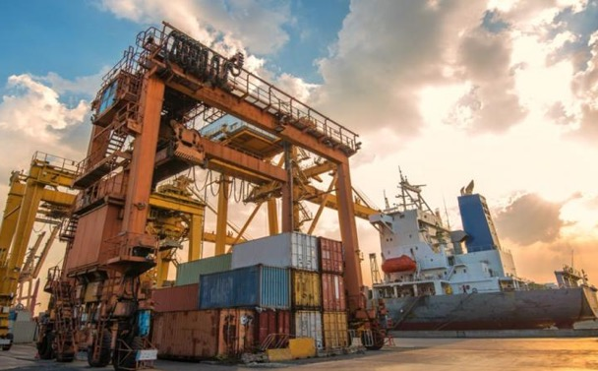
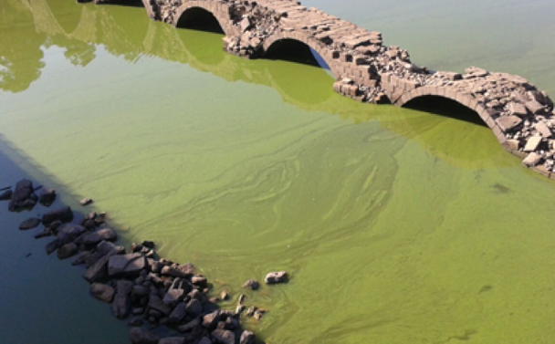
Business pilots (initial 6)
D9.1 "1st Stage Business Pilots Overview and Work Plans” (M3)
Dedicated overview webpages for each pilot: https://eosc-hub.eu/digital-innovation-hub
All defined architecture mapped to EOSC-hub services and infra
Progressing inline with detailed implementation plan
Improving safety and operational performance of seaports
A Cloud Framework for State-of-the-art Space Weather
Using data cloud Services to manage harmful algae blooms
ACTION Seaport
Space Weather Data for the DRACO Observatory
CyberHAB
Demos ran at DI4R 2018 - Lisbon
Solutions to secure online services from Botnets Attacks
Analyzing Sport Performance through a Cloud-hosted platform
Platform-as-a-Service Data Analytics for the Furniture Industry
Bot Mitigation Engine
Sport Smart Video Analysis
Furniture Enterprise Analytics Datafurn
Under evaluation by early adopters
1st pilot to finish (PM12) – Final report in progress (~Feb’19)
Notes:
The first 4 bullets points at the top of the slide give a nice overview of activities
The animation helps to work through the 6 as you did in the rehearsal
Highlight that the other 4 pilots are planning to show demos at the EOSC-hub Week in Prague (April)

Slide 12
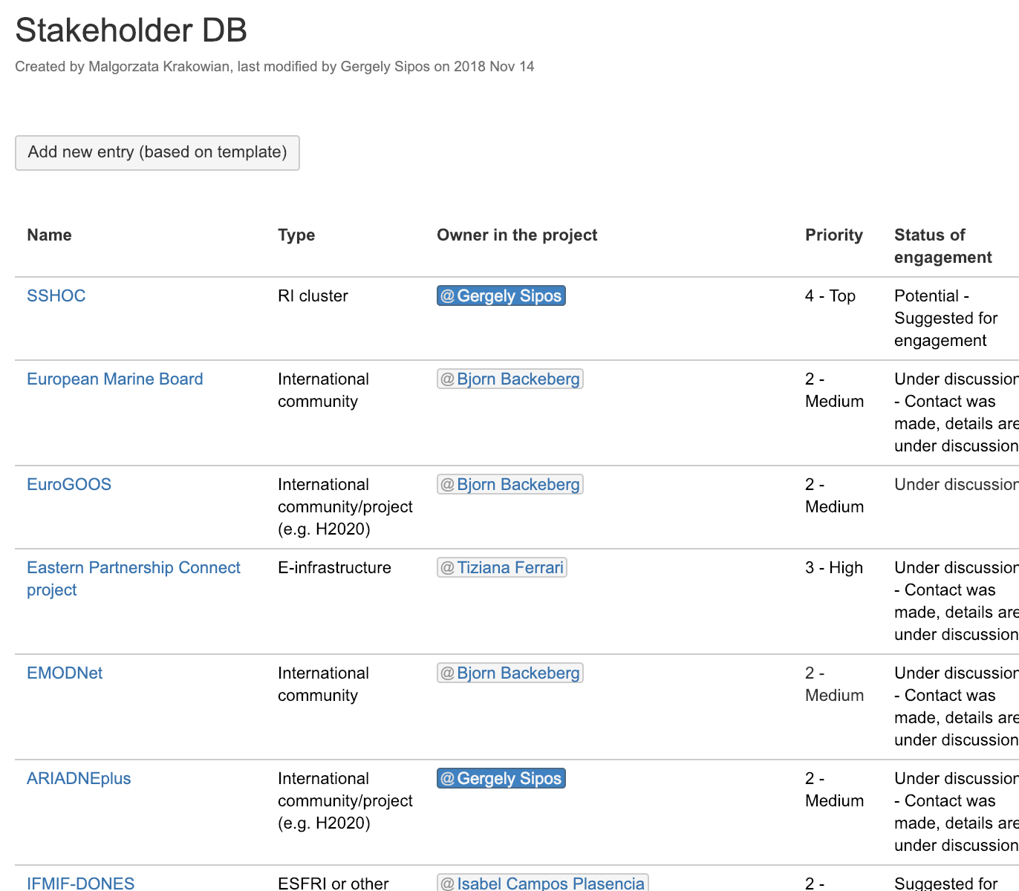
Engagement with new communities
Competence Centres
Stakeholders (D3.1)
ESFRI clusters
ESFRI or other RI
International communities & projects
Service provider institutes (academic)
Business organisations
Funding and policy agencies
Preparatory activities (e.g. EOSCpilot)
Long tail of science
Technology providers
General public
Roles
User/customer
Provider
Enabler
Digital Innovation Hub

Slide 13
ESFRI clusters
2018:
Jan-Mar: Support proposal preparation → ENVRI-FAIR; ESCAPE; EOSC-Life; PaNoSC; (SSHOC)
April: Dedicated session at EOSC-hub week → Initial recommendations and expectations
Joint workshops with EOSCpilot at current clusters’ events → EOSC Service Roadmap (EOSCpilot)
ASTERICS; ENVRIplus; PARTHENOS
Presentation at CORBEL AGM
2019:
Jan: ESFRI-EOSC liaison workshop (EC organised event)
Q1: Participation (at some) cluster kick-off meetings
Q2 onward: Joint focused events, technical collaboration

Slide 14
Major engagement milestones in 2018
Apr: EOSC-hub week with dedicated sessions for
ESFRI clusters
International projects (users & providers)
May: Service order form opened
Sep: Join as provider form opened
Oct: DI4R
Nov: EOSC Portal opened
EOSC-hub presentations at 15+ external community events, such as TNC, VI-SEEM Conference, ISGC, Digital Humanities Conference, Eur. Ocean Observatory Systems Conference, Medical Infrastructure Users Forum, …

Slide 15
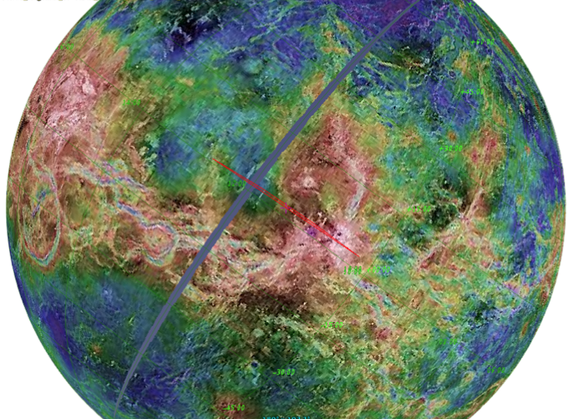
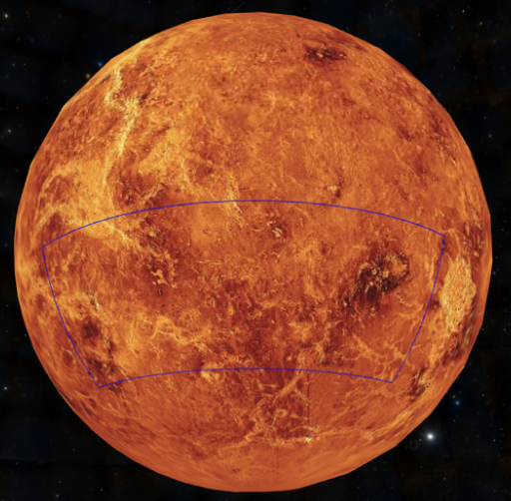
Example: VESPA
A VESPA is a Virtual Observatory for Solar System sciences
Connecting data and providing modern tools to interact with them
To act as provider AND as IaaS cloud user in EOSC
What happened so far:
Oct
First contact with the Observatoire of Paris at DI4R (WP3)
Nov
Call for support was opened for IaaS cloud providers, IN2P3 responded (WP6)
Dec
Cloud site is configured with federated AAI (WP6);
Service description template was pre-filled and sent to provider (WP2)

Slide 16
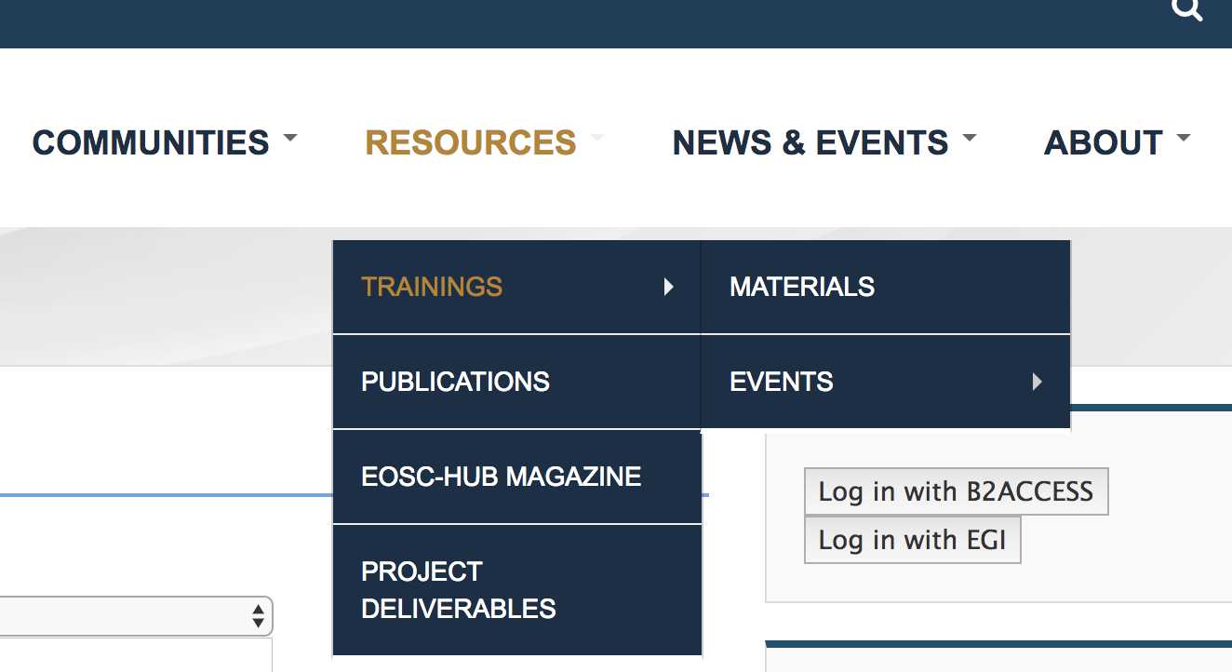
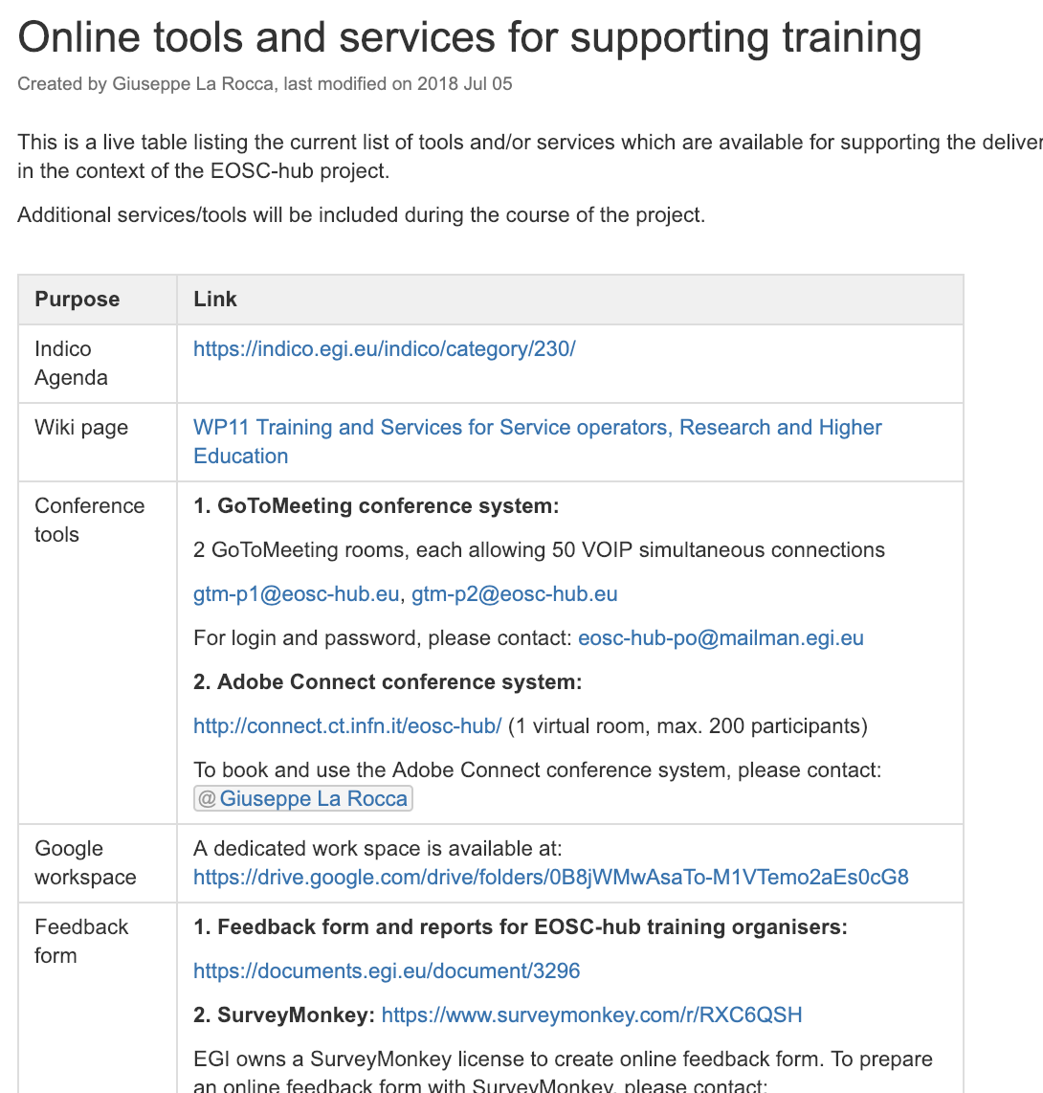
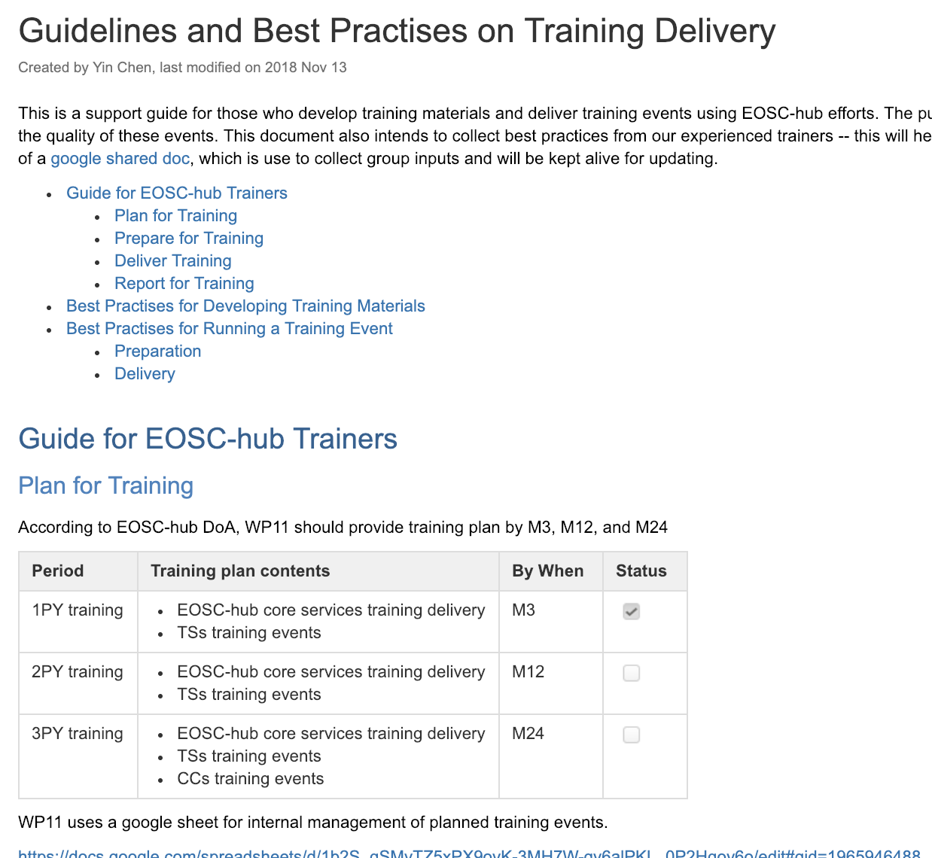
Training (WP11)
Reaching training audience
Set-up an online registry of training events and training materials on the website
35 events
200+ modules
Announcements to WP7-8-9 and externally
Reaching trainers
Online guide about tools and materials for training
1h webinar about tools and good practices in training
Participation in EOSC ‘Training coordinators Community of Practice’ initiative
16

Slide 17
Delivered events: 35 events; 890 attendees
1. Data Management Planning (T11.2) → 447 attendees
9 DMP Training Events (6 events jointly organized with the OpenAIRE-Advance project)
2. Federated Service Management (T11.3) → 133 attendees, 60 FitSM certified
4 FitSM Certification Training Events
2 Webinars “Lightweight Service Management for Research Infrastructures: FitSM Approach”
3. Common and federated services (T11.4) → 112 attendees
2 Security workshop for users
3 tech talks on AAI, Storage and Cloud technologies
1 Webinar for the EOSC-hub trainers to reach out the communities
4. Doman-specific training (T11.5 through WP6, WP7) → 198 attendees
14 events: Tech-talks (webinars) on storage; AAI, cloud; INTRUCT training course: Advanced methods for the integration of diverse structural data; IEEE Workshop on Big Data Governance and Metadata and Management; 1st ECAS training event; UNIDATA workshop…

Slide 18
Future plans
CCs:
Mar: D8.1-Technology validation and integration plan
Sep: First Thematic services by Marine, EISCAT_3D, ICOS
DIH:
Conclude and promote first business pilots; Onboard new pilots
Expand the voucher programme (to additional services)
Commercialization support for EOSC service providers
Engagement:
Q1-2: ESFRI cluster events
Q1: Prioritise and engage directly with individual ESFRIs
April: Call for use case and providers (with funding and integration support)
Training:
Intensify Thematic Service and Competence Centre based events
Offer first round of Advanced level FitSM courses

Slide 19
Conclusion – Major results
Service integration with ESFRIs and business organisations is ongoing
Community architectures, good practices, blueprints are emerging
Instruments are in place to engage with and serve new communities
Marketplace
Form for new providers
Support teams from WP3 and WP10
Training events, materials
Joint events with ESFRI clusters
Service vouchers for industry
Research communities success stories
Digital Innovation Hub
Trainings and training materials

