Slide 1
Research Enabling Services – Thematic services
WP7, WP13
Diego Scardaci
EOSC-hub AMB co-Chair
Dissemination level: Public

Slide 2
Outline
Research Enabling services
  What are they ?
  Thematic services
Thematic services (TSs) and the Hub
  Which services ?
  TSs as early adopter of the Hub services
  Initial TSs offered by the Hub
  TSs in the EOSC Marketplace
Enhancing the Hub and extend its service offer

Slide 3
Research Enabling services - What are they?
User facing services offered by means of the EOSC Marketplace
  Common services:
    provide added value to exploit storage, compute and data resources
    can be re-used by other services
  Thematic services:
    scientific applications like those offered by the Research Infrastructures
    research data, advanced data brokering and analysis capabilities for specific research communities and multidisciplinary research.

Slide 4
Thematic Services in EOSC-hub
Initial set of services from various disciplines offered by the Hub:
Provider | Discipline | Services
CLARIN | Humanities | Virtual Language Observatory (VLO), Virtual Collection Registry, Language Resource Switchboard
CMS | Physical Sciences | DODAS
ENES | Earth Sciences | ECAS
GEOSS | Earth Sciences | GEO DAB
LNEC | Earth Sciences | OPENCoasts
WeNMR | Biological Sciences, Medical and Health Sciences | WeNMR suite
Various from Earth Observation | Earth Sciences | All EO Pillar services
DARIAH | Humanities | DARIAH Science Gateway, Invenio repository, DARIAH repository

Slide 5
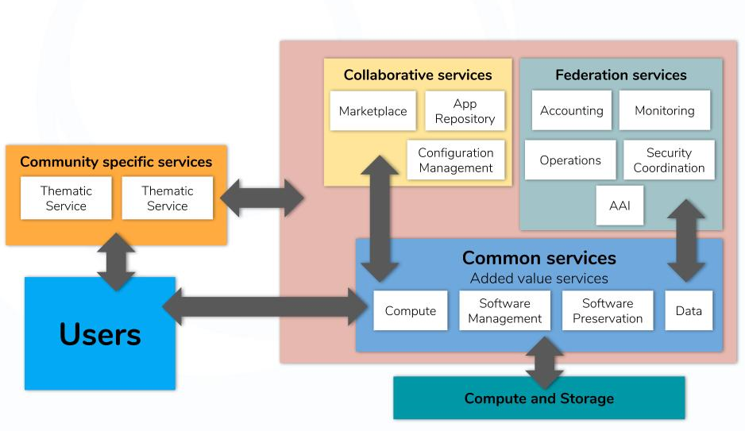
Thematic services and the Hub
Early adopters of the EOSC-hub services
Marketplace
Marketplace
Monitoring
Config Mngmt
Operations
Thematic service
Thematic service
AAI
AAI
Compute
Data

Slide 6
Thematic Services – Service adoption
Provider | Service | Launch | Integration with Hub
CLARIN | Virtual Language Observatory (VLO) | 01/07/2018 | EGI Cloud Compute, Fed. Services, B2SHARE
CLARIN | Virtual Collection Registry | 01/01/2019 | B2SHARE, B2FIND
CLARIN | Language Resource Switchboard | 01/02/2019 | EGI Cloud Compute, B2DROP, B2SHARE
CMS | DODAS | 01/03/2018 | EGI DataHub, CVFMS, EGI Check-in, INDIGO IAM, Orchestrator, Accounting
ENES | ECAS | 01/09/2019 | EGI DataHub, INDIGO IAM, B2ACCESS, EGI Check-in, B2SHARE, B2DROP, B2HANDLE, INDIGO IM
GEOSS | GEO DAB | 01/06/2020 | EGI Cloud Compute and Cloud Container, EGI HTC, EGI DataHub, EGI Check-in B2STAGE Accounting Monitoring
LNEC | OPENCoasts | 01/09/2018 | EGI Cloud Compute, EGI HTC, DIRAC4EGI, EGI DataHub, EGI Check-in, B2STAGE, B2SAFE, Accounting, Orchestrator
WeNMR | WeNMR suite | 01/01/2018 | EGI HTC, EGI Cloud Compute, DIRAC4EGI, EGI Check-in INDIGO udocker, EGI DataHub B2DROP
Various from EO | All EO Pillar services | 01/07/2018 | EGI Check-in, EGI Cloud Compute, EGI DataHub, B2SHARE, Monitoring, Accounting
DARIAH | DARIAH Science Gateway | 01/01/2018 | EGI Cloud Compute EOSC AAI Accounting Monitoring
DARIAH | Invenio repo | 01/01/2018 | INDIGO IAM, INDIGO Orchestrator, EGI Cloud Compute
DARIAH | DARIAH repo | 01/01/2018 | EOSC Federation Services
Green: Integration completed
Grey: Integration planned
Gold: Integration ongoing

Slide 7
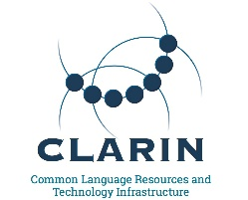
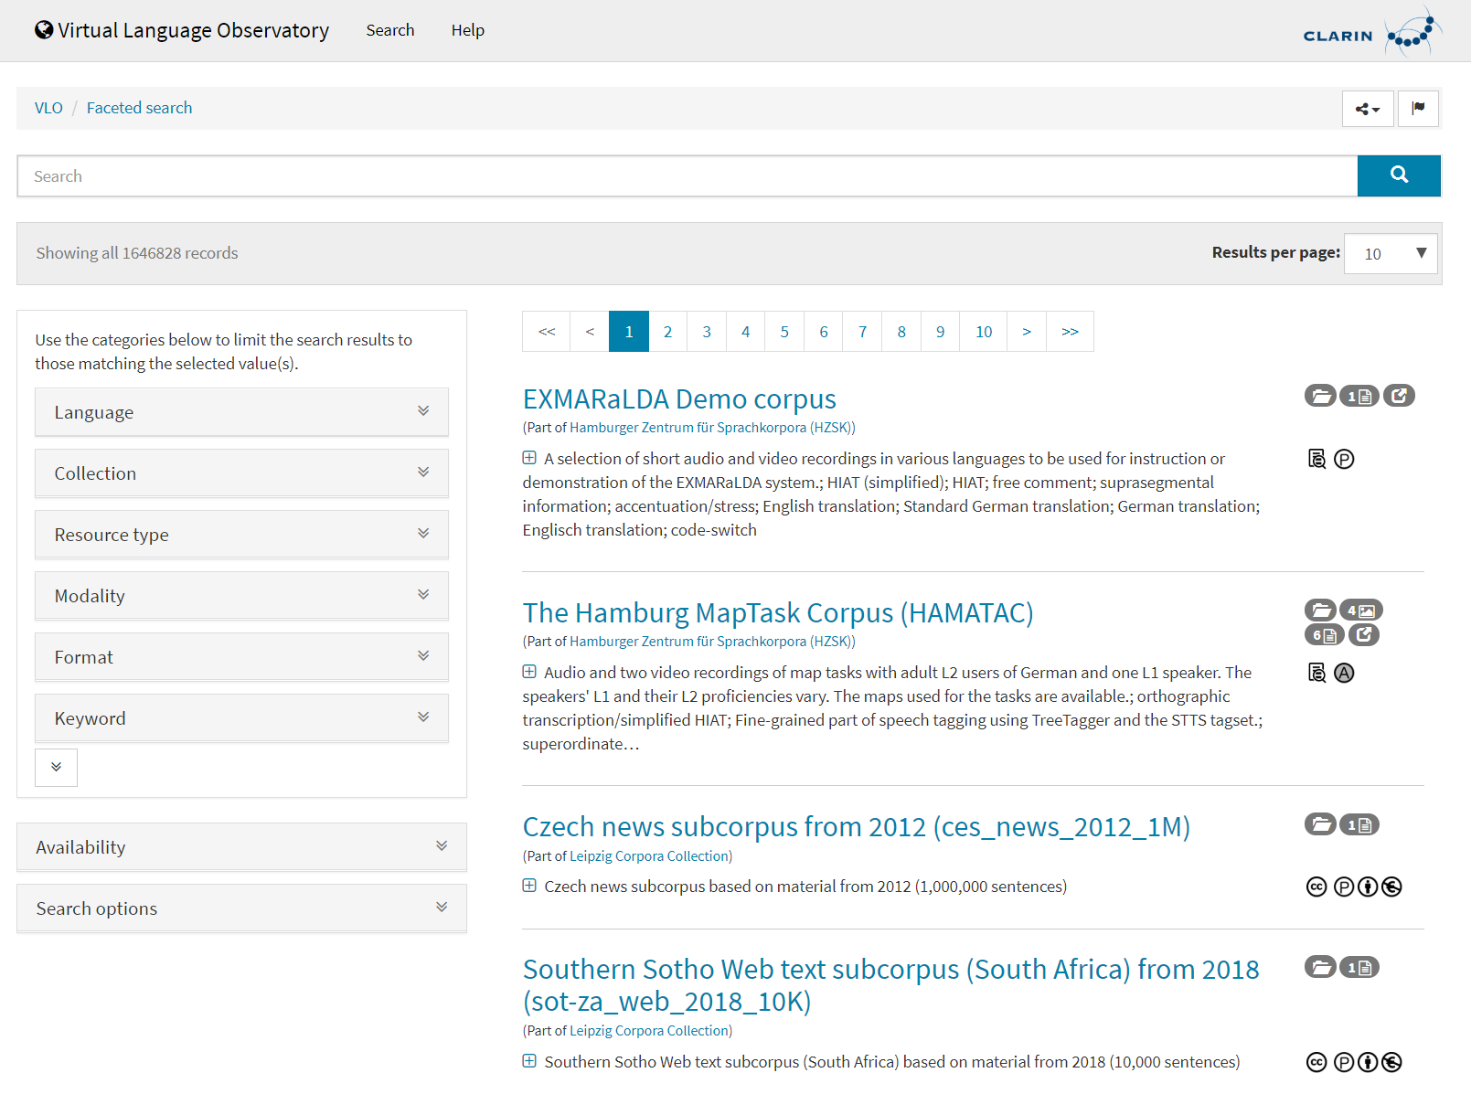
CLARIN - European Research Infrastructure for Language Resources and Technology
Virtual Language Observatory: uniform search and discovery functionality for language resources and tools
Virtual Collection Registry: a registry of CLARIN digital objects
Language Resource Switchboard: find a matching language for data
VLO - VA Metrics
Visits: 259/months
Harvested metadata records: 896473
Service | Launch | Integration with Hub
Virtual Language Observatory (VLO) | 01/07/2018 | EGI Cloud Compute, Fed. Services, B2SHARE
Virtual Collection Registry | 01/01/2019 | B2SHARE, B2FIND
Language Resource Switchboard | 01/02/2019 | EGI Cloud Compute, B2DROP, B2SHARE

Slide 8
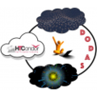
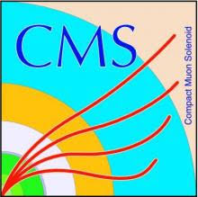
WLCG CMS Experiment - DODAS
Dynamic On Demand Analysis Service (DODAS) automates the process of provisioning, creating, managing and accessing a pool of heterogeneous computing and storage resources:
  HTCondor based batch system as a Service
  Big Data platform for Machine Learning as a Service
Adopted by the Alpha Magnetic Spectrometer experiment
Service | Launch | Integration with Hub
DODAS | 01/03/2018 | EGI DataHub CVFMS EGI Check-in INDIGO IAM Orchestrator Accounting
DODAS - VA Metrics
Jobs: 70k (50K CMS + 20K AMS)
Clusters deployed: 622

Slide 9


ENES European Network for Earth System Modelling - ECAS
ECAS Climate Analytics Service (ECAS) enables scientific end-users to perform data analysis experiments on large volumes of multidimensional data:
  PID-enabled, server-side, and parallel approach
  Focus on data intensive analysis, provenance management, and server-side approaches
  Ophidia Big Data Analytics framework
4 main use cases:
Users with no directly available computing or data analysis resources
Users from climate data communities
Climate data cross-model/large-scale ensemble analysis
Prototyping applications with datacube concept
Service | Launch | Integration with Hub
ECAS | 01/09/2019 | EGI DataHub INDIGO IAM B2ACCESS EGI Check-in B2SHARE, B2DROP, B2HANDLE INDIGO Infrastructure Manager
Also integrated with Earth System Grid Federation (ESGF),
JupyterHub and the ECAS-Lab web portal

Slide 10


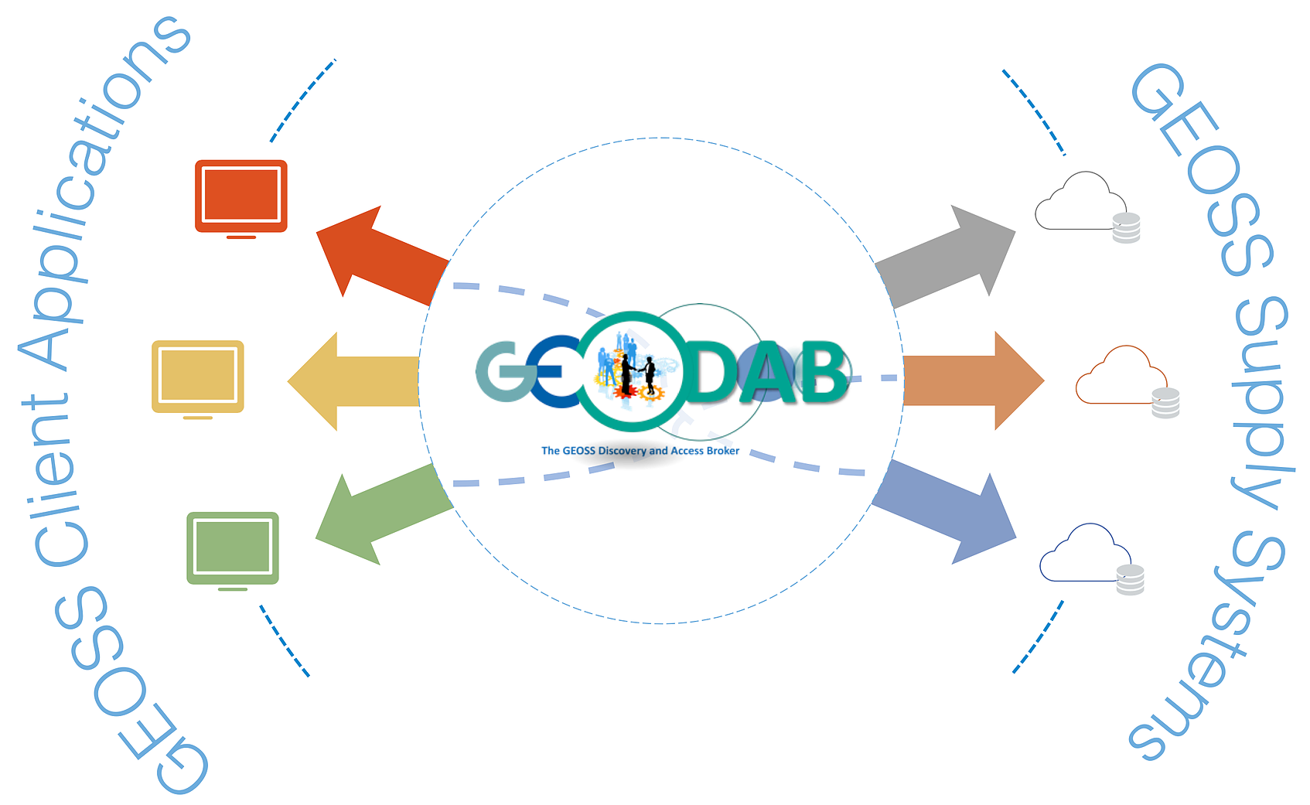
GEOSS - Global Earth Observation System of Systems
GEO Discovery and Access Broker (GEO DAB) transparently connects GEOSS User’s requests to the resources shared by the GEOSS Providers:
  brokering framework that interconnects hundreds of heterogeneous and autonomous supply systems (constituting the GEO metasystem)
  provides mediation, harmonization, transformation, and QoS capabilities
  simplify cross and multi-disciplinary discovery, access, and use (or reuse) of disparate data and information
Main use cases:
Discovery and Access of GEOSS datasets
Generation of new products utilising GEOSS datasets (discover) through the execution and orchestration of workflows
Service | Launch | Integration with Hub
GEO DAB | 01/06/2020 | EGI Cloud Compute and Cloud Container EGI HTC EGI DataHub EGI Check-in B2STAGE Accounting Monitoring

Slide 11

OPENCoasts - Coastal circulation on-demand forecast
From national to European scope:
integration with European and global services for water levels and meteorological forcing (e.g. EMNODNET)
OPENCoastS service builds on-demand circulation forecast systems for user-selected sections of the North Atlantic coast:
  daily forecasts of water levels and 2D velocities over the spatial region of interest for periods of 48 hours
  forcing conditions at the boundaries and over the domain are defined by the user from global forecast databases
  automatic comparison with real-time in-situ sensor data can be provided for a number of user specified locations
Main use cases:
Forecast systems to anticipate hazardous events and prepare emergency response
Support planning activities, from daily tasks to strategic interventions
Studies of coastal processes, of the climate change and anthropogenic impacts in the coastal zone
Facilitate the access to circulation forecasts
Service | Launch | Integration with Hub
OPENCoasts | 01/09/2018 | EGI Cloud Compute EGI HTC DIRAC4EGI EGI DataHub EGI Check-in B2STAGE B2SAFE Accounting, Orchestr.
OPENCoasts - VA Metrics
International deployments: 14
Countries reached: 8 (Belgium, Germany, France, Spain, Finland,Italy, USA, Portuga)

Slide 12

WeNMR - A Worldwide e-infrastructure for NMR and structural biology
The WeNMR suite is composed of seven individual platforms:
AMPS-NMR: a web portal for Nuclear Magnetic Resonance (NMR) structures
CS-ROSETTA: to model the 3D structure of proteins
DISVIS: to visualise and quantify the accessible interaction space in macromolecular complexes
FANTEN: for multiple alignment of nucleic acid and protein sequences
HADDOCK: to model complexes of proteins and other biomolecules
POWERFIT: for rigid body fitting of atomic structures into cryo-EM density maps
SPOTON: to identify and classify interfacial residues as Hot-Spots (HS) in protein-protein complexes
Main use cases:
Disease-causing mutations
Engineer better molecules for material, health or food applications
Obtain a starting point for drug design to combat disease
WeNMR suite - VA Metrics
New users: from 1750 to 2273 (+ 30%)
Number of user runs submitted: from 13800 to 36179 (+162%)
Job submitted: 5034534 | CPU time: 15685748 hours
Reached countries: 96
Service | Launch | Integration with Hub
WeNMR suite | 01/01/2018 | EGI HTC, EGI Cloud Compute, DIRAC4EGI EGI Check-in INDIGO udocker EGI DataHub B2DROP

Slide 13
WeNMR - A Worldwide e-infrastructure for NMR and structural biology
The WeNMR suite is composed of seven individual platforms:
AMPS-NMR: a web portal for Nuclear Magnetic Resonance (NMR) structures
CS-ROSETTA: to model the 3D structure of proteins
DISVIS: to visualise and quantify the accessible interaction space in macromolecular complexes
FANTEN: for multiple alignment of nucleic acid and protein sequences
HADDOCK: to model complexes of proteins and other biomolecules
POWERFIT: for rigid body fitting of atomic structures into cryo-EM density maps
SPOTON: to identify and classify interfacial residues as Hot-Spots (HS) in protein-protein complexes
Main use cases:
Disease-causing mutations
Engineer better molecules for material, health or food applications
Obtain a starting point for drug design to combat disease
WeNMR suite - VA Metrics
New users: from 1750 to 2273 (+ 30%)
Number of user runs submitted: from 13800 to 36179 (+162%)
Job submitted: 5034534 | CPU time: 15685748 hours
Reached countries: 96
Service | Launch | Integration with Hub
WeNMR suite | 01/01/2018 | EGI HTC EGI Check-in INDIGO udocker

Slide 14
EO Pillar
EO Pillar - VA Metrics
EODC EO DATA available: > 3 PB
OSS-X Sentinel: Number of published products
CloudFerro: EO data available: > 9 PB
CloudFerro: Number of users: 200
CloudFerro: EOBrowser Collections: 9
The EO-Pillar service provides access to different services in the field of Earth Observation (EO).
Data Access and Computing services
EO Data Exploitation services
EO general user services
EODC Data Catalogue Service
EODC JupyterHub for global Copernicus data
OSX-Sentinel
CloudFerro Data Collections Catalog
CloudFerro Infrastructure
CloudFerro EO Finder
CloudFerro EO Browser
Geohazards Exploitation Platform (GEP)
MEA Platform
Rasdaman EO Datacube
Sentinel Hub
EPOSAR Service
Service | Launch | Integration with Hub
All services except MEA Platform and EPOSAR | 01/07/2018 | EGI Check-in EGI Cloud Compute EGI DataHub B2SHARE Monitoring Accounting
MEA and EPOSAR | 01/06/2019

Slide 15
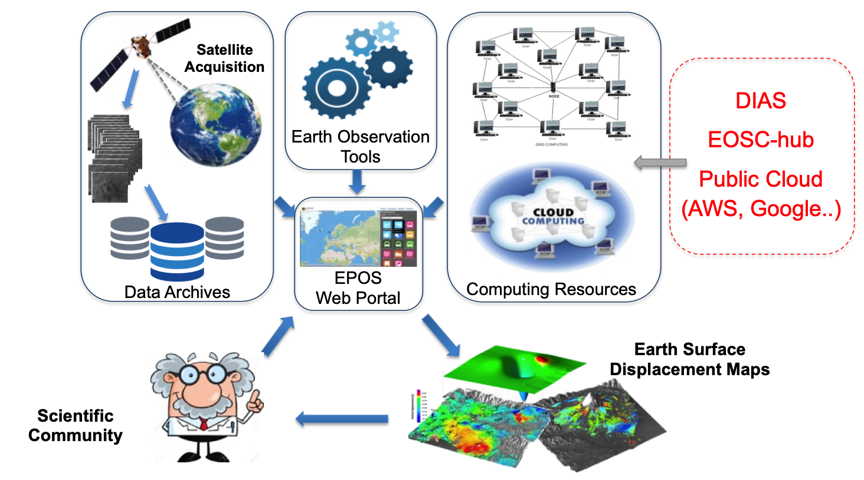
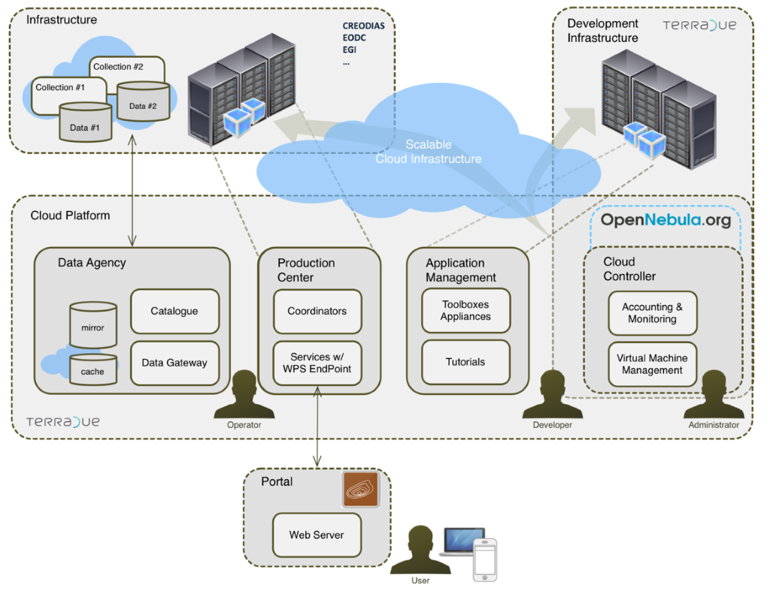
EO Pillar – Two examples
Geohazard Exploitation Platform
EPOSAR

Slide 16

DARIAH - Digital RI for the Arts and Humanities
DARIAH Science Gateway: provides a set of generic and customized services and tools
  Semantic Search Engine (SSE): allows users to search in Open Access Document Repositories and Data Repositories and to discover new correlations about document and data
  Parallel Semantic Search Engine (PSSE): enabling users to semantically correlate contents in geographically distributed digital repositories
  Simple Cloud Access: workflow creation and execution
  DBO@Cloud: Cloud repository of Bavarian dialects
Invenio-based repository in the cloud:
  enables users to easily create, deploy and configure their own Invenio-based repository instance in the cloud
DARIAH repository: storing and searching objects in research projects
Service | Launch | Integration with Hub
DARIAH Science Gateway | 01/01/2018 | EGI Cloud Compute EOSC-hub AAI Accounting Monitoring
Invenio repo | 01/01/2018 | INDIGO IAM INDIGO Orchestrator EGI Cloud Compute
DARIAH repo | 01/01/2018 | EOSC Federation Services
DARIAH - VA Metrics
Number of supported applications: 5
Country reached: 10

Slide 17
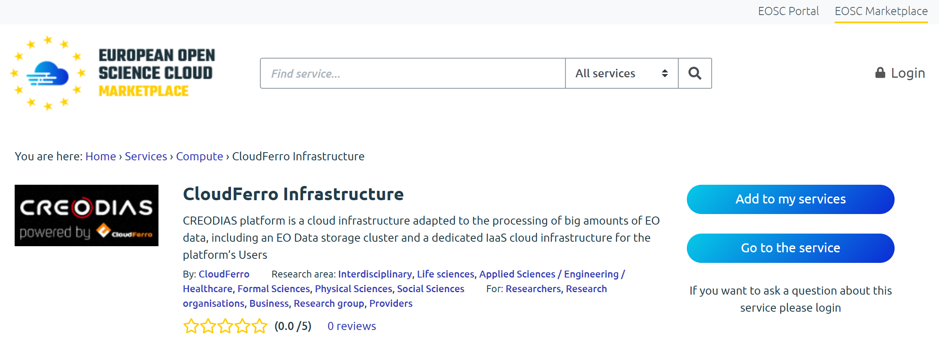
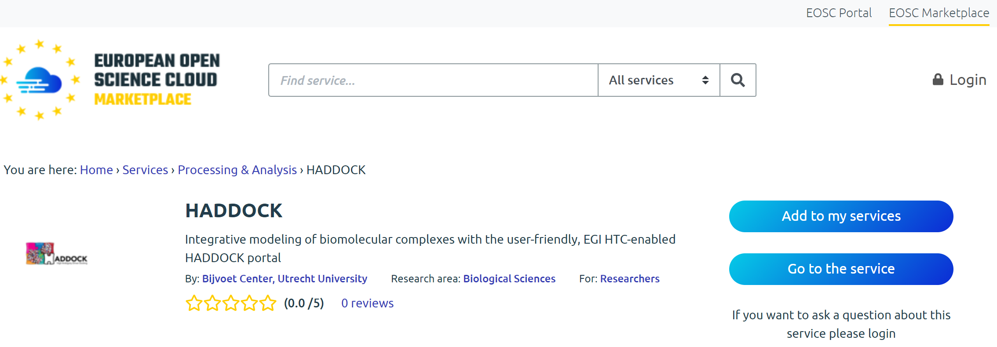
Thematic services in the EOSC Marketplace
All the Thematic Services have been published in the EOSC Marketplace and are accessible via the EOSC Portal
  Requests to access are accounted via the SOCRM process
Service integration
E.g. Catalogue of scientific data + Analytics

Slide 18
Enhance the Hub to better serve Thematic services
Research enabling services as source of requirements for EOSC-hub access enabling and common services
To drive the evolution of the other services
Thematic Services (WP7)
Use cases analysis
Technical Support
(WP10)
Service Developer
(WP5/WP6)
Tech requirements
Hub Services
New service releases
Service adoption

Slide 19
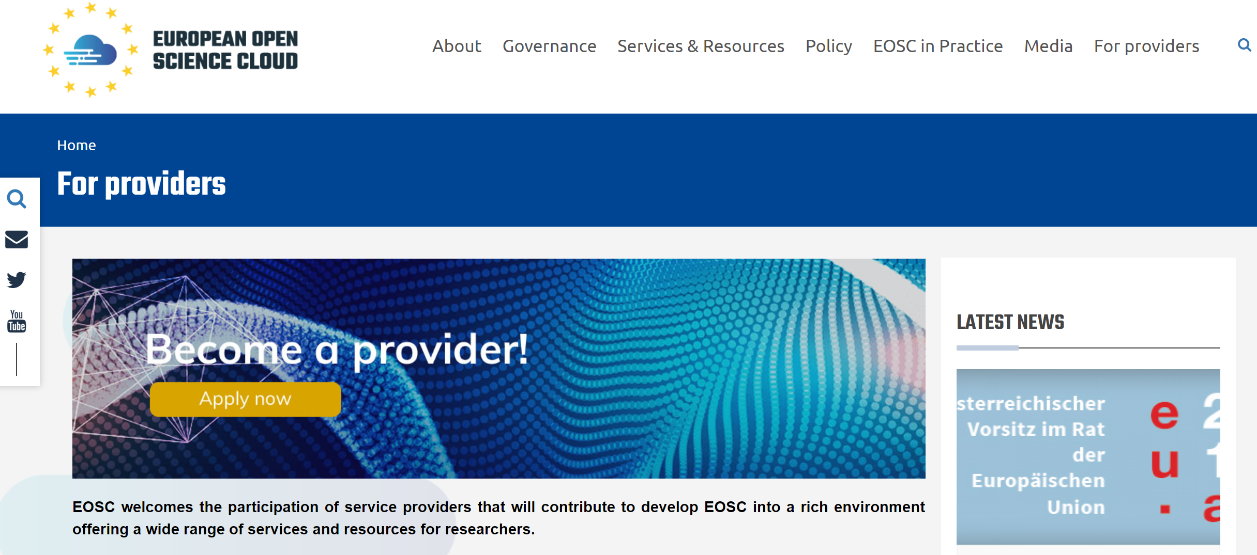
Extend the EOSC-hub service offer
The number of TSs offered by the Hub will be extended:
  EOSC-portal
  Competence Centers (WP8)
  Engagement activities (WP3)

Slide 20
Summary
First set of Thematic services offered via the Hub
  From various scientific disciplines and large research infrastructures
TSs are early adopter of the Hub services
  First samples of service integration/composition
  Sources of requirements to improve the Hub service offer
Thematic services accessible via the EOSC Portal and the EOSC Marketplace
Procedures to extend the offer of Thematic services up & running

Slide 21
Future plans
Increase the integration of the TSs with the Hub
  More Hub services adopted
Support new TSs
  Use case analysis
  Integration with the Hub
Advertise the TSs offer in the Hub to widen their usage
  Marketplace, training events, participation to conference, etc.

