Slide 1
EOSC-hub Strategy and Positioning
Per Öster
EOSC-hub Project Director, CSC
Contributions: WP2 and WP12
Dissemination level: Public

Slide 2
Presentation outline
The process of strategic planning in EOSC-hub
The role of the EOSC-hub Strategy Board
Positioning of EOSC-hub in EOSC
State of play with market research
How EOSC-hub will contribute to the EOSC implementation roadmap
Summary of achievements
Ongoing activities and next steps
This presentation is based upon the contributions of the EOSC-hub WP2 (Strategy and business development) and WP12 (Business models and procurement).
Notes:
The last line about the contributing work packages to be mentioned. The two WPs are intertwined as both of them have the positioning of EOSC-hub in their scope. WP12 surveys the needs of different stakeholders for different types of services and analyses possible business models to satisfy these needs. Thus, the output of WP12 enlightens on the issues in user landscape and help making appropriate strategic choices in WP2.

Slide 3
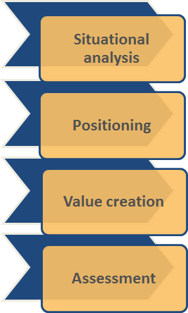
The process of strategic planning in EOSC-hub
Strategic planning of EOSC-hub serves the project’s need to
Profoundly understand the stakeholders’ expectations and the drivers that shape the landscape. What future do we need to plan for?
Share a clear vision among all stakeholders of what the EOSC-hub system will be and include. Where do we want to be?
Give direction to different activities of the project so that they effectively implement the vision and contribute to sustainable EOSC
Learn and perform prudent adjustments to stay optimally attuned to the stakeholders’ needs
Notes:
Strategic planning is done in EOSC-hub in order
to get all stakeholder (external and internal) on the same page and aligned with the project vision and mission
to understand the emerging trends, change drivers and scenarios that could impact our aims
to identify and evaluate the best way to accomplish the project goals
to develop an implementation plan to keep everybody on track and accountable for deliverables
A strategy plan is guide for all stakeholders to know where EOSC-hub is going and why.

Slide 4
The process of strategic planning in EOSC-hub
The process capitalizes on
Participatory consultation methods, results of the EOSCpilot project, and applicable strategic analysis tools to produce a well-reasoned situational and need analyses and to define justified key success factors
Close dialogue with peer projects, e.g. OpenAIRE-Advance and eInfraCentral, on strategic directions to promote sustainable and inviting EOSC
The guidance of the EOSC-hub Strategy Board
Notes:
The document that contains the strategic plan is not what is valuable. It's the information within it and the process used to create it -> Successful strategic planning is about dialogue, reasoning and assessing arguments to deepen the stakeholders’ understanding and creating commitment. Hence, a participatory process, empowering all stakeholders, is the key success factor. Examples of the participatory methods include e.g. interviewing, network think tanks, etc.
The strategy process of EOSC-hub can not be a waterfall type of exercise due to the complexity and turbulence of the field. It needs to be a dynamic instrument that captures signals, analyses them and drives the change. Therefore, it is re-evaluated on an ongoing basis.

Slide 5
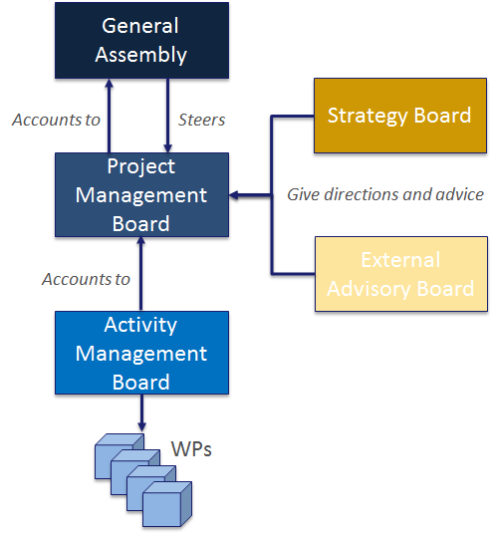
Role of the EOSC-hub Strategy Board
Gives direction to the EOSC-hub Project Management Board by advising on strategy, including exploitation and service deployment plans
The advice and direction will be provided in the form of written recommendations on the strategy plan and its implementation
The Terms of Reference of the EOSC-hub Strategy Board were adopted on 26 September 2018
Notes:
The Terms of Reference define detailed requirements concerning the organization of the EOSC-hub Strategy Board. The five articles define
The role of the SB
Membership and representation
Meeting procudures and information distribution
Conflicts of interest and cofidentiality
Amendment of articles

Slide 6
The EOSC-hub Strategy Board members
EOSC-hub Strategy Board members appointed in May-June 2018
Niklas Blomberg ELIXIR and Life Sciences RIs participating in CORBEL
Serge Bogaert PRACE e-Infrastructure
Ron Dekker (Chair) CESSDA
Andrew Gotz ESRF and Neutron and Photon Research Infrastructures
Giovanni Lamanna CTA and Astronomy, Astrophysics and Astro-particle Physics RIs participating in ASTERICS
Andreas Petzold Environments Research Infrastructures, ENVRI community and ENVRI-FAIR project proposal consortium
Ex-officio non-voting members
Tiziana Ferrari Project Coordinator, EGI Foundation
Per Öster Project Director, CSC
Notes:
The EOSC-hub Strategy Board (SB) was set up with six members from e-Infrastructures, Research Infrastructures and thematic service providers contributing to the project and ESFRI cluster project representatives. The members were appointed by the Project Management Board for the whole duration of the EOSC-hub project. Ron Dekker, from CESSDA,was elected to Chair by the SB members.

Slide 7
The EOSC-hub Strategy Board activities
Contributions to The First EOSC-hub Strategy Plan (Deliverable D2.1) through individual interviews conducted in 21-31 May 2018
The 1st Strategy Board meeting was held in Vienna in 23 November 2018
The Strategy Board will prepare a common written view, by end of January 2019, on how to better position the EOSC-hub contribution to the EOSC Portal activities, and hence, to decide on future directions. The questions to be addressed are:
What should the Portal offer, beyond what exists now in the Portal and elsewhere, to attract various users?
Which directions or actions should EOSC-hub take and implement into the Portal to boost the interplay between disciplines, and thus, to accelerate novel science and innovations?
What kind of service delivery and brokering strategies should we exercise to attract committed FAIR compliant service providers?
What role can the portal play in facilitating the "B2B processes” between public entities, e.g computer centres to ERICs?
What are the (most important three) key success factors that the EOSC-hub need to meet from the point of view of user communities, service providers, funders?
Notes:
Five SB members out of six were interviewed when preparing the 1st EOSC-hub Strategy Plan. (Andreas Petzold was appointed only in the beginning of June and we couldn’t fit in a suitable time into his schedule.) Two alternative options for positioning EOSC-hub within EOSC were prepared and shared beforehand and they were discussed and assessed in one hour individual interviews. The interviews also produced rich information on communities’ expectations and priorities in regard to EOSC-hub.
For now on, the SB will work as a team and provide advices in a written form.

Slide 8
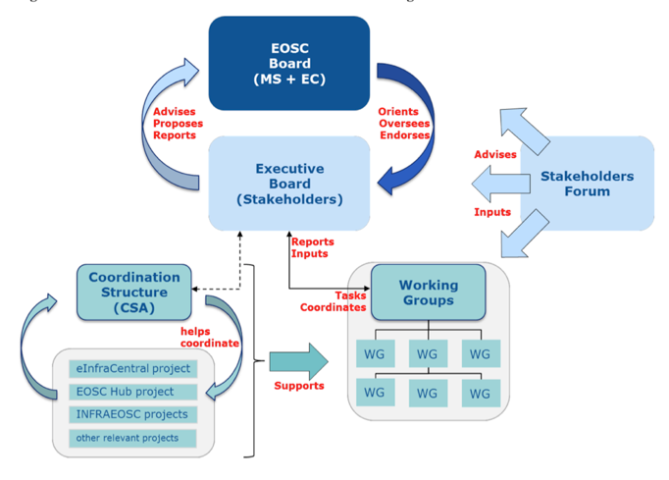
EOSC-hub in EOSC Governance
Contribute through coordination structure
Support co-creation activities
Propose, support and participate in WGs
Participate in and promote EOSC stakeholder forum

Slide 9
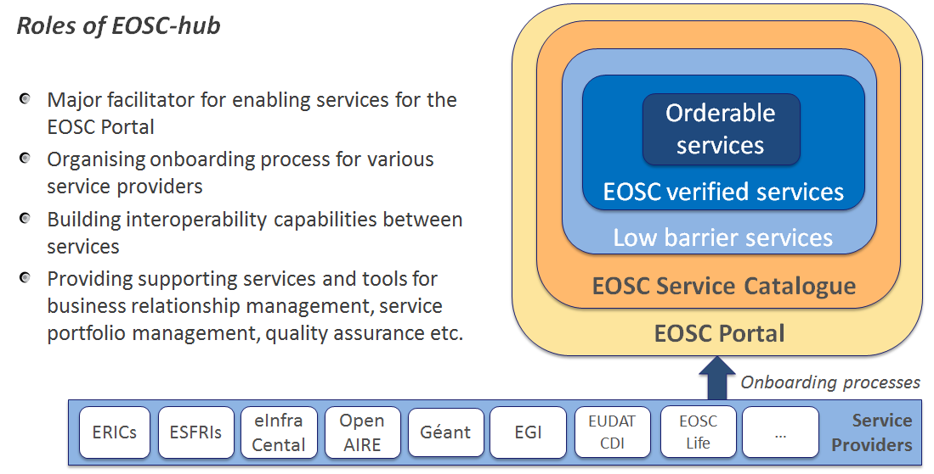
The positioning of EOSC-hub in EOSC
Notes:
EOSC-hub project develops and maintains the EOSC Portal together with the eInfraCentral, EOSCpilot and OpenAIRE-Advance projects. The role of EOSC-hub is to provide means and processes for service providers to contribute their services and resources to the EOSC catalogue.

Slide 10
Demand-side market research
Objectives:
Understand the need for and level of demand of digital services for research in the context of the EOSC
Understand the manner in which such needs and demand are currently satisfied
Understand the challenges presently being faced in respect of analysis workflows, data management and related infrastructure and services
Identify current and preferred delivery models for such services
Identify funding streams and procurement constraints
Identify areas of improvements for business models
Target audience: organisations that need to acquire/procure digital services in order to serve research
Large organised research communities (e.g. EIROs, big labs, ESFRIs)
Organisations serving small research groups (e.g. Universities, research centres)
NRENs
H2020 projects

Slide 11
Demand-side market research: status
Defined market research methodology
Completing interviews with selected organisations among the target groups (target 50 organisations) - Jan 2019
Structure of the interviews
Current demand of digital services for research
Current and preferred delivery models
Funding streams & procurement constraints
Challenges and opportunities

Slide 12
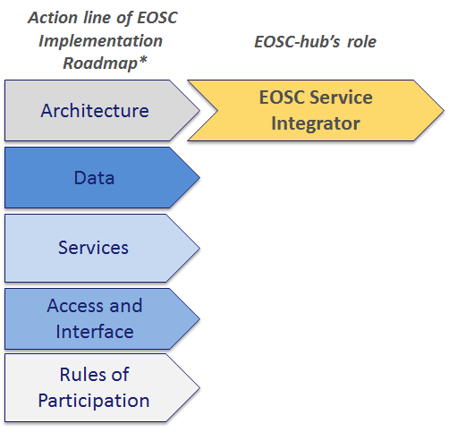
Contribution of EOSC-hub to the EOSC implementation roadmap
Provides a framework to manage services sourced from a number of service providers
Is accountable for end-to-end service governance, management, integration, assurance and coordination
Manages the relationships with service providers through processes like business relationship management, service portfolio management, quality assurance
Provides supporting services and activities, such as the Service Portfolio Management Tool, marketplace etc.
* The Commission Staff Working Document on the Implementation Roadmap of the European Open Science Cloud
https://ec.europa.eu/research/openscience/pdf/swd_2018_83_f1_staff_working_paper_en.pdf

Slide 13
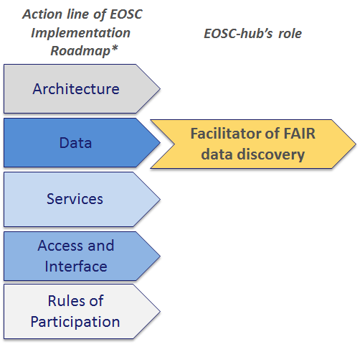
Contribution of EOSC-hub to the EOSC implementation roadmap
Provides a discovery and access channel to FAIR-accredited datasets
Offers EUDAT B2FIND metadata catalogue and other registries of repositories, as well as community-specific data discovery and access tools that are part of the EOSC-hub catalogue
Makes available generic data management and compute services to end users to access, stage and analyse data from FAIR-compliant sources
* The Commission Staff Working Document on the Implementation Roadmap of the European Open Science Cloud
https://ec.europa.eu/research/openscience/pdf/swd_2018_83_f1_staff_working_paper_en.pdf

Slide 14
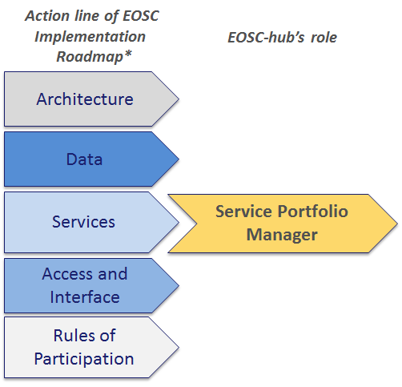
Contribution of EOSC-hub to the EOSC implementation roadmap
Contributes to the definition of a participatory and lightweight service portfolio management process in collaboration with the participating service providers
Maintains the service portfolio so that all services are specified, including planning, design and transition of new or changed services
Maps offer against demand, identifying gaps, i.e. needs that are partly or not covered at all
Monitors and assesses service use as well as service provider performance and conformance to the EOSC Rules of Participation
Defines procurement and delivery model(s) for services
* The Commission Staff Working Document on the Implementation Roadmap of the European Open Science Cloud
https://ec.europa.eu/research/openscience/pdf/swd_2018_83_f1_staff_working_paper_en.pdf

Slide 15
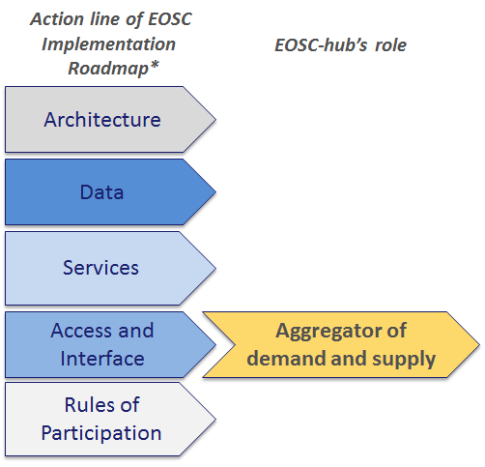
Contribution of EOSC-hub to the EOSC implementation roadmap
Engages with the demand and supply side of the EOSC
Co-develops and operates a marketplace as one entry point to EOSC
Co-develops with research communities the policies and tools that enable federated access and supply
Supports different access policies (e.g. sponsored access, policy-based access and pay for use access) to enable different business models
* The Commission Staff Working Document on the Implementation Roadmap of the European Open Science Cloud
https://ec.europa.eu/research/openscience/pdf/swd_2018_83_f1_staff_working_paper_en.pdf

Slide 16
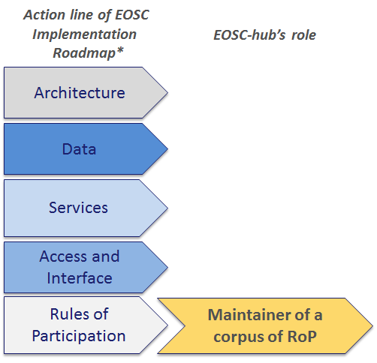
Contribution of EOSC-hub to the EOSC implementation roadmap
With input from collaborating projects and initiatives, collectively gathers and maintains a corpus of Rules of Participation to the Hub
Defines the conditions for service providers to offer services through the Hub, taking into account different perspectives, for example technical, operational, legal and financial
Provides a framework of service/resource-specific procedures for lightweight quality assurance, for example through the periodic auditing of conformance of the participating providers
* The Commission Staff Working Document on the Implementation Roadmap of the European Open Science Cloud
https://ec.europa.eu/research/openscience/pdf/swd_2018_83_f1_staff_working_paper_en.pdf

Slide 17
Summary of achievements
Mapping of EOSC-hub activities to the Action Lines of the EOSC Implementation Roadmap*
The EOSC-hub Strategy Board mobilised
Terms of Reference of the EOSC-hub Strategy Board adopted in September 2018 (Milestone M2.1)
The Strategy Board is working actively: The 1st guiding paper is due in 21 January 2019 and the next SB meeting will be in April 2019
The First EOSC-hub Strategy Plan (Deliverable D2.1) completed
Published in 11 September 2018, https://documents.egi.eu/document/3354
Presented in the EOSC-hub General Assembly meeting in Lisbon, Portugal in 8 October 2018 and in the EOSC-hub Strategy Board meeting in Vienna, Austria in November 2018
* The Commission Staff Working Document on the Implementation Roadmap of the European Open Science Cloud
https://ec.europa.eu/research/openscience/pdf/swd_2018_83_f1_staff_working_paper_en.pdf

Slide 18
Ongoing Activities and Next steps
The Final EOSC-hub Strategy Plan (Deliverable 2.2, due June 2019)
02-03/2019: Stakeholder consultation
03-04/2019: Preliminary version of the D2.2, including the evaluation of the key drivers of the operational environment, analysis of the stakeholder input, and scrutiny of related strategies and roadmaps affecting to the EOSC-hub strategy
05-06/2019: Final EOSC-hub Strategy Plan submitted for the external review
EOSC-hub / OpenAIRE-Advance collaboration on strategy activated
White Paper outlining a common vision for EOSC, service placement, and role in the upcoming EOSC governance is under work (Joint Activity milestone 3.3)
Aligned roadmap(s) for service positioning and sustainability within EOSC, (Joint Activity milestone 3.4, due June 2019)
Procurement requirements and demand assessment (Deliverable 12.1, due April 2019 based on analysis of results from interviews)

