Slide 1
Service architecture and integration
WP10-WP6-WP5
Giacinto Donvito -- INFN -- Technology Coordinator
donvito@infn.it

Slide 2
Outline
From where we start from
Service definition and EOSC Service architecture
Service integrations
Communities’ Thematic Services
Roadmap and future plans
Dealing with the technical roadmap and users’ requirements

Slide 3
Three e-Infrastructure experiences
e-Infrastructure | expertise/area of activities | Standards and bodies
 | Cloud Computing HTC/HTC Computing Online data access | OGF
 | data stewardship/management | RDA W3C
 | High-Level PaaS services Computing and Storage Federation | RDA OASIS/TOSCA
Plus several others Research Infrastructures providing several “vertical” and “research enabling” services

Slide 4
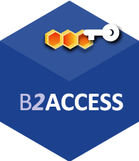
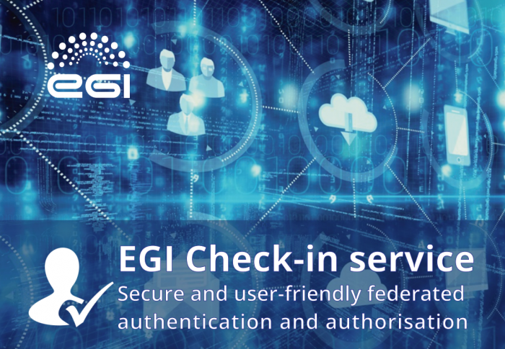
Service definition
Access Enabling services:
Federation services: they guarantee the operation of the hub itself and support the processes and procedures of the EOSC Service Management System (SMS).
Open Collaborative services: this category includes open science platforms for discovering and sharing research digital objects like datasets, scientific applications, code, pipelines and virtual appliances.

Slide 5
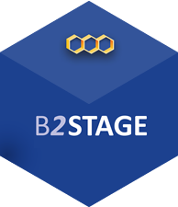
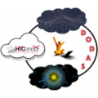
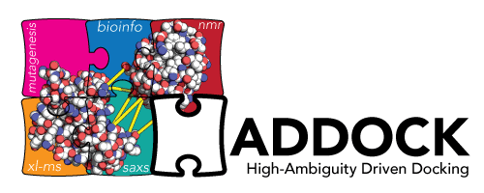
Service definition
Research Enabling services: user facing services offered to users and research communities by means of the EOSC Marketplace.
Common services: provide added value to exploit storage, compute and data resources and can be re-used by other services
Thematic services: scientific applications offered by the Research Infrastructures, research data, advanced data brokering and analysis capabilities for specific research communities and multidisciplinary research.

Slide 6
Service architecture
4
Access, Deposition & Sharing
Application DB (software & VM)
B2DROP (data)
B2Note (data)
B2SHARE (data)
DataHub
3
1
Data Management, Curation & Preservation
Federation Services
Discover & Reuse
B2HANDLE
B2SAFE
European Certified Trusted Repository
Federated AAI. monitoring, accounting
SLA and order Management
Security incident response and policies
Technical support & Training
B2FIND (data)
Marketplace (Services)
2
Processing & Analysis
Applications on Demand
Federated HTC & Cloud Compute IaaS & PaaS
Processing of sensitive data
Jupyter Notebook
Thematic data analytics
Scientific Workflow Management, Orchestration (DIRAC, PaaS Orchestrator)

Slide 7
Service integration
Integration between services in the Hub is made simple by the large adoption of open and standard interfaces.
This allows the creation of an ecosystem enabling an easy and fast development of scientific services.
The community developers can focus on the scientific added value and rely on well-established services from main European e-infrastructures (EGI, EUDAT and INDIGO-DataCloud)
implementing basic features (AAI, accounting, monitoring, etc)
exploiting compute, storage and data resources.

Slide 8
Service integration
The objective of the EOSC-hub project is allowing users to select various services offered by the Hub and compose them according to their needs,
to create added-value solutions for research.
an end-user can compose together different scientific algorithms, offered as a service by the Hub,
creating new workflows/solutions that use as input datasets made available by the Hub as well.
A pre-condition to achieve this objective is the interoperability between services that requires the adoption of open interfaces.

Slide 9
Common Service integration example
Common Service A
+
Common Service B
+
Federation service A
Developer
New Thematic Service
TS Examples: DODAS, WeNMR, ICOS, etc…
Notes:
Alternative to slide 8

Slide 10
Common Service integration example
PaaS service (INDIGO-DC)
AAI service (EGI)
SAML2, SCIM
OpenID Connect
OAuth2, X.509,
OASIS, OpenStack, OpenNebula
Compute service EGI
Data service EUDAT
WebDAV, GlobusGFTP/HTTP
Developer
TS Examples: ENES
New Thematic Service
Notes:
Alternative to slide 9

Slide 11
Research-enabling service integration example
Repository Service
+
Analytics tool
+
AAI Service
Examples:
Earth Observation data
Examples:
Sentinel Hub
Developer
New workflow for scientific analysis
Notes:
Alternative to slide 11

Slide 12
Service integrations examples
interoperability between the AAI services (EGI Check-in, EUDAT B2ACCESS and INDIGO-DataCloud IAM)
DODAS(CMS), ECAS(ENES), OPENCoasts(LNEC), etc
staging data stored in EGI DataHub by B2STAGE for processing
sharing processed data by B2SHARE: data processed in the EGI FedCloud are moved via B2STAGE to B2SHARE to be shared

Slide 13
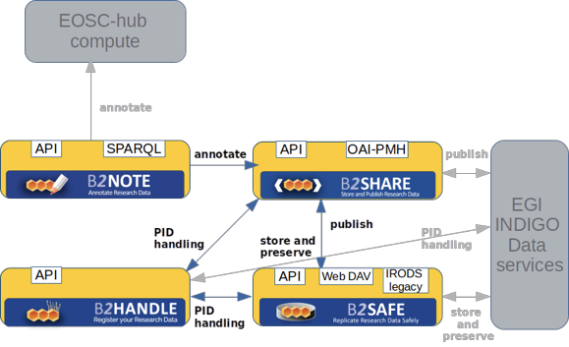
Service integration: Metadata
Harvesting:
B2FIND uses the standardized protocol OAI-PMH to harvest metadata from the data providers. Additionally other API’s like CSW, SparQL or JSON-API are supported by B2FIND.
Mapping:
B2FIND exploits generic schema based on the DataCite4.1 metadata schema. The mapping of metadata elements is based on standardized vocabularies and ontologies
the discoverability of EGI DataHub datasets via B2FIND:

Slide 14
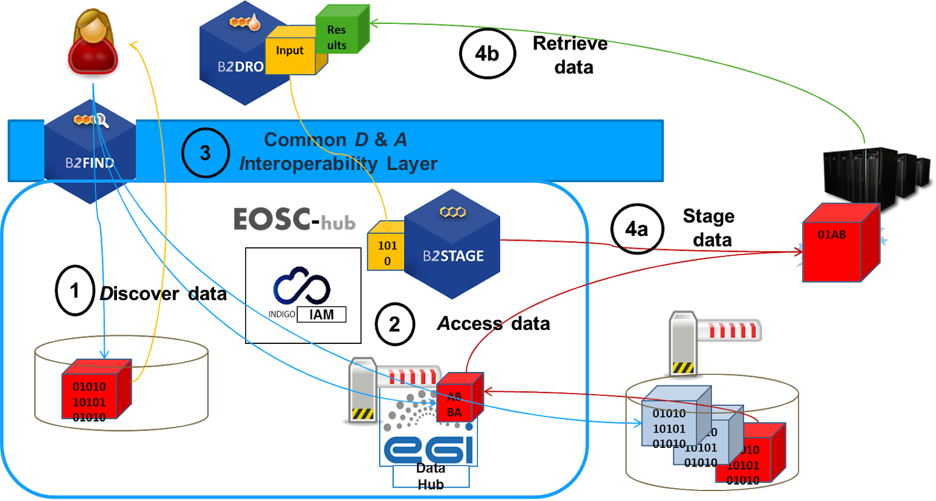
Integration of EOSC-hub services in a typical analysis workflow
1.[F] search for distributed data in EOSC-hub and beyond
2.[A] seamless access to distributed data resources where ever they are located
3.[I] usage of open standards and domain agnostic tools and interfaces
4.[R] reuse, exchange and staging of data (depending on use case)

Slide 15
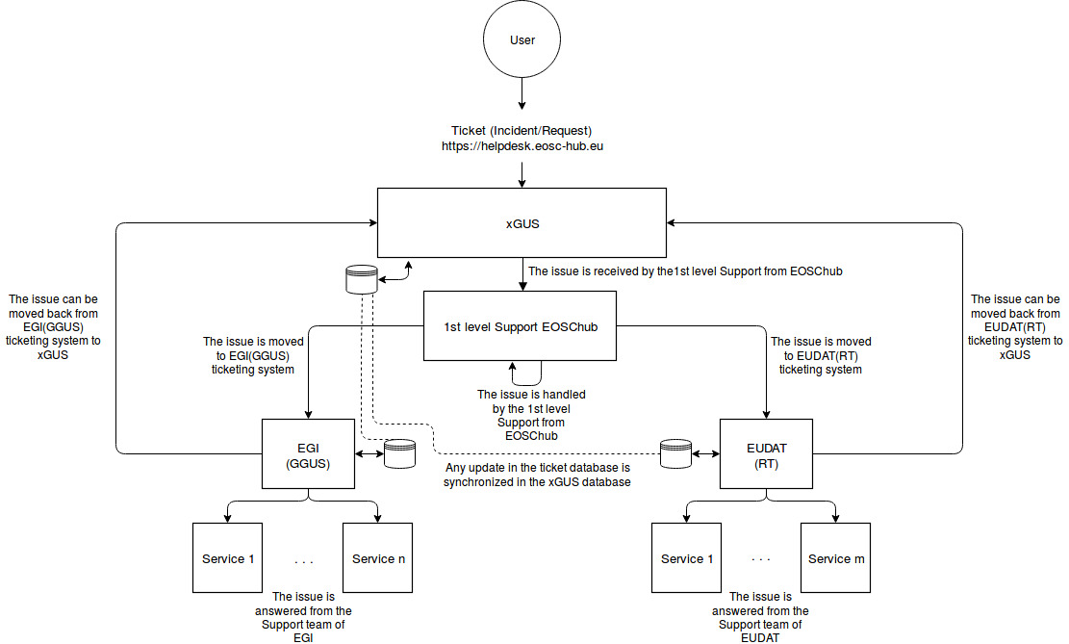
WP5...
Integration of the EGI and EUDAT ticketing systems
workflow for the tickets received at EOSC-hub helpdesk

Slide 16
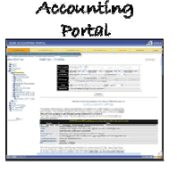
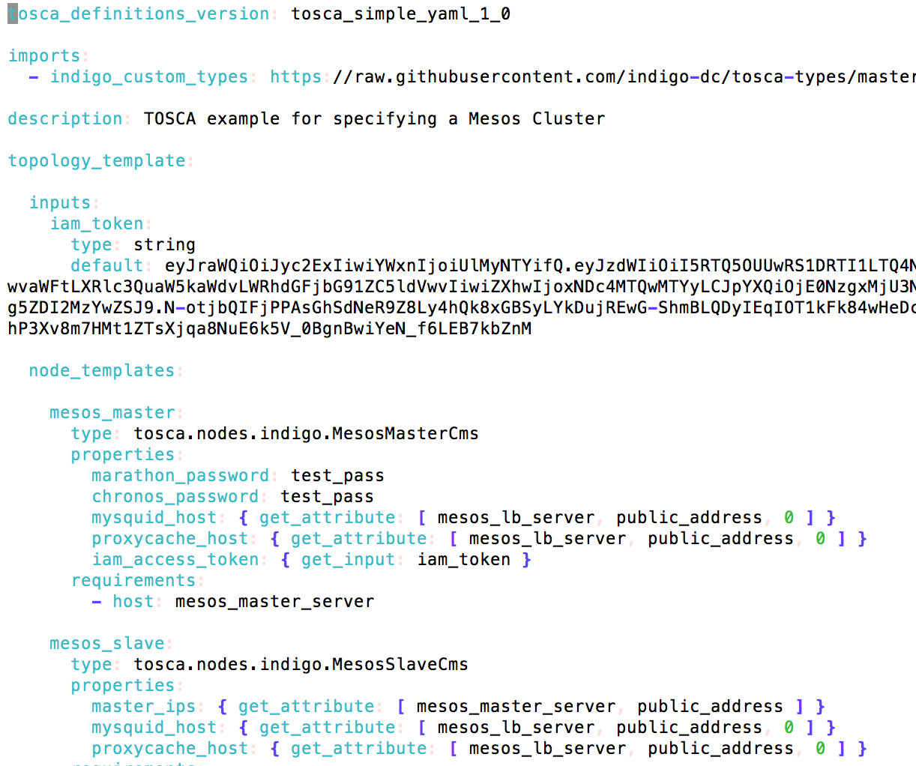
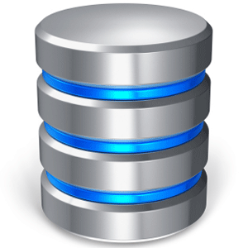
DODAS TS: a vertical community service
APEL Portal
TOSCA (+Ansible)
Data Analysts
DODAS Manager
PaaS Orchestrator
Orchent
APEL DB
IM
Jobs
AuthN
Home IdP
IAM
Check-in
Service
Service
Service
B2Access
Service
Slave
Slave
Load
Balancer
DATA I/O
WaTTS
X.509
Master
CVMFS Server
Stratum0/1
Slave
External Distributed Storages
The Services come-out from different experiences: INDIGO-DataCloud, EGI
The end user is able to instantiate dynamic clusters exploiting heterogeneous computing resources and distributed storage

Slide 17
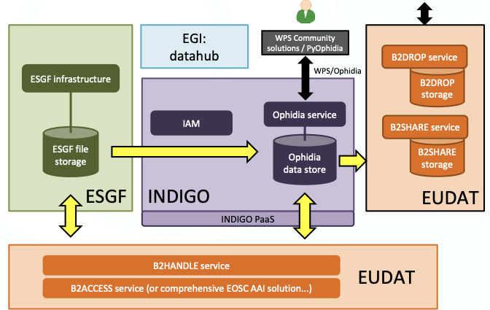
ENES Climate Analytics Service (ECAS)
The Services provided by: INDIGO-DataCloud, EUDAT, EGI
The user may exploit the data previously stored in EUDAT Services, to process with an high level PaaS solution that provide easy and straightforward way of deployment of the analysis workflow

Slide 18
Roadmap and future plans
Discovery and Access:
Improve the integration on the metadata exchange
Improve seamless data transfers between EGI/INDIGO Data service and EUDAT ones by using WebDav as standard access protocol
Processing and Orchestration:
Integrate the EGI and INDIGO services for the information system to improve the seamless computing exploitation and federation via INDIGO PaaS Layer
Marketplace:
To enable the end users with the possibility to exploit the composition of services “via the Marketplace” (creation projects)

Slide 19
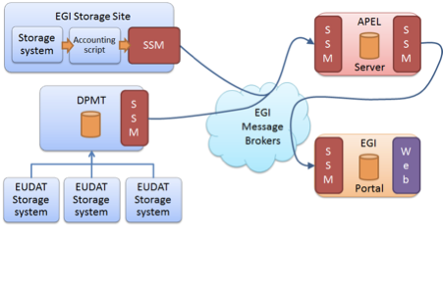
Roadmap and future plans
Accounting:
Improve the integration between the EUDAT and EGI accounting systems
Both accounting already using: STAR standard accounting record

Slide 20
TCOM: Purpose and Responsibilities
The Technology Committee (TCOM) works with the AMB and has responsibility for:
Defining, maintaining and evolving the technical roadmap,
Stimulating and supervising the contribution to open source community projects and standards bodies,
Ensuring compliance to standards and security in defining and assessing the acceptance criteria for the evolution of the service catalogue.
TCOM Areas:
Data Platforms for Processing
Data Publishing and Open Data
Data Preservation/Curation/Provenance
Metadata Management and Data Discovery
HTC/HPC Compute
AAI
Cloud Compute (inc Containerisation and orchestration)
Software Release and SQA
Federation tools
PaaS Solutions
Workflow management and user interfaces and Data analytics
Security
Notes:
Original first line: The TCOM guides and works with the AMB with responsibility for:

Slide 21
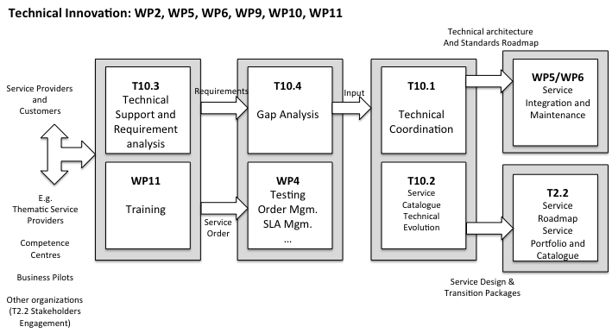
Technical Innovation process

Slide 22
Workflow for users’ requirements gathering
Community requirements DB
TS / CC / DIH
Task 10.3,10.4
Requirements analysis and feedback on them
Compiles
Technical Teams
WP5, WP6
TCOM
External projects / tools
Interaction with technical WPs
Scouting on external projects/tools

Slide 23
Summary
The integration activities involving Common and Federated services are progressing in line with the plan
The integration of AAI services empower users to build their own scientific workflows with services from different e-infrastructures
The Thematic Services exploit and integrate Common and Federated services to provide high-level community services to users.

Slide 24
Achievements
Deliverable 10.3:
This document will draft the overview of the service architecture for the EOSC-Hub platform. This will take into account all the services coming out from the various projects and community joining EOSC-Hub. The architecture will also cover the interaction among the services.
Setup of the Technology Committee (TCOM)
Leading writing of the Rule of Participation
Filled up 22 use cases in the “Community requirements DB”
Participating and organizing phone conference with users to understand technical requirements
Both internal and external to the project
Participating to the defining of the integration plan among services

Slide 25
Future plans
D10.1 -- EOSC Hub Technical Roadmap v1 [PM12]
This document will draft the first version of the Service Roadmap. It will provide details about each chosen service in the EOSC-Hub catalogue with their features, capabilities and information about development status.
D10.5 -- Requirements and gap analysis report v1 [PM12]
This document will provide a detailed report about the first round of technical gap analysis taking into account all the requirements coming from WP7, WP8 and WP9. This document will also draft the proposed solution to fill the identified gaps.
D10.4 -- EOSC Hub Technical Architecture and standards roadmap v2 [PM18]
This document will update the service architecture for the EOSC-Hub platform. This will take into account all the services coming out from the various projects and community joining EOSC-Hub. The architecture will also cover the interaction among the services.

Slide 26
Future plans
Going on with the user requirement analysis:
The last part of implementation of the TS
Supporting the Competence Centers activities
And the external users/developers/service providers that will be willing to join and/or exploit EOSC-Hub service catalogue
Continue on steering of the service integration activities as needed by the end-users

Slide 27
Thank you for your attention!
Contact:
donvito@infn.it
www.eosc-hub.eu
Questions?

Slide 28
Contribution to Standards
WP10 has the responsibility to oversee the project's contribution to the RDA roadmap and liaise with standards bodies
We are exploiting, working closely and providing contribution into several standards:
OASIS TOSCA
OpenIDC
CDMI
OAI-PMH
…
Involved in many WG/IG within RDA:
https://docs.google.com/spreadsheets/d/10bUKpdh6u8zxDXGfl-rTwYcOnbn-x1n63ImPm9AyQsA/edit#gid=0

Slide 29
Contribution to RDA
Both EOSC-hub and OpenAIRE-advance organized a BoF in the RDA Eleventh Plenary Meeting, Berlin, 21-23rd March 2018 to discus about their contribution to the RDA.
They also agreed that could be useful to propose these new WG
Potential new areas for RDA IG/WG: please add a description if some technical activities could benefit from a RDA group | EOSC-hub Task numbers and (brief) description of EOSC-hub activities | Type of EOSC-hub contribution envisaged
Data Usage Metrics WG, not yet endorsed, is currently in review | T10.1, T6.4 | Contribute to requirements to measure and to exchange of usage statistics, pilot with implementing the new usage statistics guidelines
Defining guidelines for describing and identifying scientific communities across infrastructure and services | T10.1, T6.1, T6.4 | Contribute to requirements and in defining guidelines, pilot in implementing the new guidelines, possible an area of collaboration with Freya
Defining guidelines for describing and publishing scientific products like services, software, virtual machines and appliances and workflows | T10.1, T5.6 | Contribute to requirements and in defining guidelines, pilot in implementing the new guidelines, possible an area of collaboration with Freya

