Slide 1
Results, Dissemination & Impact
(All WPs with focus on WP3)
Sara Garavelli, Trust-IT Services, WP3
Luxembourg, 23 January 2019

Slide 2
Outline
EOSC-hub expected impact
EOSC-hub Stakeholders
Key Exploitable Results in EOSC-hub
Main achievements, dissemination & engagement activities towards impact
Next Steps

Slide 3
EOSC-hub expected impact
The major impact of the EOSC-hub project will be a significant reduction in the fragmentation of the IT facilities, services and tools for data-intensive research and innovation in Europe.
1. Optimised access to IT equipment and services
2. Establishment of partnerships with industrial & private partners
3. More people trained in research and academic sectors
4. No lock-in to particular hardware or software platforms
5. More scientific communities using storage and computing infrastructures
6. Increased incentives for scientific discovery and collaboration across disciplinary and geographical boundaries
7. Further development of the European economic innovation capacity

Slide 4
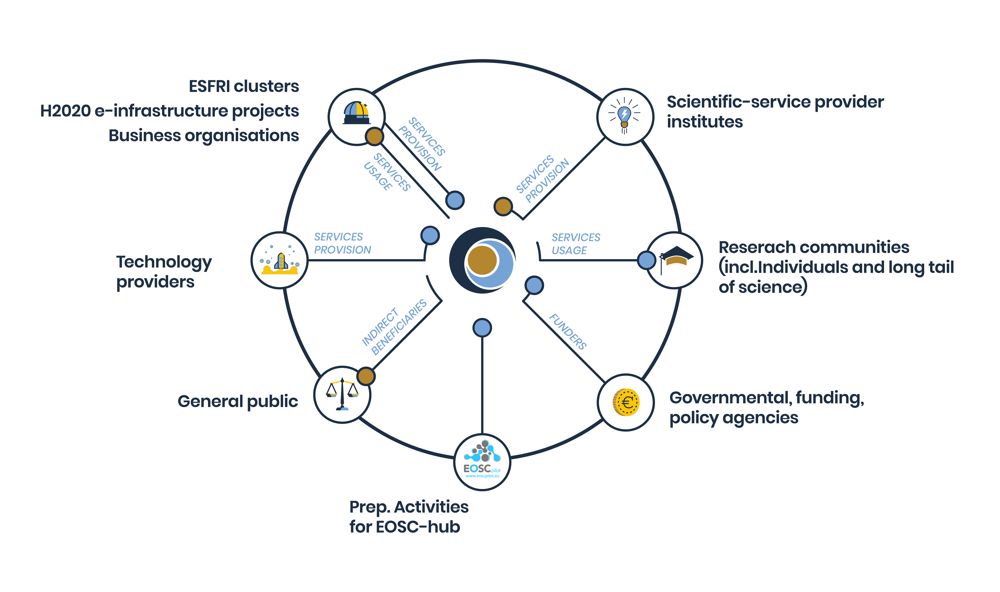
EOSC-hub Stakeholders
D3.1 EOSC-hub Communication & Stakeholder Engagement Plan

Slide 5
Key Exploitable Results - Overview
The Hub
A system with: Federation & collaboration services; Processes & policies; Business models & procurement experience; Strategy & Technical Service Roadmap, etc.
Competence Centre
Usage experience with common services and guidelines; requirements collection
EOSC Service Portfolio
Common &Thematic services; Business models for individual services; Rules for participation, etc.
Service integration,
training, documentation
and best practices
Best practices on Open Science, IM / Service Management / IT Security / DM trainings, etc.
EOSC Digital Innovation Hub
a platform that facilitates engagement between private industry and public institutions participating in the EOSC.

Slide 6
Impact 1. Optimised access to IT equipment and services
74 Services [KPI1]
+27% Jul-Dec 2018
57 Services published
+21 in verification
46 service providers
60 individuals ISO certified
The operation of a federated European data and distributed computing infrastructure for research and
education communities will optimise the access to IT equipment and services and will put all European
researchers and educators in equal footing to access essential resources to express their talent and creativity

Slide 7
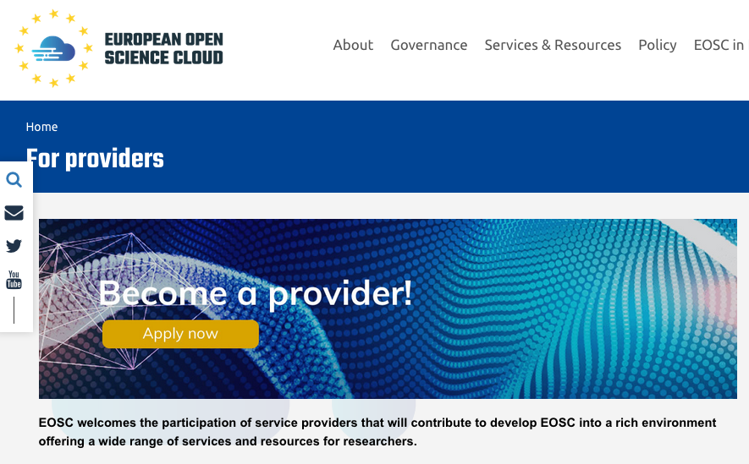
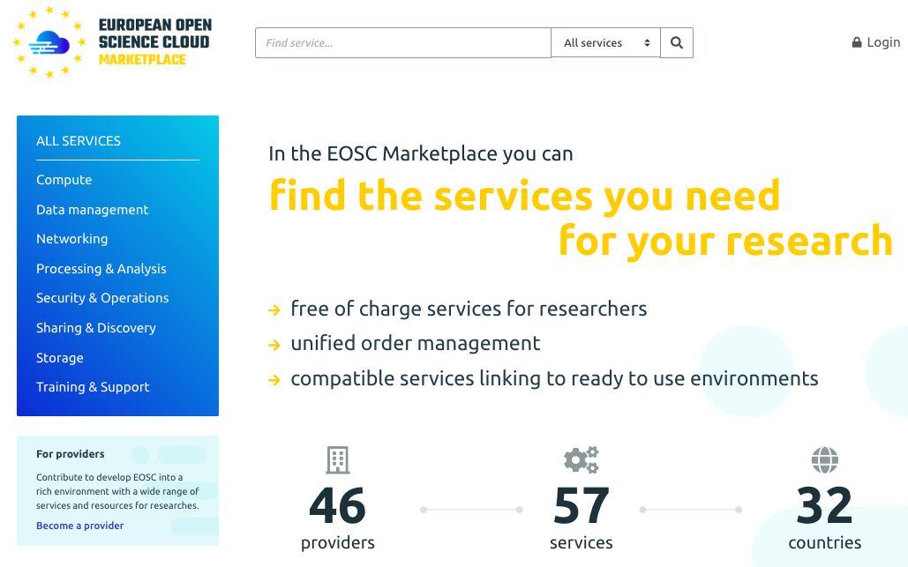
Impact 1/Main achievements in 2018
EOSC-hub service portfolio integrating over 70 services from EGI, EUDAT, Indigo-DataCloud and from research communities
From Nov 2018 EOSC-hub services are discoverable and orderable via the Marketplace in the context of the EOSC portal
July-Dec 2018: +27% registrations of service entries in the Marketplace
EOSC-hub operates the EOSC Portal website, the Marketplace and the whitelabel EOSC AAI
Service Providers onboarding process in place and integrated with the EOSC portal
21 new services currently under integration
Harmonisation of service management processes for the operation of federated services ongoing
> 60 individuals ISO certified

Slide 8
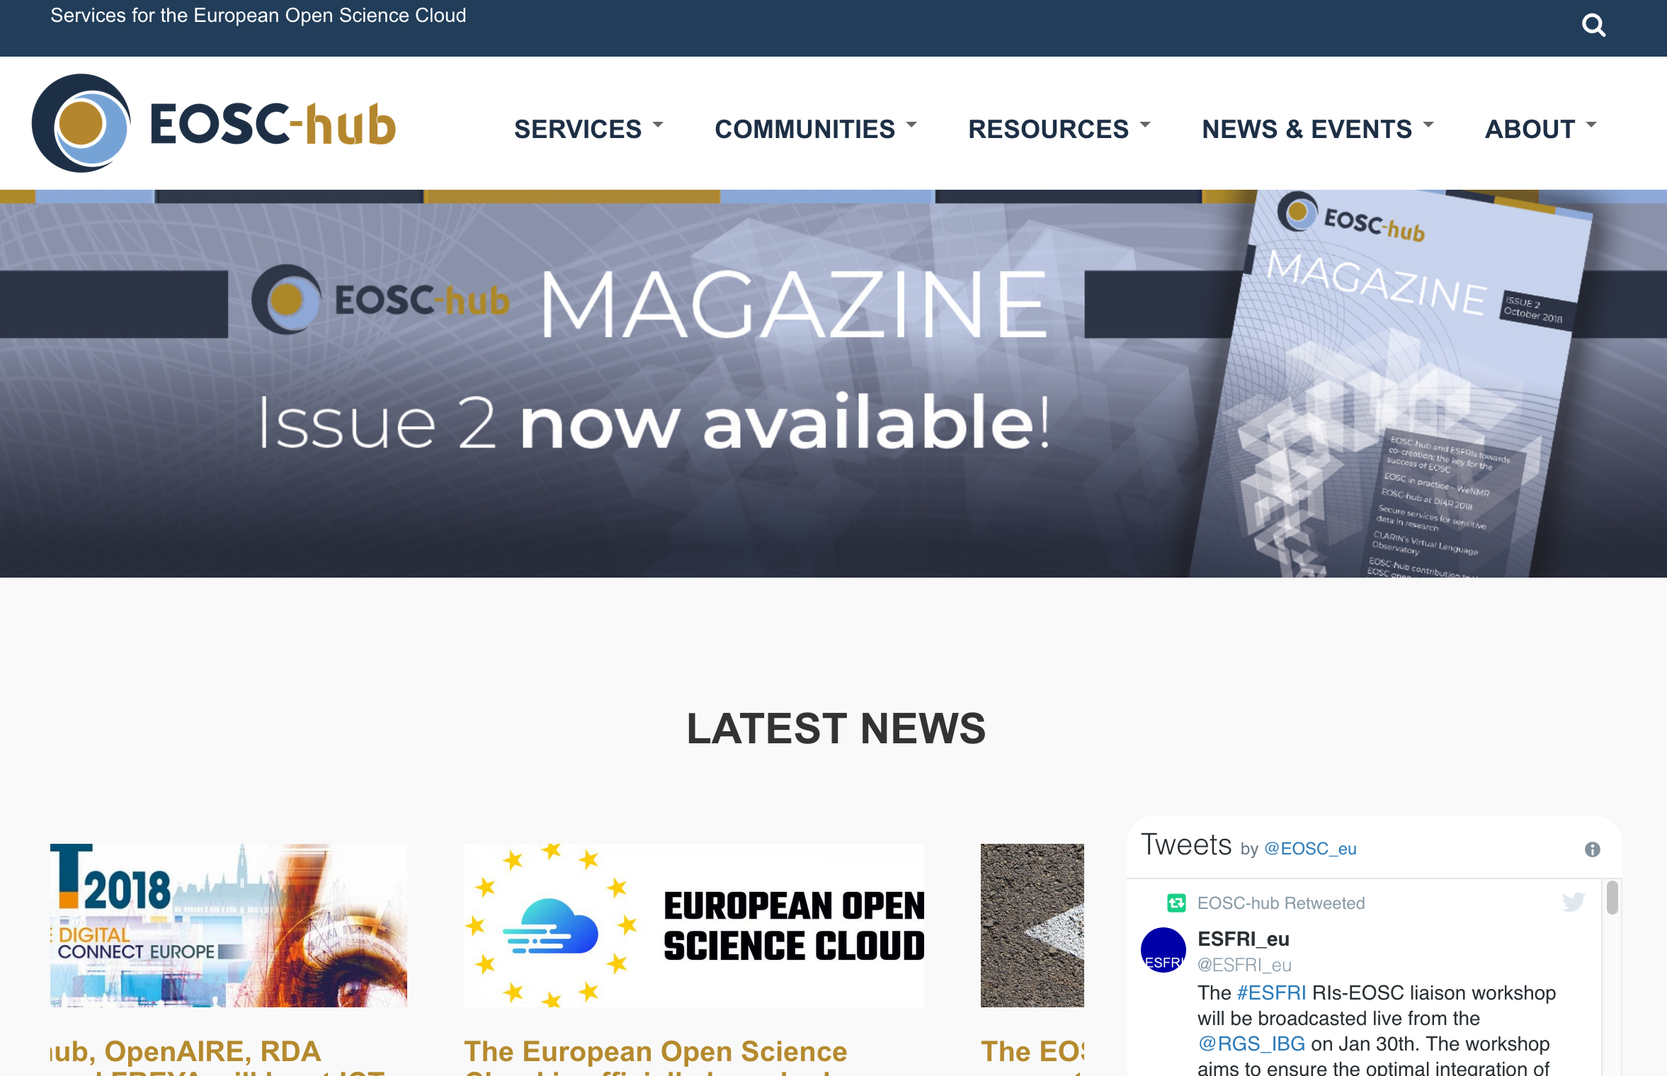
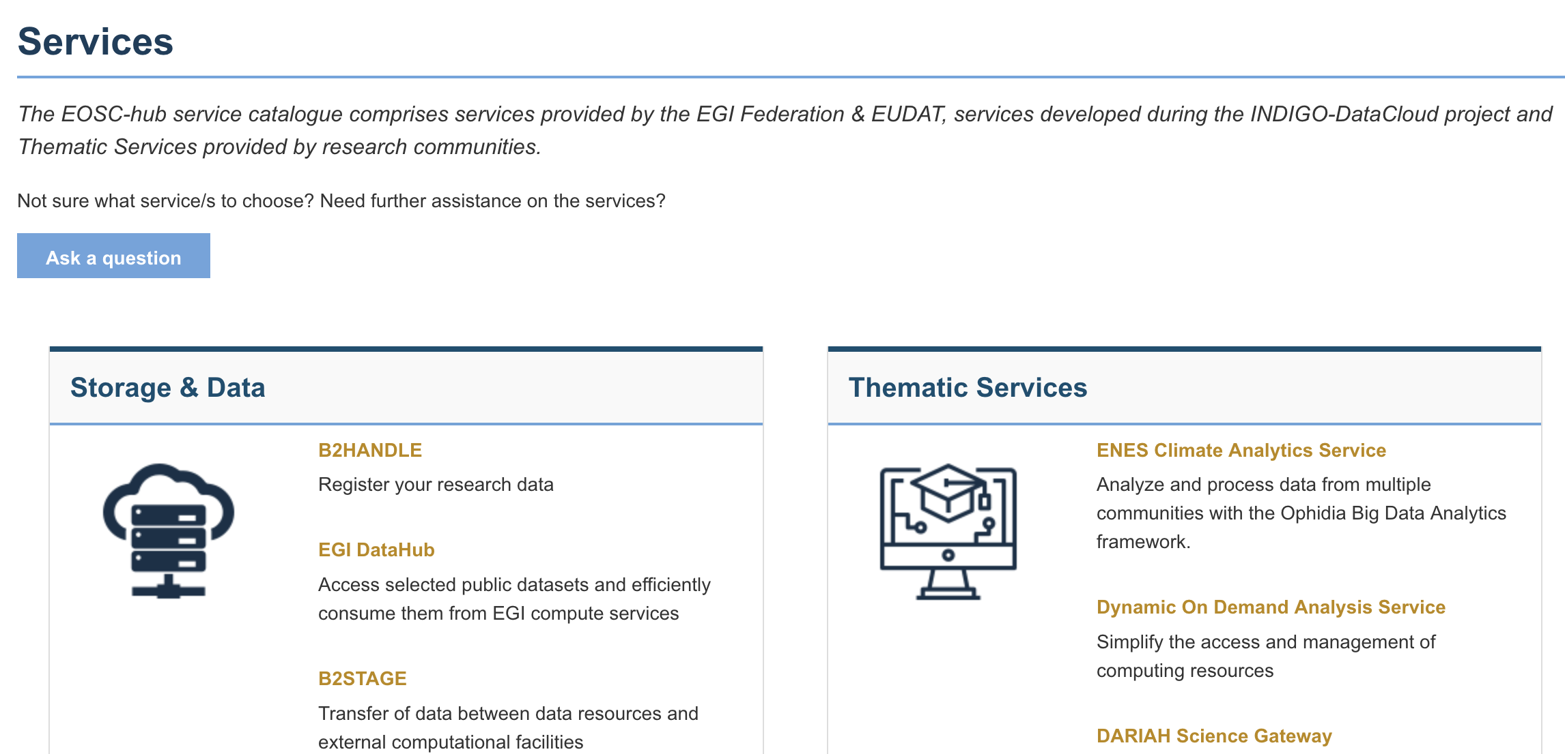
Impact 1/Dissemination and engagement
The set up and wide promotion of the EOSC-hub webplatform hosting the EOSC-hub service catalogue (www.eosc-hub.eu)
The contribution to the creation of the EOSC portal (together with eInfraCentral & OpenAIRE project)
The marketing campaign performed to create awareness about the benefits of becoming a EOSC-hub service provider
The FitSM trainings and the organisation of the first EOSC-hub week (2018) that allowed around 100 participants to discuss the rules and the procedures to make the EOSC-hub ecosystem operational

Slide 9
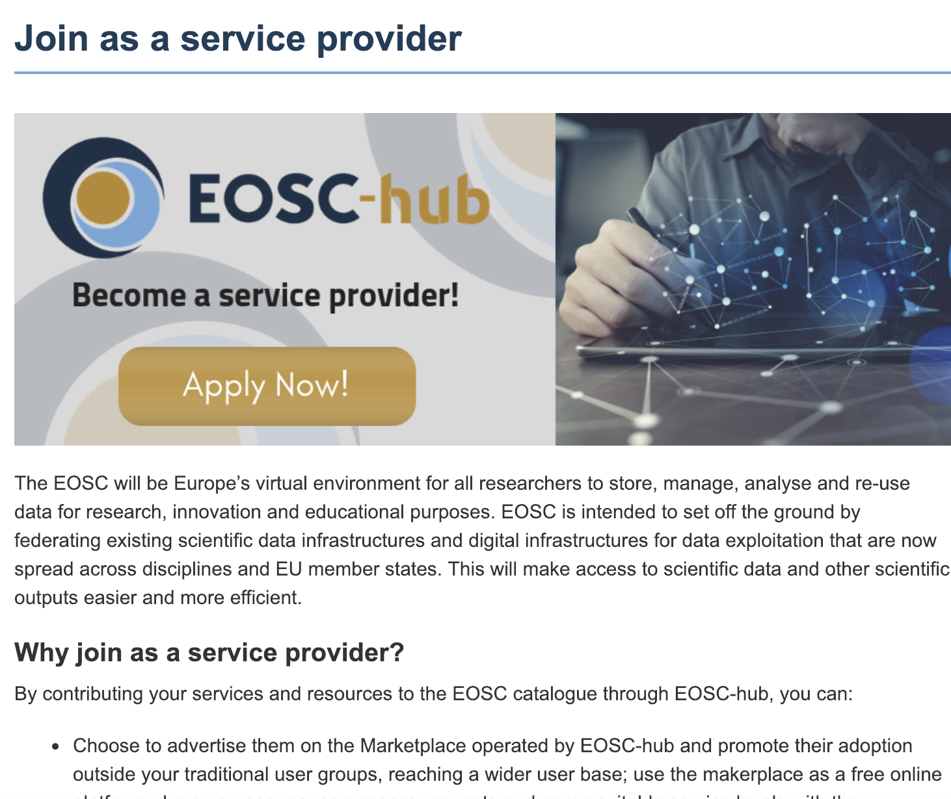
Why join as service provider
To advertise your services and promote their adoption outside your traditional user groups
To get statistics about access requests and customer feedback
To leverage on a platform where you can manage service requests, interact with users and provide support to them, and agree the most suitable service levels.
To allow users to authenticate with their own credentials
To contribute to the definition of EOSC service provisioning policies and the portfolio roadmap.
To join the group of providers that meet EOSC quality standards.

Slide 10
Impact 1/Success Story: WeNMR for Life Sciences
“Our online services are used by thousands of researchers studying molecular forces and biomolecular interactions to guide drug design, treatments and diagnostics. To give an example, HADDOCK has over 11500 registered users worldwide and in 2017-2018 was acknowledged in 350 papers.
We need to hide the complexity of the computing resources used to power the services, and on the other side, to ensure sufficient resources to operate those”
A. Bonvin
Professor of Computational Structural Biology at Utrecht University
2273 new users (+30%)
+126% simulations submitted

Slide 11
Impact 1/Success Story: Empowering the CLARIN offer
Over 500.000 humanities and social sciences researchers in Europe need automated and high-quality analysis of language data
“To be able to use language data, researchers need the support of a service platform that can turn linguistic content into a directly usable data source, via language-specific tools (e.g. the CLARIN Virtual Language Observatory & Switchboard) as well as generic services (e.g. EUDAT’s B2FIND & B2SHARE)”
Franciska de Jong,
CLARIN ERIC Executive Director
Language data can be found within seconds via EOSC
Results discoverable, easy to access & re-usable via B2SHARE

Slide 12
Impact 2. Establishing partnerships with industrial and private partners
6 Business Pilots
+ 12 New partnerships
10 Industry events
5 Industry/SMEs providers

Slide 13
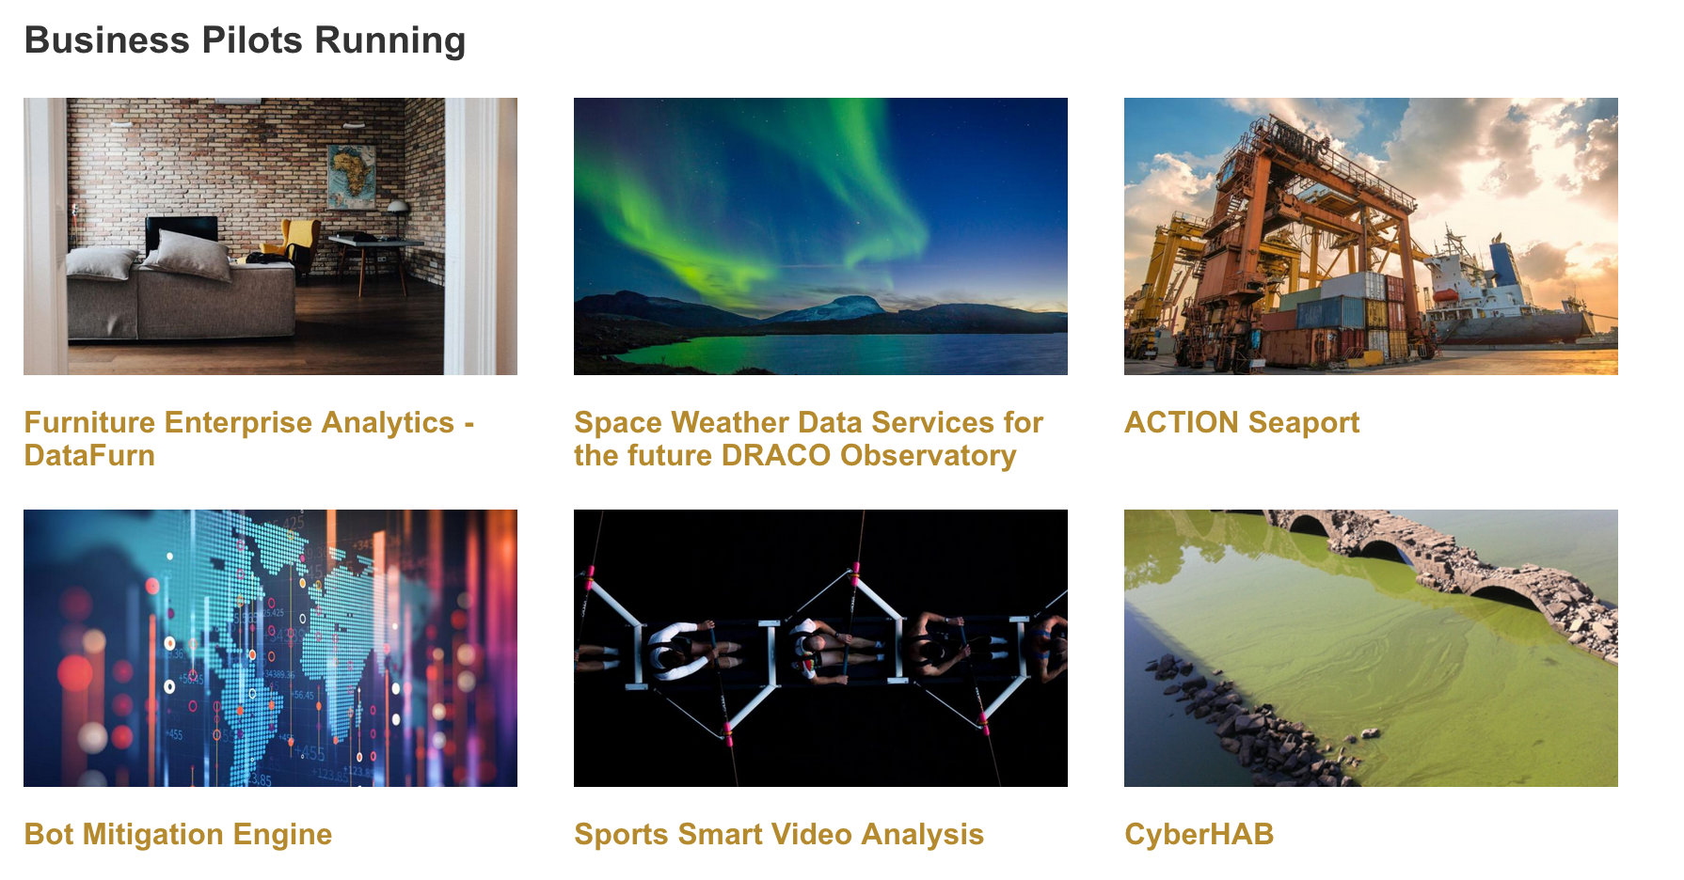
Impact 2/Main achievements in 2018
Piloting and co-design
Technical Access
Training and Support
Visibility through the Marketplace
The EOSC Digital Innovation Hub (DIH) was successfully established in QR4 and is now officially part of the EU Digital Innovation Hub catalogue
6 business pilots up and running
Vouchers programme for free Cloud service access now open!
EO Pillar SME providers actively engaged in the Marketplace
www.eosc-dih.eu/

Slide 14
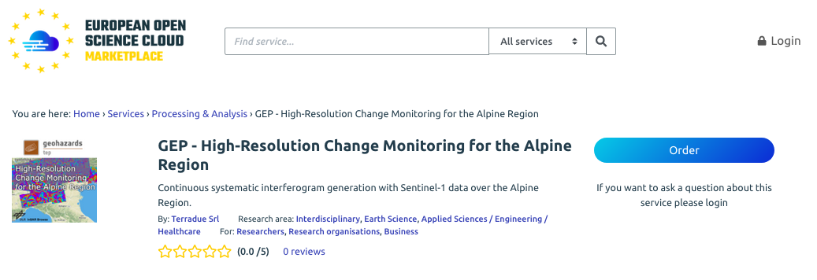
Impact 2/Success story
The Terradue Cloud Platform is a solution to transfer EO processing algorithms to cloud infrastructures.
Terradue provides the engineering and operational support for the Geohazards Exploitation Platform (GEP), which offers a rich set of ready to use EO data processing services for the analysis and monitoring of earthquake, volcanoes and landslides.
GEP is integrated with the EGI fed cloud and is now part of the Marketplace offering
> 1.4 Million Cloud Compute hours
+108% Increase of use in QR3-QR4

Slide 15
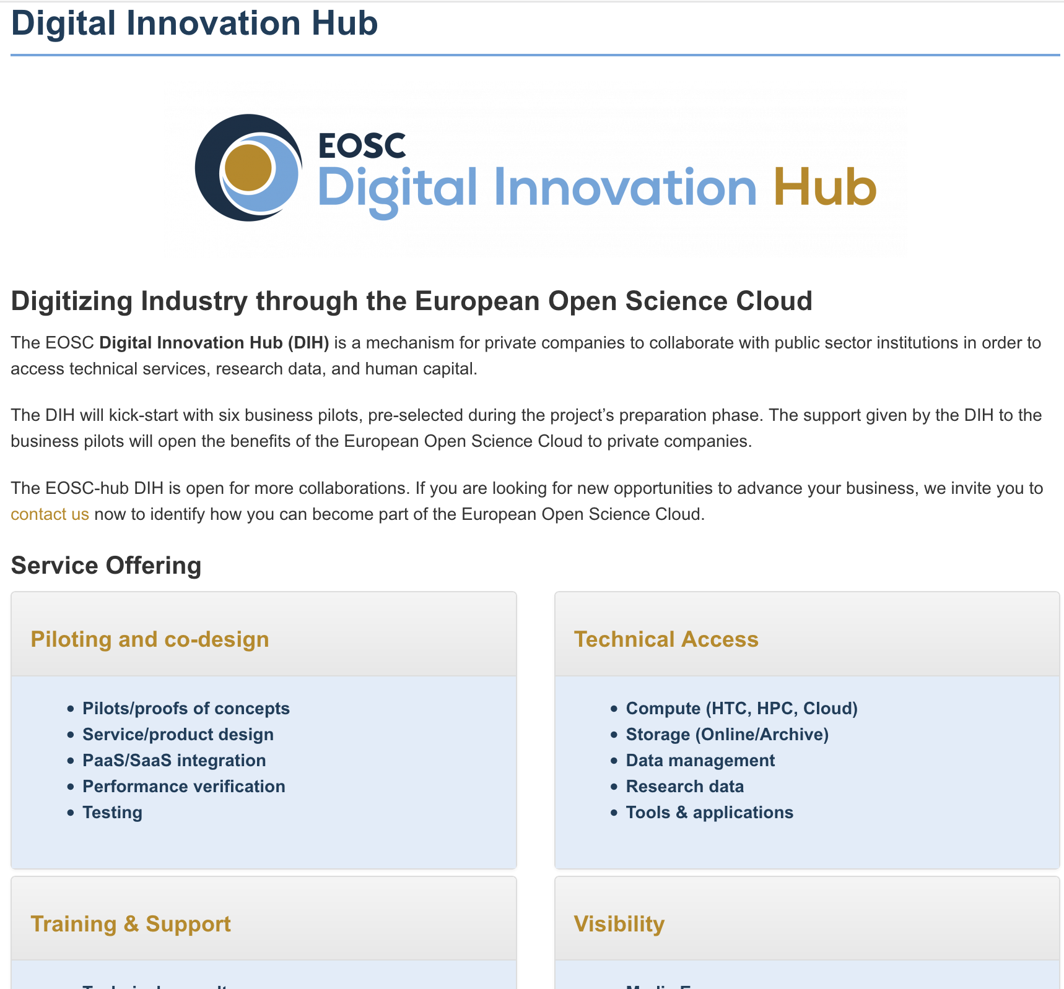
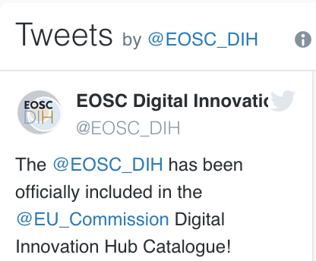
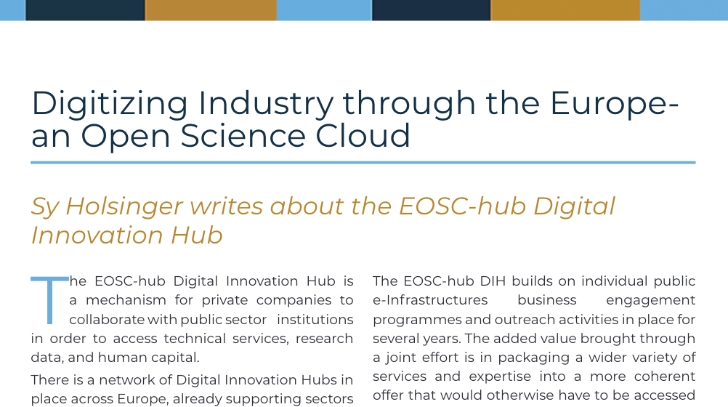
Impact 2/Dissemination and Engagement
The set up of a dedicated online channel for the EOSC-hub DIH (eosc-hub.eu/digital-innovation-hub)
Promotion of DIH & businesses onboarding at specific procurement & industry events (e.g. ICT2018, )
DIH marketing campaign on social media channels and via the EOSC-hub magazine reaching out more than 4000 readers
Set up of the Free Trial campaign

Slide 16
Impact 3. More people trained in research and academic sectors
35 training events [KPI6]
(16 in QR4)
890 trained people
217 training modules in catalogue
8 FitSM trainings, 12 DPM trainings
Train people in research and academic organisations preventing lack of skilled and specialised infrastructure operators

Slide 17
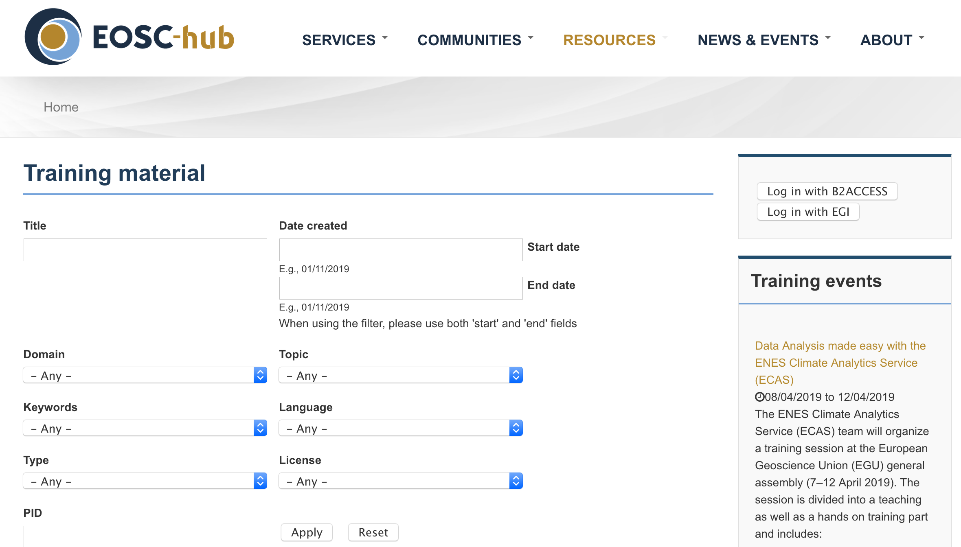
Impact 3/Main achievements 2018
Over 800 individuals trained
Supporting Dissemination/Engagement activities
9 DMP training events - 6 events jointly organized with the OpenAIRE-Advance project
2019 Joint training programme for OpenAIRE and EOSC-hub
Other areas:
Security, AAI, Storage and Cloud Technologies, service-specific training for users
4 FitSM Certification Training events + 2 webinars + 1 individual FitSM process grouping webinar
Domain-specific training activities in collaboration with:
CODATA, ENVRI, INSTRUCT, VIRGO and NGSchool
eosc-hub.eu/training-material

Slide 18
Impact 3/Success stories - OPENCoastS
OpenCoastS: an innovative and free platform to generated on-demond forecasts
First national EOSC-hub thematic service provider which joined the Marketplace, opening access to international user communities thanks to VA funding
International cooperation with the Atlantic Interactions Research Centre
148 participants to the e-Tutorial 13/12/2018 “e-Tutorial: from processes knowledge to on-demand circulation forecasts”
Objectives: Empower potential users by providing an introduction to the relevant physical processes, the numerical model SCHISM and unstructured grid generation
Minimize the learning effort by a step-by-step tutorial on the use of OPENCoastS
+58% cloud utilization QR4 2018
14 countries and 148 people in the training

Slide 19
Impact 4. Avoid the locking-in to particular hardware or software platforms that would jeopardise the long-term planning for capacity upgrades
Increase service interoperability by exposing well-defined interfaces based on open specifications that improve reusability and develop technical and service roadmaps to ensure a coherent evolution of the technical solutions and service offering
4 over 7 TSs integrated to open interfaces [KPI9]
46 user technical requirements
Contributions to 4 RDA WGs
Contributions to 3 standard bodies/open source projects

Slide 20
Impact 4/Main achievements in 2018
The EOSC-hub technical roadmap and activities are fully aligned with the EC Implementation Roadmap.
The first EOSC-hub Technical Architecture & Standards Roadmap (D10.3) defining interfaces for composibility of services across multiple suppliers, was released. Roadmaps take into account the requirements gathered by the interested stakeholders (research infrastructures, business pilots, etc).
Technical coordination (WP10) fostered the further adoption of standards protocols and APIs widely used in international context like RDA or ICT standards (OGF, W3C, OASIS)

Slide 21
Impact 4/Main achievements in 2018 (cont)
2 technical joint roadmaps developed (OpenAIRE and GÉANT) focusing on DMP, AAI, Cloud interoperability, etc.) and one is under development with RDA to align roadmaps with RDA outputs
4 Thematic SPs were successfully integrated and introduced into the EOSC Marketplace exploiting the open interfaces EOSC-hub provides
Implementation of AARC AAI Blueprint for the EOSC AAI
The implementation of the EOSC-hub service management system complies to the FitSM standard and will be audited to comply to ISO service management and quality standards.

Slide 22
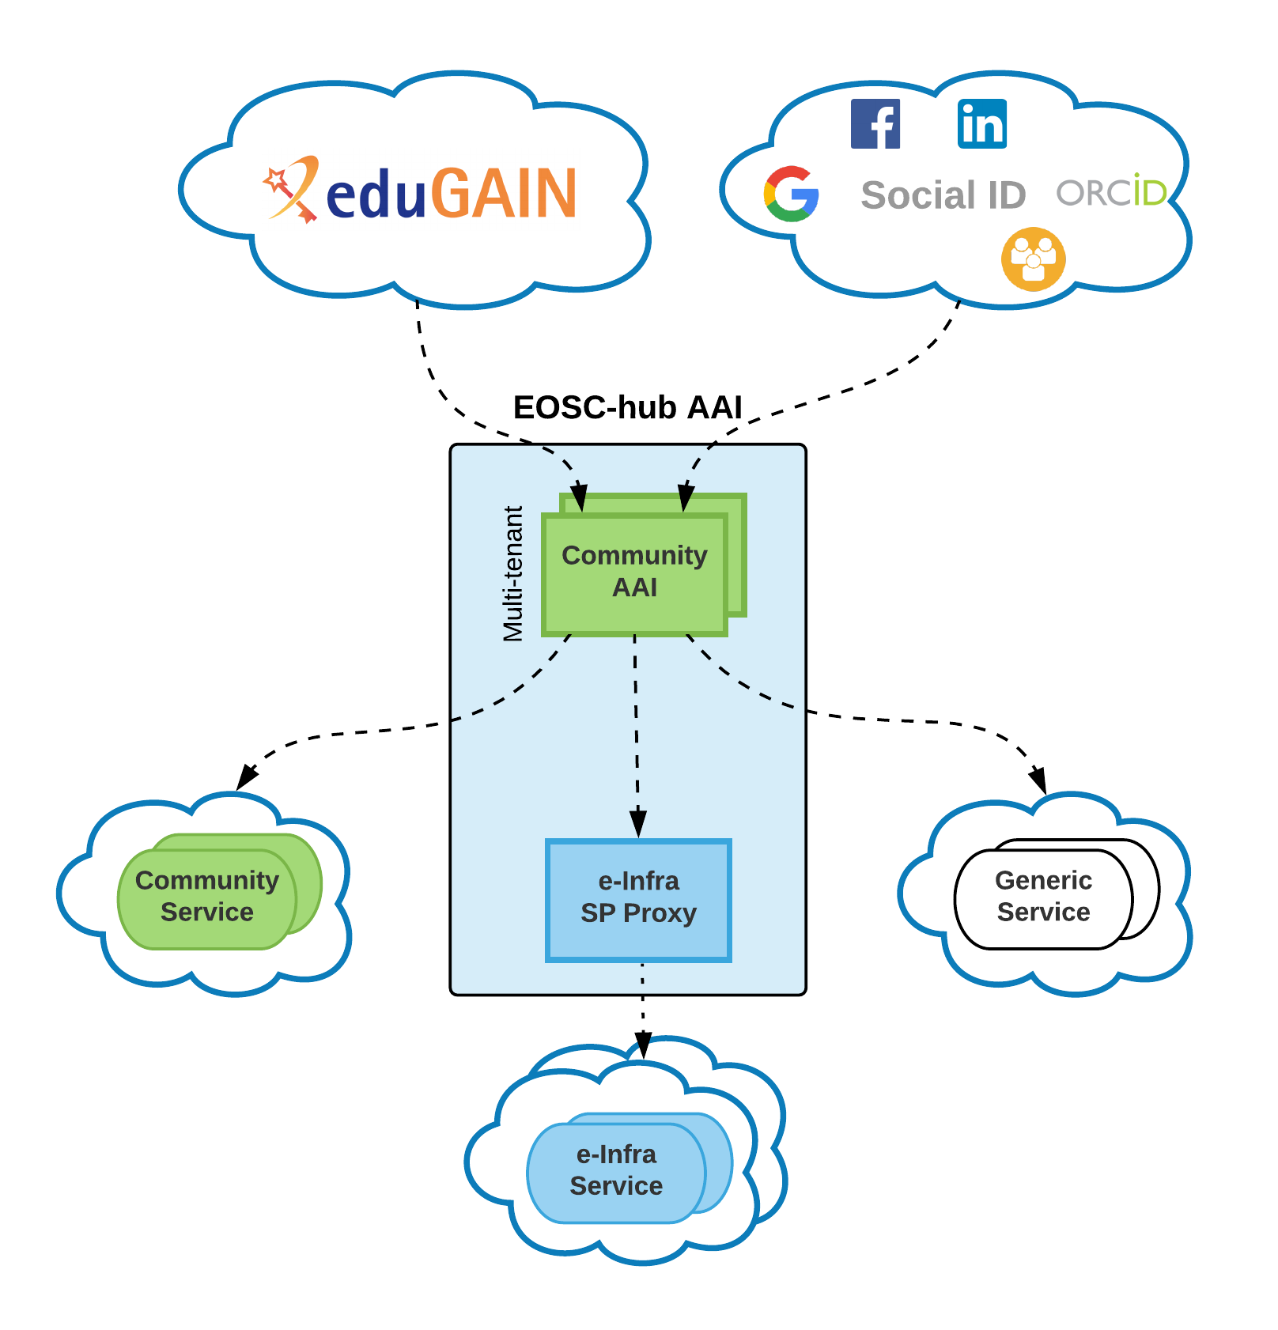
Impact 4/Success story – Federated AAI
EOSC branded multi-tenant service: for federated AAI supporting all standard authentication options (eduGAIN, social media, ORCID..) and group membership capabilities
AAI SaaS: individual components or AAI platform as a whole): all the standard authentication options (eduGAIN, social media, ORCID), plus community-specific IdPs with customization
Completed integration activities
Alignment of unique user identifiers
Alignment of group membership and role information
Interconnection of EGI Check-in with EUDAT B2ACCESS
Online Certification Authority (Rcauth) migration and support for high availability

Slide 23
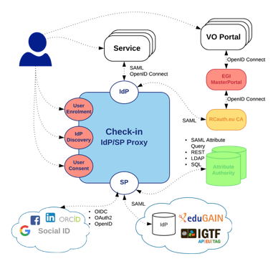
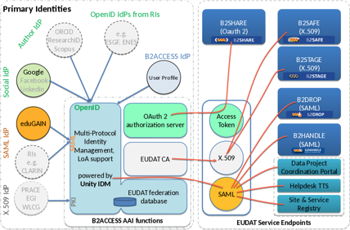
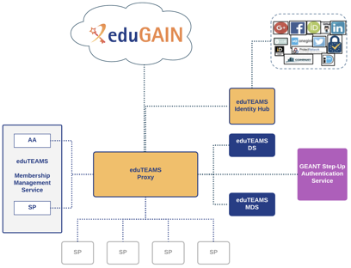
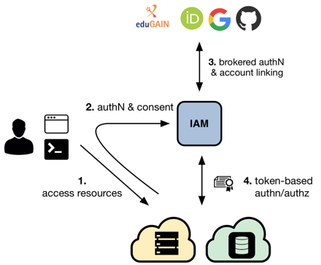
EOSC-hub Community AAI technical solutions
EGI Check-in
EUDAT B2ACCESS
GÉANT edutEAMS
INDIGO-IAM
PaNOSC Kickoff

Slide 24
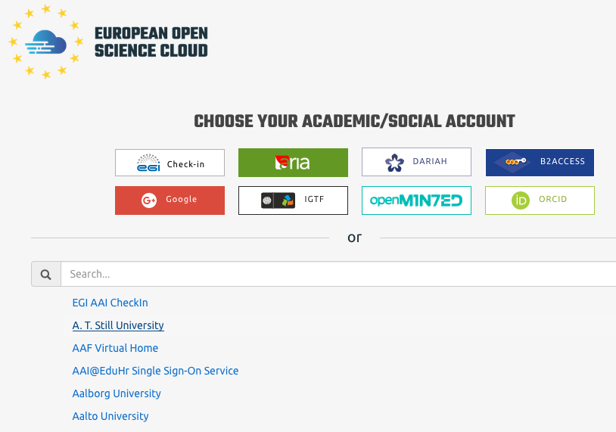
Impact 4/Dissemination and Engagement
EOSC Summit & EOSC launch
EOSC-hub / OpenAIRE / GÉANT GN4-2 / RDA concertation meetings
Technical support meetings

Slide 25
Impact 5. Extend the user base
Scientific Applications on Demand uptake: +135% July-Dec 2018
New User Communities in pilot stage: 5 [KPI9]
New User Communities in production: 2 [KPI10]
4.4 Billion CPU hours in 2018
+20%
More scientific communities will use storage and computing infrastructures with state-of-the-art services for their research and education activities; the open nature of the infrastructure will allow scientists, educators and students to improve the service quality by interacting with data, software and computing resources

Slide 26
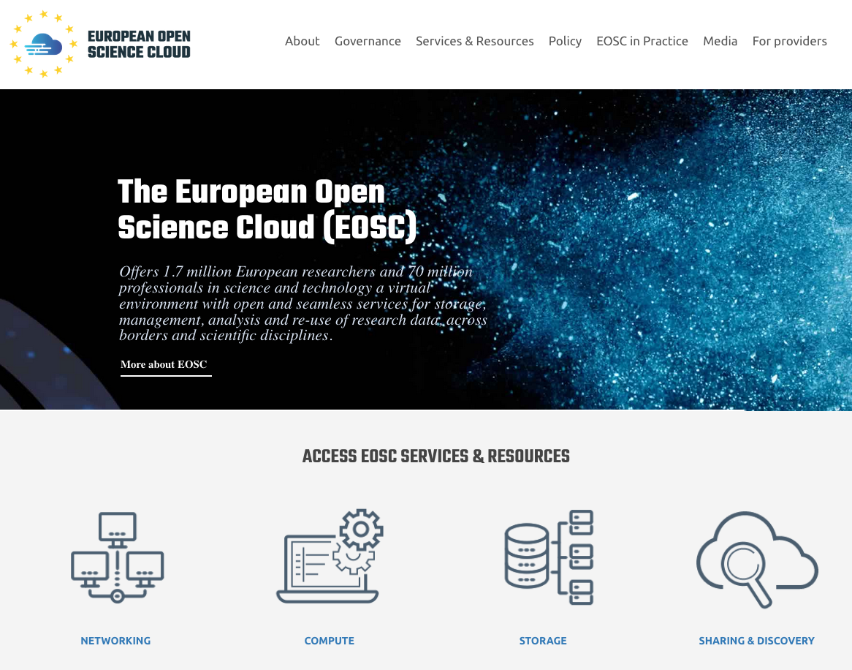
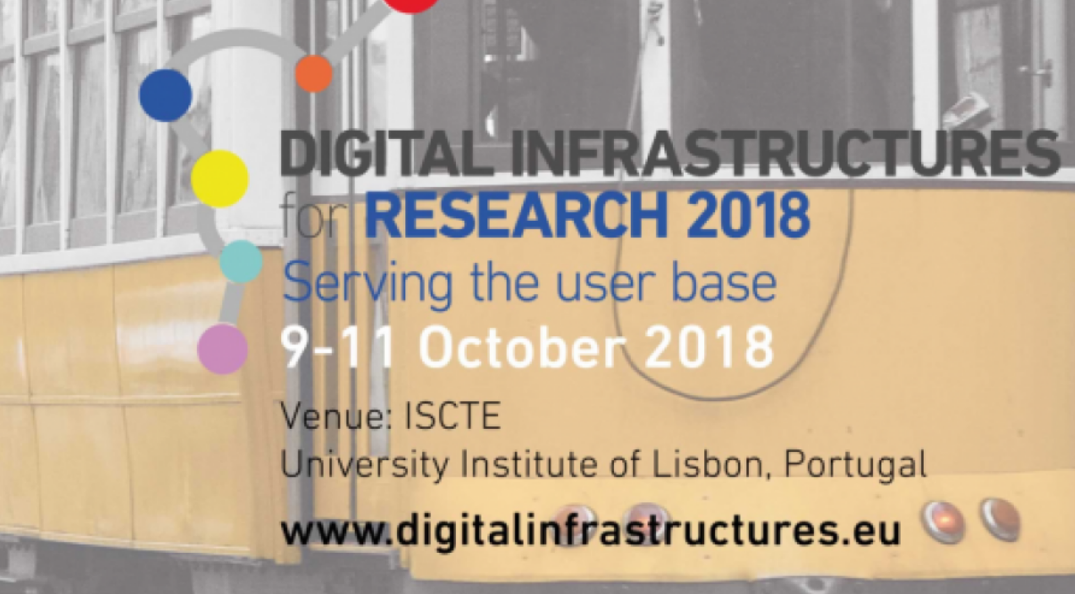
Impact 5/Main Achievements
#visits EOSC portal: 3811 (Nov/Jan 2018)
Expanded access to services outside the traditional user base via the EOSC portal
8 Competence Centres piloting EOSC-hub Services: ICOS, ELIXIR, Radio-Astronomy; Disaster Mitigation, EPOS-Orfeus, CLARIN, GEO-DAB
A stakeholders database with over 50 potential leads
5 new funded ESFRI-clusters projects working in collaboration with EOSC-hub, active support to PaNOSC for cloud/distributed data management/Jupyter Notebooks/AAI
EOSC-hub contribution and support to DI4R 2018 (380 participants in 2018)
Dissemination of EOSC-hub services at over 20 third-party events
An online community of around 2000 members (Twitter, LinkedIn, SlideShare)
#visits MP: 2106 (Nov/Jan 2018)
30 orders (Nov/Jan 2018)

Slide 27
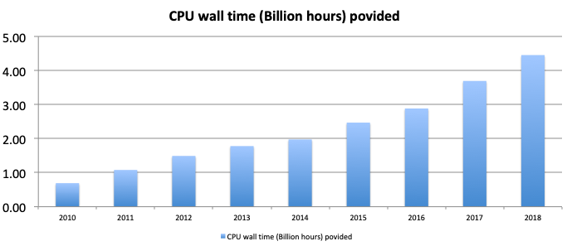
Impact 5/Success story – An increase in the use of computing resources
4.4 Billion CPU core wall time delivered in 2018
> 1 Million computing cores for the first time in the EGI history
356 PB disk & 380 PB tape storage
1170 open access publications / year
31 large scale ESFRI projects/landmarks supported
+20% utilization of computing in 2018

Slide 28
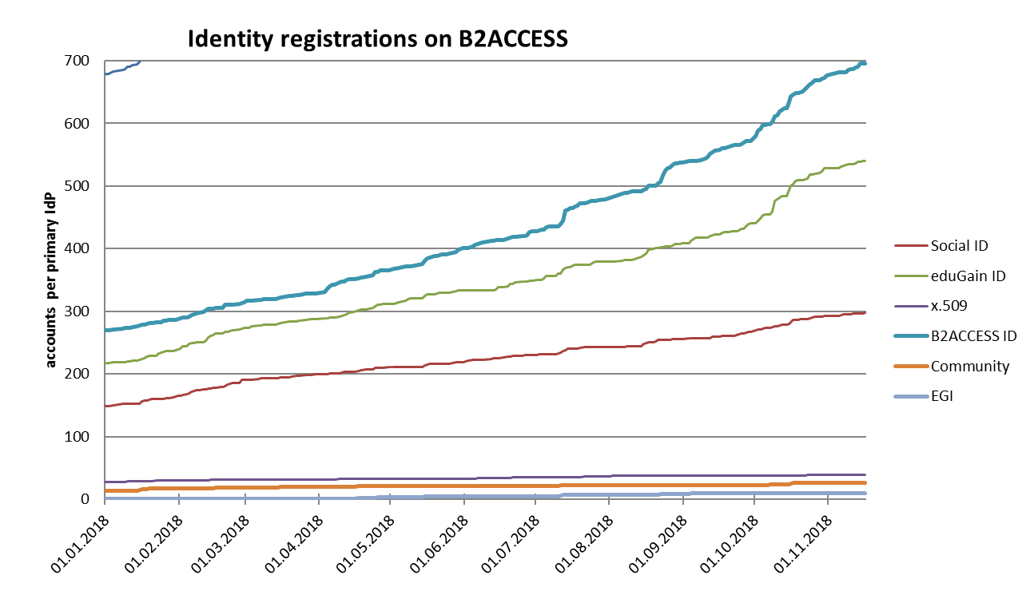
Impact 5/Success story – An increase in the usage of data management services
Over 700K data discoverable via the EUDAT CDI (repositories from 16 communities harvested, 10k data sets in B2SHARE@CSC and B2SHARE@JUELICH)
90M data registered within the CDI (+15% in 2018)
1600 users registered on B2ACCESS (+33% in 2018)
14 new projects since 3/2018

Slide 29
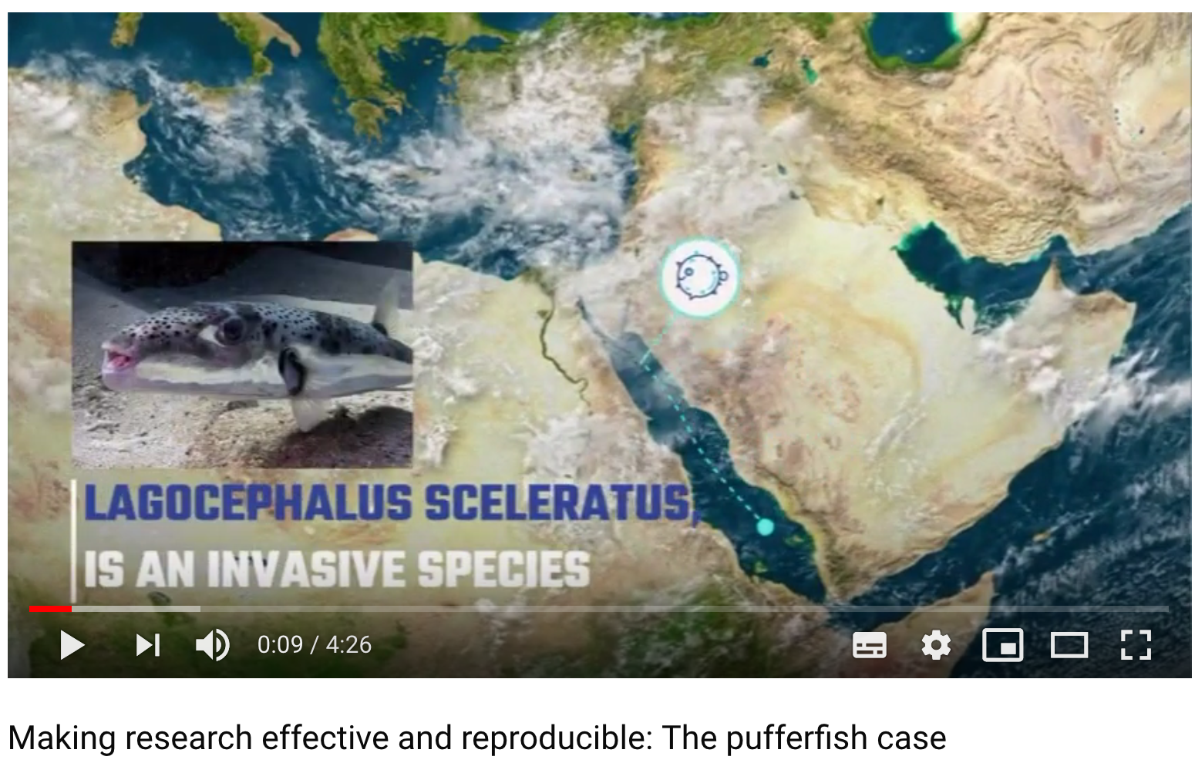
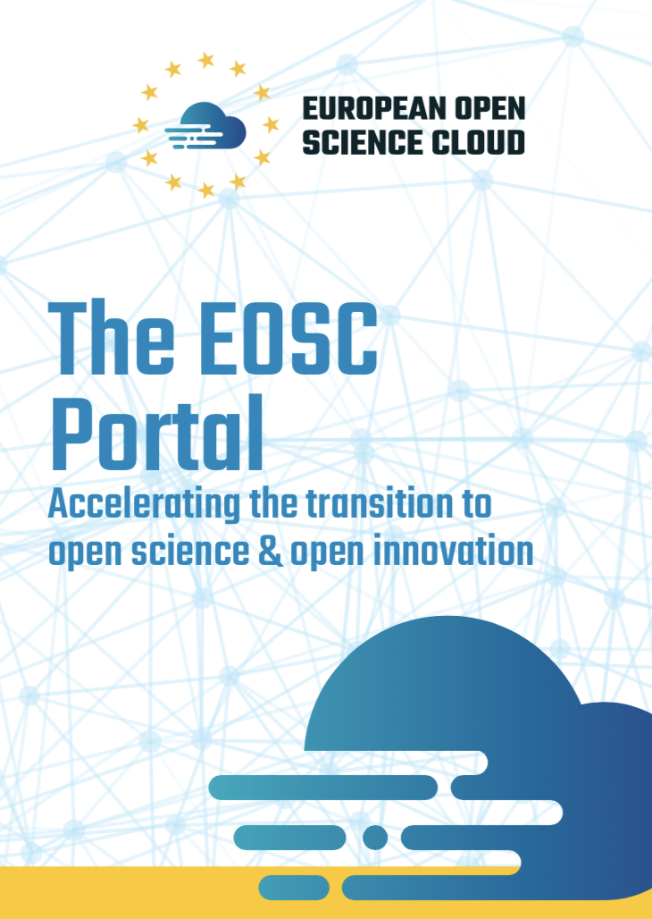
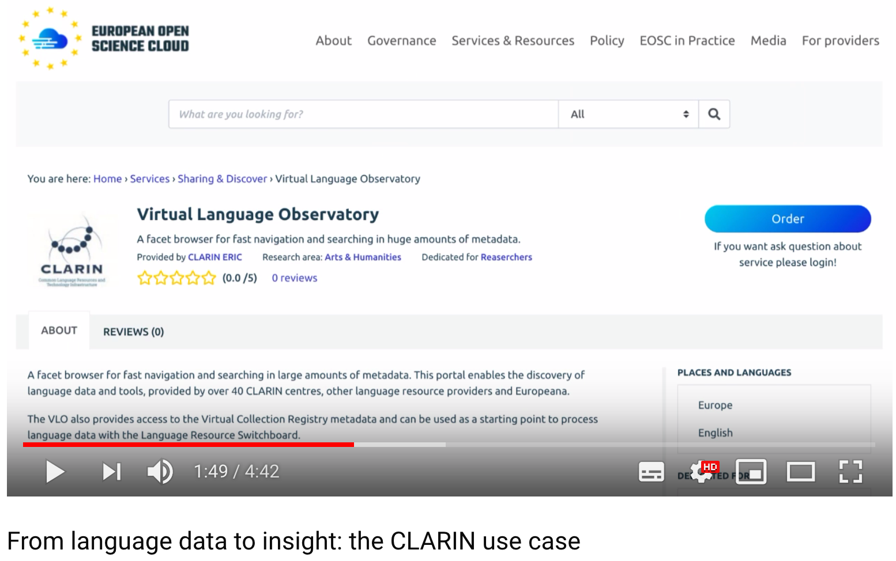
Impact 5/Dissemination and Engagement
Focussed dissemination and communication activities in order to improve uptake of EOSC-hub services within target groups:
Set up and promotion of the EOSC portal
Joint dissemination activities with GÉANT GN4-2 and OpenAIRE
2 Dedicated workshops with ESFRI clusters
Organisation of DI4R2018 in collaboration with GÉANT, OpenAIRE, PRACE
Active participation to the EOSCpilot stakeholders forum
Release of 2 editions of the EOSC-hub magazine including adoption success stories
Preparation of 2 videos showcasing how communities benefit from the EOSC-hub services demonstrated at the EOSC launch event
Promotion of the benefits of using the EOSC-hub services via the EOSC portal booklet

Slide 30
Impact 6. Increased incentives for scientific discovery and collaboration across disciplinary and geographical boundaries Impact 7: Further development of the European economic innovation capacity
107 Countries supported by Virtual Access [KPI16]
30 Orders through the EOSC Marketplace over Dec/Jan
Engage adjacent but fragmented scientific communities and promote the uptake of services from multiple sectors and geographic locations
Stimulate opening up of services with the virtual access funding mechanism

Slide 31
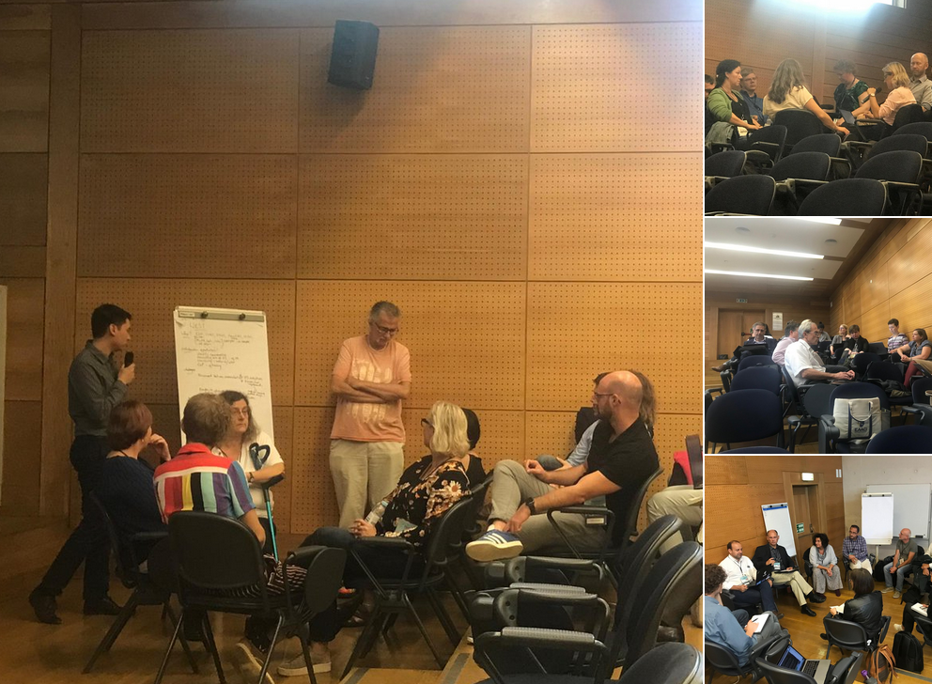
Impact 6-7/Main Achievements, Dissemination and Activities
Started a dialogue with experts at national and global level
8 Competence Centers for infrastructure and service co-design, piloting and adoption
Digital Innovation Hub operations
Organisation of a series of workshops to align activities and strengthen synergies at national level in collaboration with GÉANT, OpenAIRE, PRACE, RDA
Organisation of the EOSC-hub /OpenAIRE /FREYA BoF at the RDA Plenary 11
Meetings with international security initiatives
Session on national initiatives at DI4R2018

Slide 32
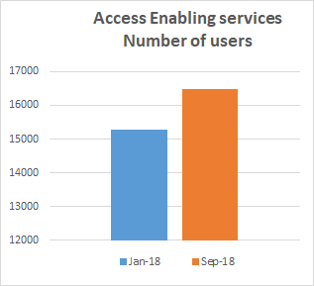
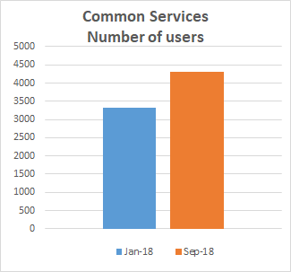
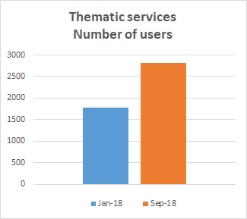
Impact 6-7/highlights Jan-Sep 2018
+ 1200 users
+ 1000 users
+ 1000 users

Slide 33
Impact 6-7/Success Story – GEOSS Portal
“The European GEOSS community, in the framework of the EuroGEOSS initiative, aims at demonstrating the benefit of Earth Observation for the society. EOSC will be instrumental in providing the large computation and storage capabilities we need to run scientific models at local, national, regional and potentially global scale.
The EOSC Portal in particular will give our scientists the possibility to access and run analytic models in a transparent way, without the need of a local infrastructure hosting data and computing facilities.”
The GEOSS portal was ported to the EGI Federated Cloud in Oct 2018, and will be followed by the GEO DAB
The GEOSS Portal is now available in the EOSC Marketplace
The GEOSS (Global Earth Observation System of Systems) Web Portal is the main entry point for discovering and accessing GEOSS data.
The GEOSS Platform interconnects more than 170 data systems globally, providing discoverability of more than 400 M datasets. The EOSC-hub version of the GEOSS Web Portal is connected also to the ECOPotential Virtual Laboratory, allowing users to execute available models utilizing GEOSS data as inputs.

Slide 34
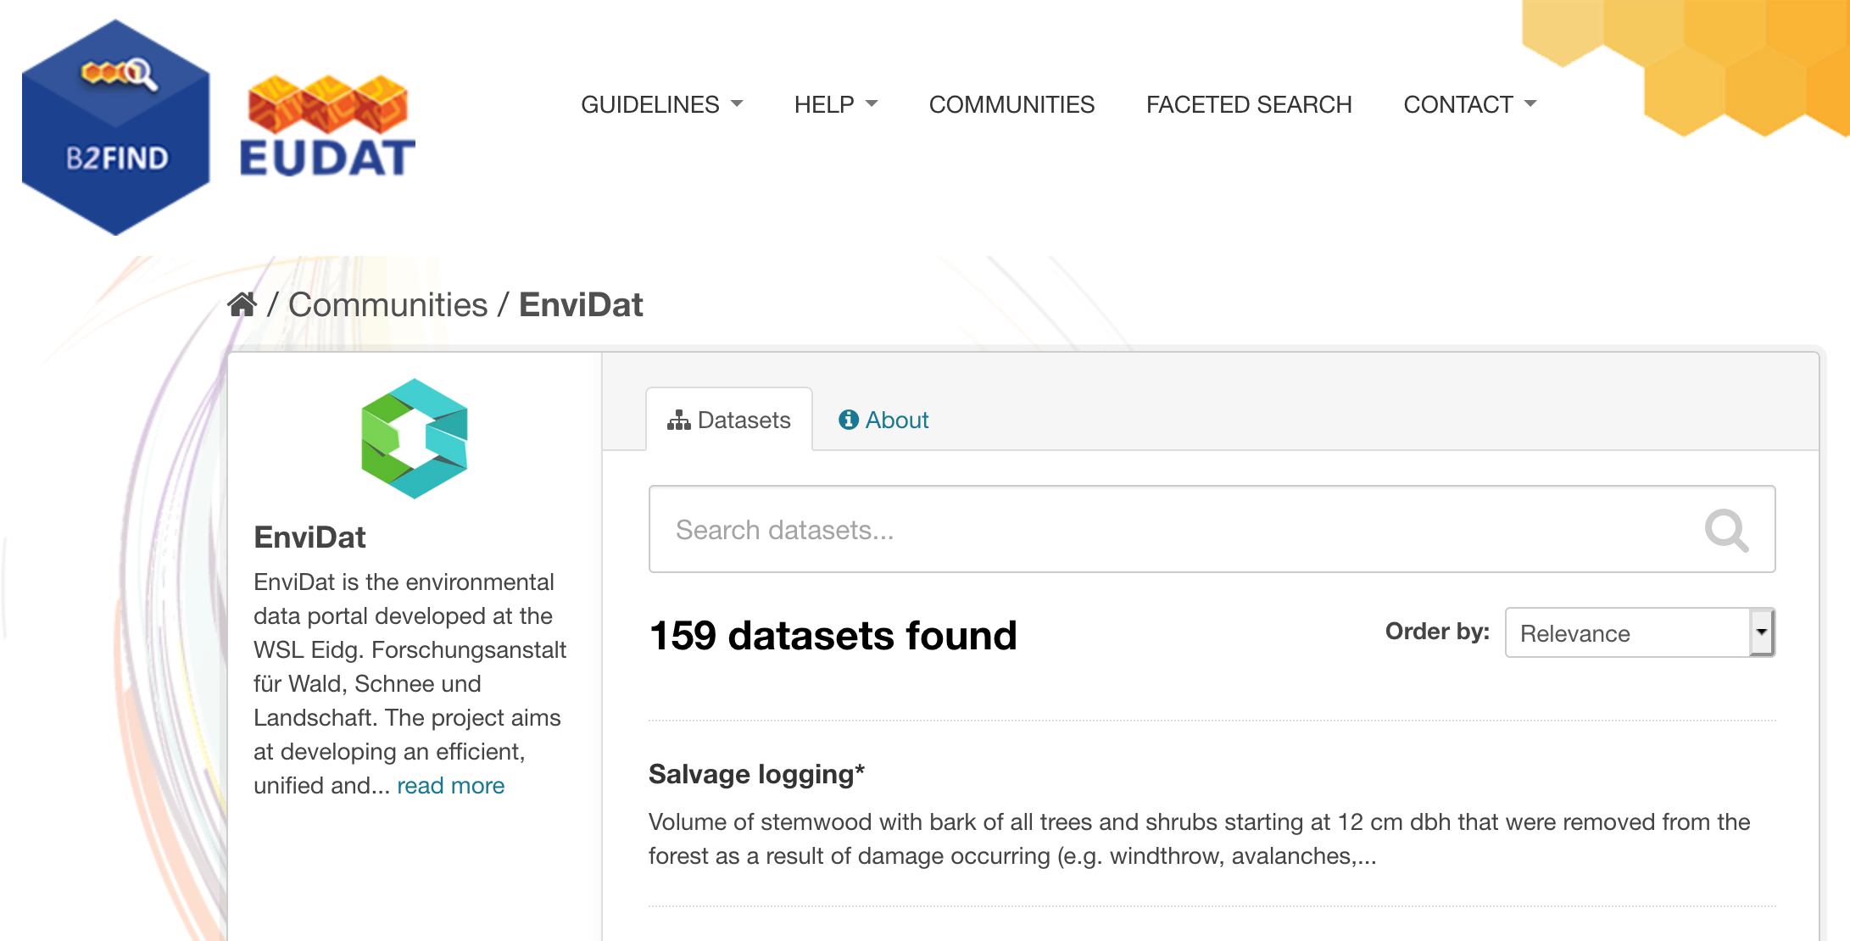
Impact 6-7/Success Story – EnviDat
EnviDat is the WSL data portal providing unified and managed access to environmental monitoring and research data. The portal has the capability to host and publish data sets.
159 EnviDat records harvested in B2FIND making discovery easier for EOSC/EOSC-hub users
EnviDat service as part of the EOSC-hub service catalogue

Slide 35
Next Steps – Priorities for 2019
Onboarding of new users & providers: launch of an open call in spring 2019
Further engagement of EOSC-hub key stakeholders: EOSC-hub week 2019; DI4R2019, EOSC stakeholders forum
Close interaction with the new ESFRI clusters projects & HPC Centers of Excellence
Further promotion of opportunities for industry via the DIH; publication of the first business pilots success stories & close collaboration with the Open Cloud for Research Environments (OCRE) project
Continuous training of users and service providers – joint trainings in collaboration with OpenAIRE
Strong collaboration with OpenAIRE, GÉANT GN4-2, RDA from a technical and a dissemination point of view
Focussed dissemination and communication activities in order to improve uptake of EOSC-hub services within target groups: Publication of business and research success stories via the EOSC-hub Magazines, short demo videos to promote the EOSC-hub service offer, etc.
Continuous contribution to the future developments of the EOSC portal

Slide 36
Conclusions
The results achieved in terms of Impact are positive and some project KPIs have already been achieved
The collaborative work performed by the partners has been key in achieving these early results
The dissemination activities put in place by the project seem adequate for boosting impact in the upcoming years

