Slide 1
Communications, Engagement, Support and Training
Najla Rettberg, Pedro Principe, Sara Coelho, Sara Garavelli,Gergely Sipos,

Slide 2
Outline
Three areas of activity
Milestones
Highlights
Any Issues to Raise
Future plans and Directions

Slide 3
Highlights
Communications:
Joint communications plan, EOSC portal launch, Joint use cases, EOSC launch demonstrators, EOSC portal editorial board
Events:
DI4R2018 / ICT2018
Series of events on national initiatives
Training:
Joint training schedule
Held 4 well-attended webinars (365), plus four f2f sessions (138)
OpenAIRE & EOSC-hub launched a Community of Practice for training coordinators and managers

Slide 4
Communications
Harmonise Strategies / approaches
Promote Usage
Communications Activities
"Common Channel”

Slide 5
JA 2.1 Communications
•Aim: Promote value of the Collaboration
•Highlights: EOSC portal
•Milestones reached:
MS Communications Plan,
Teamwork towards the EOSC launch, 2 meta-use cases & joint monthly articles showcasing services interoperability, Set up of EOSC portal editorial board and its workflows
•Issues/Next Steps: Liaise w Technical Roadmaps
Notes:
Released a set of
Add the editorial board workflows

Slide 6
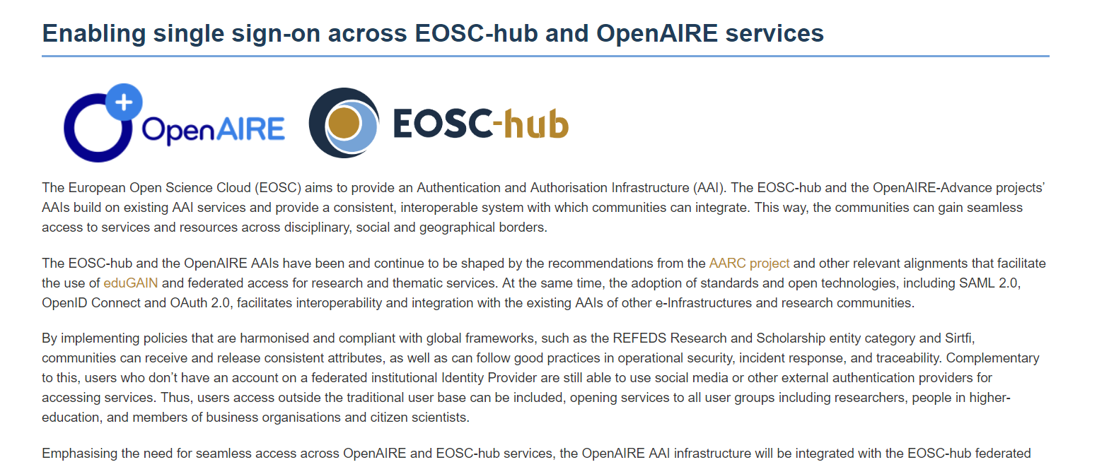

Slide 7
Support and Training
Joint training activities
Body of training materials
Empower national nodes so they can support

Slide 8
JA 2.2 Support and Training
Aim: Empower National nodes/ Uptake of Services
Highlights:
Good attendance to Training: c.500
Community of Practice for training coordinators and managers: CESSDA, DARIAH, ELIXIR, OpenAIRE, , EOSCpilot, FREYA, GEANT, RDA Europe, Parthenos, PRACE and ANDC .
Milestones reached: Joint training schedule, including 8 joint training events delivered (JAM2.5) https://goo.gl/NUZ5xF
Notes:
Monthly calls, f2f, impact
In May OpenAIRE and EOSC-hub launched a Community of Practice (CoP) for training coordinators and managers - an informal network to share training experiences - with representatives of ANDC (Australia), CESSDA, DARIAH, ELIXIR, EOSC-hub, EOSCpilot, FREYA, GEANT, RDA Europe, Parthenos, PRACE and national training initiatives in Belgium, Croatia, Denmark and Luxembourg. The monthly calls and a face-to-face session at DI4R (presentations are available at https://indico.egi.eu/indico/event/3973/session/41/contribution/35) provided a good platform to discuss how to make training materials FAIR, open badges for training activities, how to measure impact of training, build training skills and competencies more effectively and other topics. CoP Slack channel: http://coptrainingeu.slack.com
Interaction w research communities
In the milestone report we tackle research comms.
We need more support material on how to use the services. Gergely: esp those bidding, puzzled what it means to integrate w EOSC - joint view on this. When writing proposals. Project need to interface w einfra 12 rules. They are refering back to us. Dontthink if go to eosc portal there is no entry to openaire
A4 support we give together - AAI, Training, Repository registration
Maintenance of trainig materials. Own databases. Put this in the challenges. We concluded that baed on our joint programme keep a db of comp training materials. Define shared support mechanims. Put next steps. The RIs arent interested. We need marketing material.
We ned a joint message about hte snail diagramm

Slide 9
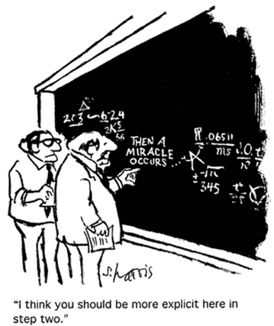
JA 2.2 Support and Training
Issues: Need for a comprehensive display of joint training materials.
Next steps: New Training plan in M14
Coming up! FAIR Data - Licensing - Data Reuse. Federated Services via Thematic Areas
Notes:
Interaction w research communities
In the milestone report we tackle research comms.
We need more support material on how to use the services. Gergely: esp those bidding, puzzled what it means to integrate w EOSC - joint view on this. When writing proposals. Project need to interface w einfra 12 rules. They are refering back to us. Dontthink if go to eosc portal there is no entry to openaire
A4 support we give together - AAI, Training, Repository registration
Maintenance of trainig materials. Own databases. Put this in the challenges. We concluded that baed on our joint programme keep a db of comp training materials. Define shared support mechanims. Put next steps. The RIs arent interested. We need marketing material.
We ned a joint message about hte snail diagramm

Slide 10
Joint training events (for researchers/communities)
Title | When | Target audience | #
Webinar on how to manage your data to make them Open and FAIR | May 2018 | Researchers, research support staff, data librarians | 230
Workshop: Towards cultural change in data management- data stewardship in practice | May 2018 | researchers, research support staff, funders/policy makers | 20
Training of “EUDAT Tools” (workshop part of “Train-the-Trainer: Exploring tools for FAIR data”) | Aug. 2018 | Researchers, librarians and research support staff interested in learning about international and national tools and services available for making research data FAIR. | 30
Workshop: Planning early, following through: Data Management Planning in the EOSC | Oct. 2018 | Supporters of research projects and research infrastructures, and other stakeholders that are managing research data | 18
Webinar on Data Privacy and Sensitive Data Services | Dec. 2018 | Academic and research community revolve around processing of data, particularly with respect to workflows/processes, tools and good practices for sensitive data sharing | 45

Slide 11
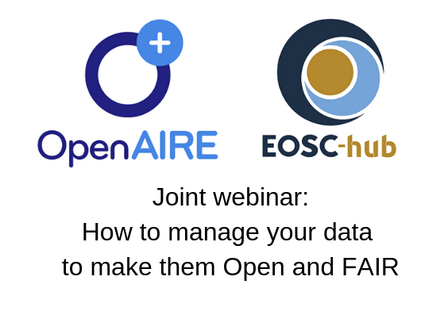
Joint training event (for NOADs and NILs)
Title | When | Target audience | #
EOSC-hub - OpenAIRE-Advance Webinar for national entities (NGIs and NOADs) | April 2018 | EOSC-hub and OpenAIRE-Advance national networks | 50
Building better collaborative national networks to support Open Science (F2F DI4R session) | Oct. 2018 | EOSC-hub and OpenAIRE-Advance national networks, plus other RIs representatives. | 70
+
Webinar on FAIR data and trusted repositories | Oct. 2018 | Repository managers, Research support staff, data librarians | 30

Slide 12
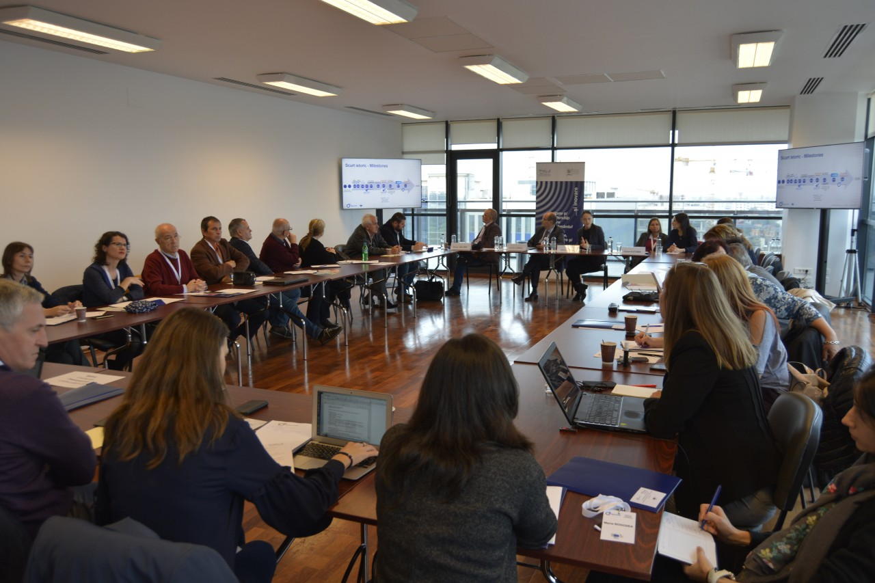
Engaging National Frameworks: 1st Year
Hungary: Had national f2f meetings among national EGI, OpenAIRE, RDA nodes.
Italy: OpenAIRE and RDA Italian Node successfully carried on a series of webinars on Open Science.
Romania: 22 October. EOSC hub Representative
Finland: National Workshop
Croatia: Roadshow in 4 major cities
Switzerland
“I already have a good working relationship with the OpenAIRE NOAD: I expect that during 2019 we will continue to liaise/collaborate about topics related to open science” Switzerland NGI
Notes:
Mention this is in their Action Plans / Engagement tables
From OpenAIRE side we have at national level we prepare an action plan for NOADs. In those national action plans a specific part expressing how they are working w
Four chapters were carried out between October and November 2018, With a total of around 350 participants! A blog post to be posted soon and a page already available in RDA and OpenAIRE websites: https://rd-alliance.org/group/rda-italy/wiki/open-science-webinar-series-2018. Italian Open Science Portal to be delivered soon.

Slide 13
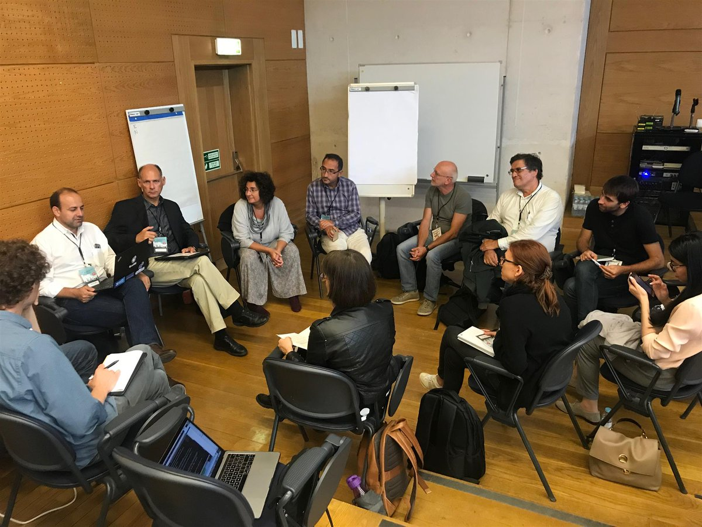
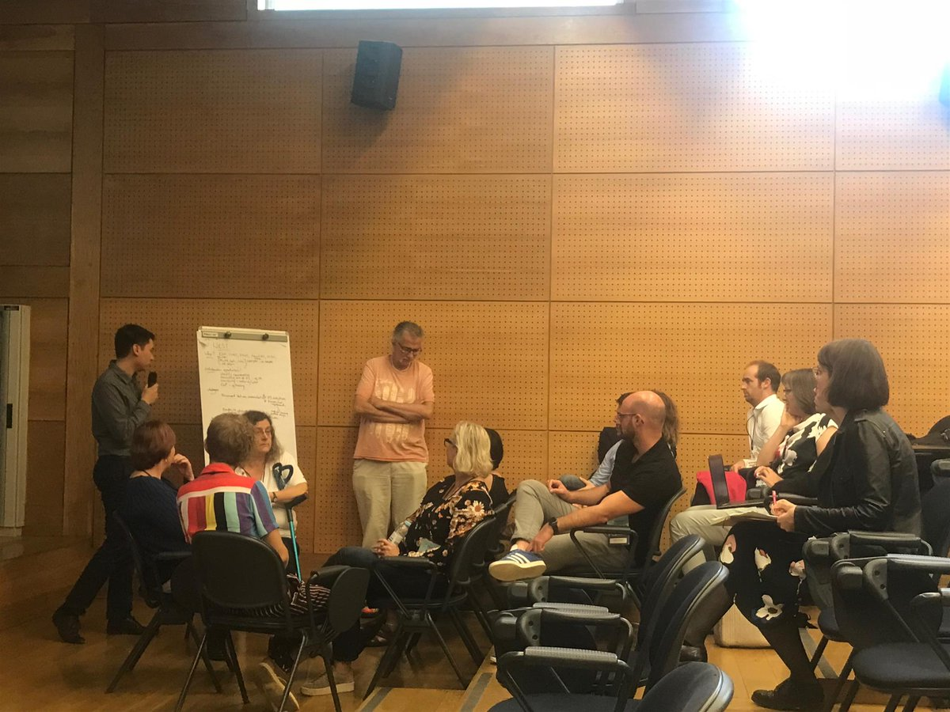
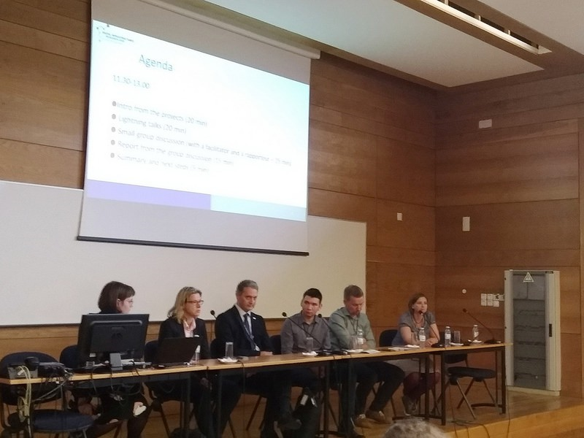
Workhop at DI4R
OpenAIRE
EOSC hub
GEANT
RDA Europe
PRACE
Take aways:
Commonalities between RIs
Sharing success stories/Skills
Cultural Change
“More Open Minds makes it easier to make Open Science take root”
“More of the same please….”
Notes:
•Ambassadors (who understands the local problem)
•Cultural change at managerial level
–More open minds for open science
•Get into international networks (such as LERU?)
•Data from Eastern Europe are needed (are valuable) for the rest of Europe
–We must find a way

Slide 14
Events
Joint Events
Management
Feedback

Slide 15
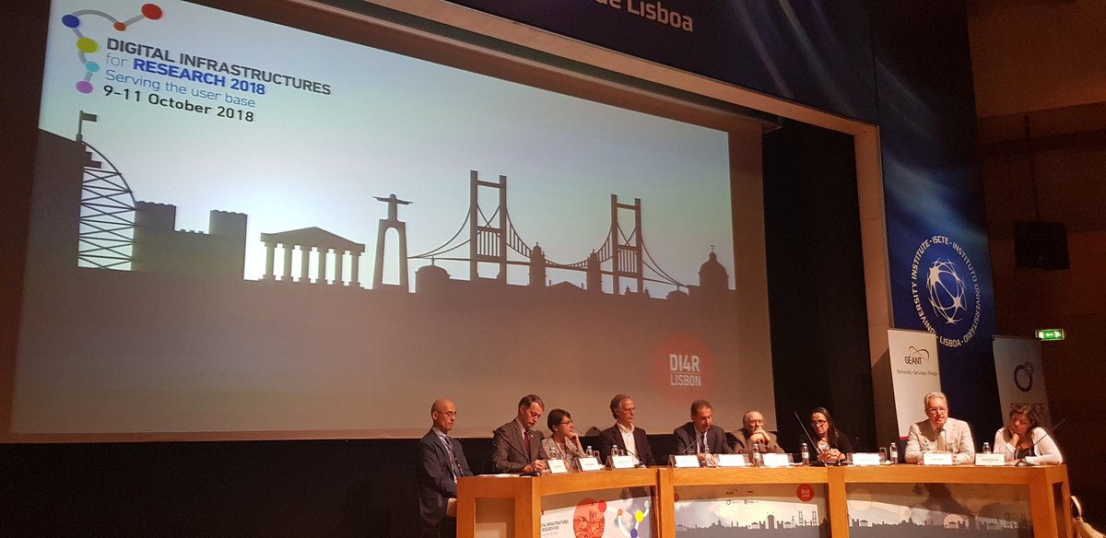
JA 2.3 Events
•Aim: Coordinating joint events
•Highlights:
DI4R2018
RDA Presence - P11 Berlin BoF session ICT2018.
Notes:
Stress success of di4r, new people, thanks to collaboration
Specific task about RDA. what are the joint topics we can prove we are contributing to? Identify both groups. Plans for the RDA wgs. Then we can be collaborative. Need our individual approaches.

Slide 16
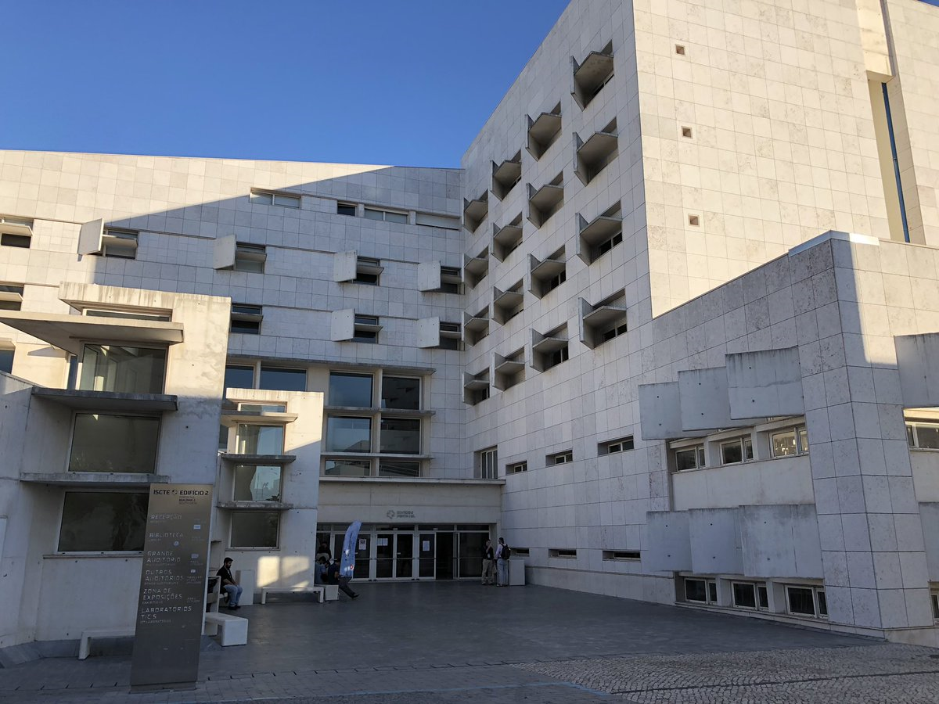
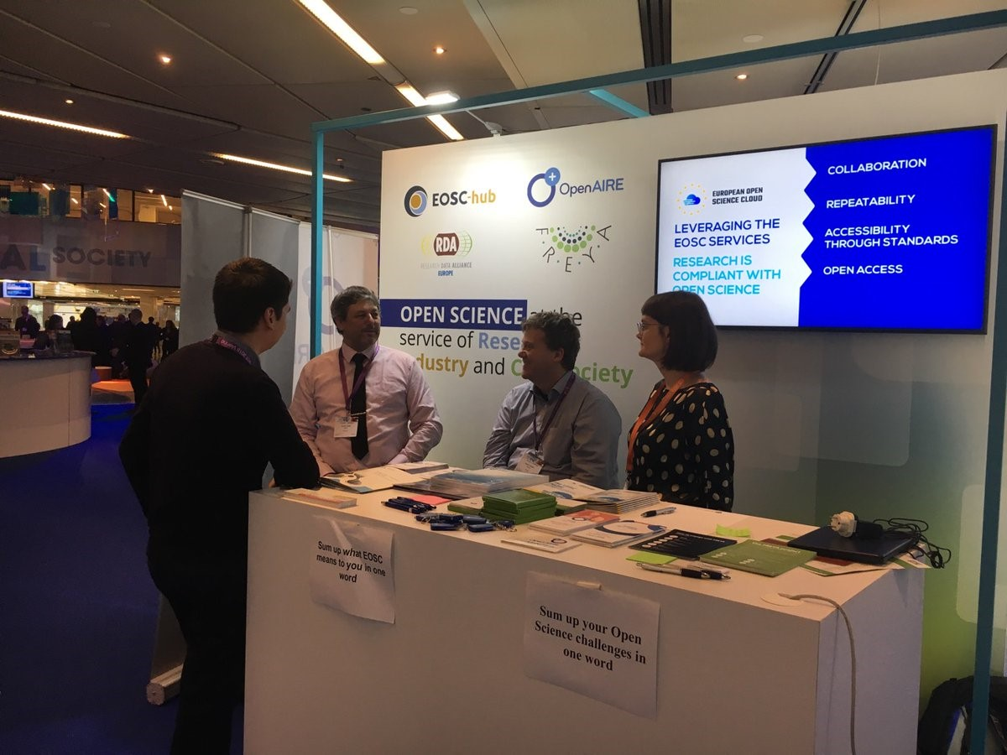
JA 2.3 Events
•Milestones reached:
JAM2.8 A common template and workflow for event organisation and JAM2.9 Joint event programme
Notes:
Stress success of di4r, new people, thanks to collaboration
Specific task about RDA. what are the joint topics we can prove we are contributing to? Identify both groups. Plans for the RDA wgs. Then we can be collaborative. Need our individual approaches.

Slide 17
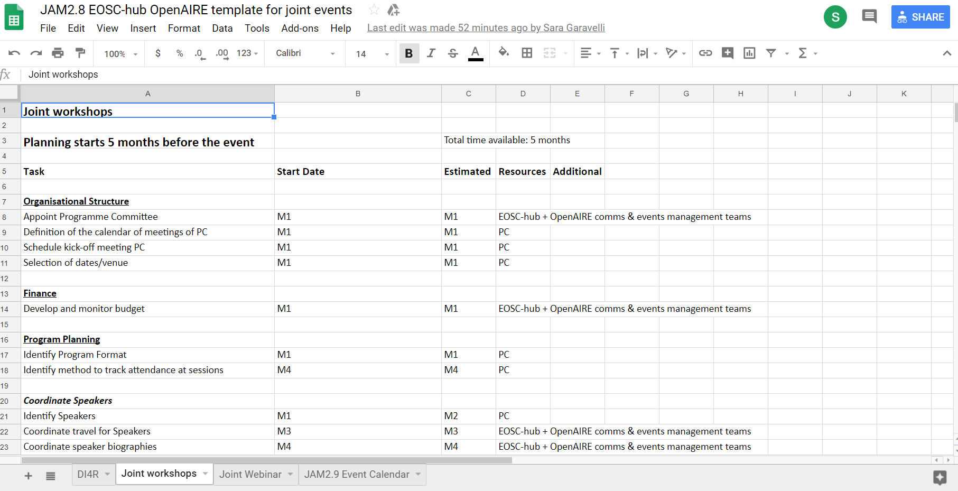

Slide 18
JAM2.1 | Communications Plan | PM6
JAM2.2 | Establishment of joint channel | PM8
JAM2.3 | First report on communications activities & update of Communications Plan | PM17
JAM2.4 | Second report on communications activities & update of Communications Plan | PM29
JAM2.5 | Joint training schedule, including 3 joint training events delivered in PY1 | PM8

Slide 19
JAM2.6 | First summary report of joint events | PM17
JAM2.7 | Second summary report of joint events | PM35
JAM2.8 | A common template and workflow for event organisation | PM6
JAM2.9 | Joint event programme – first issue (PM1 – PM18) | PM9
JAM2.10 | Joint event programme – second issue (PM19 – PM36) | PM17

Slide 20
Next Steps
Communications: Set up schedule for 2019
Training: Training Material to add to EOSC portal
Training: Add Research Communities to training
DI4R 2019, end of Nov 2019
Joint EOSC-hub/OpenAIRE/RDA Workshop at EOSC-hub week
FAIR Services + session on national initiatives collaboration
Webinars for SMEs (basic guidance on OS)
Policy / MS area of the portal: strategy coming
Examples - neuroinformatics community using both sets of services

